Slide 1
Nuclear Astrophysics and
Underground Science
Ani Aprahamian
University of Notre Dame
and
Alikhanyan National Science Laboratory of Armenia
Michael Wiescher
University of Notre Dame
Notes:
Pleasure to be here this morning…in this underground scinalthough in Armenia it is already evening…I am in Armenia….and my colleague Michael Wiescher is at the University of Notre Dame in South Bend, IN…
We are both experimental nuclear astrophysicists…working on different ends of creation/birth of stars and death of stars….
We have split our presentations accordingly….
I am in Armenia on a Fulbright to bring tools of experimental nuclear physics to the launch of nuclear medicine in Armenia….

Slide 2
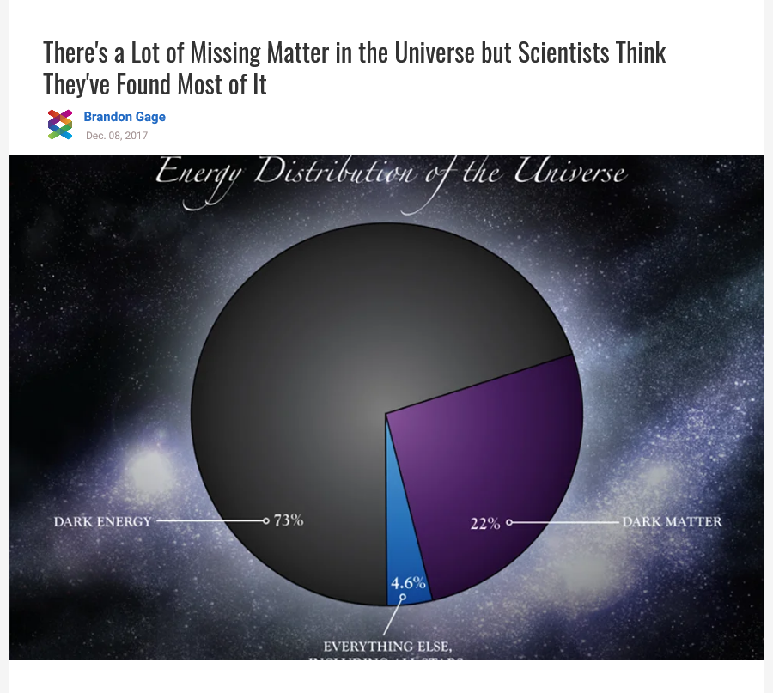
Big Overarching Science Questions
The fate of baryonic matter
The origin of biological elements
The chemical evolution of our universe
Neutrino origins and signatures
Baryonic Matter
Notes:
As noted by Laura Baudis and others…the energy distribution of the cosmos….leaves us less than 5% of the visible universe to solve the
the overarching astrophysical questions…..

Slide 3
Nuclear Astrophysics
is
the Engine of the Universe
Notes:
I appreciated the talks of Derek and Hunter to start explaining what is an earthquake…
Nuclear astrophysics ….is the engine of the universe…it operates in the broad spectra of cosmic events to yield the chemical elements and the signatures resulting from the chemical elements in the universe.

Slide 4
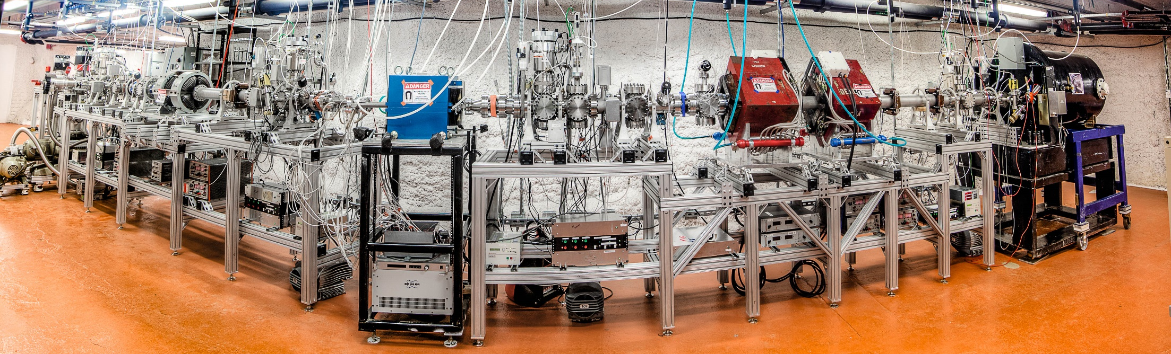
Nuclear Astrophysics (CASPAR) at SURF
Vision and goals of underground accelerators I
Ani Aprahamian
University of Notre Dame
Alikanyan National Laboratory of Armenia (AANL)
Notes:
This round table discussion is specifically about the future of nuclear astrophysics underground at SURF….
This picture is the accelerator hall where our 1 MV accelerator named CASPAR was located and the results of the first experiments are already at hand….

Slide 5
Big Questions
Formation of elements beyond Fe
  Identification and quantification of neutron induced processes: r-, weak r-, n-, i-, s- weak s-processes
  The identification of neutron sources for stellar environments
Nucleosynthesis in First Stars
  The emergence of biological elements C, O
  Nuclear clusters as stepping stones
The Solar Metallicity and the Standard Solar Model
  The origin of the CNO neutrino flux
  Branchings and equilibrium in the CNO cycles
He-burning and C/O production for late stellar evolution and the end of stellar life
The endpoint of nova nucleosynthesis
Notes:
So localizing our focus…..on underground nuclear astrophysics… the science questions?

Slide 6
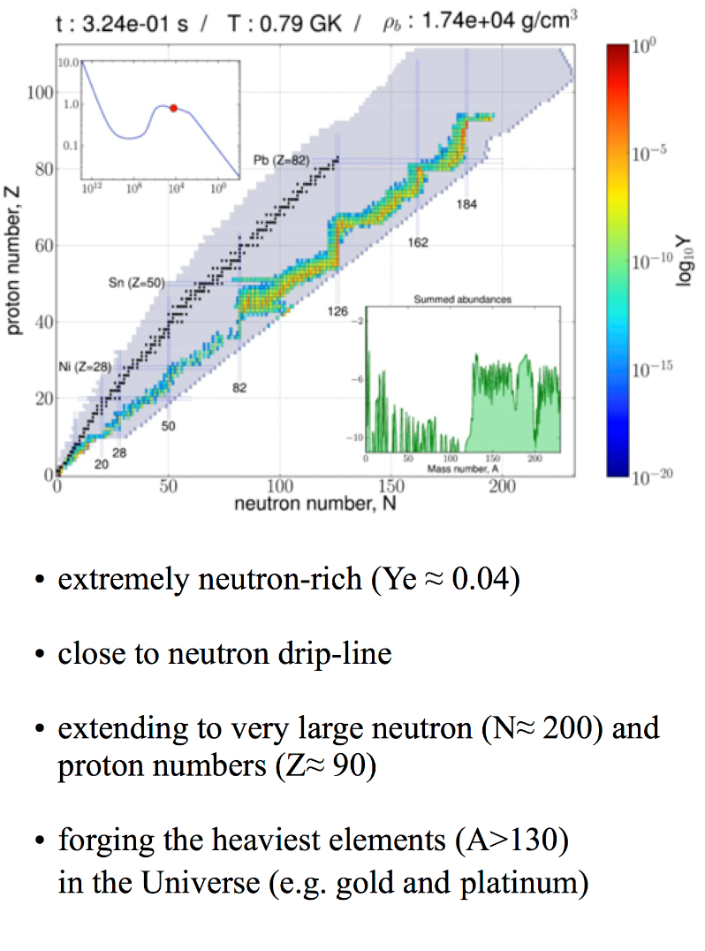

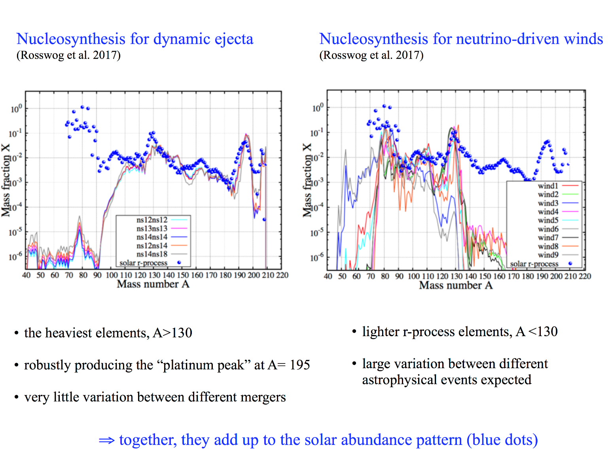
The large question over the last decade – the nature of the r-process
Merging neutron stars versus core collapse supernovae, gravitational wave detection identified neutron star mergers as source of the very heavy elements!

Slide 7
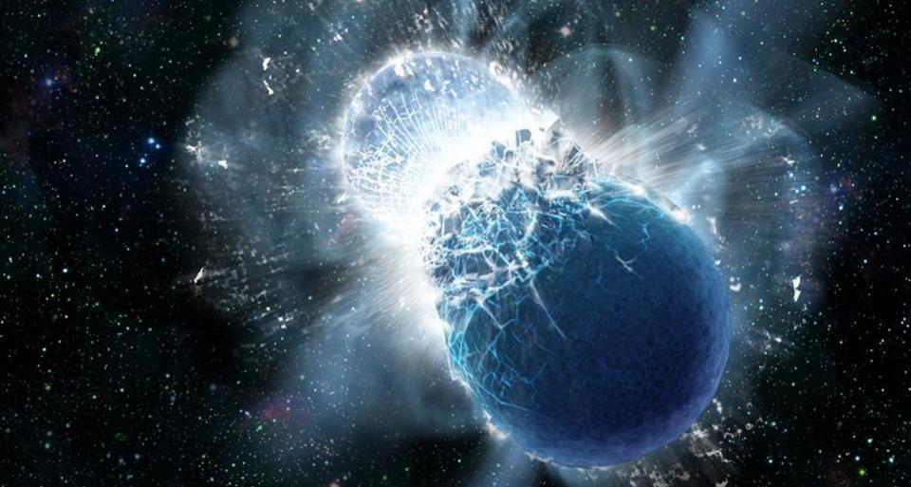
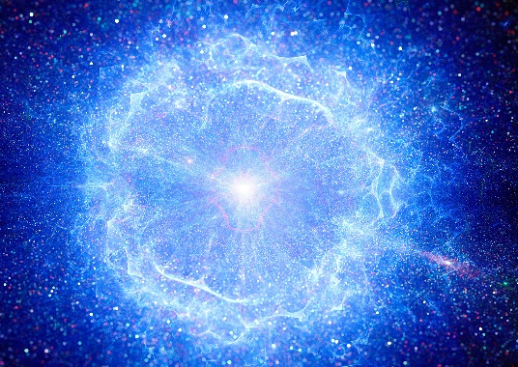
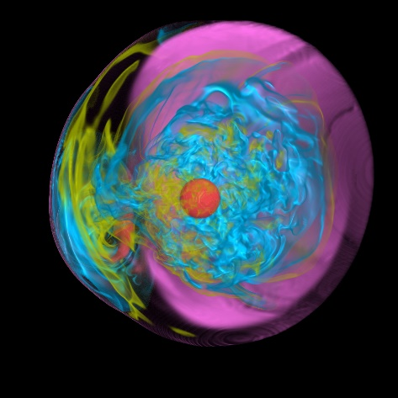
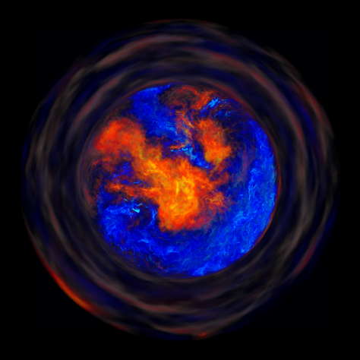
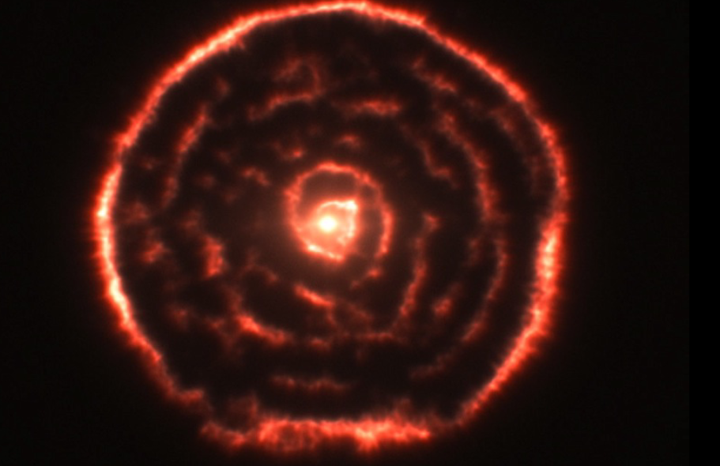
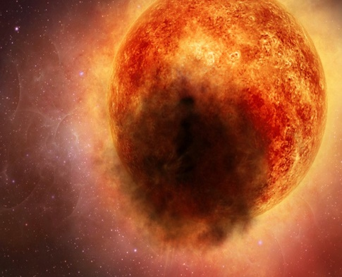
Stellar Neutron Sources?
The chemical evolution of heavy elements requires stellar neutron sources.
Merging neutron stars for r-process
Supernovae for weak r-process
Supernova shock for n-process
Early stars for i-process
AGB stars for s-process
RGB stars for weak s-process
Notes:
Nuclear astrophysics side of concern is the source of the neutrons….

Slide 8
F. Timmes
Notes:
Luminosity of neutrinos as a function of time for some supernova models…is shown here….from Frank Timmes…

Slide 9
F. Timmes
Notes:
As Josh mentioned yesterday…when we have advance notice of an impending supernova….a day or 10 hrs ahead

Slide 10
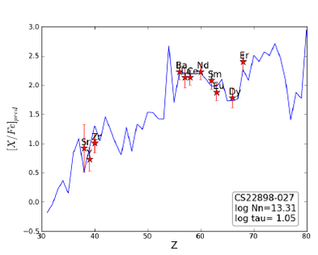
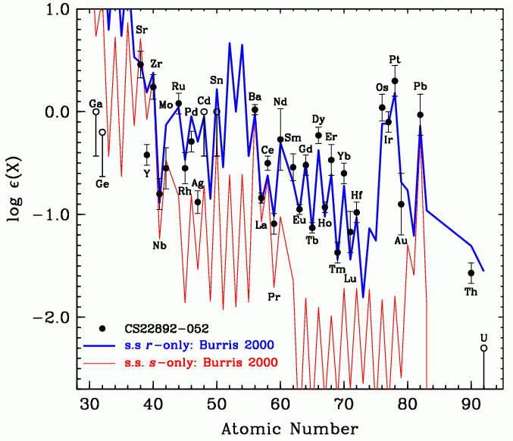
Abundances from other neutron induced nucleosynthesis processes
The s-process in comparison to the r-process.
The scaling depends on the strength of the
s-process neutron source
The i-process in CEMP stars, again the scale depends on the strength of neutron source

Slide 11
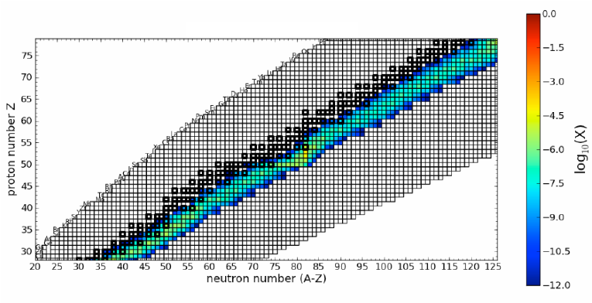
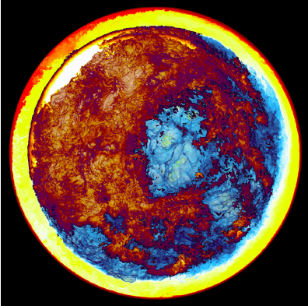
Neutron Sources?
First stars
Depends on seed material X in stellar environment and reaction rates for X(α,n) reactions. The
goal is to map the reaction cross sections to stellar energies.

Slide 12
Thank you

