Slide 1
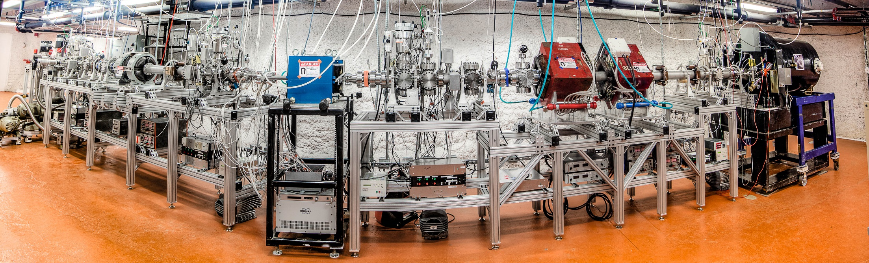
CASPAR at SURF
Program and goals of underground accelerators II
Michael Wiescher
University of Notre Dame
Joint Institute for Nuclear Astrophysics (JINA)

Slide 2
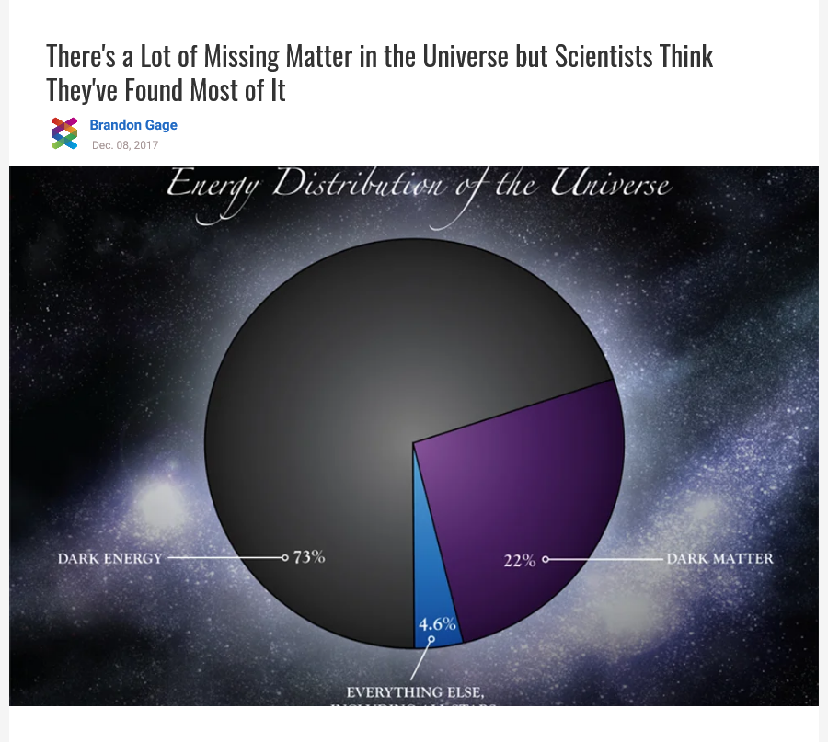
Big Overarching Science Questions
The fate of baryonic matter
The origin of biological elements
The chemical evolution of our universe
Neutrino origins and signatures
Baryonic Matter

Slide 3
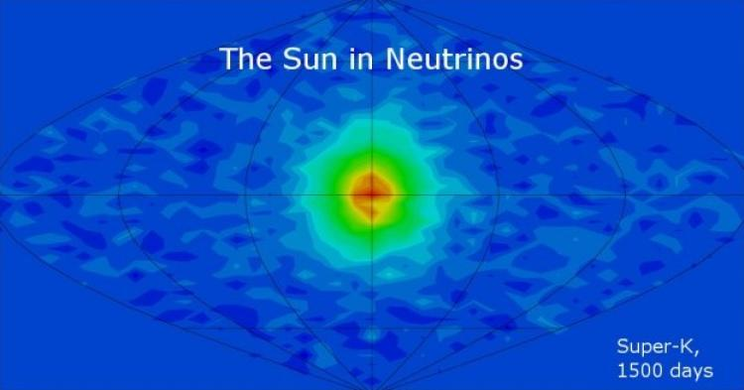
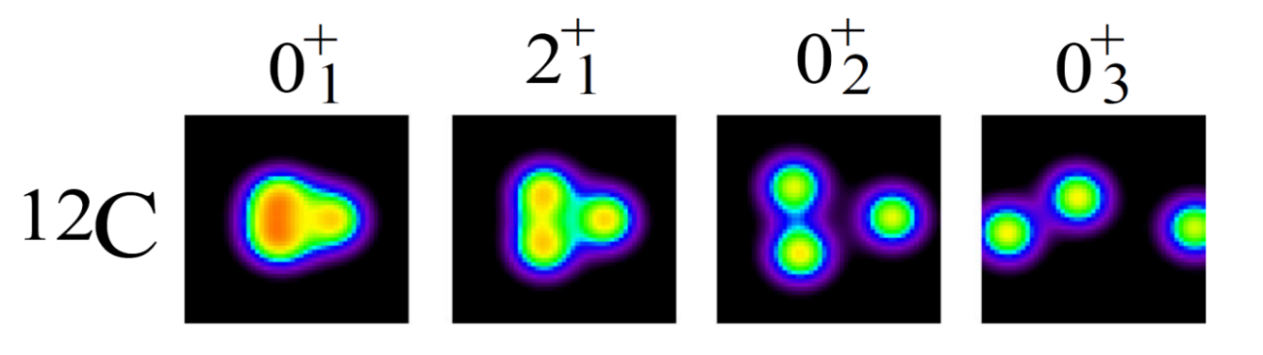
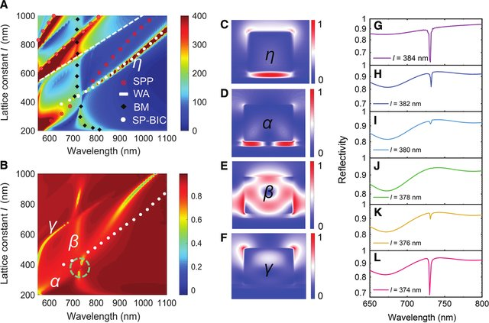
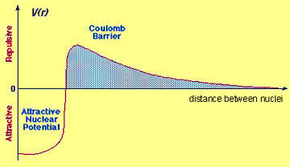
The quantum mechanics at the threshold remains unknown!
Stars are cold! Nuclear reactions occur at low energies (10-100 keV) very much below the Coulomb energy
Unexplored regions in the nucleus energy scheme
Emergence of cluster configurations
Interference between bound and unbound state causing drastic cross section changes
Coupling of bound state wave functions to the continuum
Modifications in the Coulomb barrier by potential model effects
Modifications in the Coulomb barrier by electron screening effects

Slide 4
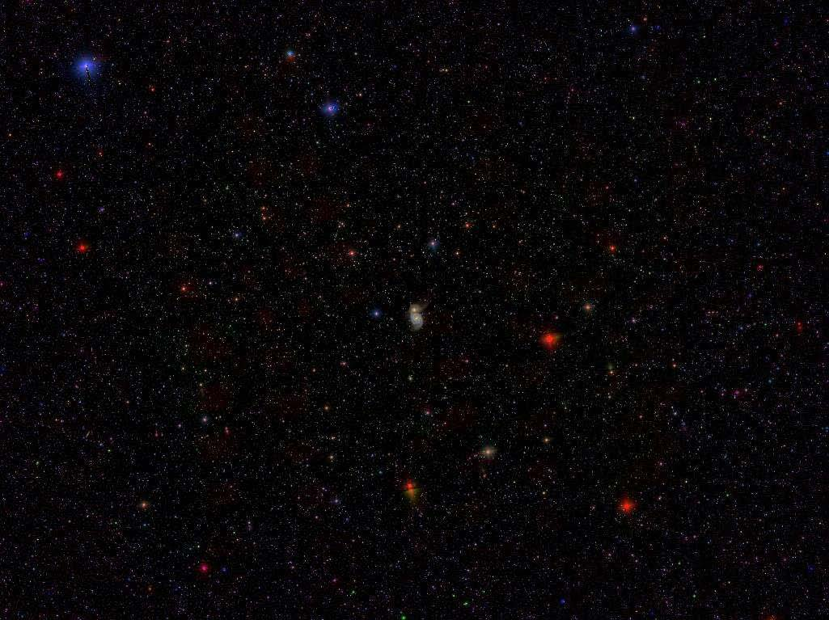
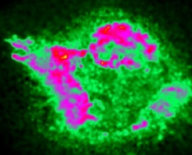
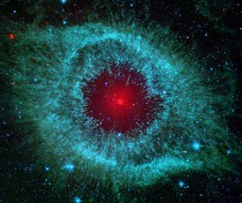
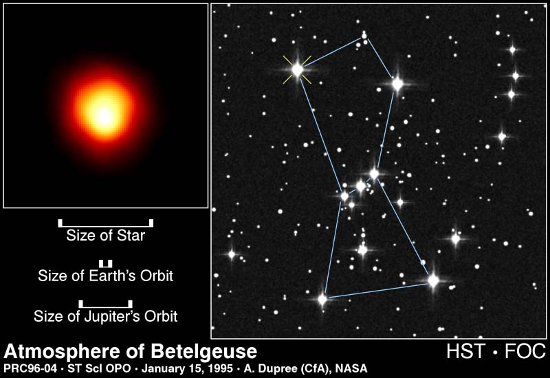
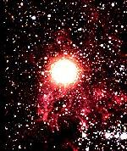
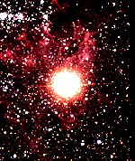
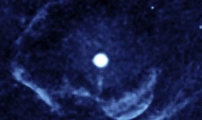
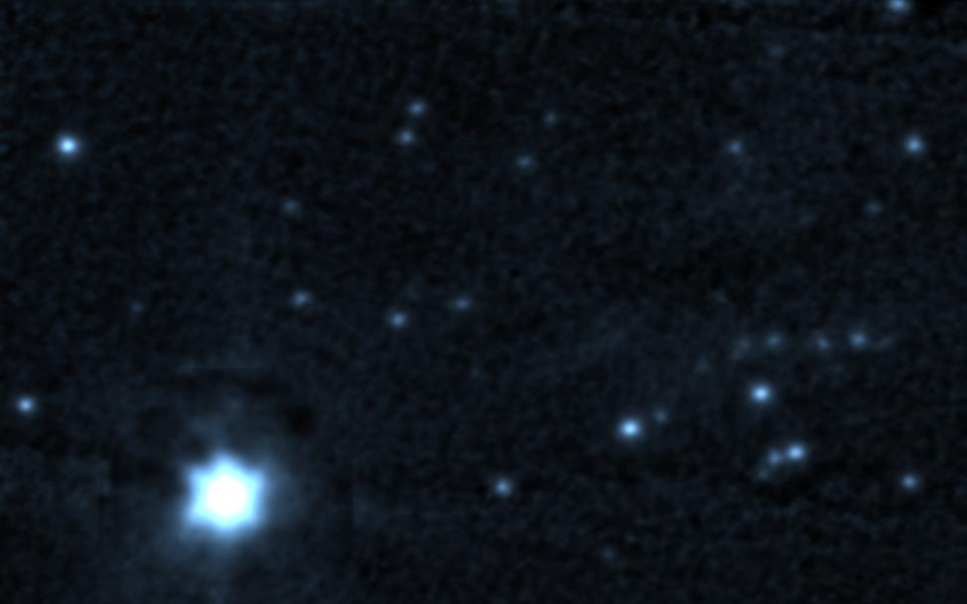
Stellar Burning and Cosmic Observables
Low energy nuclear reactions determine stellar evolution:
10
Si-ignition
O-ignition
Ne-ignition
9
C-ignition
log (T_{c})
He-ignition
8
H-ignition
7
0
2
4
4
6
8
10
log (ρ_{c})
evolution time scale
seed abundance distribution
ignition conditions for SN
4. Black hole mass range
Black hole occurrence
Neutrino signals!

Slide 5
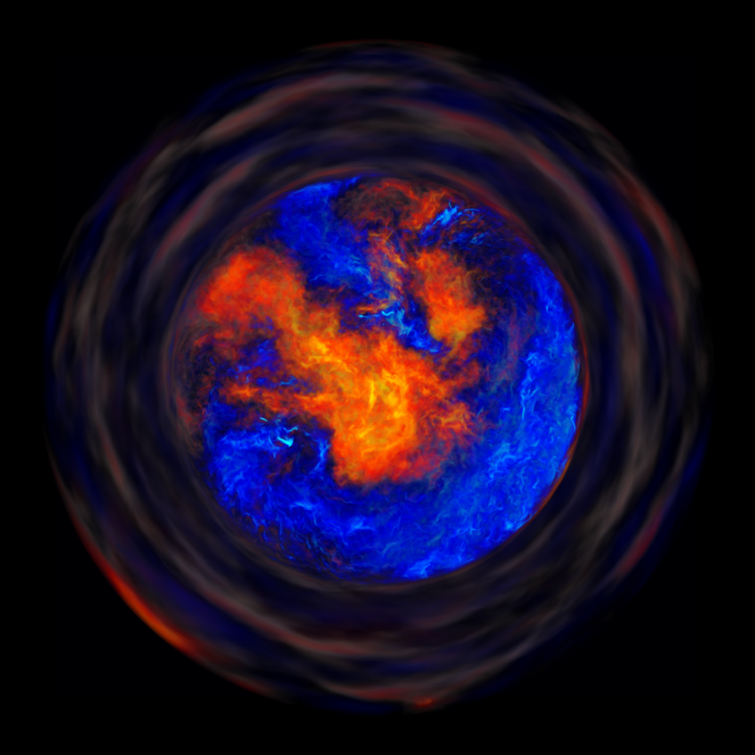
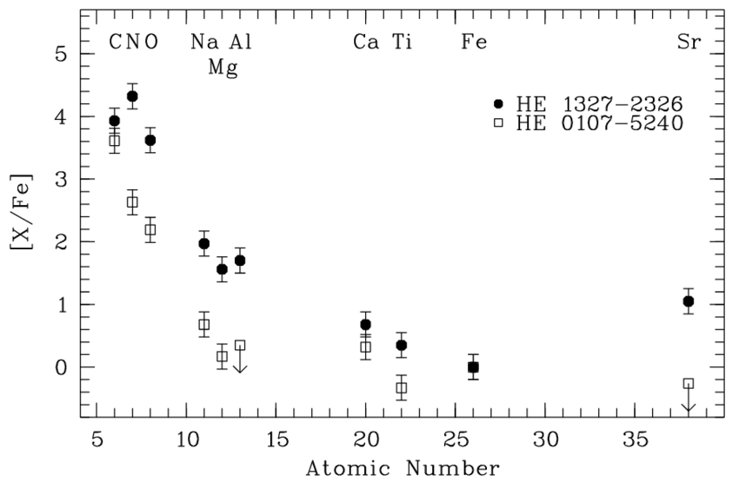
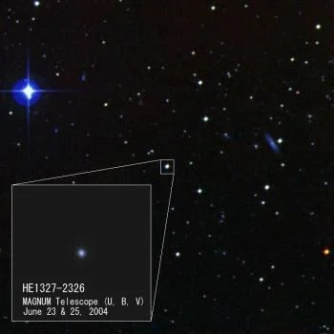
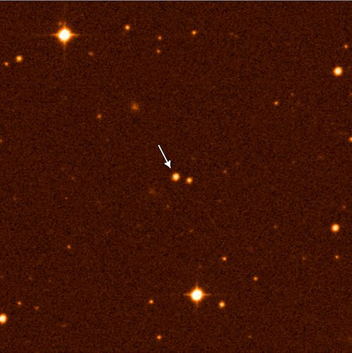
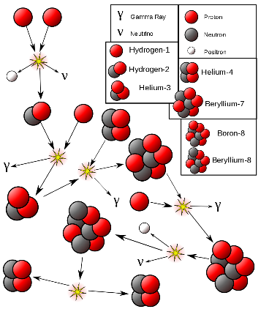

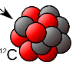









First Stars and the emergence of the biological elements C and O
From primordial Big Bang to First Stars
Crossing the A=5&8 gaps: from primordial H, He to stellar C, O elements
Explaining the Li problem by first star nucleosynthesis
He 1327-2326
He 0107-5240
Deuterium fuel recirculation
n
Mostly unknown but cluster enhanced reaction rates for primordial stars
⁴He
¹³N
²H
⁶Li
⁴He
¹⁰B
²H
⁴He
⁴He
¹H
¹²C
⁴He
¹⁶O
¹³C

Slide 6





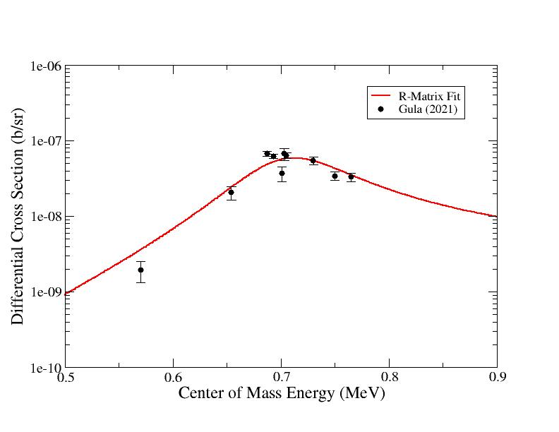
Nucleosynthesis in first stars from primordial (H, He) to biological elements (C, O) and beyond using alpha cluster states as stepping stones for bridging mass 5 and 8 gap.
Nuclear Stepping Stones
d ⇨ ⁶Li ⇨ ¹⁰B ⇨ ¹⁴N
d ⇨ d⊗α ⇨ d⊗⁸Be ⇨ d⊗¹²C
alpha cluster configuration near the alpha threshold (Ikeda rule)
⁶Li(ɑ,γ)¹⁰B

Slide 7
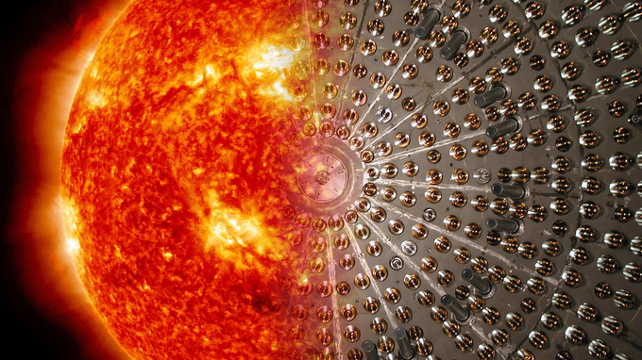
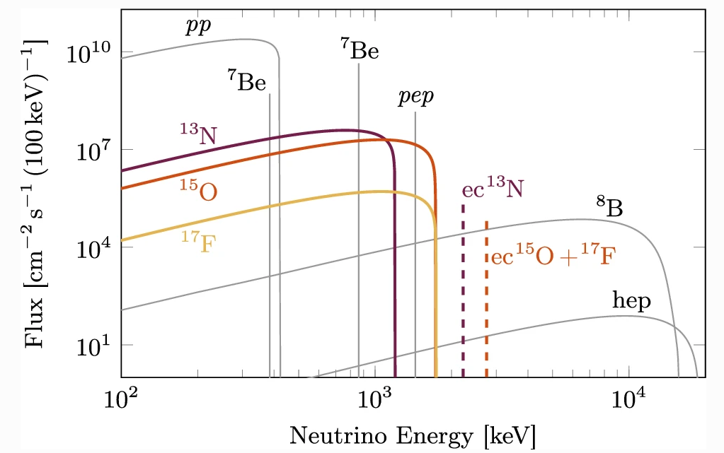
The solar Neutrinos and the metallicity (CNO) of the sun
Discrepancies in the predicted solar metallicity and helioseismology
Using the CNO neutrino flux for an independent measure of metallicity of the solar core! (see Josh Klein)
The neutrino flux
The low energy cross sections
of CNO reactions need to be known with high accuracy!

Slide 8
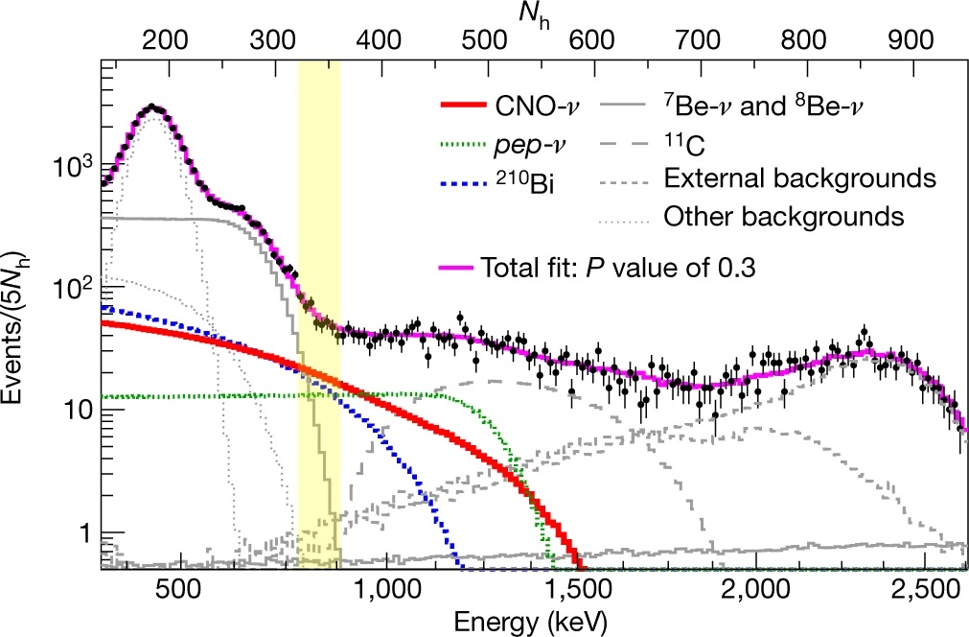
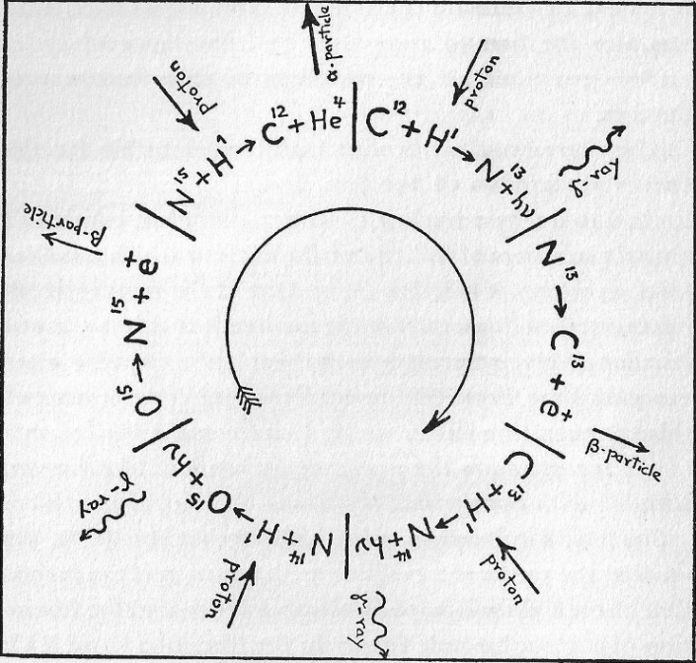
Borexino observation
Determination of the solar CNO neutrino source and test the predictions of the solar metallicity in the standard solar model.
ν
ν
BOREXINO CNO neutrino detection
BOREXINO results suggest a higher metallicity than predicted by CNO predictions. The studies of ¹²C(p,γ)¹³N and ¹⁶O(p,γ)¹⁷F are in progress towards a reliable prediction of the ¹³N and ¹⁷F neutrino flux!

Slide 9
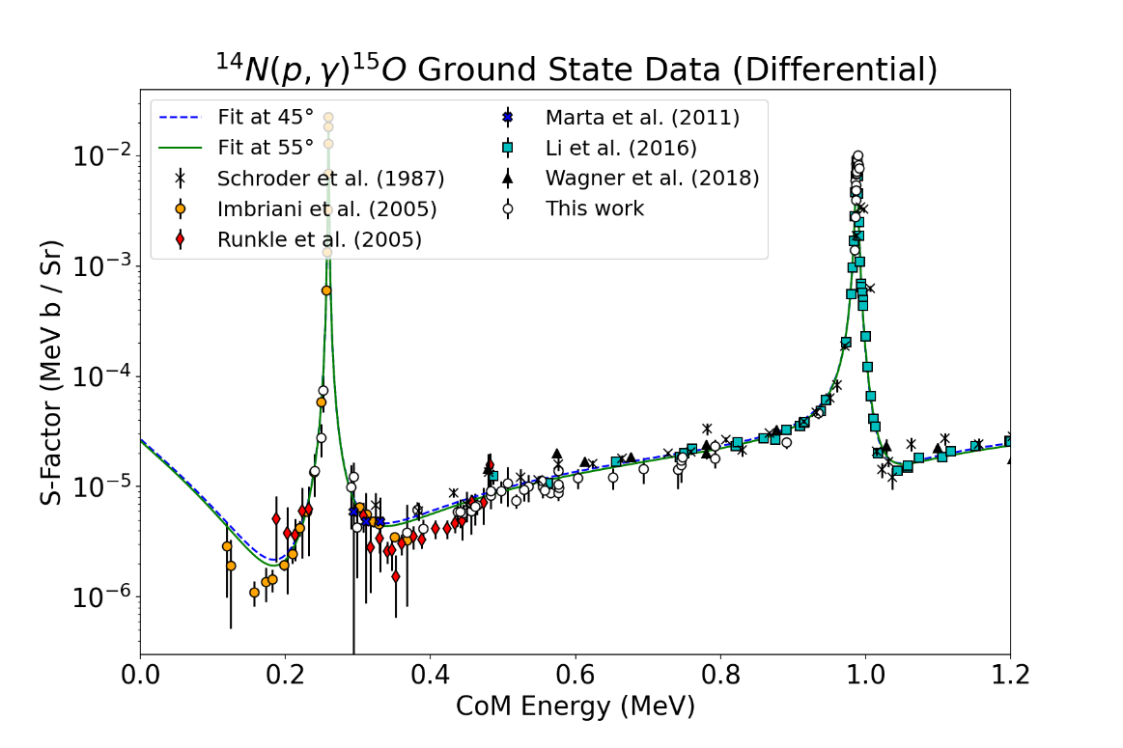
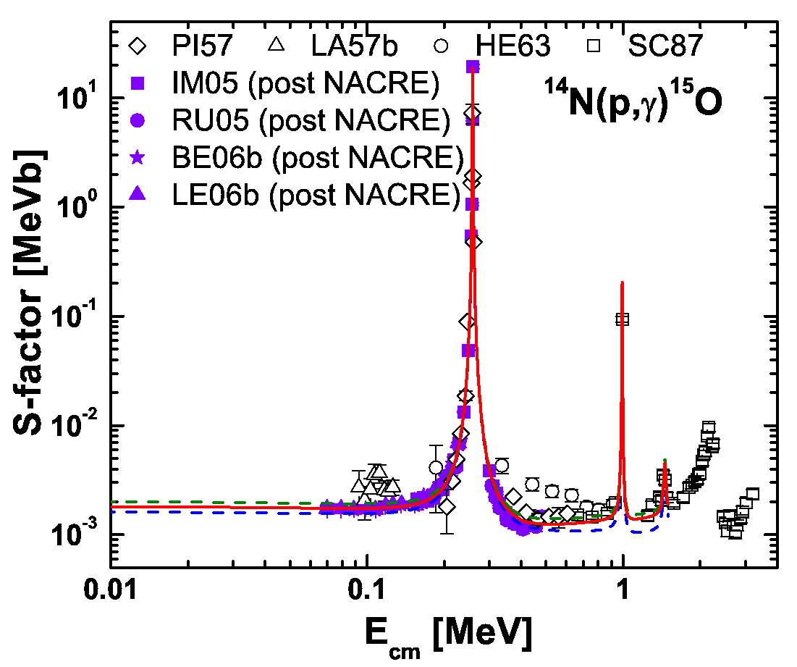
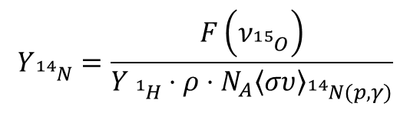
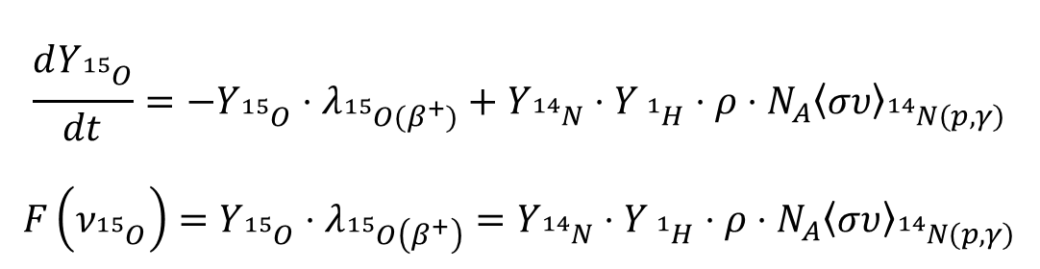
CNO neutrino uncertainties
$$\frac{dY_{{}_{}^{15}O}}{dt}=−Y_{{}_{}^{15}O}⋅λ_{{}_{}^{15}O(β^{+})}+Y_{{}_{}^{14}N}⋅Y_{{}_{}^{1}H}⋅ρ⋅N_{A}{\left\langle συ\right\rangle }_{{}_{}^{14}N(p,γ)}$$
$${F\left(ν_{{}_{}^{15}O}\right)=Y}_{{}_{}^{15}O}⋅λ_{{}_{}^{15}O\left(β^{+}\right)}=Y_{{}_{}^{14}N}⋅Y_{{}_{}^{1}H}⋅ρ⋅N_{A}{\left\langle συ\right\rangle }_{{}_{}^{14}N(p,γ)}$$
CNO reactions are all in equilibrium!
$$Y_{{}_{}^{14}N}=\frac{F\left(ν_{{}_{}^{15}O}\right)}{Y_{{}_{}^{1}H}⋅ρ⋅N_{A}{\left\langle συ\right\rangle }_{{}_{}^{14}N(p,γ)}}$$

Slide 10
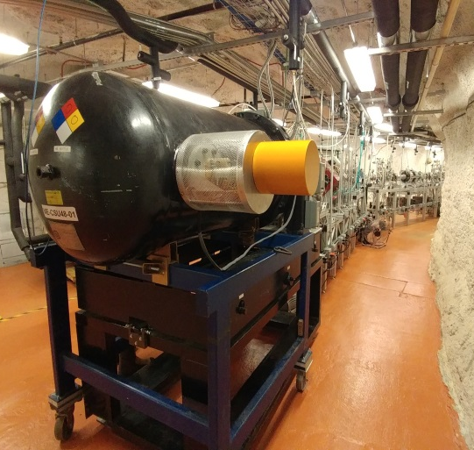
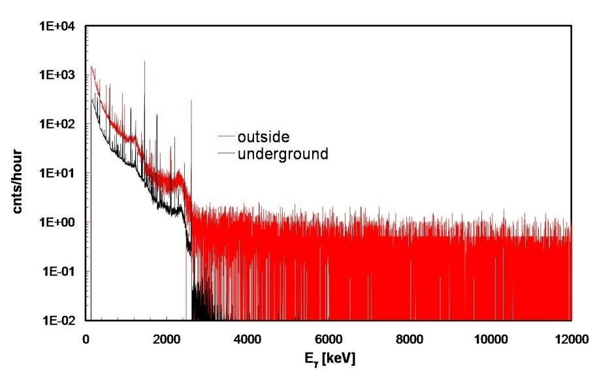
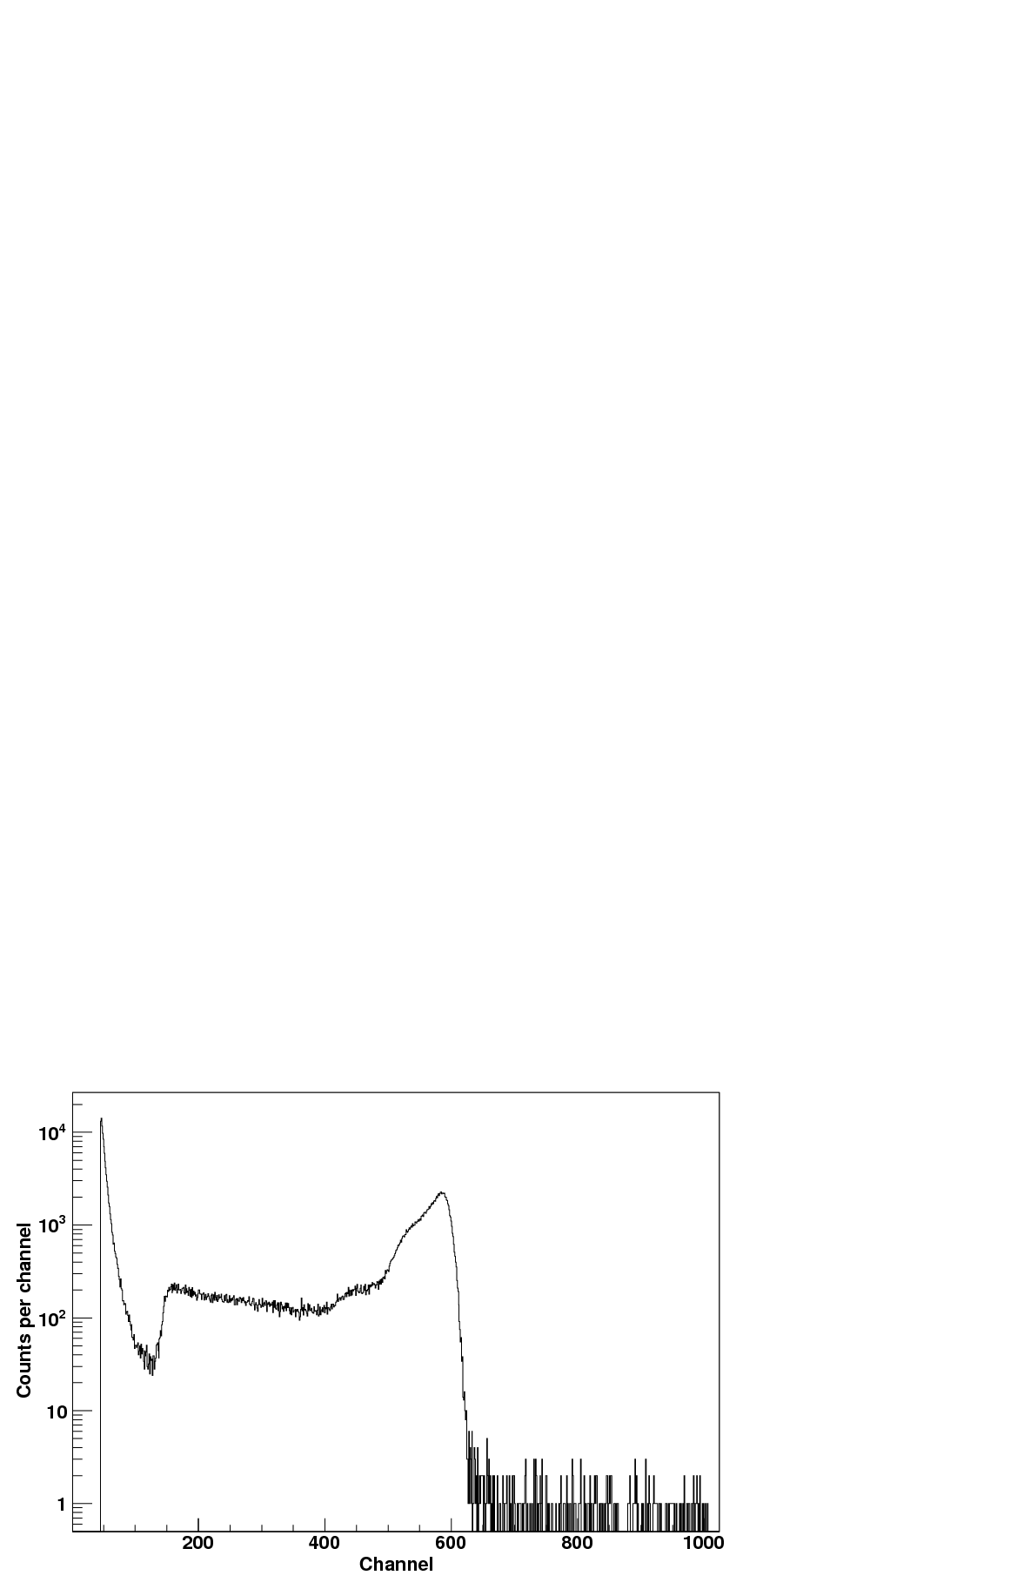
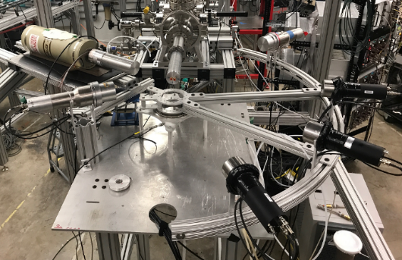
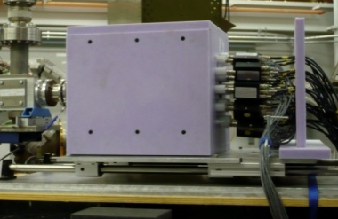
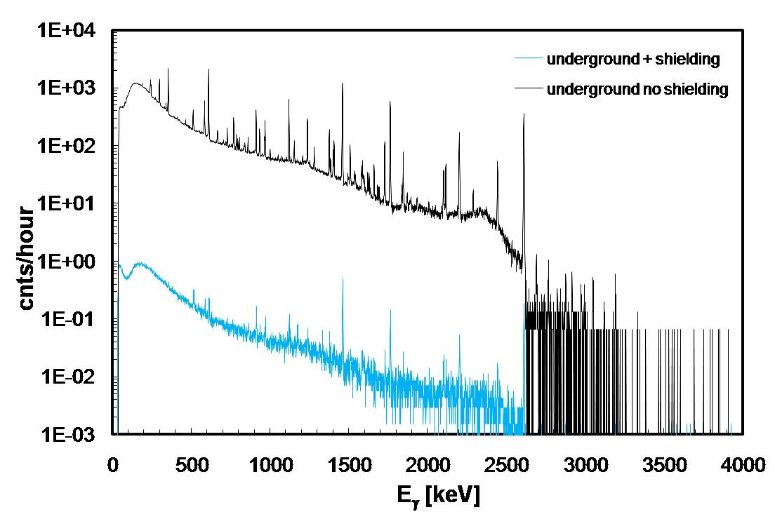
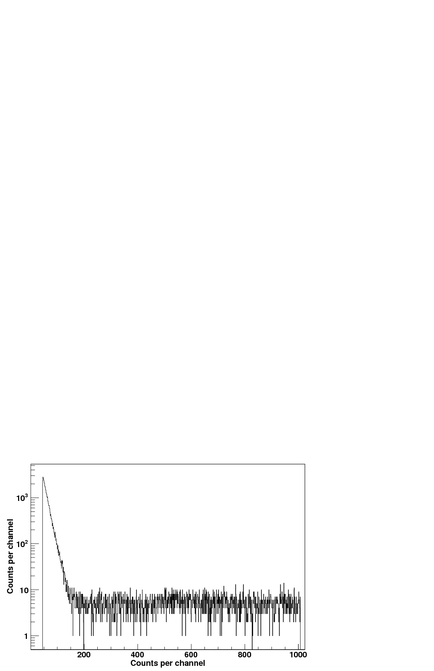
What are the approaches to address these questions?
Operation of a low energy accelerator with high p and ɑ intensities for extended periods of time to measure low energy cross sections in a CR free environment. New detection systems are being developed to complement the passive CR background shield with active background shielding through coincidence techniques.
Environmental Radioactivity
CR induced neutron spectrum
CR induced γ spectrum
underground gamma spectrum
underground neutron spectrum

Slide 11
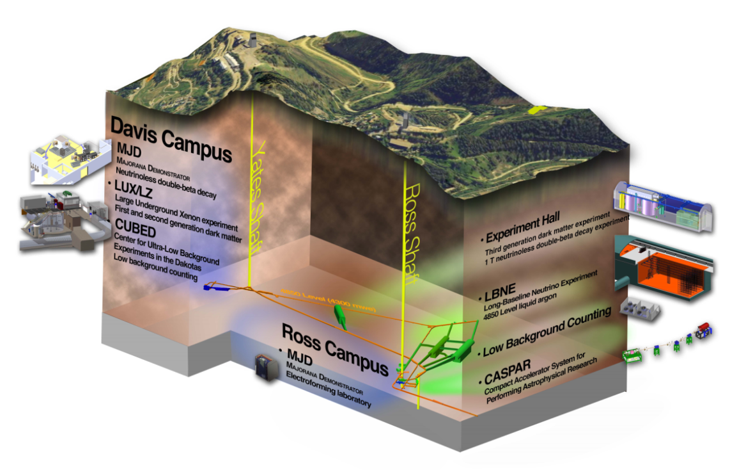
Are there particular facility design aspects that will benefit this research
The facility should be in the 3000 to 5000 ft depth range, but equally important would be a low level radiogenic rock environment to reduce the overall background. Support requires power, liquid nitrogen delivery access such as developed for CASPAR. Experiments are long duration runs, with access for personnel for maintenance and operation. Specific locations for this type of facility are best isolated from larger particle detection experiments.
Access to a SURF workshop above ground would be desirable!
Location at lower depth but with reduced radiogenic background conditions might be advantageous!

Slide 12
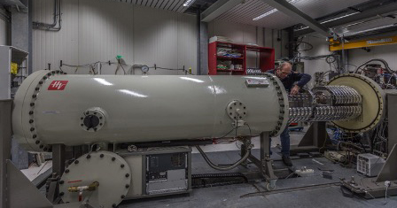
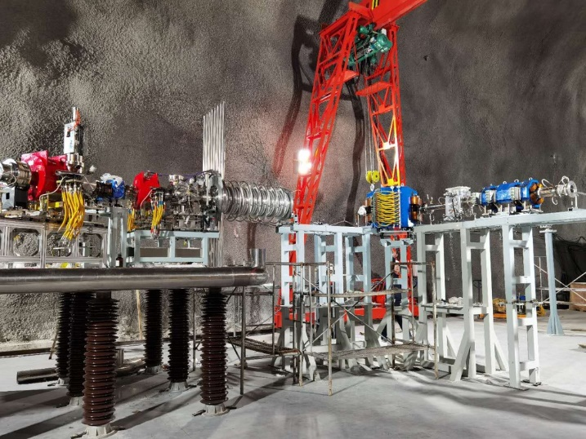
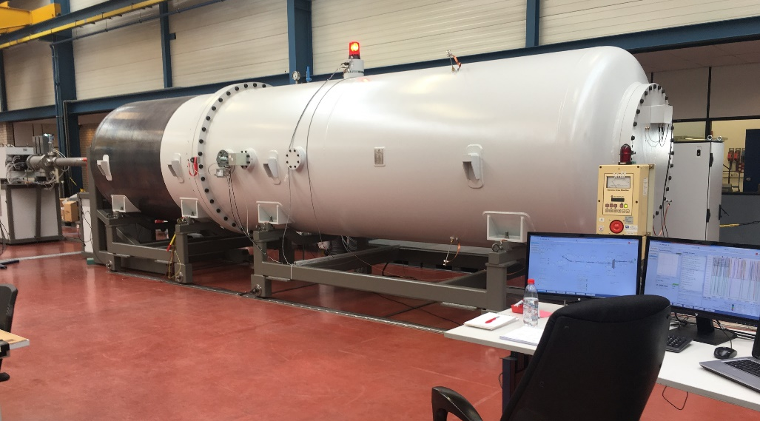
What are the international efforts
LUNA @ Gran Sasso (EU,Italy)
JUNA @ CJUL (China)
400 keV HV accelerator for
proton and alpha induced reactions
400 keV open platform accelerator
for proton and alpha induced reactions
LUNA-MV becomes operationable in 2022. Upgrade for JUNA to MeV range energies is being proposed!
3.5 MV HV accelerator for
alpha and carbon induced reactions

Slide 13
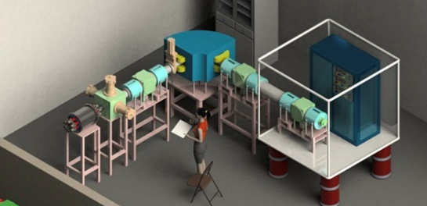

Closing
Low energy reaction studies probe the quantum mechanics at the threshold and the associated reaction dynamic. This is not known and represents the main source of uncertainty in the field. We don’t know the physics at the threshold!
The emergence of cluster configurations in the reaction compound
Interference and other coupling effects between bound and unbound regions of the nucleus changing the wave functions
How well do we know the Coulomb barrier at the threshold? What is the impact of screening through the electron cloud in cold materials and hot plasmas.
The continuous effort to push the experimental data to ever lower limit is not a moot and boring exercise, it remains an essential effort to solidify the foundations of the field and put the models on reliable ground!

