Slide 1
Underground Science Round Table
Dr. Hunter Knox
Geophysicist
Notes:
Image: Sequim Bay

Slide 2

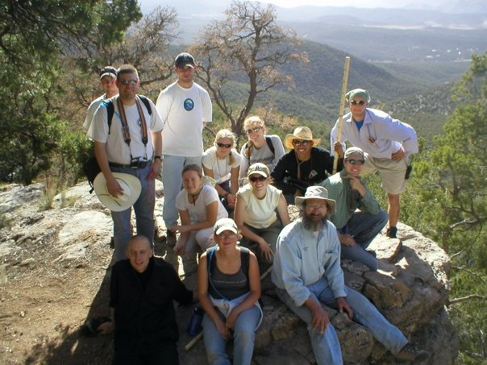


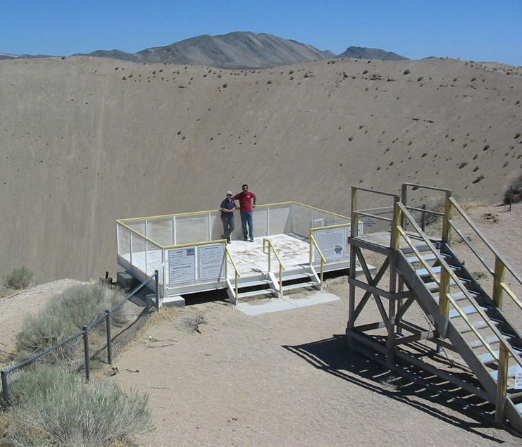
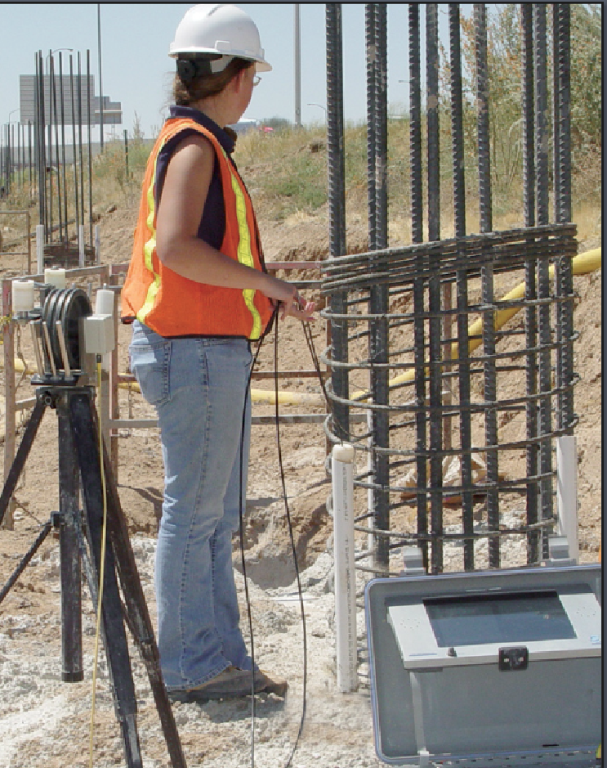
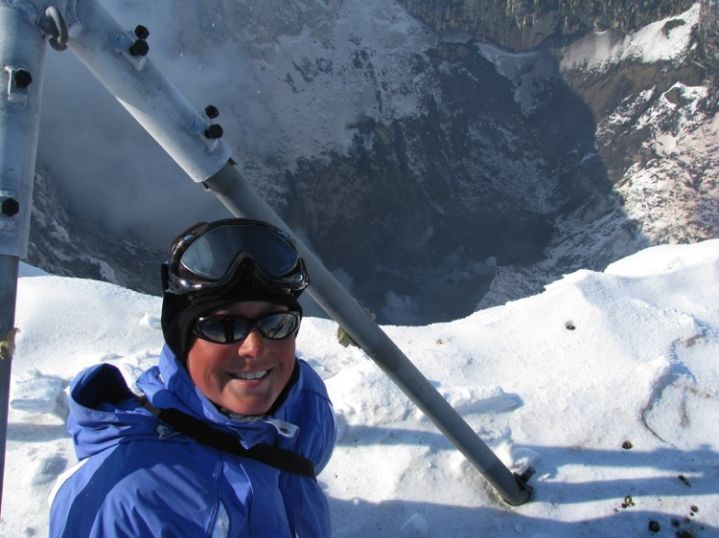
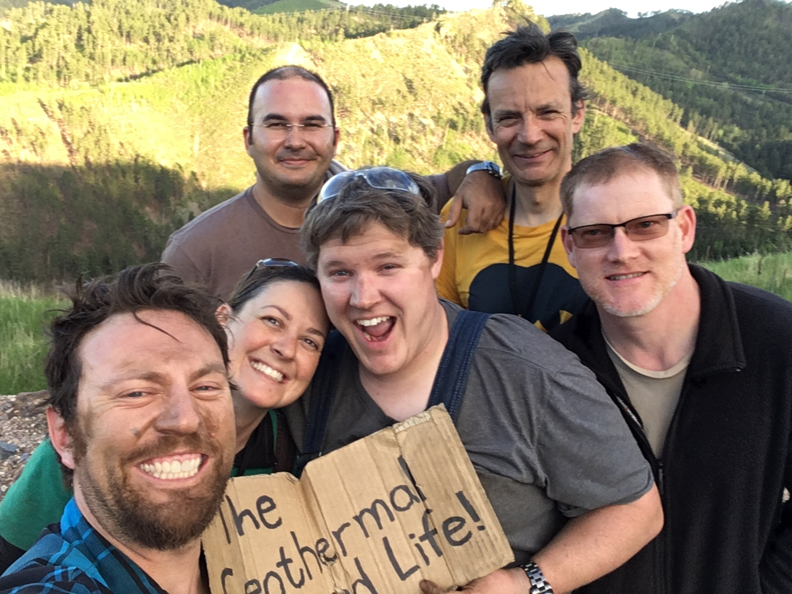
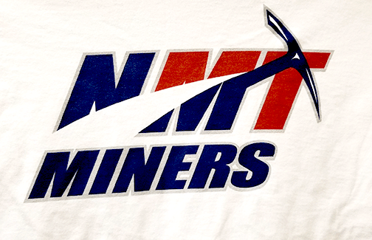
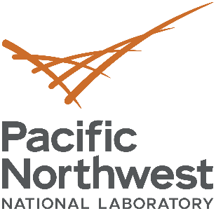
A bit about my past and how it led me underground …

Slide 3
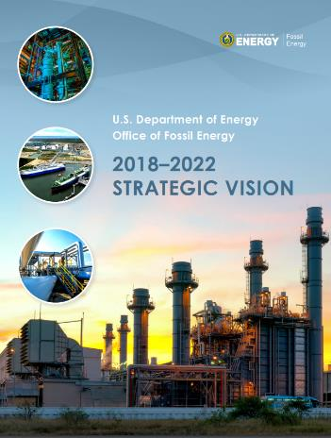
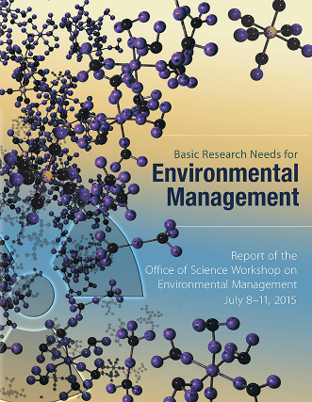
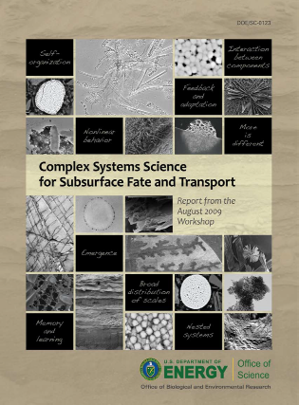
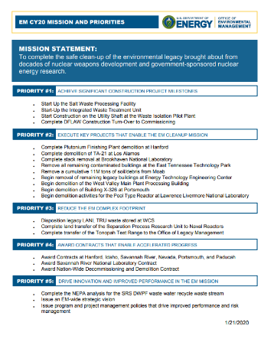
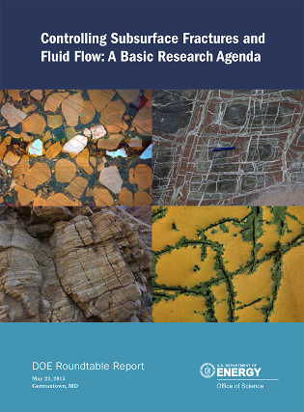
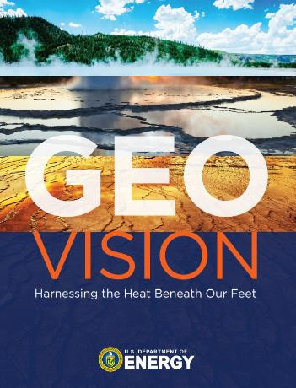
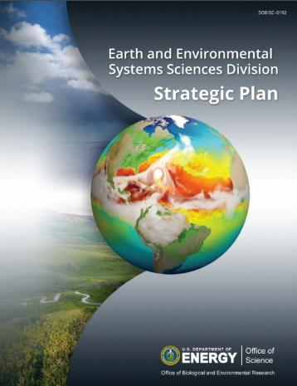
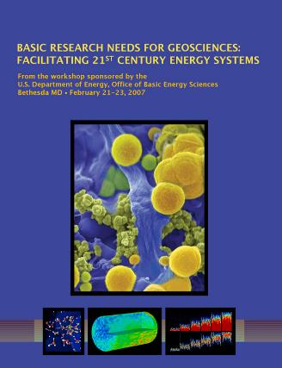
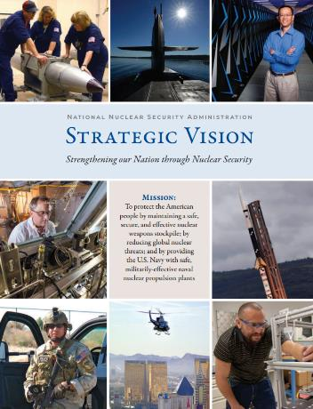
National Need
Every DOE “think-tank” report produced over the last 20 years has strongly emphasized the enormous need for improved methods to image, interrogate, better understand and predict subsurface processes
Notes:
(What is the national problem or challenge?)
The subsurface arguable the most critical component of earth to humanity. Unfortunately, the subsurface is highly heterogeneous, difficult and costly to access. It is the only part of our planet that is still essentially invisible to us, yet its importance cannot be overstated. It should be no surprise that every DOE “think-tank” report produced over the last 20 years has strongly emphasized the enormous need for improved methods to image, interrogate or otherwise sense subsurface processes, to better understand subsurface processes, and to enable prediction and ultimately control of the subsurface. The problem is, we just do not have, and cannot feasibly collect enough data through direct access to adequately understand and predict. We need better methods for interrogating the subsurface.

Slide 4
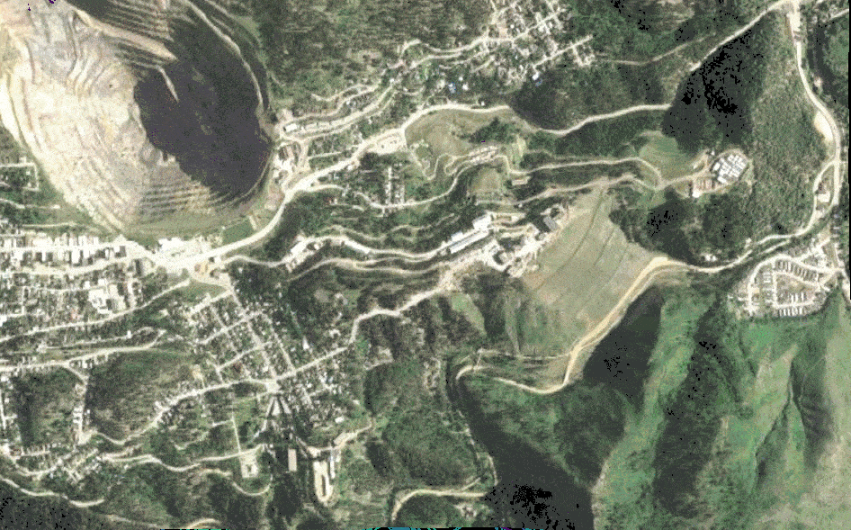
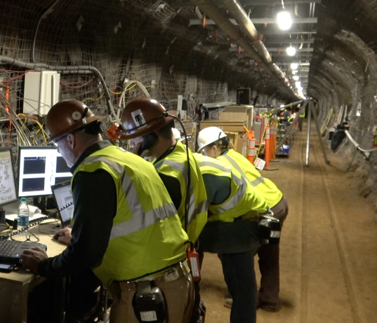
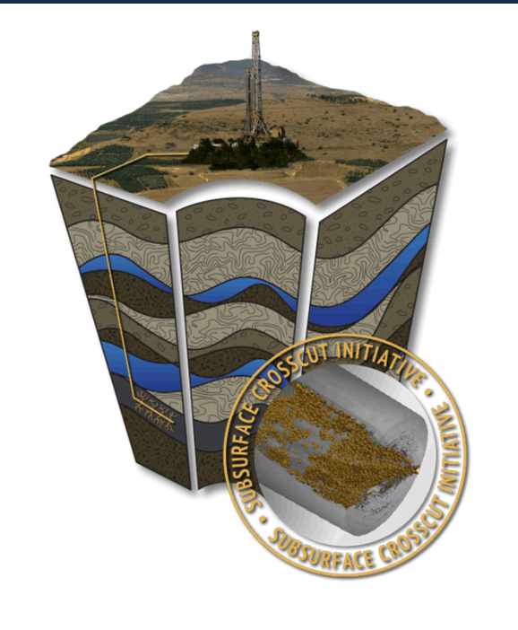
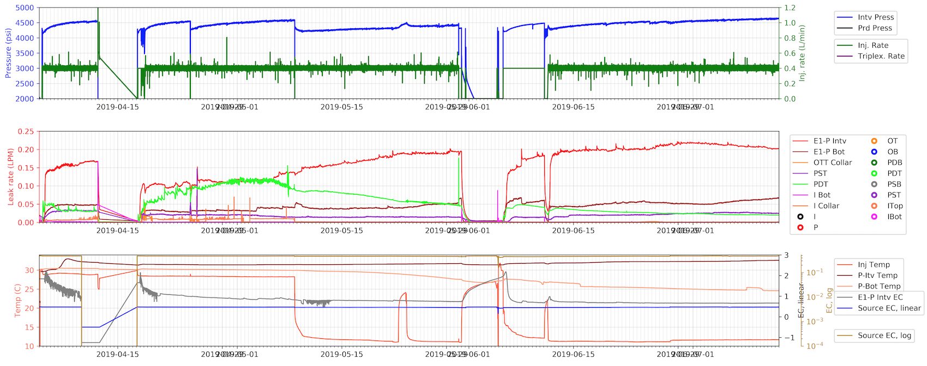
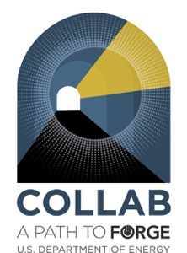

Current Research: Enhanced Geothermal Systems
120 Days

Slide 5
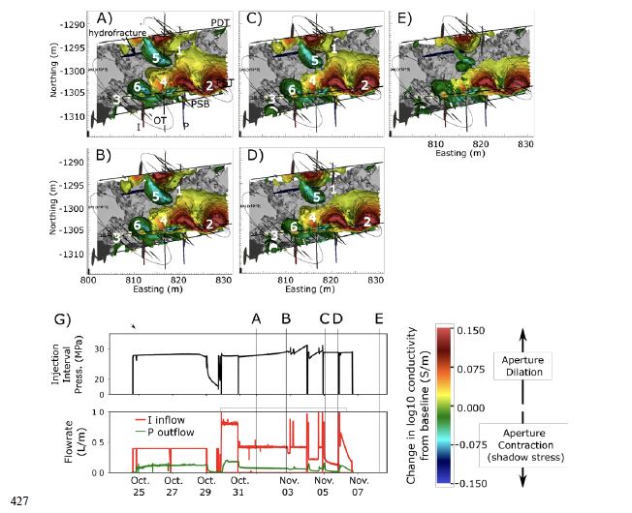
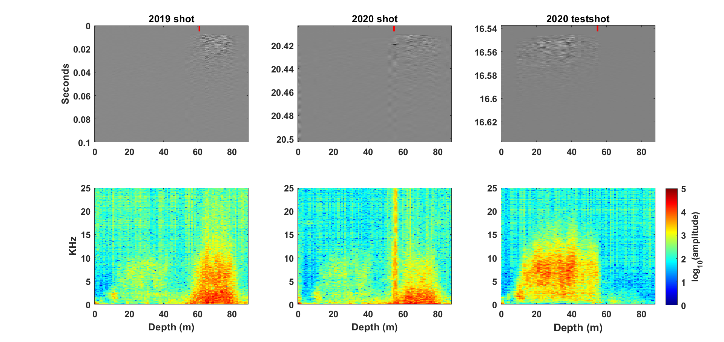
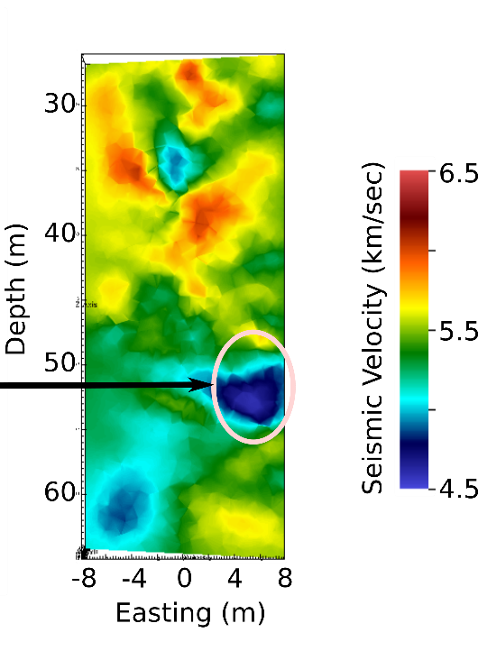
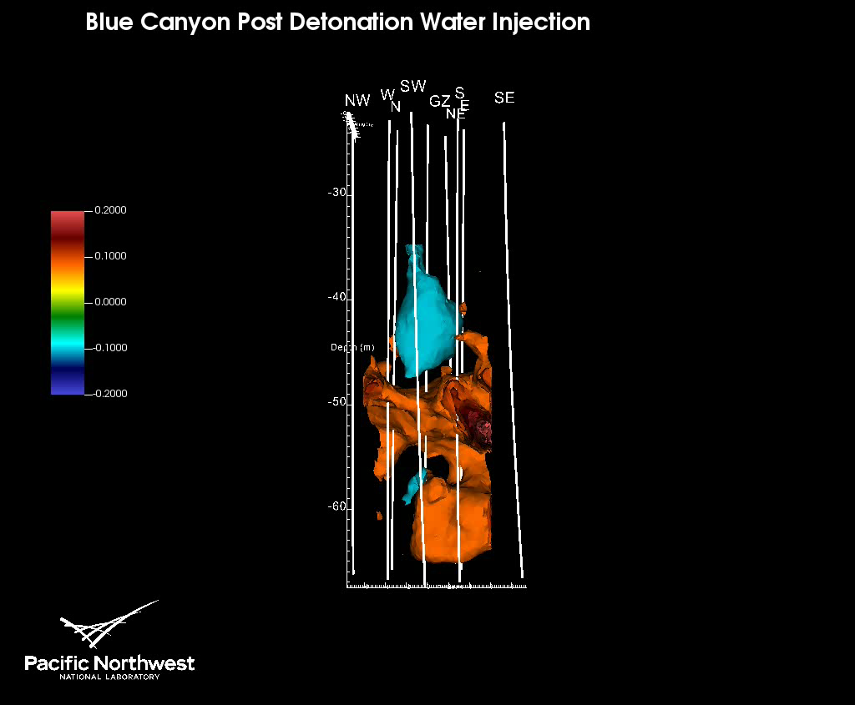
Advanced Geophysical Characterization & Monitoring

Slide 6
What big science questions will need to be addressed?
Earth Science:
  What experiments can be performed at the intermediate scale (~10-100m) to inform full field scale understanding?
  What geophysical techniques can provide real-time *relevant* feedback for operators?
  Can we develop more distributed/sensitive instrumentation for monitoring subsurface processes? What about building subsurface ”structures”?
Geothermal:
  How do we create stable fracture networks for the purposes of extracting geothermal energy?
  Can we prevent or mitigate earthquakes from subsurface injections? This will also be important for Carbon Sequestration at any meaningful scale.
  What are the early warnings for thermal break through and can anything be done about it?
  Are there closed loop or other circulation configurations that can be used to generate electricity?

Slide 7
What are the approaches to addressing these questions?
Laboratory Scale Experimentation
Subsurface Characterization
Meso - Scale Experimentation
Modeling
Path to Commercialization
Subsurface Monitoring
Field - Scale Experimentation

Slide 8
Are there particular facility design aspects that will benefit this research?
great depth => Great Stress!
large cavities => Alcoves are beneficial!
access to special areas in the underground => Different Geology!
support facilities => Warehouse, Rail Stock, Cage Transport, Machine Shop!
access for personnel and/or equipment => YES!!!
Utilities => Power, Fiber, Lighting, Phones, etc!!!
long durations => YES!!!

Slide 9
How can the facility assist with your community involvement and outreach efforts?
My two cents …
  Undergraduate and graduate geology/geophysics/hydrology/geochemistry experiences
  Getting the word out about cool subsurface science (YouTube, Twitter, etc)
  Continue to develop a diverse underground community
  Technical engagement

