Slide 1




CETUP* 2026
Notes:
10 years of CETUP* - collaboration, impact, milestones
Time Capsule – everyone has the chance to add something
Indico – Share Your CETUP Story

Slide 2

Introductions
Staff
Organizing Committee
Workshop Attendees
SUBTITLE HERE

Slide 3
Celebrating 10 Years of CETUP*
Share Milestones
Time Capsule
Timeline Graphic
Your Stories
Next 10 Years

Slide 4
Celebrating 10 Years of CETUP*
For the Time Capsule, consider contributing items such as:
• Photos from past or current CETUP* workshops
• Copies of publications or journal articles connected to CETUP* collaborations
• Workshop schedules, agendas, name badges, or group photos
• News articles featuring CETUP* or related scientific discoveries
• A short letter to future CETUP* participants describing your hopes for the field
• A commemorative item from this year's workshop
• Small mementos that capture the spirit of CETUP*

Slide 5
Celebrating 10 Years of CETUP*
To contribute, please submit your memory on the
CETUP* Indico website.
We would love to hear about:
A memorable moment or experience (photos or articles welcome)
The people, collaborations, or environment that made it meaningful
How it influenced your research, career, or perspective
Any outcomes (publications, partnerships, new directions)
The broader impact of your work connected to CETUP*

Slide 6
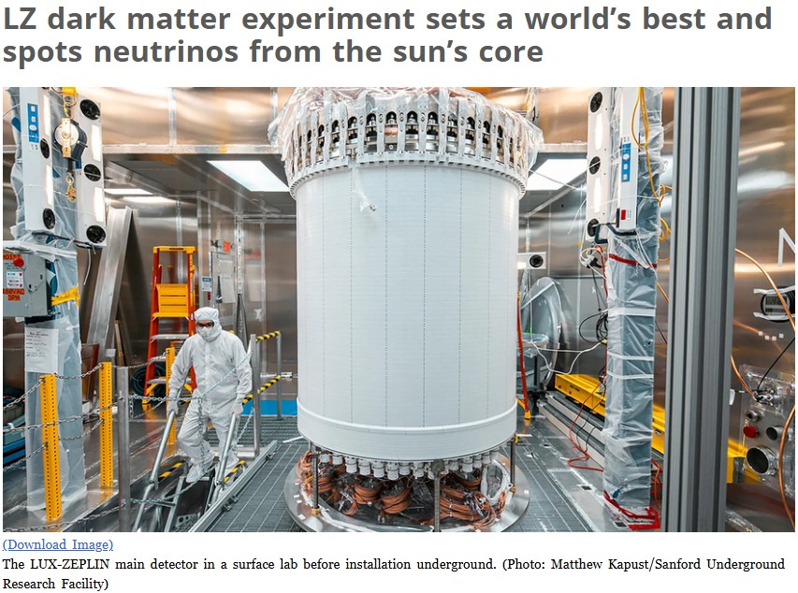
The theoretical work developed at CETUP* has been integral in motivating and interpreting important and timely experiments. An example is the recent LZ detection of solar neutrinos via coherent scattering, which provides a novel window into neutrino physics and astrophysics. CETUP* is crucial to understanding the importance of such results, which represents the culmination of over 50 years of experimental effort.
Louis Strigari, Texas A&M

Slide 7
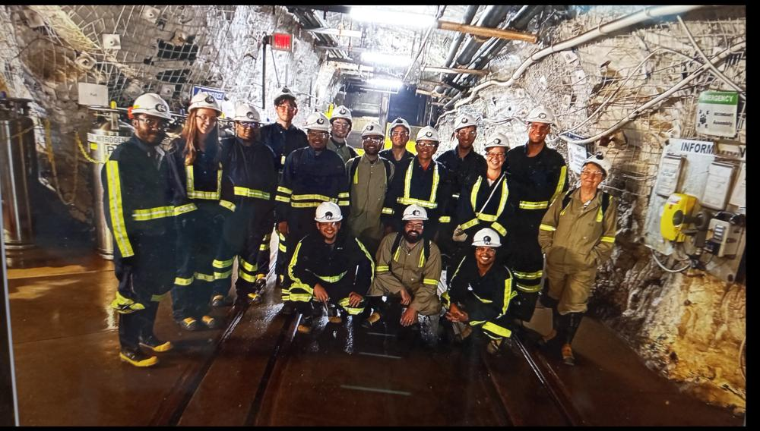
Trip to the SURF underground laboratory in 2023: A bunch of happy theorists finally seeing where the experiment they make predictions for is going to live.
Julie Gehrlein
Colorado State University
Notes:
Trip to the SURF underground laboratory in 2023: A bunch of happy theorists finally seeing where the experiment they make predictions for is going to live
Julia Gehrlein
Colorado State University

Slide 8
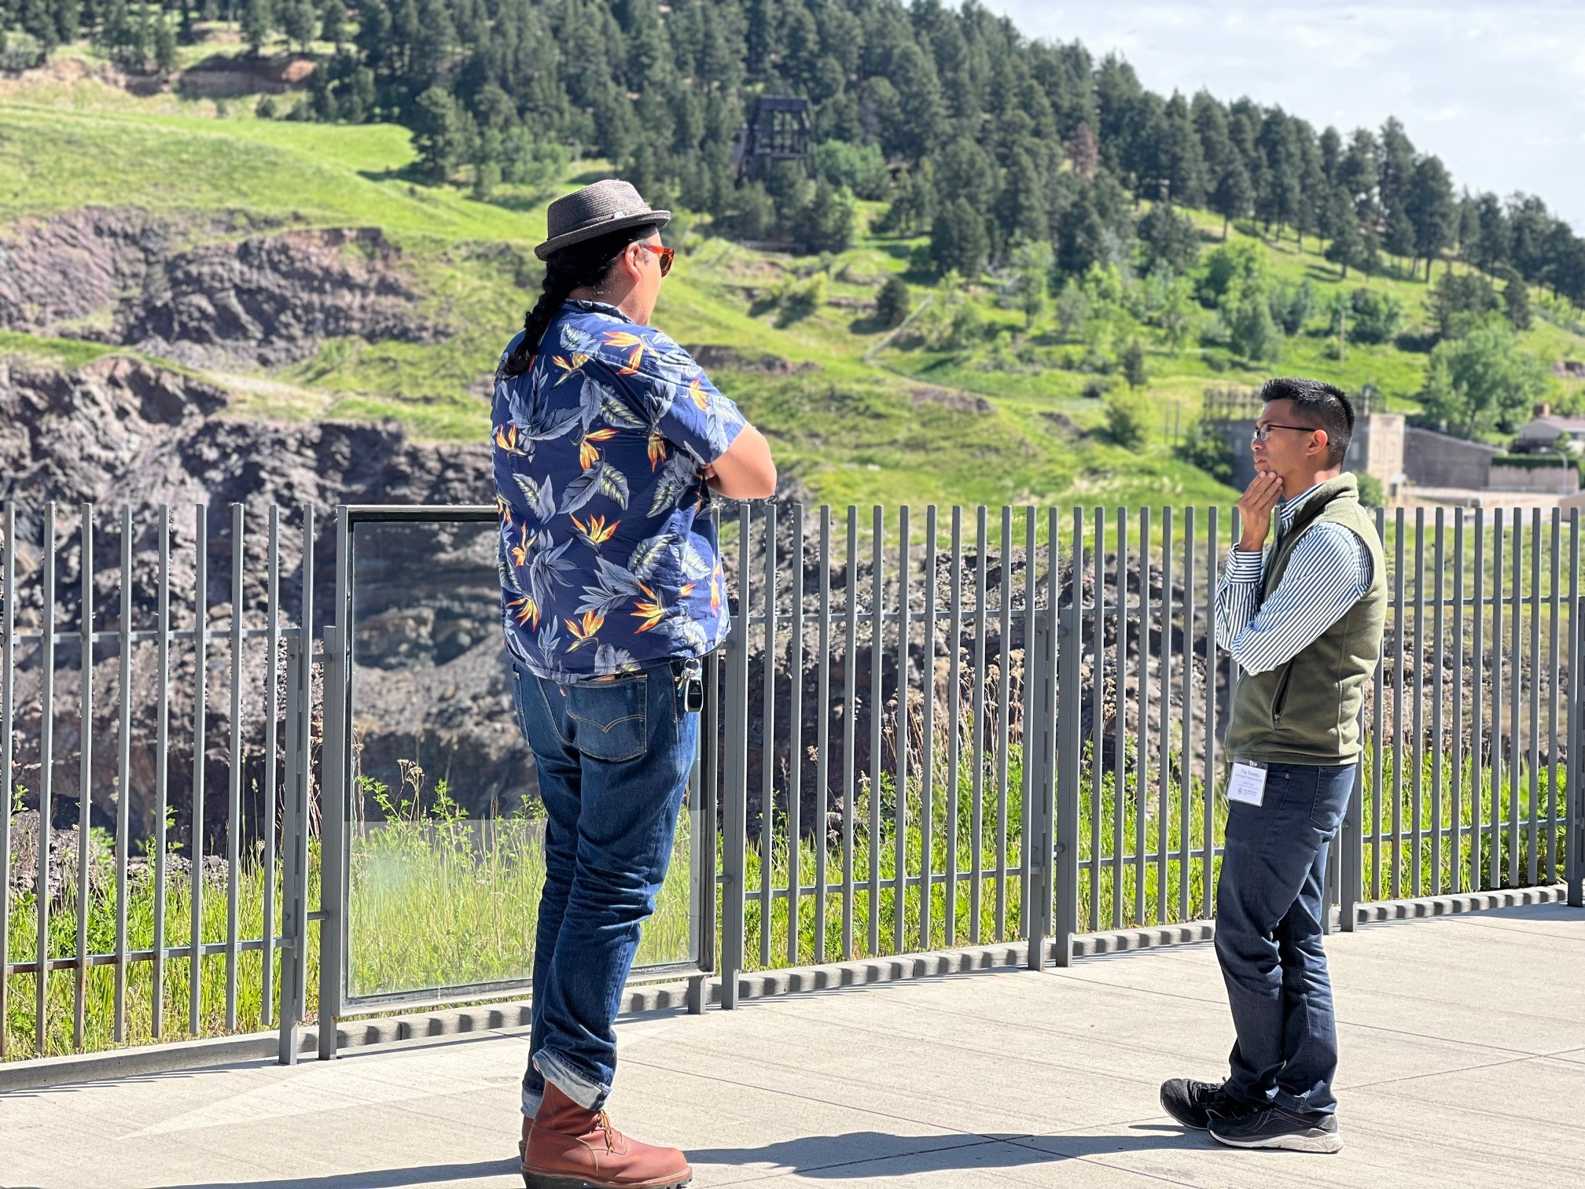
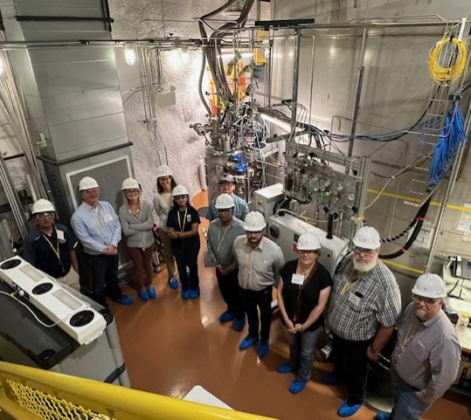
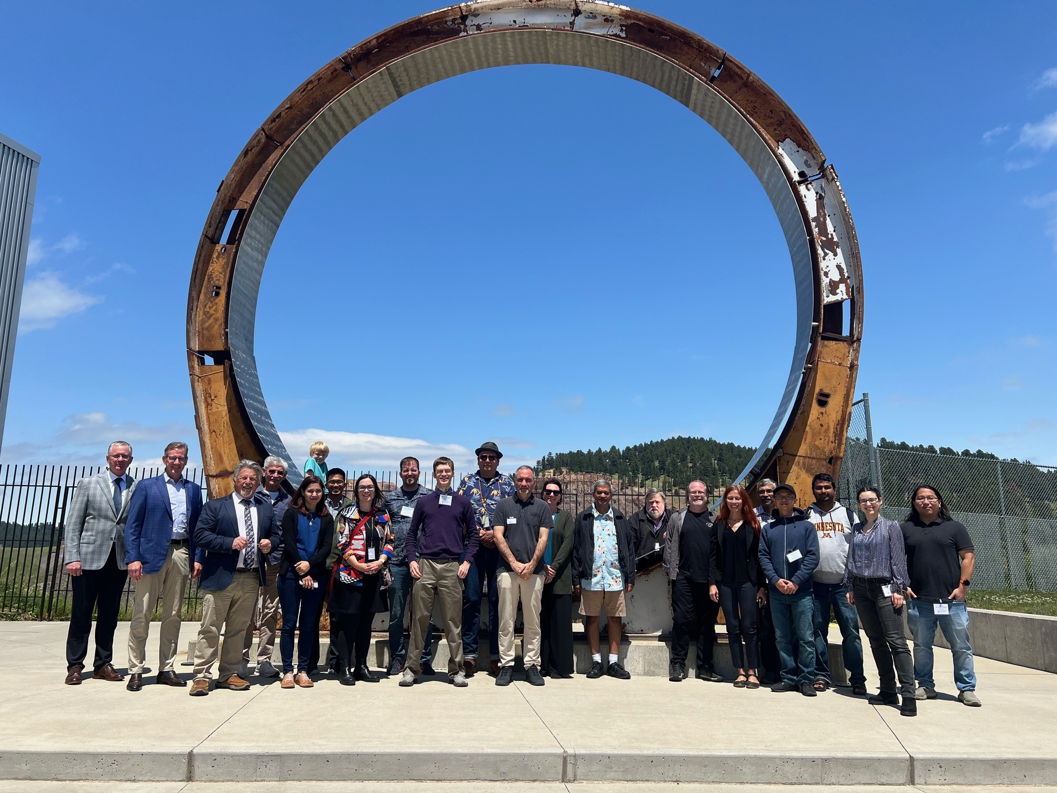


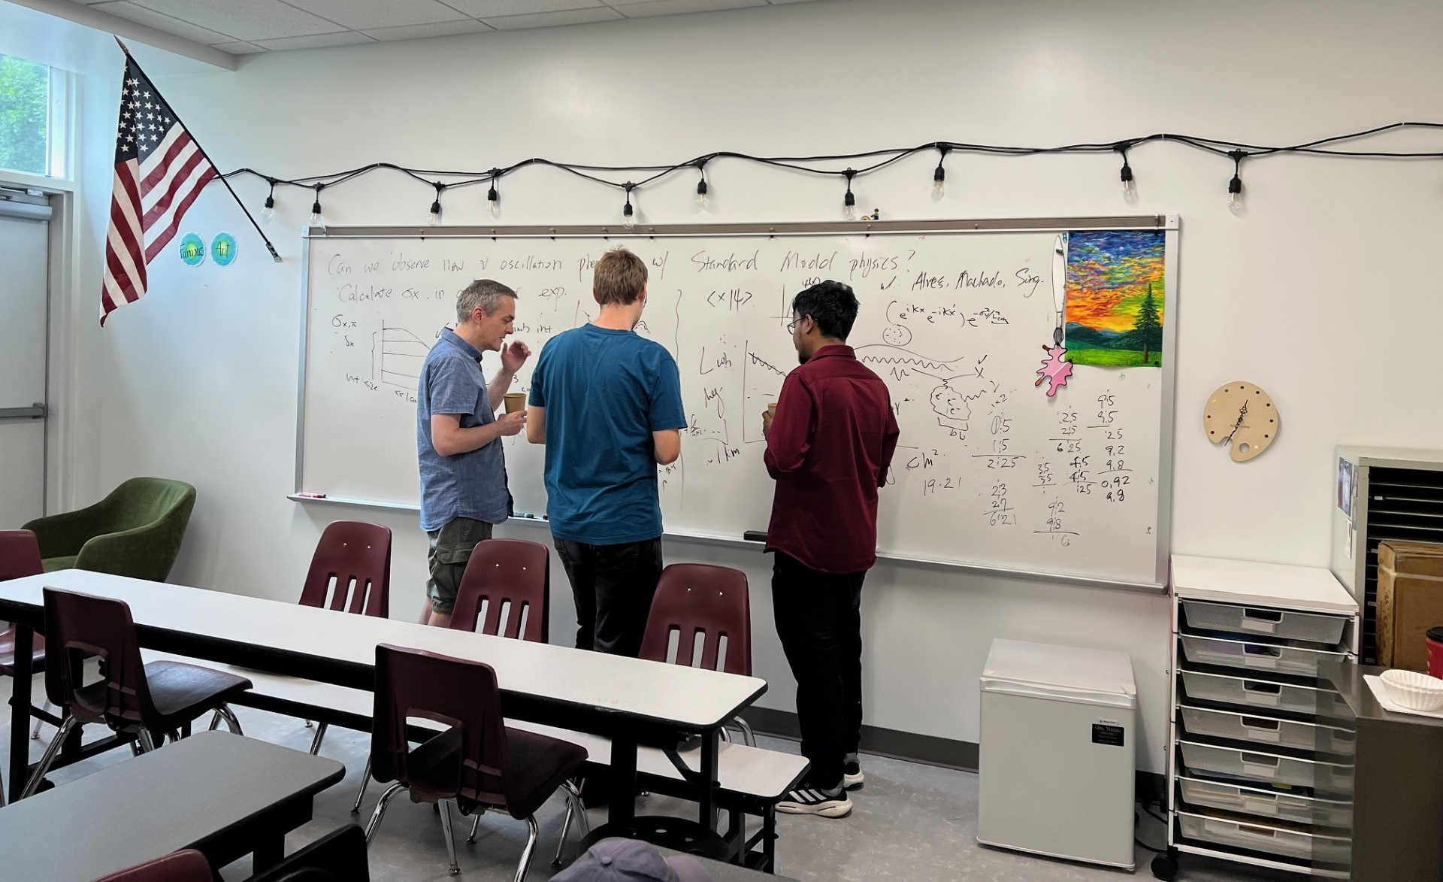
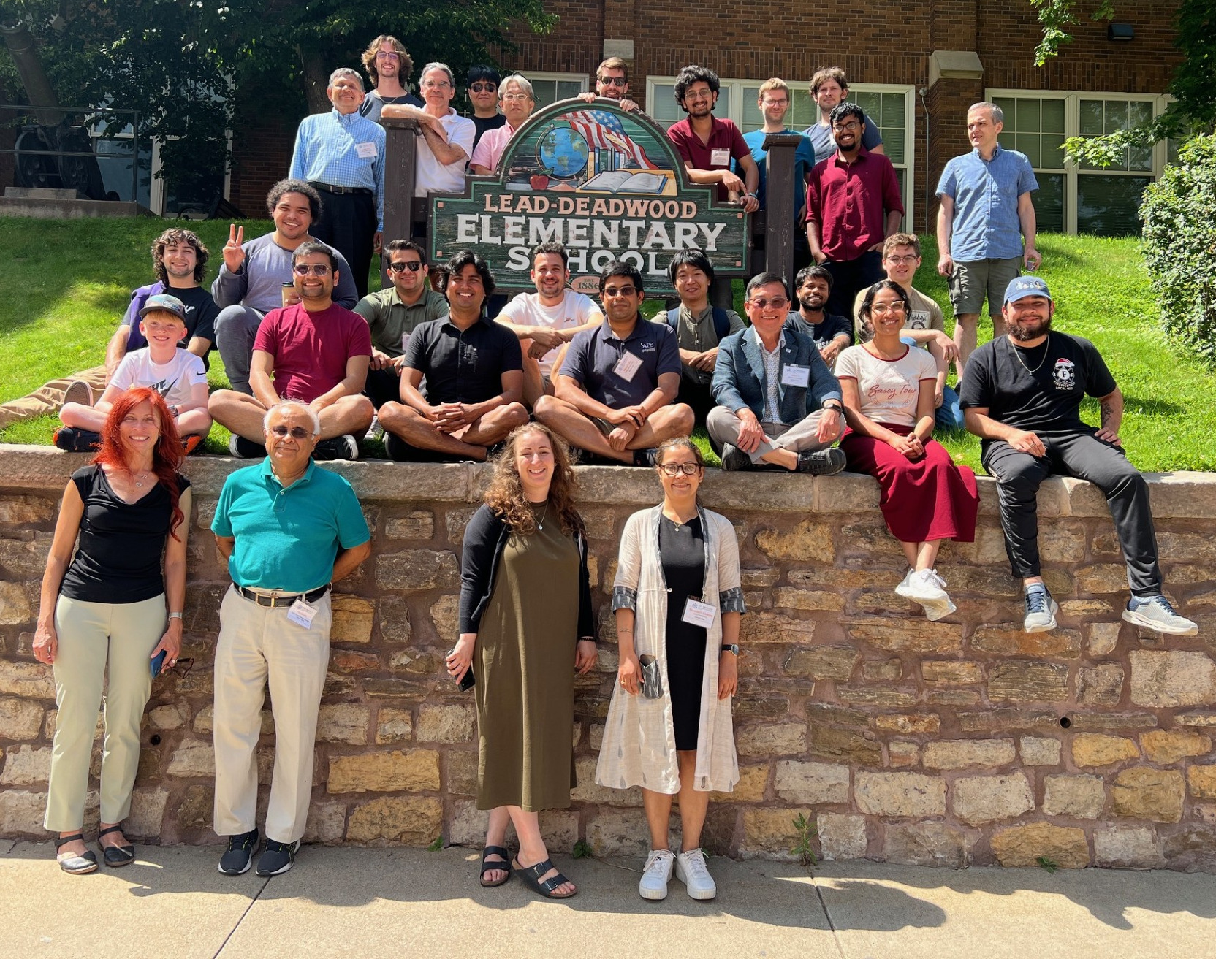
Building
Intellectual
Community

Slide 9

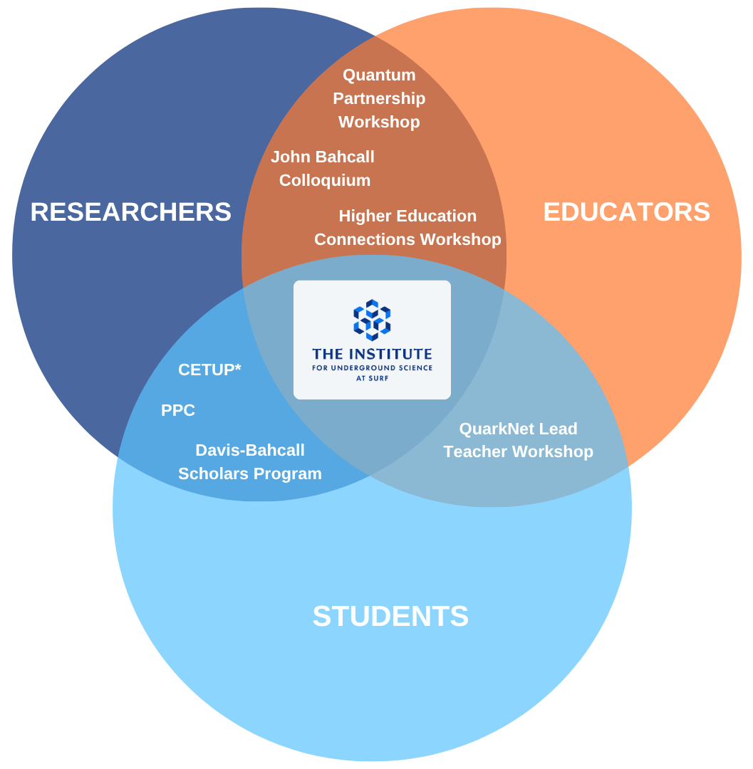



Our vision is to create a dynamic intersection of KNOWLEDGE, PEOPLE, and PLACE, dedicated to building an unparalleled intellectual community and serving as a world-leading center for underground science and technology.
Build Intellectual
Community
Foster Interdisciplinary
Collaboration
Construct a Path
for Future Generations
Expand Educational
Opportunities
Establish Passionate
Partnerships
Notes:
World-leading Center for Underground Science
Guiding principles – 5 points

Slide 10




Programmatic Impact &
Global Intellectual Community
The Institute for Underground Science delivers immersive, high-impact programs that connect people, places, ideas, and disciplines. These programs advance research, strengthen collaboration, and build a global intellectual community.
Resources for
Scientific Communities
Support for
Early-Career Scientists
Connect Underground Science Communities
Support for Development of Future Experiments
Recorded Talks & Presentation Archive
Workshop Materials & Proceedings
Digital Scientific Resource Hub
Mentorship
Career & Professional Development
Research Engagement
John Bahcall Colloquium
CETUP*
Quantum Partnership
Higher Ed Connections
Davis-Bahcall Scholars
Scientific
Planning
Research Collaboration
Strategic
Partnerships
Notes:
Goal: Design, deliver, and scale high-impact scientific programs that convene a global, multidisciplinary community; advancing underground science through collaboration, knowledge exchange, and the integration of research, education, and innovation.

Slide 11
CETUP* Dark Matter: Week 1
Meals
Catered Lunch Provided Weekdays
Transportation
Carpool
and
Ride Share
or Taxi
Communication
Staff or Organizing Committee Member
Middle School
8:00–5:00 p.m. weekdays
(2 entrances)
+
Elevator

Slide 12
CETUP* Dark Matter: Week 1
Call for Abstracts
Talk Spots Available
Workshop Announcements
Indico and
Slack
Community Outreach
Sign up to Volunteer
Dining
+
Tourism and Other Resources

Slide 13
CETUP* Dark Matter: Week 1
Monday – Welcome!
Tuesday – Deep Talks (Crazy Horse Memorial’s Dr. Caleb Ziolkowski, Chief Mountain Officer) @ 5:00 p.m.
Wednesday – Lead Walking History Tour @ 6:00 p.m.
Thursday – Pub Talks & Trivia @ 5:30 p.m.
Friday – Student Day; CETUP* Social @ 4:30 p.m.
Saturday – Badlands National Park (talk and ask a scientist) @ 1:00 p.m.

Slide 14
Connect With Us.
www.Institute.surf
Stacie Granum
sgranum@sanfordlab.org
605-571-2305

Slide 15




Slide 16
CETUP*: 10 Year Milestones
Milestones
Milestones
Milestones
Milestones

