Slide 1


High-Energy Neutrino Flavor State Transition Probabilities
John Harrison, PhD
Texas A&M University- Corpus Christi

Slide 2
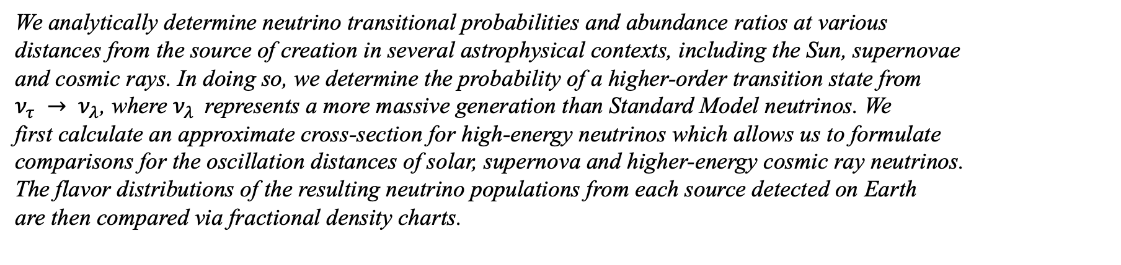
Abstract
We analytically determine neutrino transitional probabilities and abundance ratios at various
distances from the source of creation in several astrophysical contexts, including the Sun, supernovae
and cosmic rays. In doing so, we determine the probability of a higher-order transition state from
$ν_{τ} → ν_{λ}$, where $ν_{λ}$represents a more massive generation than Standard Model neutrinos. We
first calculate an approximate cross-section for high-energy neutrinos which allows us to formulate
comparisons for the oscillation distances of solar, supernova and higher-energy cosmic ray neutrinos.
The flavor distributions of the resulting neutrino populations from each source detected on Earth
are then compared via fractional density charts.

Slide 3
Outline:
Neutrino Background
Cross-Section Derivation
Mixing Matrix and Plane Wave Propagation
Flavor/Mass Linear Combination Sets
Origin State Probability
Mixing Matrix for Higher-Order Transition
Higher-Order Probability
Python
Results
Conclusions and Future Work

Slide 4
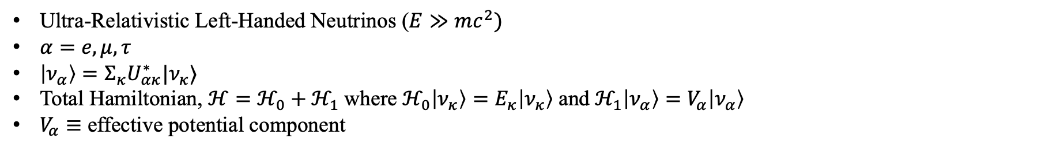
Ultra-Relativistic Left-Handed Neutrinos ($E≫mc^{2})$
$α=e, μ, τ$
$\left|ν_{α}\right\rangle =Σ_{κ}U_{ακ}^{∗}|ν_{κ}⟩$
Total Hamiltonian, $ℋ=ℋ_{0}+ℋ_{1}$where $ℋ_{0}\left|ν_{κ}\right\rangle =E_{κ}\left|ν_{κ}\right\rangle$ and${ ℋ}_{1}\left|ν_{α}\right\rangle =V_{α}\left|ν_{α}\right\rangle$
$V_{α}≡$ effective potential component

Slide 5
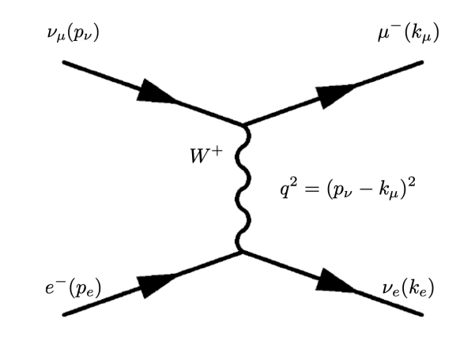
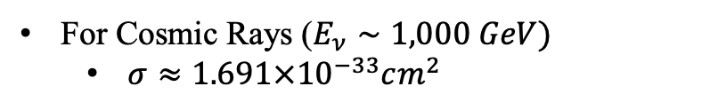
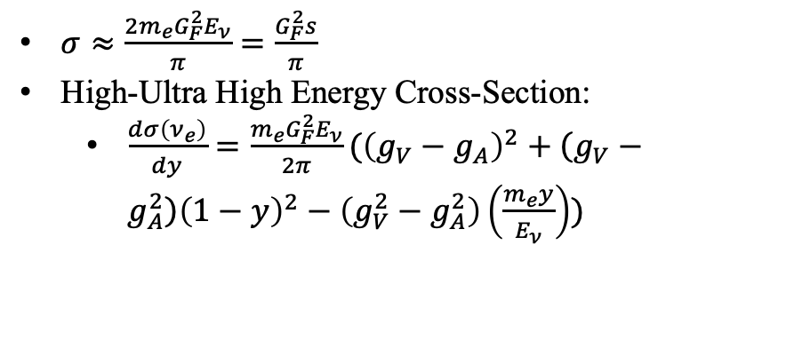
$σ≈\frac{2m_{e}G_{F}^{2}E_{ν}}{π}=\frac{G_{F}^{2}s}{π}$
High-Ultra High Energy Cross-Section:
  $\frac{dσ\left(ν_{e}\right)}{dy}=\frac{m_{e}G_{F}^{2}E_{ν}}{2π}({\left(g_{V}−g_{A}\right)}^{2}+\left(g_{V}−g_{A}^{2}\right){\left(1−y\right)}^{2}−\left(g_{V}^{2}−g_{A}^{2}\right)\left(\frac{m_{e}y}{E_{ν}}\right))$
For Cosmic Rays ($E_{ν}∼1,000 GeV)$
  $σ≈1.691×{10}^{−33}cm^{2}$
Notes:
Feynman diagram depicting the scattering of an incoming muon-neutrino and an at rest electron.
The coupling constants are given as gL = +1/2, gR = 0, gV = +1/2 and gA = +1/2 in which case L, R, V, A are the left, right, vector and axial components, respectively

Slide 6
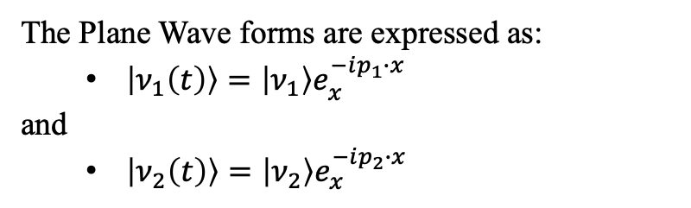

3 x 3 Pontecorvo-Maki-Nakagawa-Sakata [PMNS] flavor mixing matrix
  $\left(\begin{aligned}ν_{e} \\ ν_{μ}\end{aligned}\right)=\left(\begin{matrix}\cos{θ} & \sin{θ} \\ −\sin{θ} & \cos{θ}\end{matrix}\right)=\left(\begin{aligned}ν_{1} \\ ν_{2}\end{aligned}\right)$
Which gives us our 3 x PMNS unitary mixing matrix $(U^{∗})$
  $𝕌\left(θ\right)=$ $\left(\begin{matrix}\cos{θ} & \sin{θ} \\ −\sin{θ} & \cos{θ}\end{matrix}\right)$
The Plane Wave forms are expressed as:
  $\left|ν_{1}\left(t\right)\right\rangle =\left|ν_{1}\right\rangle e_{x }^{−ip_{1}∙x}$
and
  $\left|ν_{2}\left(t\right)\right\rangle =\left|ν_{2}\right\rangle e_{x }^{−ip_{2}∙x}$
Notes:
two possible eigenstates: flavor and mass.
Assuming that neutrinos have the ability to oscillate into three, four, or even an infinite number of flavors, we can illustrate the mixing phenomenon by examining a state involving two flavors.

Slide 7

$A × B = \{(e, m_{1}),(e, m_{2}),(e, m_{3}),(µ, m_{1}),(µ, m_{2}),(µ, m_{3}),(τ, m_{1}),(τ, m_{2}),(τ, m_{3})\}$
and conversely,
$B × A = \left\{\left(m_{1}, e\right),\left(m_{2}, e\right), \left(m_{3}, e\right),\left(m_{1}, µ\right),\left(m_{2}, µ\right),\left(m_{3}, µ\right),\left(m_{1}, τ \right),\left(m_{2}, τ \right),\left(m_{3}, τ \right)\right\}$
We must consider the eigenstates as linear combinations:
$|ν_{e}, ν_{μ}, ν_{τ}⟩$ and $|m_{1}, m_{2}, m_{3}⟩$
Notes:
If we let A be the flavor eigenstate consisting of e, µ, τ and let B be the neutrino mass eigenstate consisting of m1, m2, m3 then we must consider that A × B ̸= B × A. In other words, if we determine a state in A, that does not mean we know for certain state B, rather that all other probabilities for state B go to zero. To consider the probability of an arbitrary neutrino state prediction, we must first consider a known constraint. To make a prediction based on a flavor eigenstate, we must assume that all mass eigenstate probabilities collapse. Conversely, if we are to make a prediction based on a mass eigenstate, all the flavor eigenstate probabilities collapse.
We can now determine the probability that the initial state equals the final state.

Slide 8

  $$P\left(ν_{1}→ν_{1}\right)=1−\sin^{2}\left(2θ\right)\sin^{2}{(\frac{1.27Δm^{2}\left[eV\right]L\left[m\right]}{E[MeV]})}$$
  We will reserve the term, $λ,$ to indicate higher-order flavor transition where $λ=4,5,6…∞$
Notes:
Alternatively, we can show the probability of our mass eigenstate and the prediction of the flavor state remaining in νe. We will reserve component, λ, as an arbitrary flavor state. The constraint here, however, is certainty in one eigenstate negates certainty in the other.
For comparative purposes, on Earth, we can expect a solar neutrino flux on the order of ∼ 5.9 × 10^4 m−2 with approximately 1.7 × 10^38 neutrinos being emitted every second. Considering the Type II supernova, SN1987A, located in the Large Magellanic Cloud, which was first detected on February 23, 1987. During its luminosity peak, approximately 5.9 × 101^9 neutrinos were detected on Earth per second with an average flux of approximately 1.3 × 10^14m−2 . The distance d from SN1987A to Earth is ∼ 168, 000 light years.

Slide 9

$ν_{e},ν_{μ},ν_{τ}$
Theoretically possible for higher-order transitions
$≤$10 GeV
Majorana Particles
Neutrinos: left-handed chirality
Projection operator: $P_{L}=\frac{1−γ^{5}}{2}$
Sterile neutrinos: right-handed chirality
$W^{±}$ Bosons interact with left-handed neutrinos
Notes:
As we consider the neutrino’s ability to oscillate among $ν_{e},ν_{μ},ν_{τ}$, it is theoretically possible to oscillate into a heavier fourth flavor, without undergoing further oscillations, provided that this flavor interacts solely through the gravitational force. Due to this property, this fourth flavor has received the name sterile neutrino. It is essential to recognize that the sterile neutrino functions independently from the three active flavors. When a neutrino is generated, it can be described as a superposition of the three active flavors, each associated with their respective masses, while the sterile neutrino remains excluded from this interaction. Like other neutrinos, the sterile neutrino is electrically neutral and possesses a half-integer spin. As noted, this type of neutrino is anticipated to be heavier than the three known flavors, with theoretical mass estimates ranging from 10 GeV to 1 eV [12].
When we consider the existence of a sterile neutrino, we must also consider the probability of it being categorized as a Majorana particle. A fermion is considered Majorana when it is found to be its own antiparticle. Typical fermions are categorized as Dirac fermions at low energies, with the exception of the neutrino. Dirac fermions do not possess their own antiparticles. At this point, which category the sterile neutrino fits is unknown. If sterile neutrinos are Majorana, when two sterile neutrinos collide, they would annihilate each other with an enormous amount of energy.
We classify these particles as fermions, i.e., with a half-integer spin. In the context of neutrinos, this means their spin may either be $1/2$ or $−1/2$ depending on the spin quantum number s quantifying the direction of intrinsic rotation. Neutrinos are typically considered to be “left-handed” fermions, i.e., with Dirac spinor representations that can be expressed as projections by the left-handed projection operator $P_{L}=\frac{1−γ^{5}}{2}$. Moreover, the $W^{±}$ bosons mediating weak interactions involving neutrinos only interact with left-handed particles. When considering sterile neutrinos, they are assumed to be “right-handed” fermions, thus confirming the existence of a positive-spin neutrino.
If we take the mass of one “hand” multiplied by the other “hand” we would deduce a constant mass.
So, we can show that

Slide 10
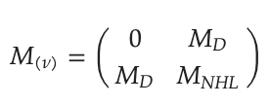
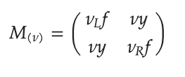
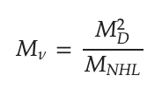
(Right Hand Mass) x (Left Hand Mass) = Constant
$M_{ν}→M_{D}→M_{NHL}$
Notes:
Therefore, we can now assume that if we were to increase the mass of one hand, that is, left or right, the other hand must become smaller. This results in a process referred to as the “Seesaw Mechanism”
where f directly corresponds to neutrinos of heavier mass; however, a mixture of f results in neutrinos of lighter mass
This mechanism gives us a matrix theorizing six neutrino fields, three of which would have masses $<1 eV$, while the other three would have masses $>1 eV$. Unlike other fermions, these Majorana particles do not exhibit intrinsic electric or magnetic moments. Instead, they would possess toroidal moments in which the field of the solenoid is bent into a torus.

Slide 11
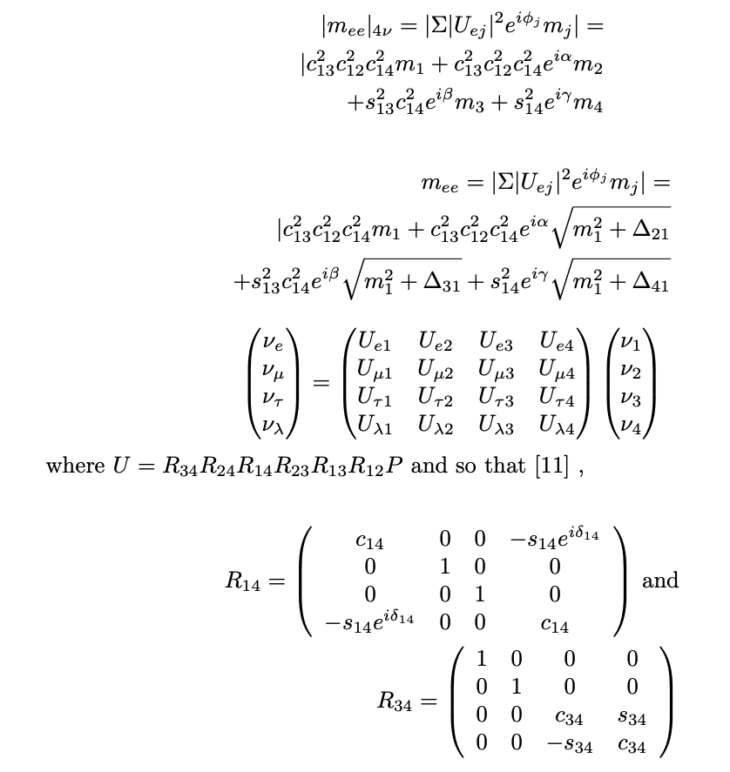
Notes:
We can now need to expand the PMNS matrix [11] to include a fourth flavor which allows us to determine the probability for higher-order transitions.

Slide 12
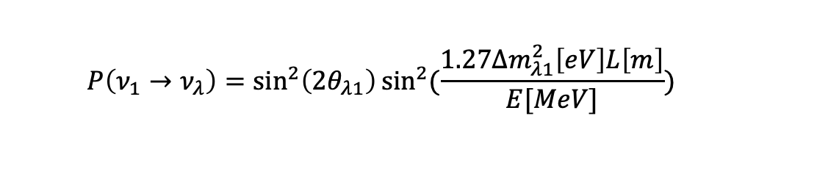
  $$P\left(ν_{1}→ν_{λ}\right)=\sin^{2}\left(2θ_{λ1}\right)\sin^{2}{(\frac{1.27Δm_{λ1}^{2}\left[eV\right]L\left[m\right]}{E[MeV]})}$$
Notes:
L[m] is the distance from the source, E[MeV ] is the energy and ∆m is the mass difference between the flavors during the oscillation. This indicates that the probability of finding a neutrino in the fourth flavor state should be equal to the probability of finding it in the any of the three flavor states, proving the linear combination flavor eigenstate to hold true for higher order states.

Slide 13
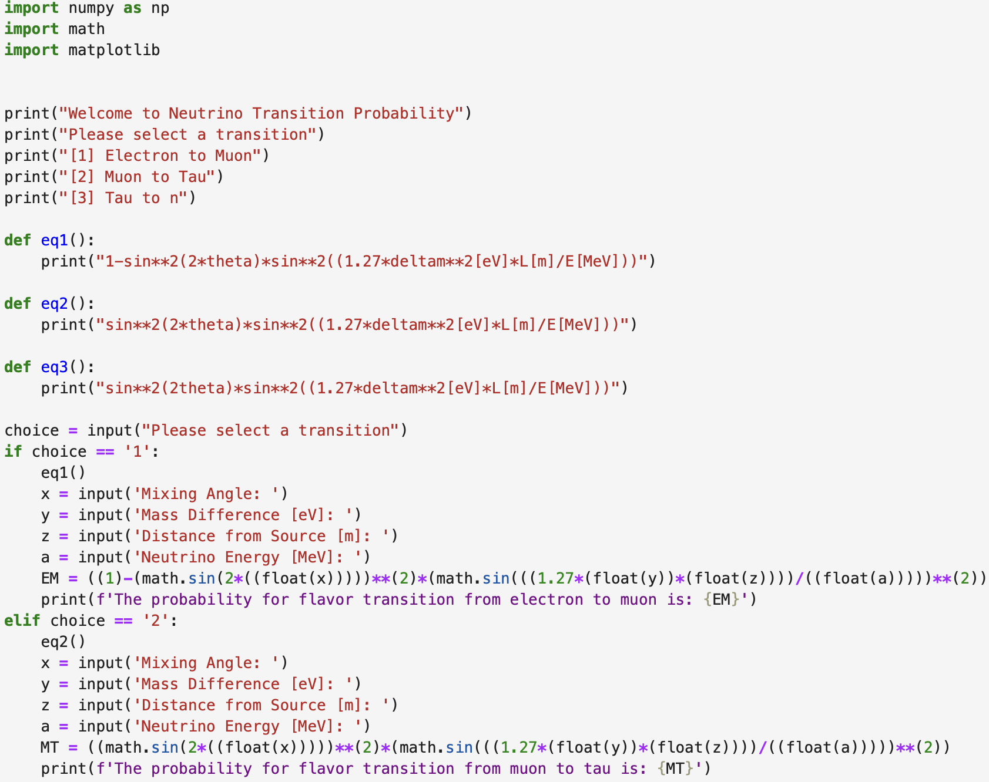
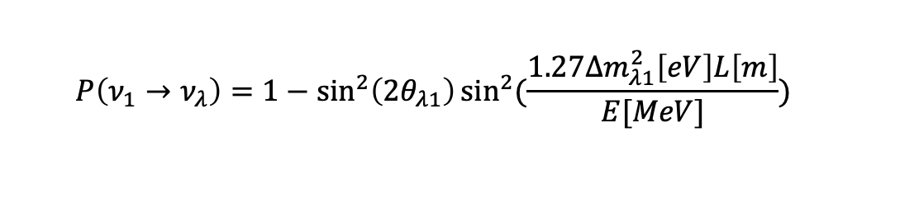
  $$P\left(ν_{1}→ν_{λ}\right)=1−\sin^{2}\left(2θ_{λ1}\right)\sin^{2}{(\frac{1.27Δm_{λ1}^{2}\left[eV\right]L\left[m\right]}{E[MeV]})}$$
Notes:
Python code for calculating probabilities.

Slide 14
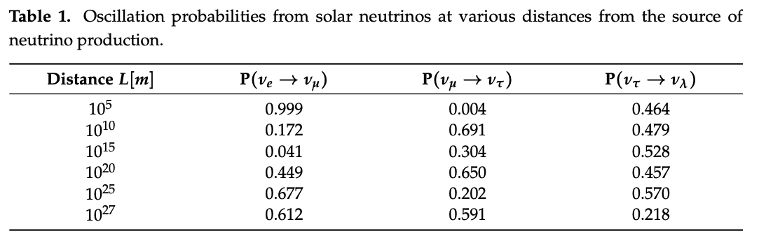
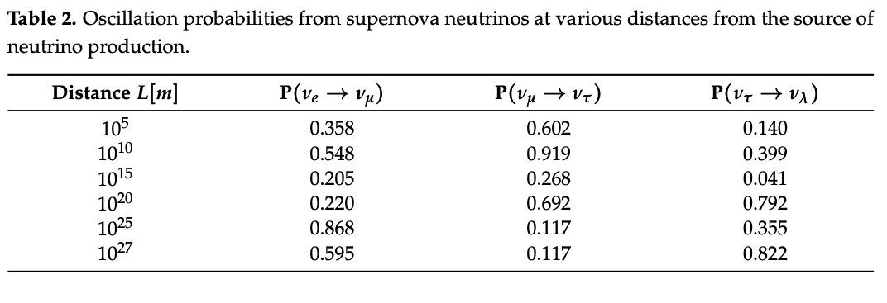
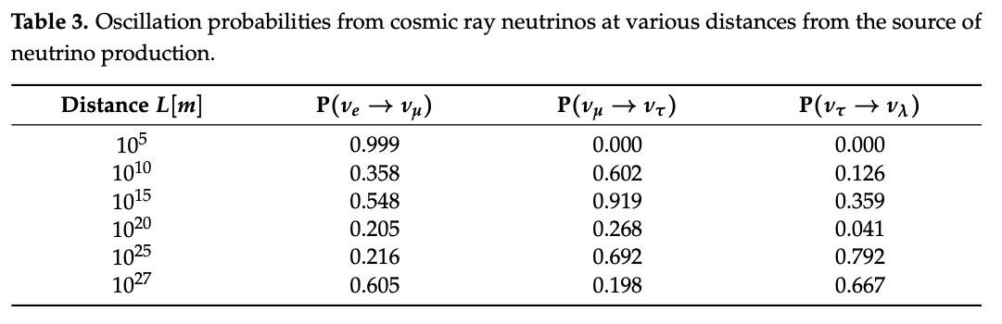
Notes:
From the above tables, we have shown the distance needed to oscillate from the first flavor to the second flavor, with a consistently high probability of transition. Once we move into the second, third and n-th flavors, we become less certain about our flavor transition probabilities. From the above two tables, we can infer why this is the case. We can clearly see that our probabilities for the higher flavors (µ → τ, τ → λ) are the lowest when the probability for the transition from the first to the second flavor (e → µ) is at its highest. For example, for a cosmic ray neutrino, using our transition from ντ → νλ at distances 105 m and 1010 m, we obtained probabilities of ∼0.00% and ∼12.6%, respectively
Taking these transition probabilities into account, we can quickly see that from varying distances and probabilities, the neutrino oscillation of flavors is simply a cycle of probabilities. In other words, the flavor transition can start again depending on the distance traveled prior to detection. What makes this concept more intriguing is that it helps explain a possible reasoning behind only having certainty in one eigenstate and not in both. When we measure a neutrino in a flavor eigenstate, we can assume that, as the tables above show, as it oscillates between flavors it becomes a combination of all possible masses m1, m2, m3, ..., mn. When we consider the combination of mass matrices, this also helps to understand the cycle of flavor oscillations prior to detection.

Slide 15
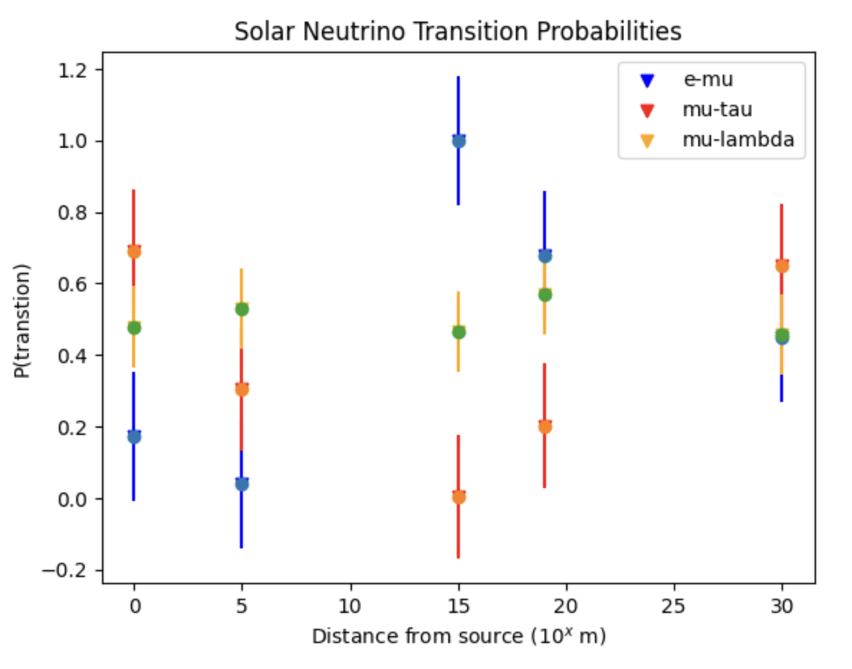
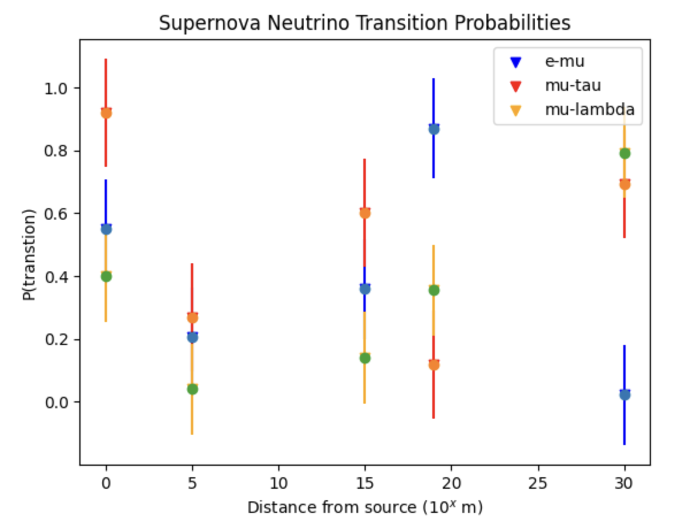
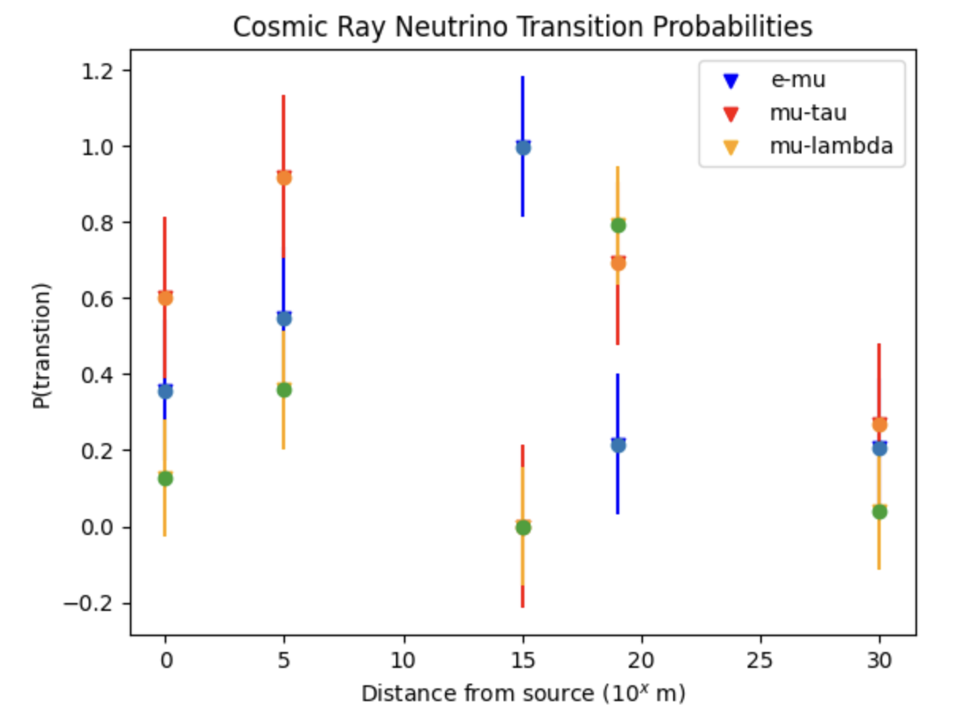
Notes:
If we are to assume that when we observe a neutrino in state A or |ν f ⟩ we have the probability for |νe, νµ, ντ , νλ⟩ with state B or |ν m⟩ for |m1, m2, m3, mλ⟩. We can predict our condition to be approximately as observed νe to have state B of |m1, 0, 0, 0⟩, for νµ we find |m1, m2, 0, 0⟩, for ντ we would show |m1, m2, m3, 0⟩ and for νλ, |m1, m2, m3, mλ⟩. This shows that each potential flavor state can be thought of simply as a combination of all possible masses.

Slide 16
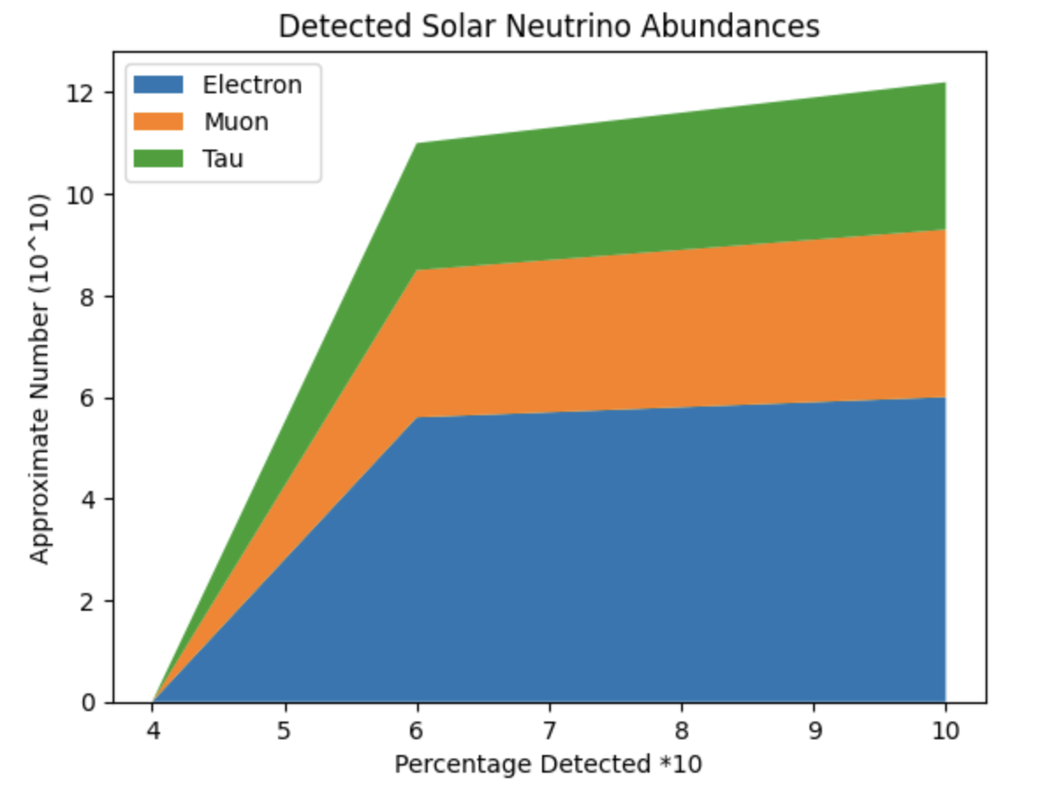
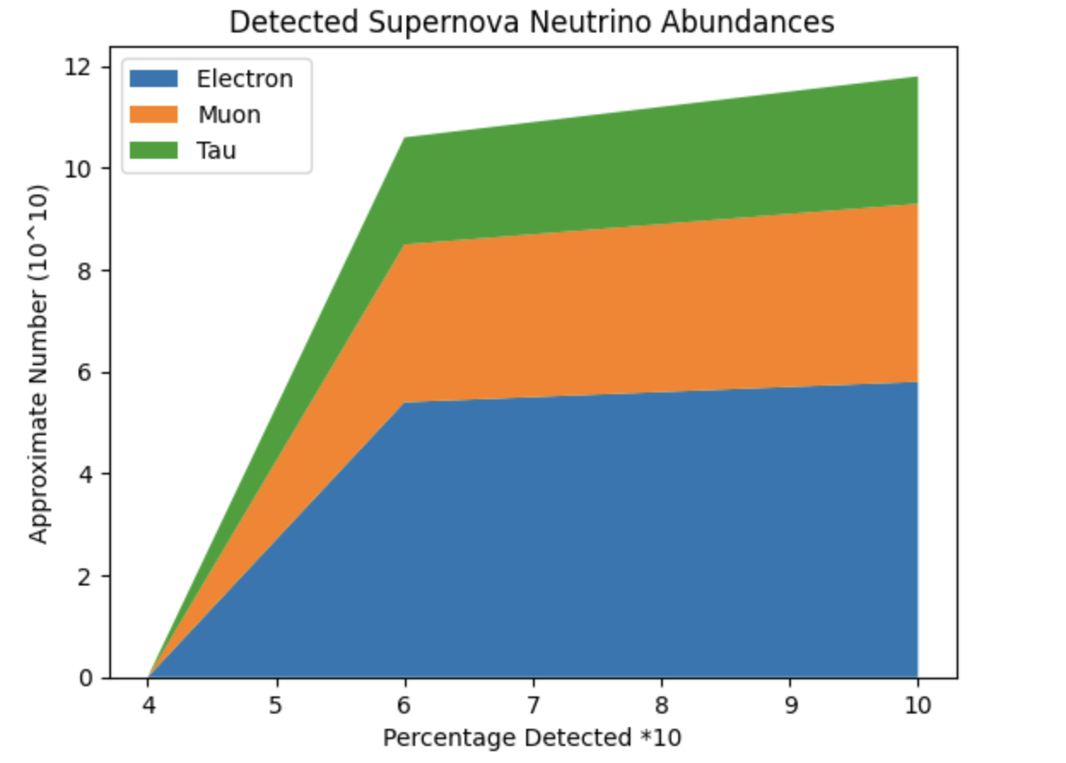
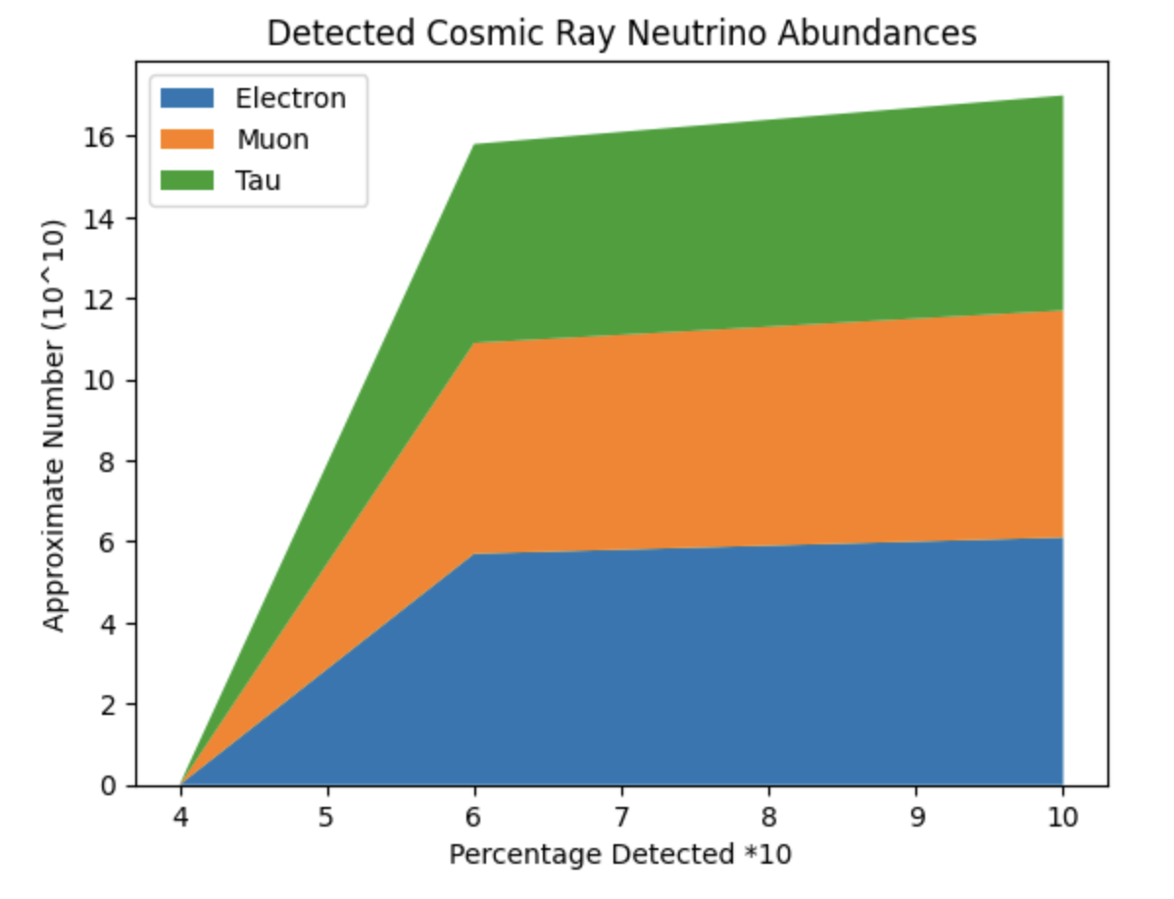
Calculated density: $\frac{Δ}{ΔL}<n_{ν_{e}}, n_{ν_{μ}}, n_{ν_{τ}}>≈<n_{0}(1−P_{12}), n_{o}P_{12}\left(1−P_{23}\right), n_{o}P_{12}P_{23}(1−P_{3λ})>$
Notes:
From the data in the figures above, we can ascertain that at a certain point, the probability of a neutrino oscillating into a fourth flavor state after a certain distance approaches the probability that the neutrino is being found in its first flavor state. This further shows that each flavor can be thought of as a proper combination of all mass and flavor eigenstates oscillating back and forth between states. The probability of oscillating into a higher nth flavor is approximately the same as that of the neutrino oscillating backward through the previous states and beginning the cycle.
When we consider the neutrino’s mean free path of ∼ 105, 700 light years, or 1021 m from its source, we can see that this fits perfectly with the neutrino energy stemming from supernova neutrinos. However, when we focus on the lower-energy solar neutrinos, we find that given a slightly further distance of travel (1027 m), we arrive at a near 0.5 probability of detecting our neutrino in the first and fourth flavor states. An inference here tells us that the lower-energy neutrinos, given a longer distance of oscillation, have a higher probability of oscillating back through and begins the cycle over again. higher-energy levels tend to oscillate much faster, creating a uniquely consistent probability distribution for flavor transformations.
We found that for the supernova neutrinos, around 50% should be detected as electron neutrinos while ∼ 30% to be detected as muon neutrinos and the final 20% should be detected as tau neutrinos. Interestingly for the cosmic ray neutrinos, we found that approximately 36% should be detected as electron neutrinos, 33% as muon neutrinos and 31% as tau neutrinos

Slide 17
Based on work found in:
Harrison, J., & Anantua, R. (2024). High-Energy Neutrino Flavor State Transition Probabilities. Applied Sciences, 14(22), 10666. https://doi.org/10.3390/app142210666
With assistance from:
BOREXINO Collaboration. Neutrinos from the primary proton-proton fusion process in the Sun. Nature 2014, 512, 383–386. [CrossRef] [PubMed]
Giunti, C.; Kim, C. Neutrino Physics and Astrophysics, 1st ed.; Oxford University Press: Oxford, UK, 2007.
Bustamente, M.; Montoya, G.D.C.; Paula, W.; Chavez, J.A.D.; Gago, A.M.; Hakobyan, H.; Jez, P.; Montañez, J.A.M.; Velasquez, A.O.; Cabal, F.P.; et al. High-energy cosmic-ray acceleration. In 2009 CERN-Latin-American School of High-Energy Physics; CLASHEP 2009-Proceedings; CERN: Geneva, Switzerland, 2010; pp. 533–539.
Greco, A.; Perri, S.; Zimbardo, G. Stochastic Fermi acceleration in the magnetotail current sheet: A numerical study. J. Geophys. Res. Space Phys. 2010, 115.. [CrossRef]
Reines, F.; Cowan, C.L. Detection of the Free Neutrino. Phys. Rev. Am. Phys. Soc. 1953, 92, 830–831. [CrossRef]
Fermilab; Rocco, N. Neutrino Cross Sections. 2019. Available online: https://indico.fnal.gov/event/19346/contributions/51548/ attachments/32048/39314/Noemi_Rocco_Lepton_nucleus_cross_section_theory.pdf (accessed on 19 February 2024).
7. Krauss, F.S. Matrix and Cross Sections Simplified. Institute for Particle Physics Phenomenology; Department of Physics, University of Durham: Durham, UK, 2019. Available online: https://www.ippp.dur.ac.uk/~krauss/Lectures/QuarksLeptons/Basics/S_ Matrix.html (accessed on 19 February 2024).
8. Formaggio, J.A.; Zeller, G.P. From eV to EeV: Neutrino Cross-Sections Across Energy Scales. arXiv 2013, arXiv:1305.7513v1.
9. Blasone, M.; De Siena, S.; Matrella, C. Non-locality and entropic uncertainty relations in neutrino oscillations. Eur. Phys. J. Plus 2022, 137, 1272. [CrossRef]
10. Korana, B.S.; Nautiyal, V.K. Effective Neutrino Masses From Four Flavor Neutrino Mixing Matrix. Int. J. Theor. Phys. 2020, 60, 781–792. [CrossRef]
11. Page, D.; Beznogov, M.V.; Garibay, I.; Lattimer, J.M.; Prakash, M.; Janka, H.T. NS 1987A in SN 1987A. Astrophys. J. 2020, 898, 125. [CrossRef]
12. Akhmedov E.; Frigerio M. Duality in left-right symmetric seesaw mechanism. Phys Rev Lett. 2006, 96, 61802. [CrossRef] [PubMed]
13. The Super-Kamiokande Collaboration. Atmospheric neutrino oscillation analysis with neutron tagging and an expanded fiducial volume in Super-Kamiokande I–V. Phys. Rev. D 2014, 109, 72014.
14. Vogel, P.; Wen, L.; Zhang, C. Neutrino Oscillation Studies with Reactors. Nat. Commun. 2015, 6, 6935. [CrossRef] [PubMed]
Notes:
So far, only three flavor states have been detected, however we have shown that the likelihood of oscillating into a fourth flavor is equal to the oscillation back through the previous flavors, ντ → νµ → νe. This raises an important question: since we know the flavors are linear combinations of the mass eigenstates, is it possible for a fourth flavor transition or would the neutrino’s transformation cease at the ντ and simply revert back to the first flavor state?
To put it more concisely, measuring in the flavor state prevents us from identifying the mass state, except as a linear combination of all possible masses. In future research, we may explore whether the assumption of non-locality suggests that mass eigenstates can also be represented as flavor eigenstates. We determined that when examining the probabilities of detected states, we can make predictions based on the distance traveled since their creation. We discovered that a neutrino not only has a nearly certain probability of oscillating further but also of oscillating back into earlier states.
This opens up opportunities for further research to focus on mass eigenstates and investigate if combinations of masses can replicate other flavors, and vice versa.

Slide 18
Thank you!
Contact Info:
John Harrison, PhD
Particle Theory
www.drjohnharrison.com
john.harrison@tamucc.edu
Or
harrisonja2@tamuv.edu

