Slide 1

Quantum Sensing of Radiative Decay Photons with Superconducting Qubits
Doojin Kim
(doojin.kim@usd.edu)
CETUP* 2026
Lead, SD
July 9th, 2026
Based on the work done by Dong, DK, Kong, Park, Soto Alcaraz, arXiv:2508.09139

Slide 2
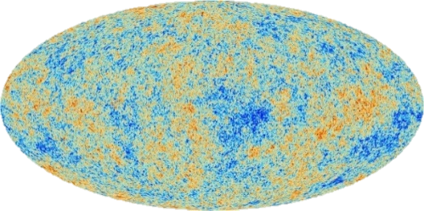
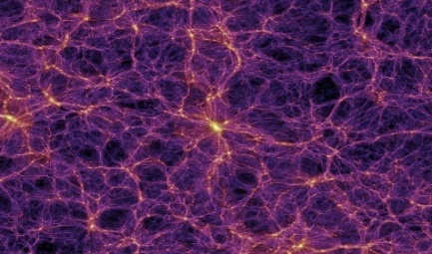
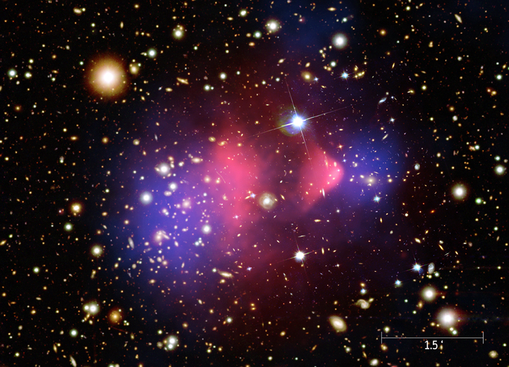
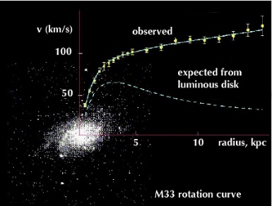
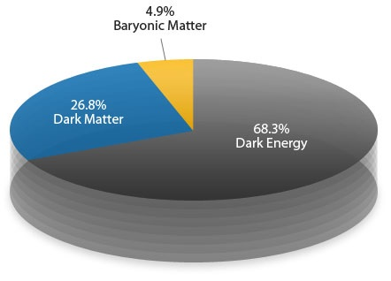
Dark Matter in the Universe
Larger scale
Earlier universe
Smaller scale
Later universe

Slide 3



Dark Matter Landscape
${10}^{−22}$eV
$μ$eV scale
keV
MeV
GeV
TeV
PeV
$100M_{⨀}\sim 1068$ eV
Ultralight
Scalar field
(QCD) Axion
Hidden photon
Non-thermal
Superlight
WDM
Sterile ν
May be thermal
Light
Particle DM can be thermal
WIMP
Well-motivated
Extensively studied
Thermal
Superheavy/Composite
Wimpzilla
Q-ball
Dark-quark nugget
Non-thermal
MACHO/Primordial BHs
Non-particle
Popular paradigm for decades
Bosonic dark matter conversion/absorption. [Chen, Fukuda, Inada, Moroi, Nitta, Sichanugrist, PRL (2023), PRD (2024); He, He, Li, Gao, Feng, Zheng, Wei, PRD (2025)]
Decaying dark matter scenario (our work)
Using emerging quantum device technologies / e-recoil: SuperCDMS, SENSEI, HeRALD, SPICE, GLIMPES (graphene Josephson Junction-based device tech, see also Jong-Chul Park’s talk. [DK, Park, Fong, Lee, PRD (2025); Jeong, DK, Park, arXiv:2604.18704]), etc
Devices are sensitive to sub-meV to eV-scale energy deposits

Slide 4
Outline
Introduction to the Transmon Qubit
Detection of Decay Photons
Physics Applications
Conclusions
$$ℏ=c=1$$

Slide 5
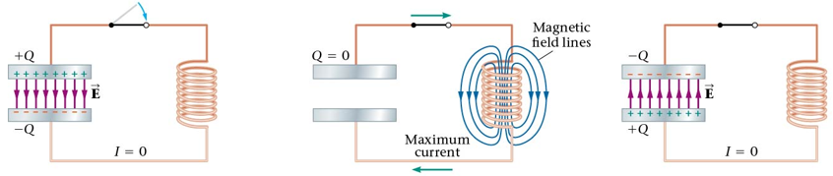
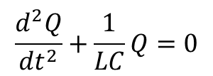
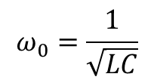
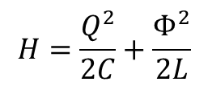
Classical LC Harmonic Oscillator
Resonance
frequency
$$H=\frac{Q^{2}}{2C}+\frac{Φ^{2}}{2L}$$
$$\frac{d^{2}Q}{{dt}^{2}}+\frac{1}{LC}Q=0$$
$$ω_{0}=\frac{1}{\sqrt{LC}}$$

Slide 6
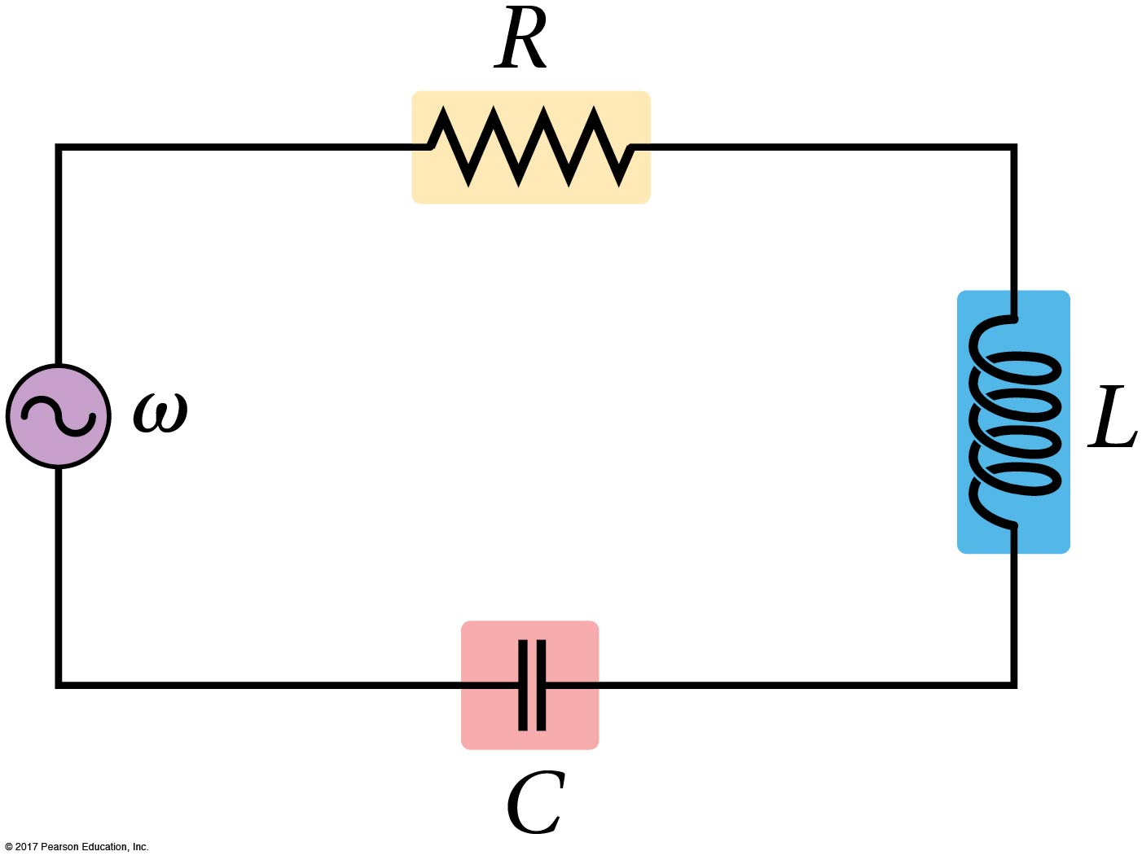
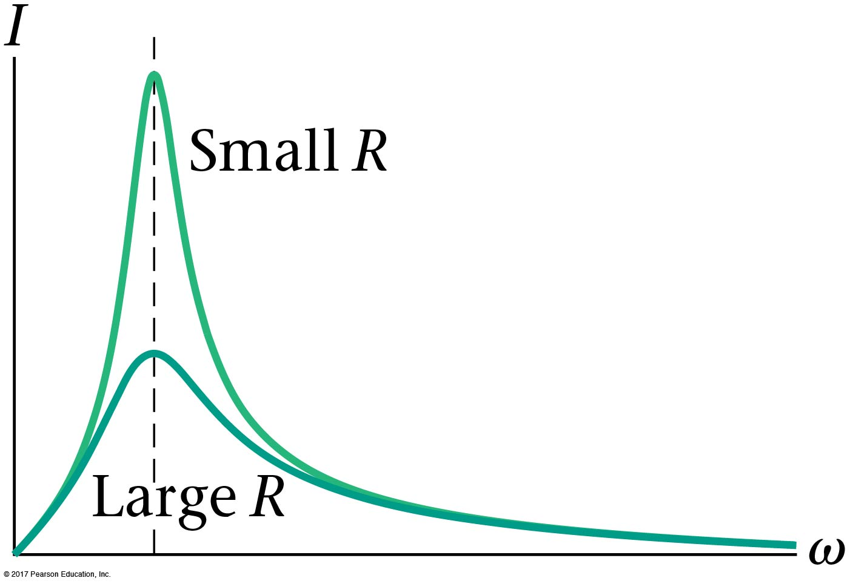
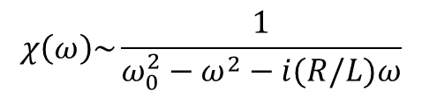
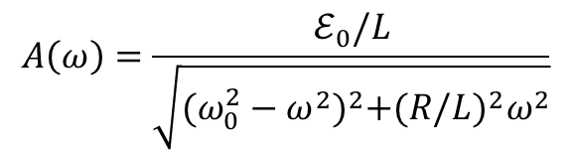

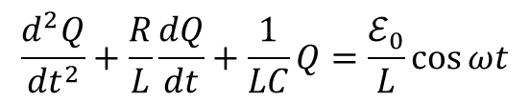
Driven LC Circuit and Resonant Absorption
$$\frac{d^{2}Q}{{dt}^{2}}+\frac{R}{L}\frac{dQ}{dt}+\frac{1}{LC}Q=\frac{ℰ_{0}}{L}\cos{ωt}$$
$$Q(t)=A(ω) cos⁡({ωt−}δ)$$
$$A\left(ω\right)=\frac{ℰ_{0}/L}{\sqrt{{(ω_{0}^{2}−ω^{2})}^{2}+{(R/L)}^{2}ω^{2}}}$$
Fourier space
$$χ\left(ω\right)\sim \frac{1}{ω_{0}^{2}−ω^{2}−i(R/L)ω}$$
A weak microwave signal is most efficiently absorbed when its frequency matches the LC resonance.

Slide 7
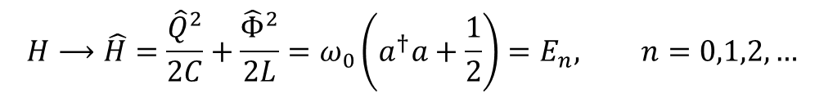

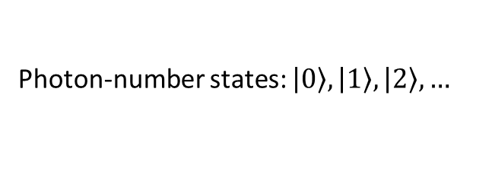
Quantum Mechanical LC Harmonic Oscillator
Quantization of the LC circuit
$$Q⟶\hat{Q}, Φ⟶\hat{Φ}, \left[\hat{Φ},\hat{Q}\right]=i$$
$$H⟶\hat{H}=\frac{{\hat{Q}}^{2}}{2C}+\frac{{\hat{Φ}}^{2}}{2L}=ω_{0}\left(a^{†}a+\frac{1}{2}\right)=E_{n}, n=0,1,2,…$$
Photon-number states: $\left.\left|0\right.\right\rangle ,\left.\left|1\right.\right\rangle ,\left.\left|2\right.\right\rangle , …$
A quantized LC circuit has discrete photon-number states separated by $ω_{0}$.

Slide 8
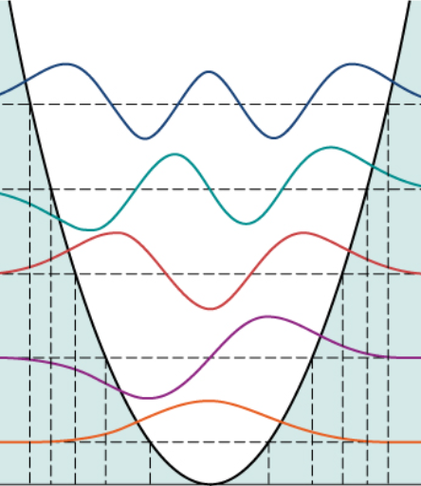

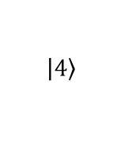

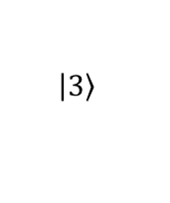

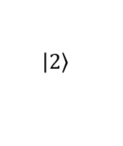

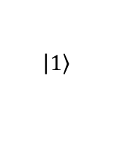
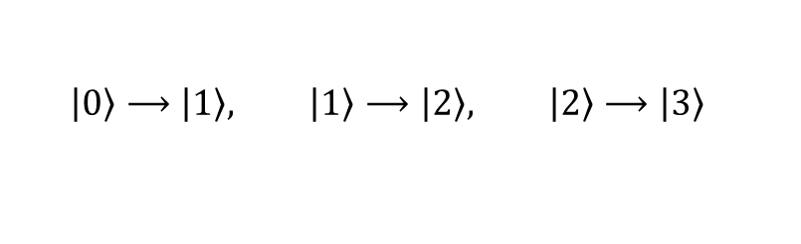
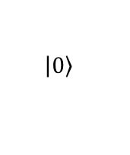
Linear LC Oscillator Not Good For a Qubit
$$E_{n+1}−E_{n}=ω_{0}$$
$$\left.\left|4\right.\right\rangle$$
$$\left.\left|3\right.\right\rangle$$
$$\left.\left|0\right.\right\rangle ⟶\left.\left|1\right.\right\rangle , \left.\left|1\right.\right\rangle ⟶\left.\left|2\right.\right\rangle , \left.\left|2\right.\right\rangle ⟶\left.\left|3\right.\right\rangle$$
$$\left.\left|2\right.\right\rangle$$
$$\left.\left|1\right.\right\rangle$$
$$ω_{0}$$
$$ω_{0}$$
$$ω_{0}$$
$$\left.\left|0\right.\right\rangle$$
Good resonator, not a good qubit because the lowest two states cannot be selectively used.
→ Needing a system giving an anharmonic spectrum $ω_{0→1}≠ω_{1→2}$

Slide 9
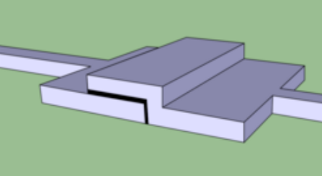
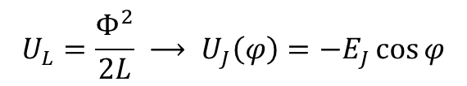

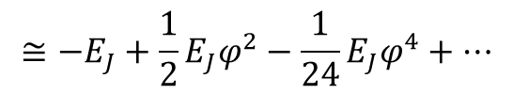
Josephson Junction as a Nonlinear Inductor
$$U_{L}=\frac{Φ^{2}}{2L} ⟶ U_{J}\left(φ\right)=−E_{J}\cos{φ}$$
$$≅−E_{J}+\frac{1}{2}E_{J}φ^{2}−\frac{1}{24}E_{J}φ^{4}+…$$
$φ:$superconducting phase difference
(interpreted as reduced flux)
For constructing LC oscillator
For unequal level spacing
Replacing the linear inductor by a Josephson junction turns a harmonic LC oscillator into an anharmonic oscillator.

Slide 10
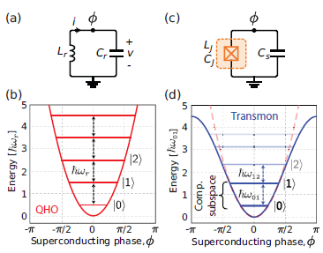
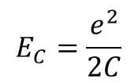
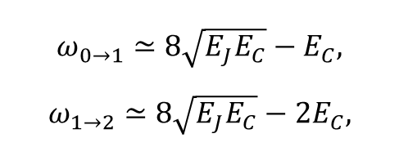


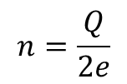
Transmon Qubits
$$E_{C}=\frac{e^{2}}{2C}$$
$${\hat{H}}_{trans}=4E_{C}{\hat{n}}^{2}−E_{J}\cos{\hat{φ}}$$
: charging energy required to add each electron
$$n=\frac{Q}{2e}$$
: reduced charge
$$\left[\hat{φ},\hat{n}\right]=i$$
$$ω_{0→1}​≃8\sqrt{E_{J}E_{C}}​​−E_{C}​,$$
$$ω_{1→2}​≃8\sqrt{E_{J}E_{C}}​​−{2E}_{C}​,$$
Anharmonicity isolates a usable two-level system from an oscillator-like circuit..
[Krantz et al, arXiv:1904.06560]

Slide 11
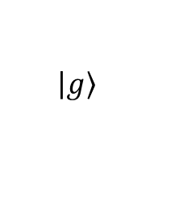


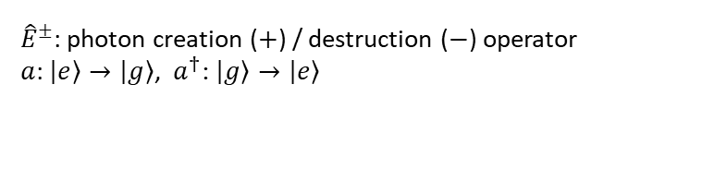

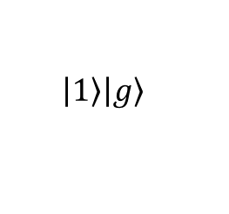

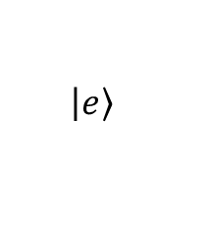
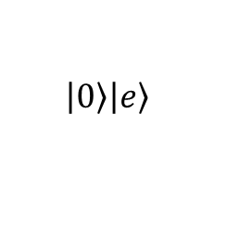
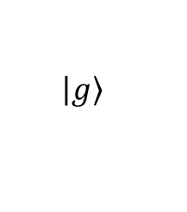
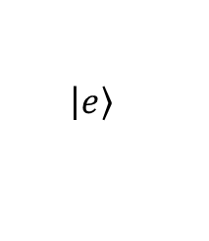
Interaction of Transmon Qubits with E&M Fields
$$E_{γ}=ω_{0}$$
$$\left.\left|e\right.\right\rangle$$
$$\left.\left|e\right.\right\rangle$$
$$ω_{0}$$
$$ω_{0}$$
$$\left.\left|g\right.\right\rangle$$
$$\left.\left|g\right.\right\rangle$$
$$\left.\left|1\right.\right\rangle \left.\left|g\right.\right\rangle$$
$$\left.\left|0\right.\right\rangle \left.\left|e\right.\right\rangle$$
Jaynes-Cummings form: ${\hat{H}}_{int}\sim ({\hat{E}}^{+}a+{\hat{E}}^{−}a^{†})$
emission
absorption
${\hat{E}}^{±}$: photon creation ($+$) / destruction ($−$) operator
$a$: $\left.\left|e\right.\right\rangle →\left.\left|g\right.\right\rangle$, ${ a}^{†}$: $\left.\left|g\right.\right\rangle →\left.\left|e\right.\right\rangle$

Slide 12
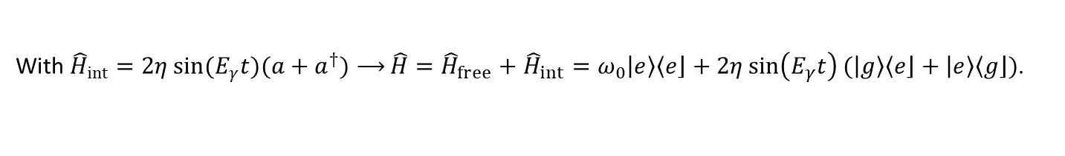

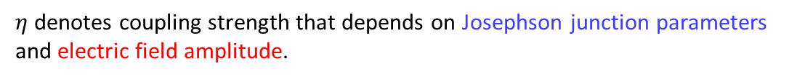

Rabi Oscillation
$${\hat{H}}_{int}\sim \left({\hat{E}}^{+}a+{\hat{E}}^{−}a^{†}\right)\sim \sin{(E_{γ}t)(a+a^{†})}$$
Revisiting later
With ${\hat{H}}_{int}=2η\sin{(E_{γ}t)(a+a^{†})⟶}\hat{H}={\hat{H}}_{free}+{\hat{H}}_{int}=ω_{0}\left.\left|e\right.\right\rangle \left\langle \left.e\right\rfloor \right.+2η\sin\left(E_{γ}t\right)(\left.\left|g\right.\right\rangle \left\langle \left.e\right\rfloor \right.+\left.\left|e\right.\right\rangle \left\langle \left.g\right\rfloor \right.)$.
$η$ denotes coupling strength that depends on Josephson junction parameters and electric field amplitude.
In the limit of rotating-wave approximation (RWA),
$$i\frac{d}{dt}\left(\begin{matrix}ψ_{g}(t) \\ ψ_{e}(t)\end{matrix}\right)≈\left(\begin{matrix}0 & −iη \\ iη & 0\end{matrix}\right)\left(\begin{matrix}ψ_{g}(t) \\ ψ_{e}(t)\end{matrix}\right)$$
Assuming $ψ_{g}\left(0\right)=1$, $ψ_{e}\left(0\right)=0$, i.e., qubits are initially at the ground state,
$ψ_{g}(t)≈\cos{(ηt)}$, $ψ_{e}(t)≈\sin{(ηt)}$
$p_{g→e}(τ)≈\sin^{2}{(ητ)}≈{(ητ)}^{2}$
within the coherence time $τ<t$
(See also [Rabi, PR (1937); Krantz et al, Appl.Phys.Rev. (2019)])

Slide 13
Outline
Introduction to the Transmon Qubit
Detection of Decay Photons
Physics Applications
Conclusions
$$ℏ=c=1$$

Slide 14
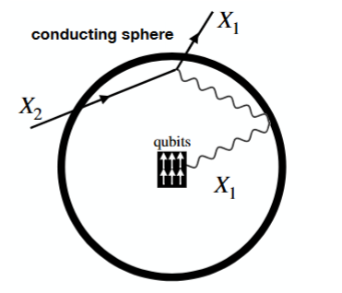
Detection of (Rare) Decay Photons
Trapped photons
Reflective inner walls

Slide 15
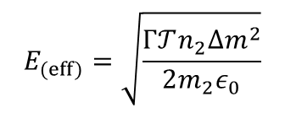
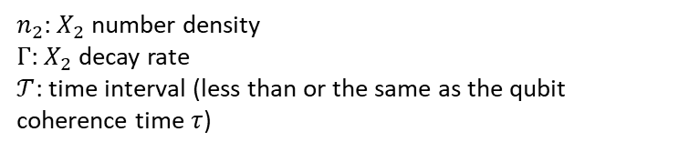



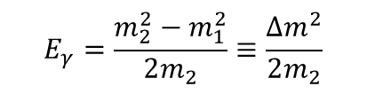

Event Rate Calculation: Semi-Classical Approach
${\vec{E}}_{(eff)}→E_{(eff)}{\hat{n}}_{E}\sin{(E_{γ}t)}$ with ${\hat{n}}_{E}$ unit vector of ${\vec{E}}_{(eff)}$
Given a decay process $X_{2}→X_{1}+γ$
$$E_{γ}=\frac{m_{2}^{2}−m_{1}^{2}}{2m_{2}}≡\frac{{∆m}^{2}}{2m_{2}}$$
for non-relativistic $X_{2}$
Photon energy density
$$ρ_{γ}=ε_{0}{\vec{E}}^{2}$$
$$E_{(eff)}=\sqrt{\frac{Γ𝒯n_{2}{Δm}^{2}}{2m_{2}ε_{0}}}$$
$$ρ_{γ}=E_{γ}×n_{γ}=\frac{{∆m}^{2}}{2m_{2}}×n_{2}Γ𝒯$$
$n_{2}$: $X_{2}$ number density
$Γ$: $X_{2}$ decay rate
$𝒯$: time interval (less than or the same as the qubit coherence time $τ$)
$p_{g→e}(τ)≈{(ητ)}^{2}∝E_{(eff)}^{2}τ^{2}$

Slide 16
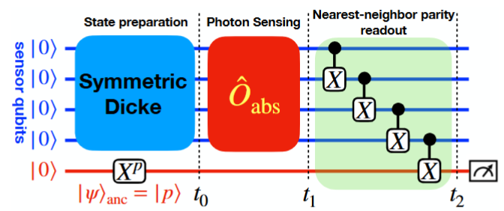

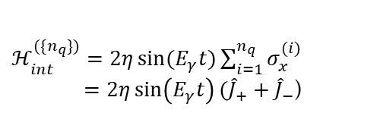
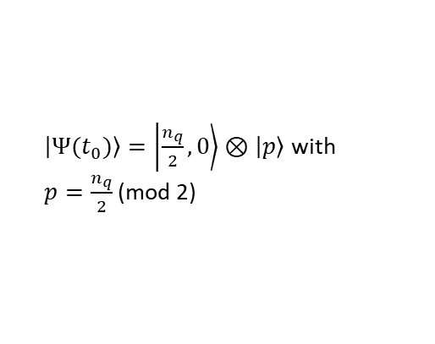
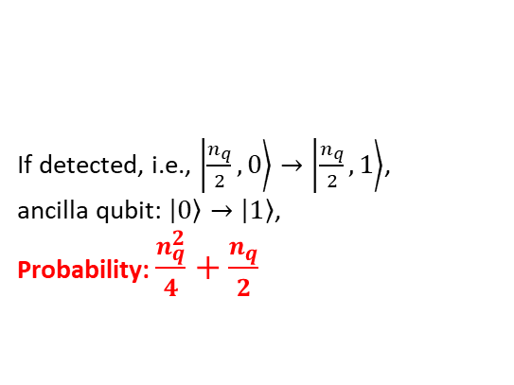
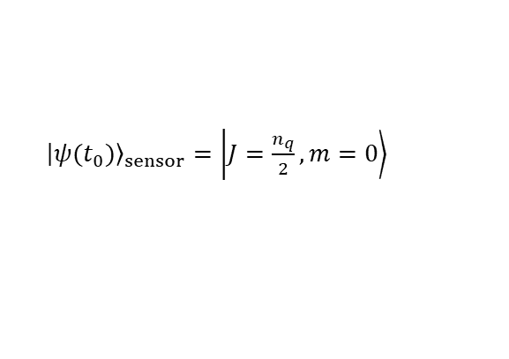
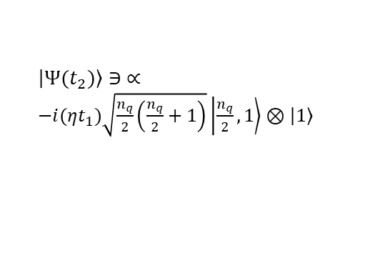

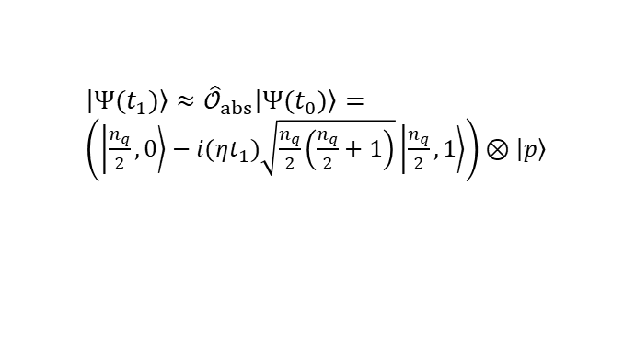
Enhancing Signal Sensitivity: Potential Superabsorption
Quantum circuit that can potentially yield an $\sim n_{q}^{2}$ collective enhancement
$n_{q}$ sensor qubit
1) State prep.
2) Photon sensing
3) Gate operation/readout
Half-excited symmetric Dicke state
$ℋ_{int}^{(\{n_{q}\})}=2η\sin{(E_{γ}t)}\sum_{i=1}^{n_{q}}{σ_{x}^{(i)}}$
$=2η\sin\left(E_{γ}t\right)({\hat{J}}_{+}+{\hat{J}}_{−}$)
$\left.\left|Ψ(t_{2})\right.\right\rangle ∋ ∝$
$−i(ηt_{1})\sqrt{\frac{n_{q}}{2}\left(\frac{n_{q}}{2}+1\right)}\left.\left|\frac{n_{q}}{2}\right.,1\right\rangle ⊗\left.\left|1\right.\right\rangle$
${\left.\left|ψ(t_{0})\right.\right\rangle }_{sensor}=\left.\left|J=\frac{n_{q}}{2}\right.,m=0\right\rangle$
${\hat{𝒪}}_{abs}≈I−i(ηt){\hat{J}}_{+}$
If detected, i.e., $\left.\left|\frac{n_{q}}{2}\right.,0\right\rangle →\left.\left|\frac{n_{q}}{2}\right.,1\right\rangle$,
ancilla qubit: $\left.\left|0\right.\right\rangle →\left.\left|1\right.\right\rangle$,
Probability: $\frac{n_{q}^{2}}{4}+\frac{n_{q}}{2}$
$\left.\left|Ψ(t_{0})\right.\right\rangle =\left.\left|\frac{n_{q}}{2}\right.,0\right\rangle ⊗\left.\left|p\right.\right\rangle$ with
$p=\frac{n_{q}}{2}$ (mod 2)
${\left.\left|Ψ(t_{1})\right.\right\rangle ≈\hat{𝒪}}_{abs}\left.\left|Ψ(t_{0})\right.\right\rangle =$
$\left(\left.\left|\frac{n_{q}}{2}\right.,0\right\rangle −i(ηt_{1})\sqrt{\frac{n_{q}}{2}\left(\frac{n_{q}}{2}+1\right)}\left.\left|\frac{n_{q}}{2}\right.,1\right\rangle \right)⊗\left.\left|p\right.\right\rangle$
(See also [Higgins et al, Nature Comm. (2014)])

Slide 17




Measurement Protocol
Step 1: qubit sensor initialization and evolution to the coherence time limit $t=τ$.
Step 2: quantum measurement/readout performed for a short time interval: e.g., $\sim 0.1$ ns for transmon qubits.
Step 3: for a given $ω_{0}$, the initialization-evolution-readout sequence is repeated $n_{rep}$ times.
Step 4: scan the frequency range 1 GHz to 10 GHz ($μ$eV-scale energy) by $Q_{eff}={10}^{6}$ small intervals.
$n_{q}×n_{rep}$ for independent measurements over $n_{q}$ qubits
The total # of measurements $N_{try}=$
$n_{rep}$ for entangled measurements over $n_{q}$ qubits (implicitly $n_{q}^{2}$-dependent)
$$N_{sig}={p_{g→e}×N}_{try}$$
$2.3×{10}^{6}$ resolvable frequency bins and $\sim 14$s of integration time per bin

Slide 18
Outline
Introduction to the Transmon Qubit
Detection of Decay Photons
Physics Applications
Conclusions
$$ℏ=c=1$$

Slide 19






Application I: Dark Matter Decay
$$ℒ⊃μX_{1}^{α}X_{2}^{β}{\tilde{F}}_{αβ}$$
Full gauge-invariant set of interactions, e.g., [Anastasopoulos, Bianchi, Dudas, Kiritsis, JHEP (2006); Dudas, Mambrini, Pokorski, Romagnoni, JHEP (2009); Lee, DK, Kong, Park, JHEP (2015)]
$⟹Γ\left(X_{2}→X_{1}+γ\right)=\frac{μ^{2}}{96π}\frac{{\left(m_{2}^{2}−m_{1}^{2}\right)}^{3}(m_{2}^{2}+m_{1}^{2})}{m_{2}^{5}m_{1}^{2}}≈\frac{μ^{2}}{48π}\frac{{\left({∆m}^{2}\right)}^{3}}{m_{2}^{5}}$ for ${Δm}^{2}≪m_{1}^{2}≲m_{2}^{2}$
$$E_{(eff)}=\sqrt{\frac{Γ𝒯ρ_{DM}{Δm}^{2}}{2m_{2}^{2}ε_{0}}}$$
with $ρ_{DM}≈m_{2}n_{2}$, assuming $X_{2}$ is the dominant component
$$p_{∗}≈p_{∗}^{0}\left(\frac{ρ_{DM}}{0.45 GeV{cm}^{−3}}\right)\left(\frac{{Δm}^{2}}{m_{2}^{2}}\right){\left(\frac{d}{100 μm}\right)}^{2}\left(\frac{C}{0.1 pF}\right)\left(\frac{f}{1 GHz}\right){\left(\frac{τ}{100 μs}\right)}^{3}$$
$p_{∗}$: transition probability of a single transmon qubit
$C, d$: capacitance and the distance between the capacitor plates
Reference probability $p_{∗}^{0}=\left\{\begin{aligned}0.023 \\ \\ 1.72×{10}^{−9}\end{aligned}\right.$
with reference $μ_{ref}^{2}≈48πm_{2}^{2}{\left(\frac{m_{2}}{{Δm}^{2}}\right)}^{3}Γ_{U}$ and $Γ_{U}=τ_{Uni}^{−1}=2.3×{10}^{−18}s^{−1}$
with $Γ_{U}$ in reference $μ_{ref}^{2}$ replaced with $Γ_{CMB}=τ_{CMB}^{−1}=1.7×{10}^{−25}s^{−1}$ [Zhang, Chen, Kamionkowski, Si, Zheng, PRD (2007)]

Slide 20

Application I: Dark Matter Decay – Sensitivity Prospects
Sensitivity prospects with $C=0.1 pF, d=100 μm, ρ_{DM}=0.45 GeV∙{cm}^{−3}$, and $τ=100 μs$
Dark-count background via thermal excitation is considered: $N_{dark}=e^{−ω_{0}/T}N_{try}$ with $T\sim 30$ mK

Slide 21





Application II: C$ν$B Decay
SM prediction for the neutrino lifetime is much longer than the age of Universe.
Many BSM scenarios can significantly enhance the neutrino magnetic moment, hence allow the neutrino decay in the present universe.
$$ℒ⊃\frac{μ_{ν}^{ij}}{2}{\overline{ν}}_{i}σ^{αβ}ν_{j}F_{αβ}+h.c.$$
$$E_{(eff)}=\sqrt{\frac{Γ_{ij}𝒯n_{ν}{Δm}_{ij}^{2}}{2m_{i}ε_{0}}}$$
$$Γ_{ij}=\frac{{(μ_{ν}^{ij})}^{2}}{8πm_{i}^{3}}{(m_{i}^{2}−m_{j}^{2})}^{3}$$
with $n_{v}≈112 {cm}^{−3}$ and
$$p_{∗}≈p_{∗}^{0}{\left(\frac{d}{100 μm}\right)}^{2}\left(\frac{C}{0.1 pF}\right)\left(\frac{f}{1 GHz}\right){\left(\frac{τ}{100 μs}\right)}^{3}{\left(\frac{μ_{ij}}{{10}^{−11}μ_{B}}\right)}^{2}{\left(\frac{{Δm}_{ij}^{2}}{{10}^{−5}{eV}^{2}}\right)}^{4}\left(\frac{n_{ν}}{112{cm}^{−3}}\right){\left(\frac{0.05 eV}{m_{i}}\right)}^{4}$$
$p_{∗}$: transition probability of a single transmon qubit
$p_{∗}^{0}$: reference probability $2.1×{10}^{−27}$
$C, d$: capacitance and the distance between the capacitor plates
$μ_{B}$: Bohr magneton

Slide 22




Application II: C$ν$B Decay – Sensitivity Prospects
No $n_{q}^{2}$-type enhancement assumed.
N_{unit} = 10³
N_{unit} = 10³
$n_{q}^{2}$-type
enhancement assumed.
${10}^{5} n_{q}$ assumed: See IBM’s roadmap to build a ${10}^{6}$-qubit quantum computer by 2033 [https://www.ibm.com/quantum/blog/100k-qubitsupercomputer]
$N_{unit}={10}^{3}$, i.e., 1,000 units of cavity, each hosting ${10}^{5}$ qubits

Slide 23















Event Rate Calculation: QM Approach – Detector Response
Beginning with dipole-type operators ${\hat{H}}_{int}\left(t\right)=g{\hat{σ}}_{x}(t)\hat{E}(t)$ with coupling $g$, we have
$$E_{γ}=ω_{0}$$
$$\left.\left|e\right.\right\rangle$$
$$\left.\left|e\right.\right\rangle$$
$$ω_{0}$$
$$ω_{0}$$
$${\hat{σ}}_{x}\left(t\right)\sim {\hat{σ}}_{−}\left(t\right)+{\hat{σ}}_{+}\left(t\right)={\hat{σ}}_{−}e^{−iω_{0}t}+{\hat{σ}}_{+}e^{+iω_{0}t}$$
$$\left.\left|g\right.\right\rangle$$
$$\left.\left|g\right.\right\rangle$$
(or equivalently, identified as $a\left(t\right)+a^{†}\left(t\right)$)
$$\left.\left|1\right.\right\rangle \left.\left|g\right.\right\rangle$$
$$\left.\left|0\right.\right\rangle \left.\left|e\right.\right\rangle$$
$\hat{E}(t)\sim {\hat{E}}^{(−)}\left(t\right)+{\hat{E}}^{(+)}\left(t\right)$ with ${\hat{E}}^{(±)}\left(t\right)∝e^{±iE_{γ}t}$
Applying the RWA and keeping the energy-conserving terms, we find
absorption emission
${\hat{H}}_{int}^{(RWA)}\left(t\right)=g{\hat{σ}}_{+}\left(t\right){\hat{E}}^{(−)}\left(t\right)+h.c.$
$𝒜=−ig\int_{0}^{T}{dt\left\langle \left.e,f\right\rfloor \right.{\hat{σ}}_{+}\left(t\right){\hat{E}}^{\left(−\right)}\left(t\right)\left.\left|g\right.,i\right\rangle }=−ig\int_{0}^{T}{dte^{+iω_{0}t}\left\langle \left.f\right\rfloor \right.{\hat{E}}^{\left(−\right)}\left(t\right)\left.i\right\rangle }$
$p_{g→e}\left(T\right)=\sum_{f}{{\left|𝒜\right|}^{2}}=g^{2}\int_{0}^{T}{{dt}_{1}}\int_{0}^{T}{{dt}_{2}e^{−iω_{0}(t_{1}−t_{2})}\left\langle {\hat{E}}^{\left(+\right)}(t_{1}){\hat{E}}^{\left(−\right)}(t_{2})\right\rangle }$
$≡g^{2}\int_{0}^{T}{{dt}_{1}}\int_{0}^{T}{{dt}_{2}e^{−iω_{0}\left(t_{1}−t_{2}\right)}G^{\left(1\right)}(t_{1},t_{2}) }$
a.k.a. Glauber correlator
Standard quantum-optics expression for absorption-driven excitation [Glauber, PR (1963)]

Slide 24




Event Rate Calculation: QM Approach – Cavity Mode Expansion
In a reflective cavity, the electric field at the qubit location can be expanded in discrete cavity modes.
${\hat{E}}^{(−)}\left(t\right)=\sum_{k}{ℰ_{k}{\hat{a}}_{k}e^{−iω_{k}t}}$, ${\hat{E}}^{(+)}\left(t\right)=\sum_{k}{ℰ_{k}^{∗}{\hat{a}}_{k}^{†}e^{+iω_{k}t}}$
$G^{\left(1\right)}\left(t_{1},t_{2}\right)=\sum_{k,k′}{ℰ_{k}^{∗}ℰ_{k′}e^{+iω_{k}t_{1}}e^{−iω_{k′}t_{2}}\left\langle {\hat{a}}_{k}^{†}{\hat{a}}_{k′}\right\rangle }$
For a photon of state $α$ emerges in the cavity, it is described by a superposition over cavity modes:
$\left.\left|1_{α}\right.\right\rangle ≡\sum_{k}{α_{k}{\hat{a}}_{k}^{†}\left.\left|0\right.\right\rangle }$, $\sum_{k}{{\left|α_{k}\right|}^{2}}=1$ for which $\left\langle {\hat{a}}_{k}^{†}{\hat{a}}_{k′}\right\rangle ={α_{k}^{∗}α}_{k′}$
$G^{\left(1\right)}\left(t_{1},t_{2}\right)=\left[\sum_{k}{ℰ_{k}^{∗}α_{k}^{∗}e^{+iω_{k}t_{1}}}\right]\left[\sum_{k′}{ℰ_{k′}α_{k′}e^{−iω_{k′}t_{2}}}\right]$

Slide 25


Event Rate Calculation: QM Approach – Near-Monochromatic Limit
If the decay photon state has dominant support around a characteristic energy $E_{γ}$ and the cavity filters the field so that the effective local amplitude is narrowband:
$\sum_{k}{ℰ_{k}α_{k}e^{−iω_{k}t}}≈ℰ_{eff}f(t)e^{−iE_{γ}t}$ with $f(t)$ being a slowly-varying envelope
$$G^{\left(1\right)}\left(t_{1},t_{2}\right)≈{\left|ℰ_{eff}\right|}^{2}f^{∗}\left(t_{1}\right)f(t_{2})e^{−iE_{γ}(t_{2}−t_{1})}$$
$$p_{g→e}\left(T\right)≈g^{2}{\left|ℰ_{eff}\right|}^{2}{\left|\int_{0}^{T}{dtf(t)e^{+i\left(ω_{0}−E_{γ}\right)t}}\right|}^{2}$$
For a quasi-stationary photon amplitude within a coherence time window $τ$, i.e., $f(t)≈1$ for $0<t<τ$,
$p_{g→e}\left(τ\right)≈g^{2}{\left|ℰ_{eff}\right|}^{2}\frac{\sin^{2}\left(\frac{\left(ω_{0}−E_{γ}\right)τ}{2}\right)}{{\left(\frac{ω_{0}−E_{γ}}{2}\right)}^{2}}\underset{→}{E_{γ}→ω_{0}}g^{2}{\left|ℰ_{eff}\right|}^{2}τ^{2}$ (vs. ${(ητ)}^{2}$)
Both semi-classical and quantum mechanical approaches result in the same transition amplitude with appropriate parameter identification.

Slide 26
Outline
Introduction to the Transmon Qubit
Detection of Decay Photons
Physics Applications
Conclusions
$$ℏ=c=1$$

Slide 27

Take-Home Messages
The detection of dark matter signals using qubit sensors is an emerging field of research: ideal for the signals involving $μ$eV-scale energy deposits.
Qubit sensors have potential to detect decay photon signals
  Radiative DM decays may be probed with near-current quantum technologies, while C$ν$B radiative decays require ambitious scaling in qubit number and/or collective enhancement.
  Potential enhancement strategies: Quantum mechanical algorithmic enhancement with Dicke-type qubit state preparation
Thank you!

