Slide 1


Pushing into the Ultra-Heavy Mass Frontier
Andrew Buchanan

Slide 2
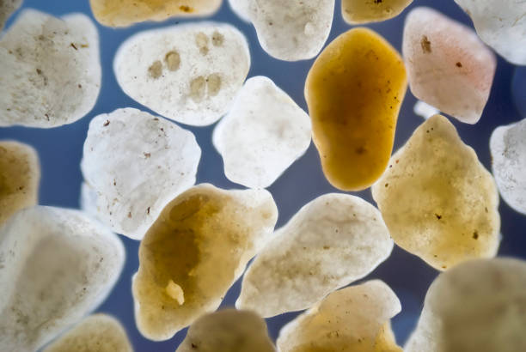
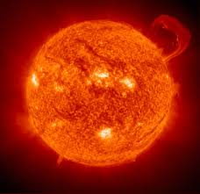
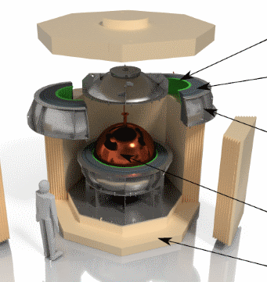
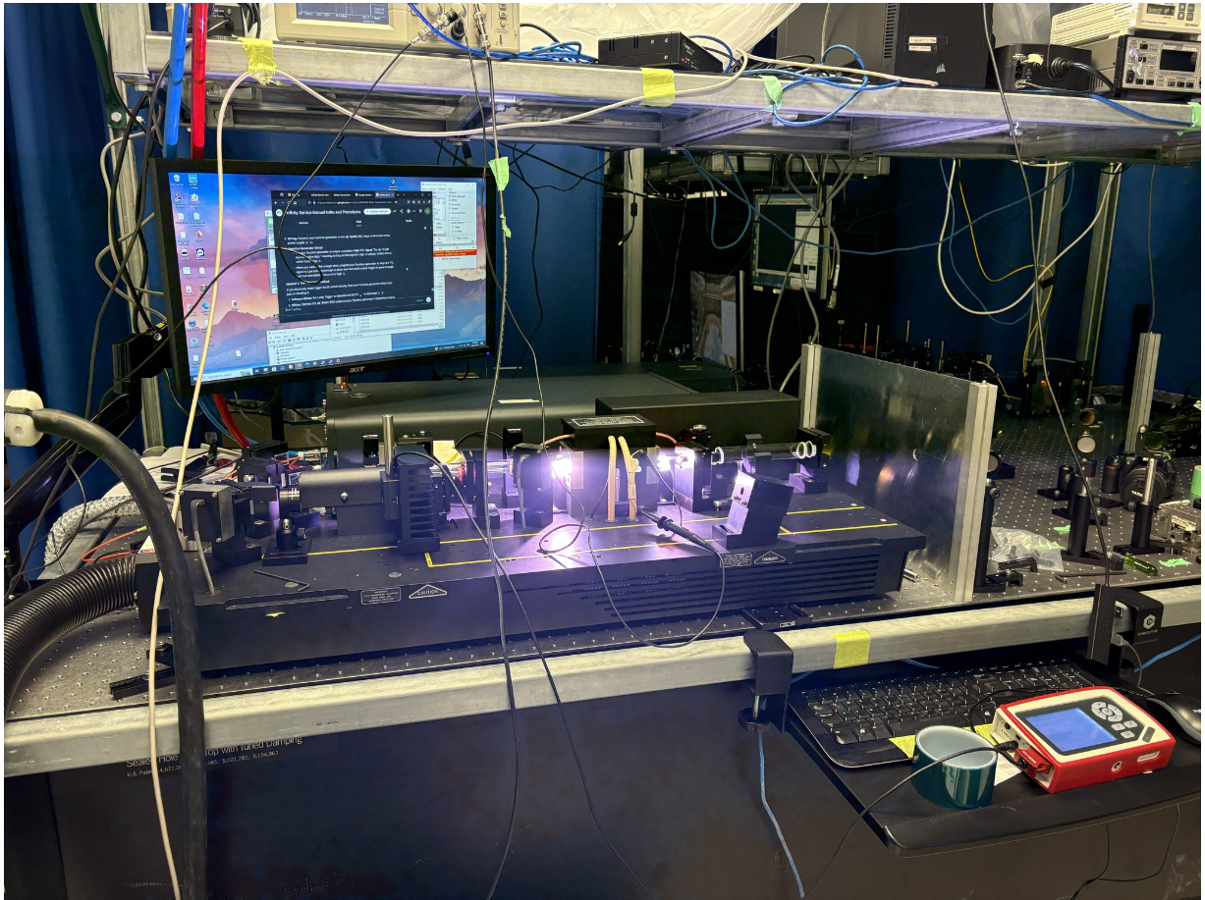
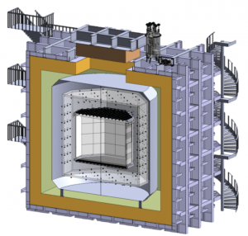

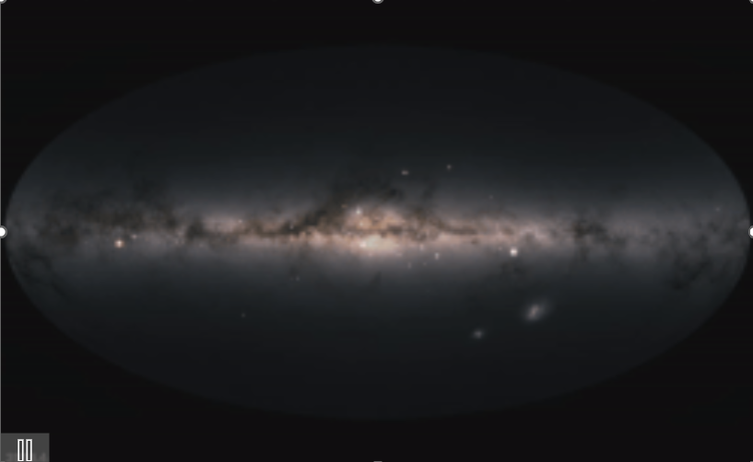






What is (Ultra)-Heavy Dark Matter?
$${10}^{−22 } eV$$
$$keV$$
$$GeV$$
$$100TeV$$
$$M_{pl}$$
$$10M_{⊙}$$
“ultralight” dark matter
“light” dark matter
“heavy” dark matter
“ultraheavy” dark matter
compact objects
CATCHY
NEWS-G
DarkSide-40k
Scale Credit: Tongyan Lin

Slide 3
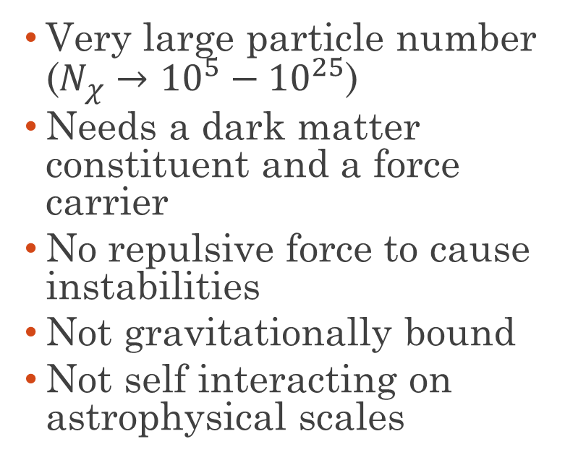
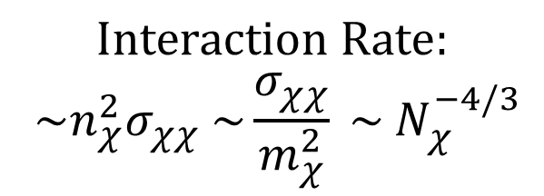

Composite Dark Matter
  Very large particle number ($N_{χ}→{10}^{5}−{10}^{25}$)
  Needs a dark matter constituent and a force carrier
  No repulsive force to cause instabilities
  Not gravitationally bound
  Not self interacting on astrophysical scales
χ
χ
χ
χ
χ
χ
χ
χ
$$Interaction Rate:$$
$${\sim n}_{χ}^{2}σ_{χχ} \sim \frac{σ_{χχ}}{m_{χ}^{2}} \sim N_{χ}^{−4/3}$$

Slide 4
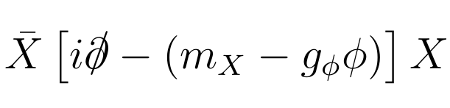
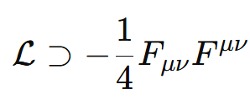
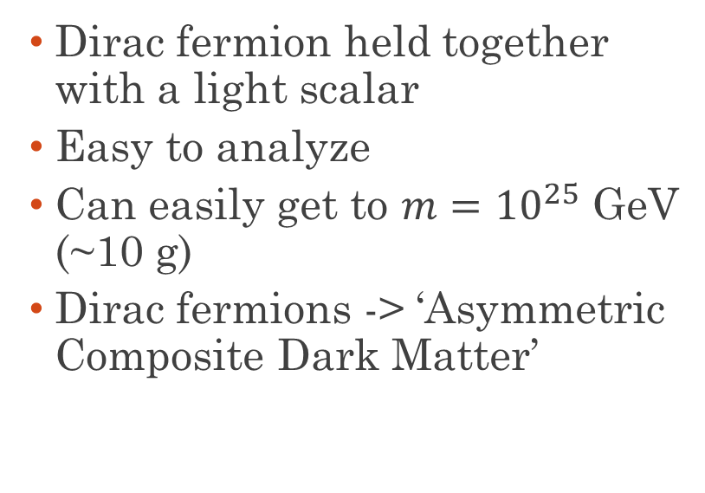
Models of Composite Dark Matter
Fermion nuggets
  Dirac fermion held together with a light scalar
  Easy to analyze
  Can easily get to $m={10}^{25}$ GeV (~10 g)
  Dirac fermions -> ‘Asymmetric Composite Dark Matter’

Slide 5
Models of Composite Dark Matter
Fermion nuggets
Dark QCD
  Dirac fermion held together with a light scalar
  Easy to analyze
  Can easily get to $m={10}^{25}$ GeV (~10 g)
  Dirac fermions -> ‘Asymmetric Composite Dark Matter’
  Dark analogue of QCD
  Quarks combine to make nucleons
  Nucleons combine to make nuclei
  No EM force to cause fission

Slide 6
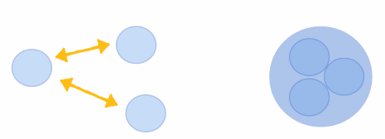
How Can Heavy Dark Matter Form?
Dark Nucleosynthesis
E.g. Sigurdson and Krnjaic 1406.1171

Slide 7
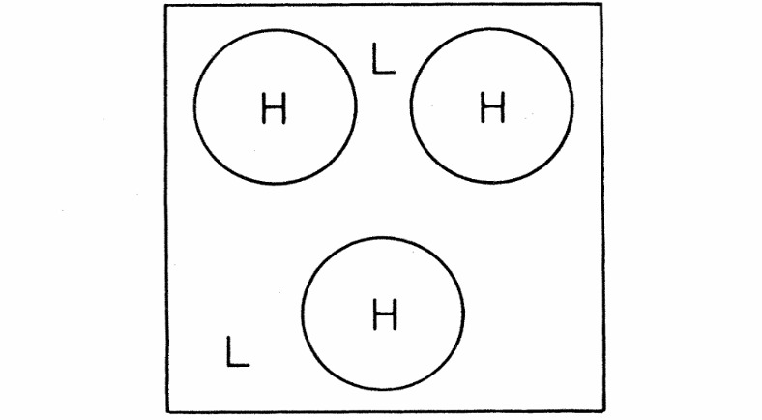
How Can Heavy Dark Matter Form?
Production from False Vacuum Bubbles
Dark Nucleosynthesis
E.g. Witten
PhysRevD.30.272
E.g. Sigurdson and Krnjaic 1406.1171

Slide 8
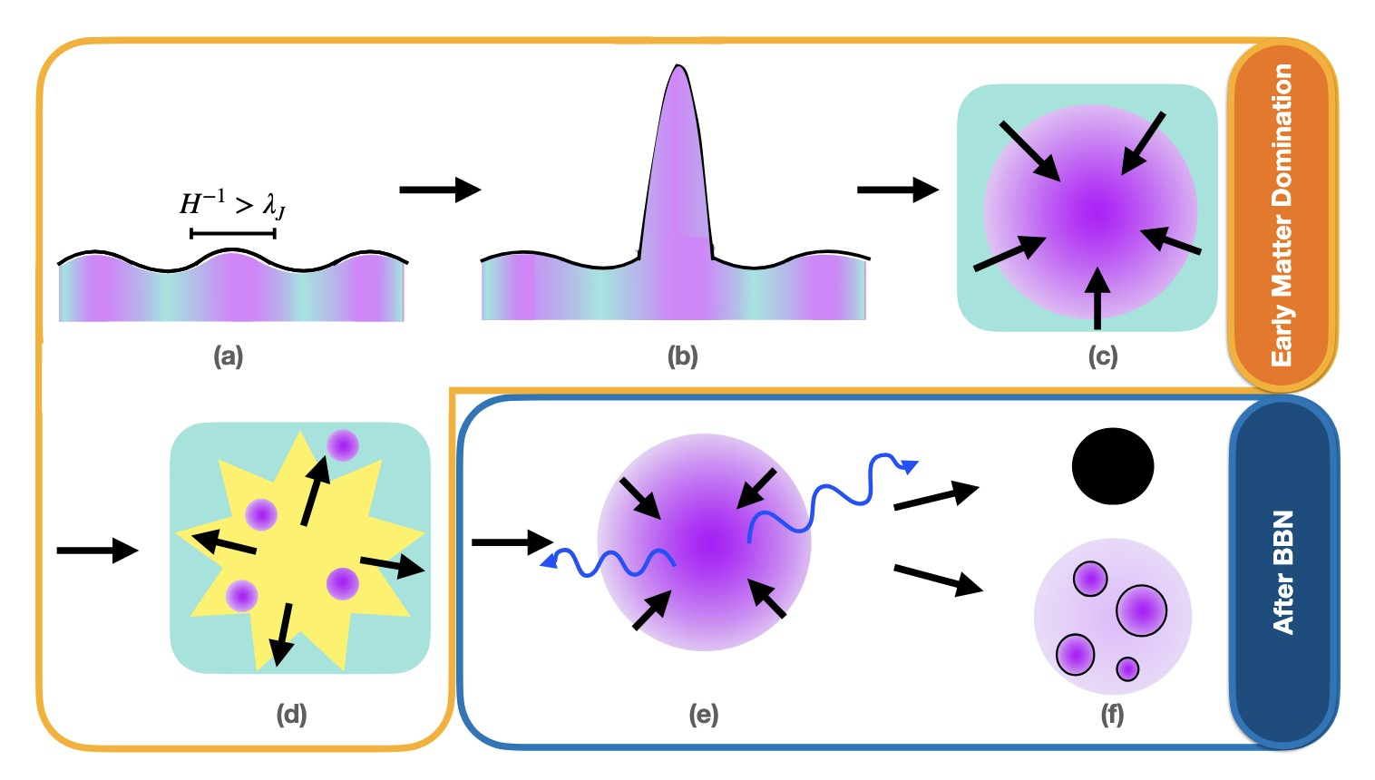
How Can Heavy Dark Matter Form?
Production from False Vacuum Bubbles
Dark Nucleosynthesis
Dissipative Processes
E.g. Witten
PhysRevD.30.272
E.g. Sigurdson and Krnjaic 1406.1171
E.g. Bramante, Cappiello, Diamond, Kim, Liu, Vincent
2405.04575

Slide 9
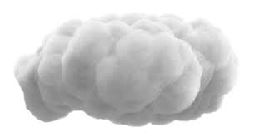
Heavy DM Interactions with Nuclei
Per-Nucleon (fluffy cloud)
  Realistic for large loosely-bound composite DM
  Each DM constituent interacts coherently with whole nucleus

Slide 10
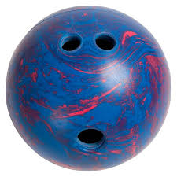
Heavy DM Interactions with Nuclei
Per-Nucleon (fluffy cloud)
Contact (bowling ball)
  Realistic for large loosely-bound composite DM
  Each DM constituent interacts coherently with whole nucleus
  Realistic for tightly-bound composite DM
  DM interacts with each nuclei with the same strength

Slide 11
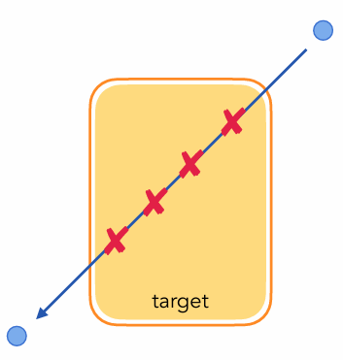
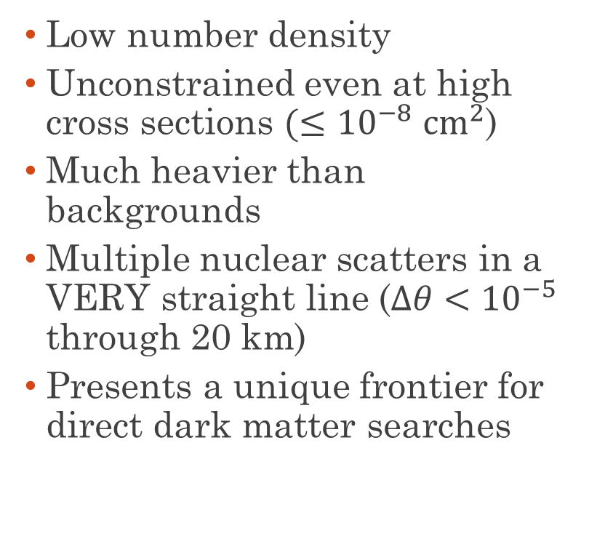
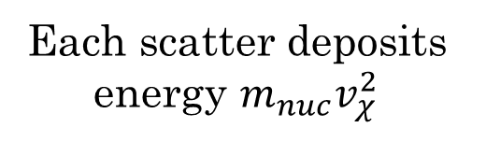
Aspects of Heavy Dark Matter Searches
  Low number density
  Unconstrained even at high cross sections $(≤{10}^{−8}$ ${cm}^{2}$)
  Much heavier than backgrounds
  Multiple nuclear scatters in a VERY straight line ($Δθ<{10}^{−5}$ through 20 km)
  Presents a unique frontier for direct dark matter searches
Each scatter deposits energy $m_{nuc}v_{χ}^{2}$

Slide 12
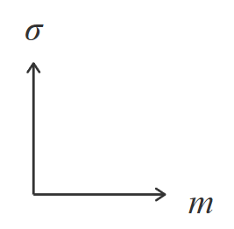


Single Scatter Bounds
Multi-Scattering Regime
Sensitivity
Flux

Slide 13



Multi-Scatter Bounds
Overburden
Flux
Sensitivity

Slide 14
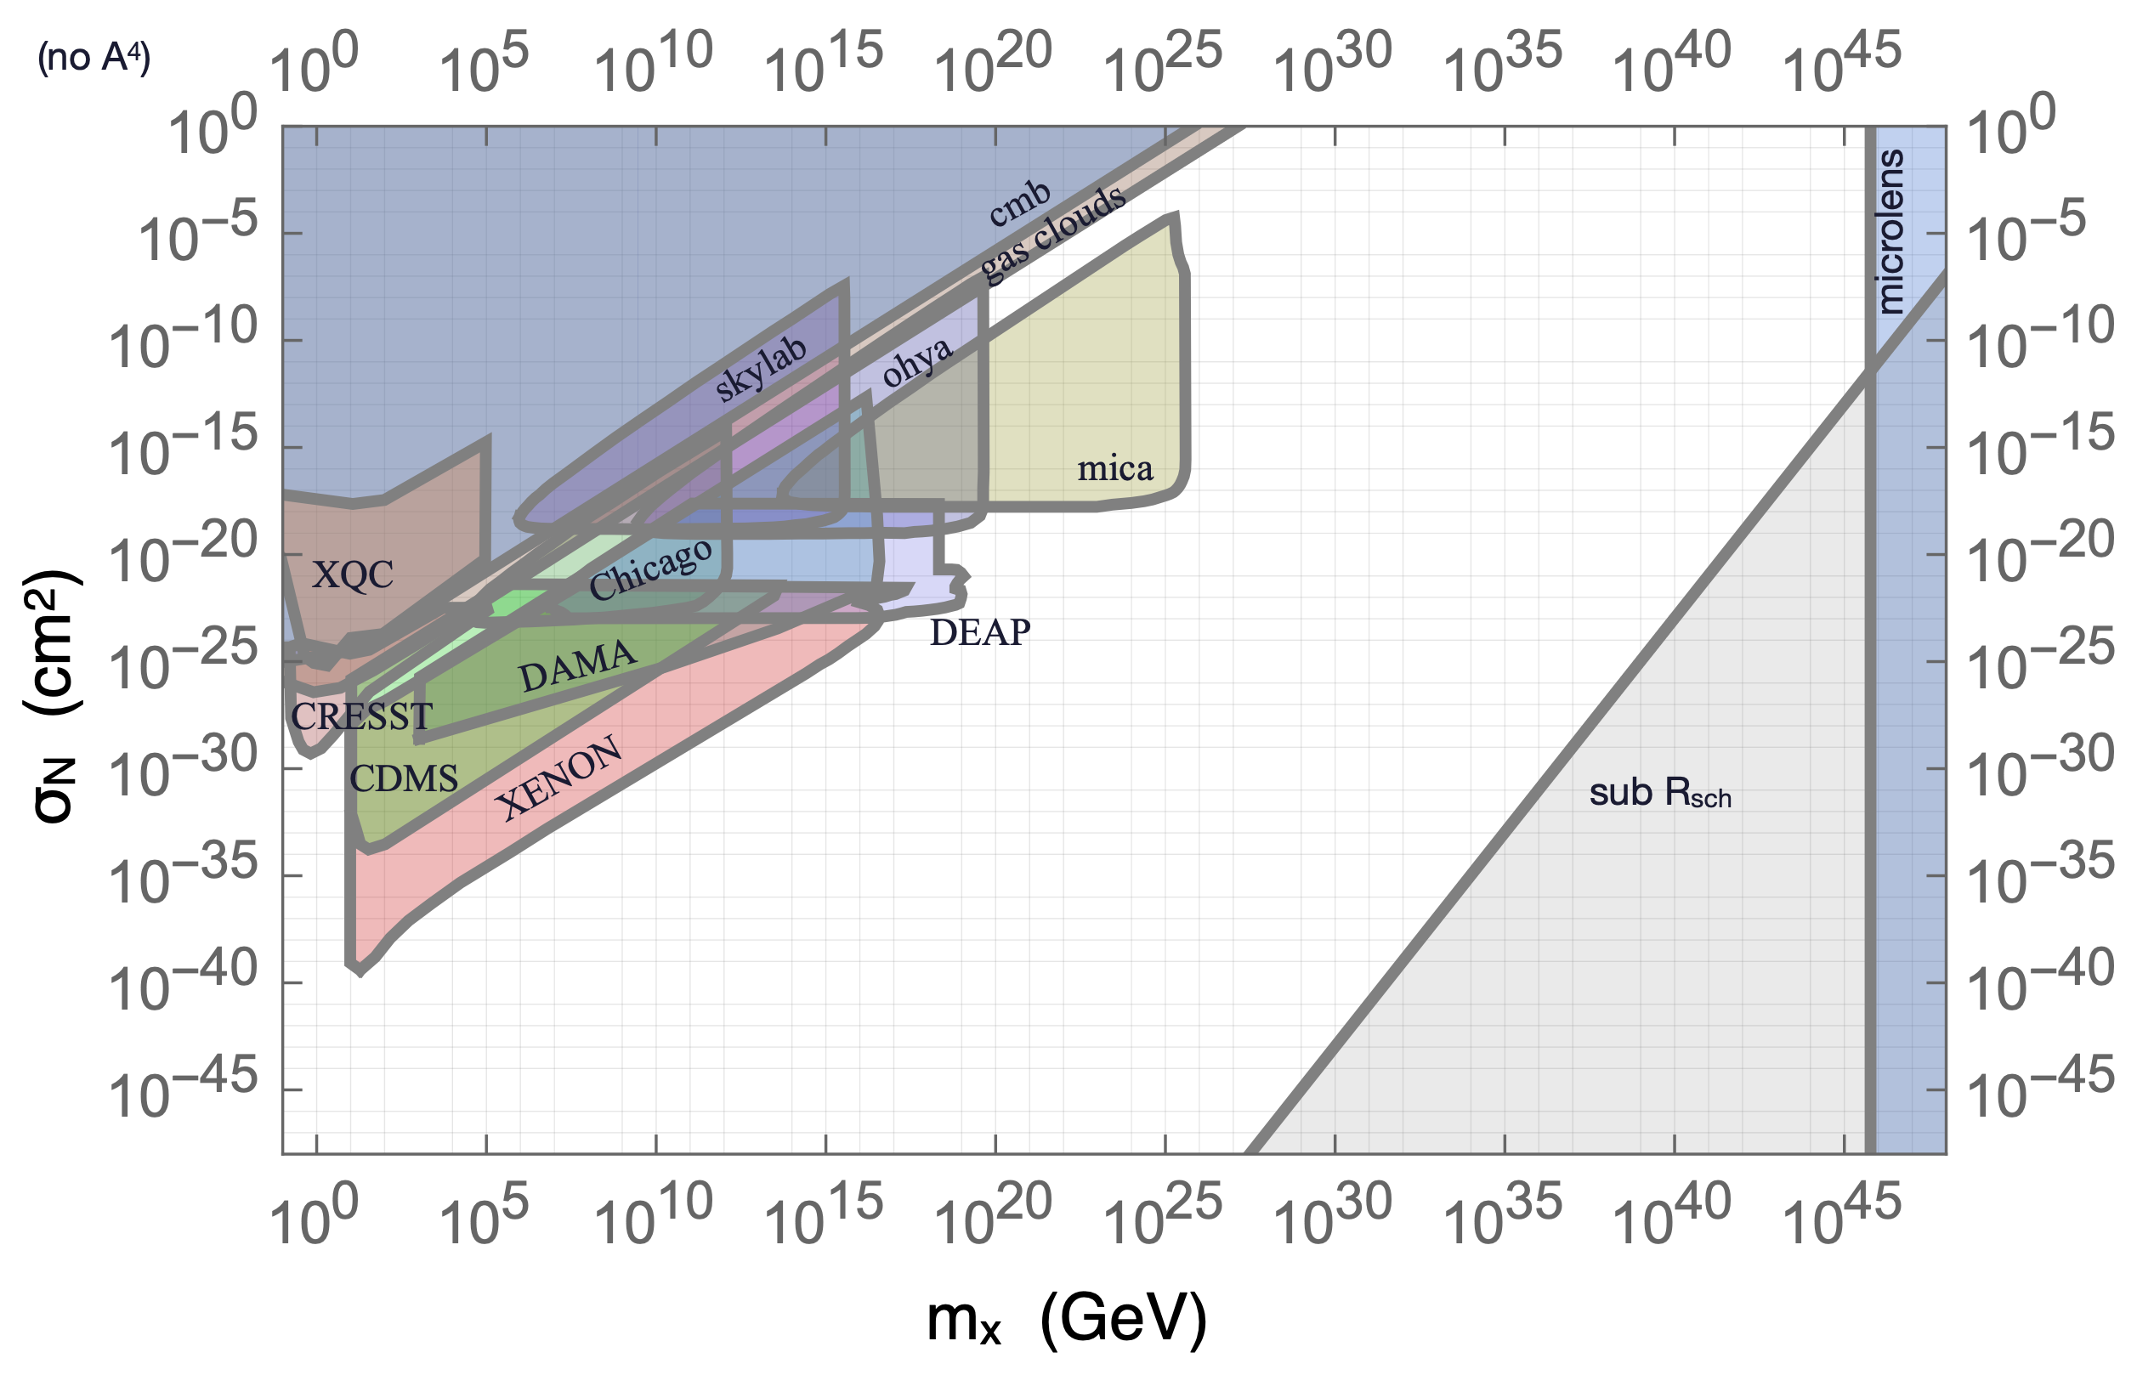
The High Mass Frontier
Indirect Detection
Gravity
Single Scatter

Slide 15
The Multi-Scatter High Mass Frontier
Mineral Detection
Plastic Etch Detectors

Slide 16
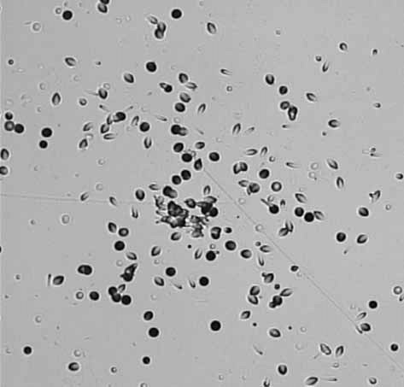
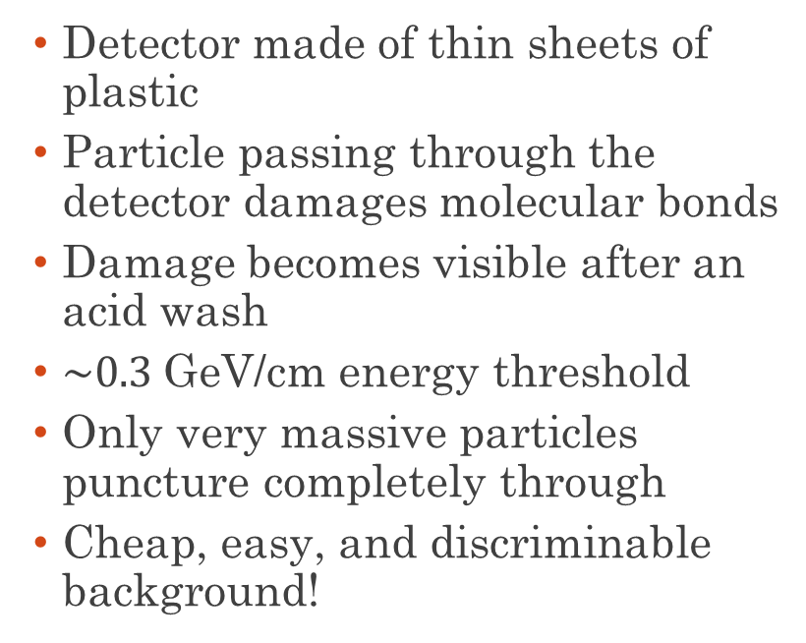
Plastic Etch Detectors
  Detector made of thin sheets of plastic
  Particle passing through the detector damages molecular bonds
  Damage becomes visible after an acid wash
  $\sim 0.3$GeV/cm energy threshold
  Only very massive particles puncture completely through
  Cheap, easy, and discriminable background!
El-Badry et al ‘07

Slide 17
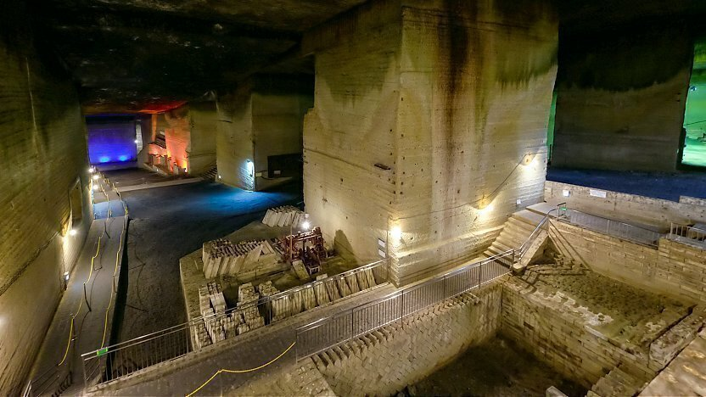
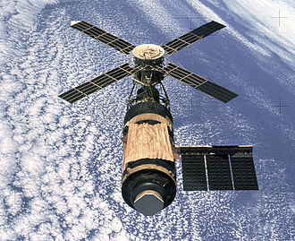
Plastic Etch Experiments
Ohya Quarry
SKYLAB
  Search for magnetic monopoles at the Ohya underground mine north of Tokyo in the 1990s
  Search for highly charged cosmic rays (Z > 60) at Skylab, the ISS predecessor in the 1970s
  Both detected nothing above background.
Notes:
Z>60 ~ Xenon (Z=54)

Slide 18
Plastic Etch Experiments
  Useful test cases!
  Want to study effects of Large Magellanic Cloud on multi-scatter searches
  Both detected nothing above background.

Slide 19
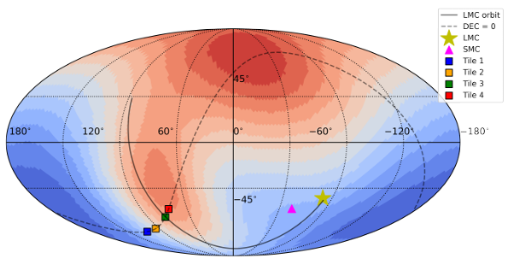
The Large Magellanic Cloud
  Satellite galaxy of Milky Way
  Big and close
  Affect local DM velocity distribution
  Nassim Bozorgnia’s group at University of Alberta models the effect of the LMC on local velocity distribution
  Uses LMC + MW analogues from Auriga simulation suite

Slide 20
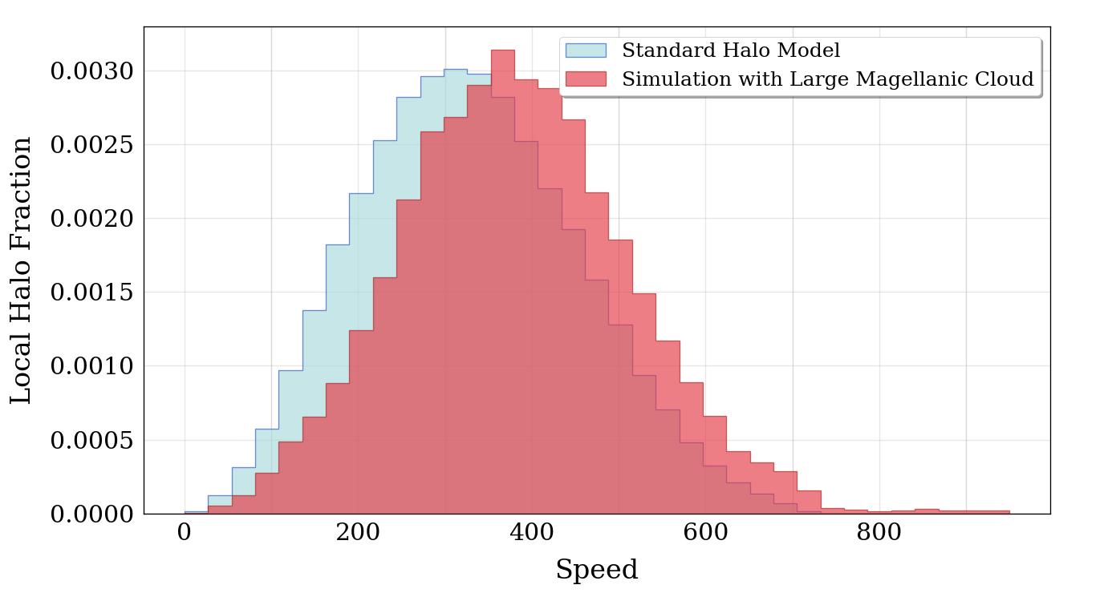
The LMC + MW Halo
Local DM Speed
Distribution

Slide 21
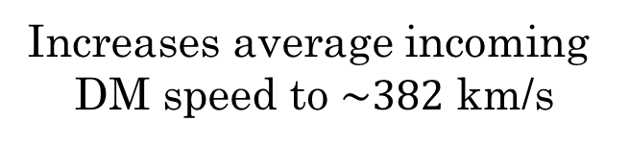
The LMC + MW Halo
Increases average incoming
DM speed to $\sim 382$ km/s
Due to alignment of the LMC’s
gravitational wake and sun’s
velocity vector (see backup slides)
Can reach slightly
higher masses

Slide 22

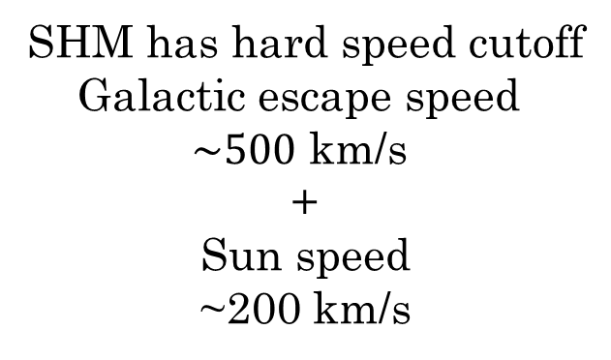
The LMC + MW Halo
SHM has hard speed cutoff
Galactic escape speed
$\sim 500$ km/s
+
Sun speed
~200 km/s
$\sim 700$ km/s

Slide 23
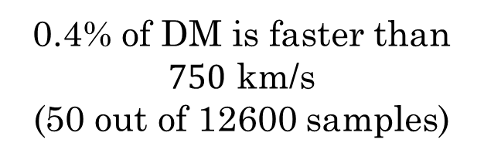
The LMC + MW Halo
Mostly particles originating from LMC with high speeds due to relative velocity
LMC induces
high speed tail
0.4% of DM is faster than $750$ km/s
(50 out of 12600 samples)

Slide 24
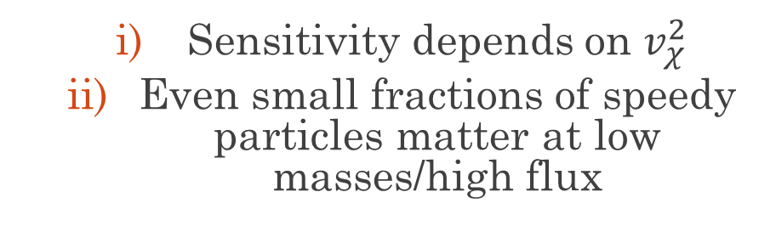
Why do High Speed Tails Help?
  Sensitivity depends on $v_{χ}^{2}$
  Even small fractions of speedy particles matter at low masses/high flux

Slide 25

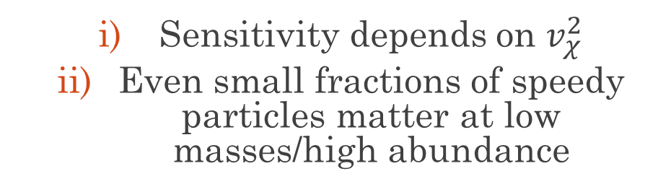

Why do High Speed Tails Help?
  Sensitivity depends on $v_{χ}^{2}$
  Even small fractions of speedy particles matter at low masses/high abundance
  Enough high-speed tail particles to trigger detector
$v_{max,MW}^{2} ≈{\left(700 km/s\right)}^{2}$
$$v_{max,LMC}^{2} ≈{\left(950 km/s\right)}^{2}$$
0.4%

Slide 26
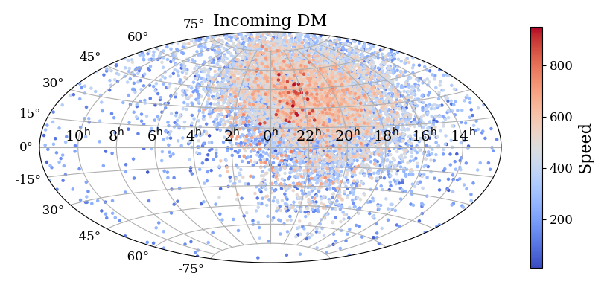

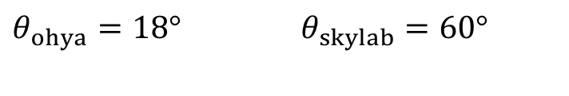

Directionality Matters
  Detector is planar and has acceptance angle $θ_{tol}$
  DM Wind from Sun’s motion
  LMC’s effects are concentrated in a small region of the sky
$$θ_{tol}$$
$θ_{ohya}=18°$ $θ_{skylab}=60°$

Slide 27
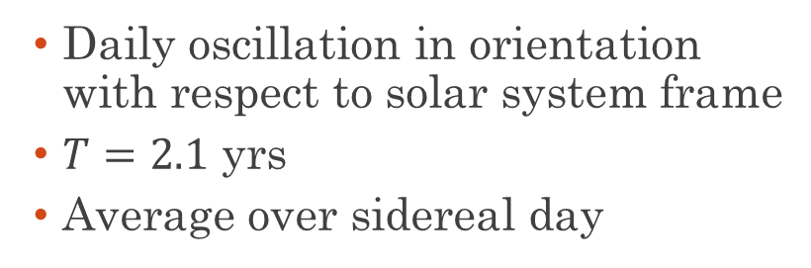
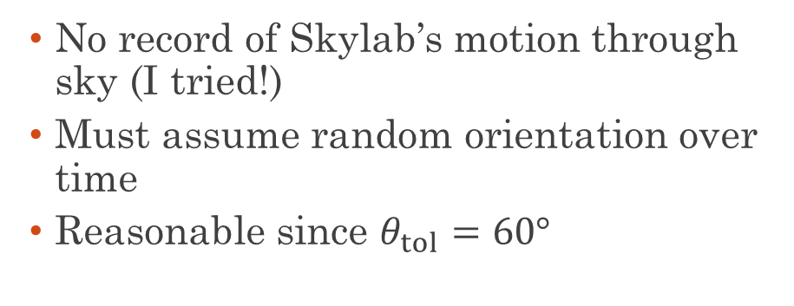
Averaging the Directional Information
OHYA
SKYLAB
  Daily oscillation in orientation with respect to solar system frame
  $T=2.1$ yrs
  Average over sidereal day
  No record of Skylab’s motion through sky (I tried!)
  Must assume random orientation over time
  Reasonable since $θ_{tol}=60°$

Slide 28
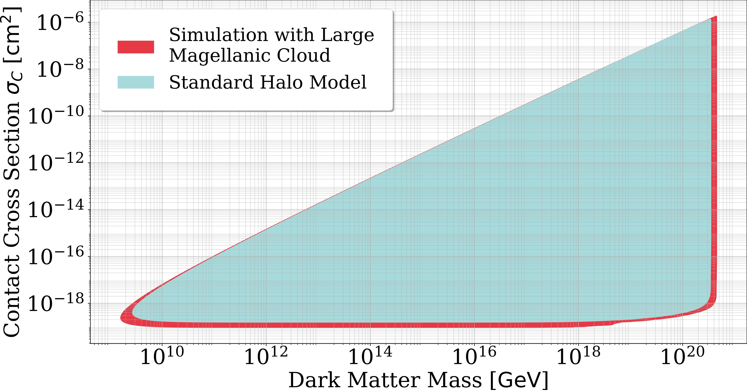
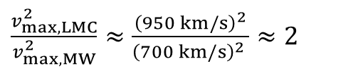
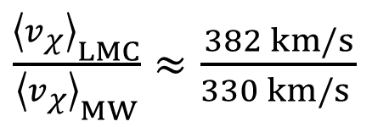
Halo Model vs Halo + LMC
$\frac{{\left\langle v_{χ}\right\rangle }_{LMC}}{{\left\langle v_{χ}\right\rangle }_{MW}}≈\frac{382 km/s}{330 km/s }$
0.4%
$\frac{v_{max,LMC}^{2}}{v_{max,MW}^{2}}≈\frac{{\left(950 km/s\right)}^{2}}{{\left(700 km/s\right)}^{2} }≈2$
2511.21841

Slide 29
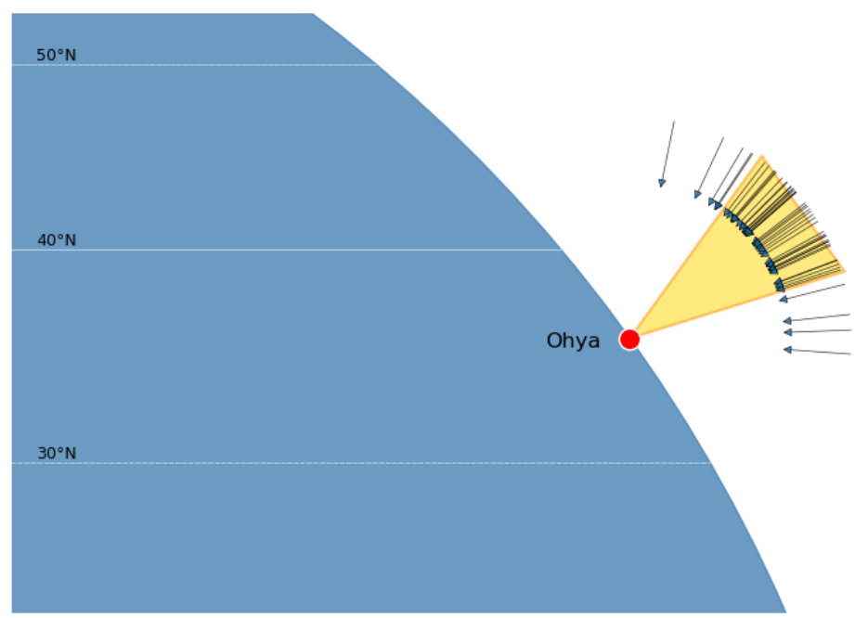
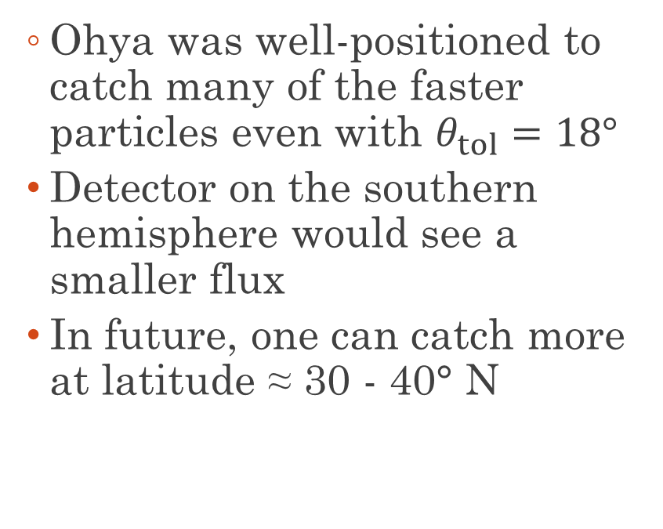
Catching the LMC Wind
  Ohya was well-positioned to catch many of the faster particles even with $θ_{tol}=18°$
  Detector on the southern hemisphere would see a smaller flux
  In future, one can catch more at latitude ≈ 30 - 40° N
Particles faster than 750 km/s

Slide 30
What Can the LMC Do for Direct Detection?
  Can improve bounds for heavy dark matter with fast dark matter due to the Large Magellanic Cloud
  Improvements can be applied straightforwardly to any multi-scattering heavy DM search
  Better bounds for free!
  Motivates more precise modelling of the effect of the LMC on the local dark matter distribution
  Choice of detector positioning can improve heavy DM detection prospects by a factor of 2!

Slide 31



DM Mass Flux on Human Scales
  How much dark matter passes through your body each year?
  Sets a soft limit on human scale experiments

Slide 32
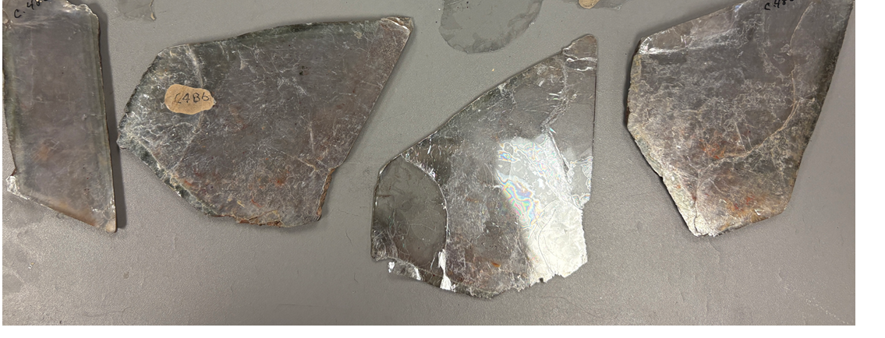
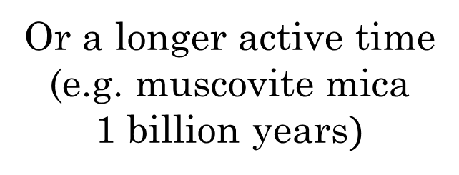
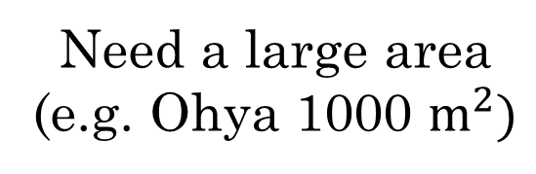
Getting To The High Mass Gap
Need a large area
(e.g. Ohya 1000 $m^{2})$
Or a longer active time
(e.g. muscovite mica
1 billion years$)$
Direct
Detection

Slide 33
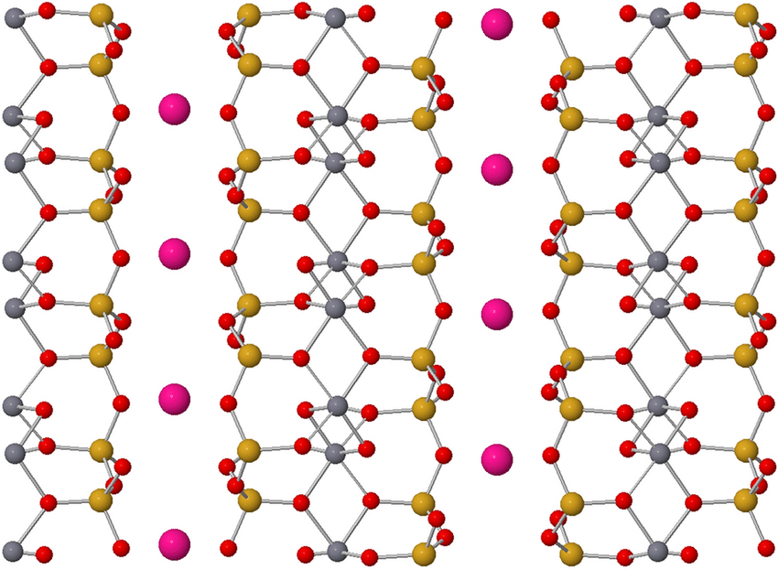
Why Muscovite Mica?
  Mineral with layered molecular structure
  Weak bonds between layers
  Can be easily cleaved into large (10² – 10³ cm² ) flat sheets
Maruvada et al ‘22
Notes:
Red = Oxygen, Grey = Aluminium, Pink = Potassium and Yellow = Silicon

Slide 34
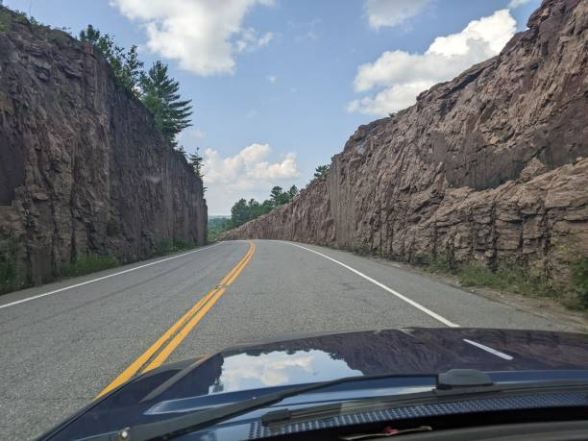
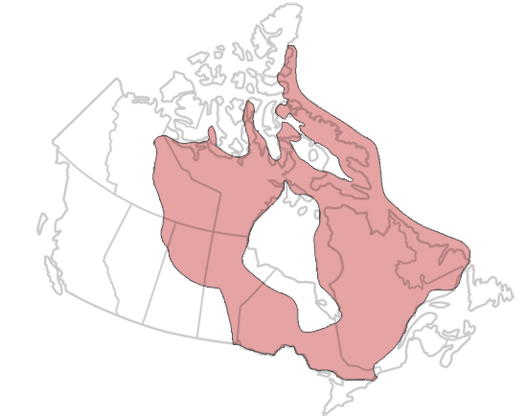
Why Muscovite Mica?
  Mineral with layered molecular structure
  Weak bonds between layers
  Can be easily cleaved into large (10² – 10³ cm² ) flat sheets
  Is plentiful in geologically stable sections of crust (“cratons”)
  DM damage will not anneal or melt away over one billion years
  Geological stability verifiable with observable fission tracks
Canadian
Shield Craton
Notes:
More on this later

Slide 35
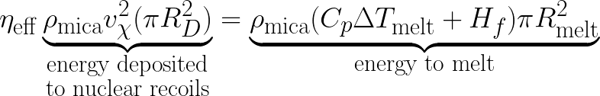
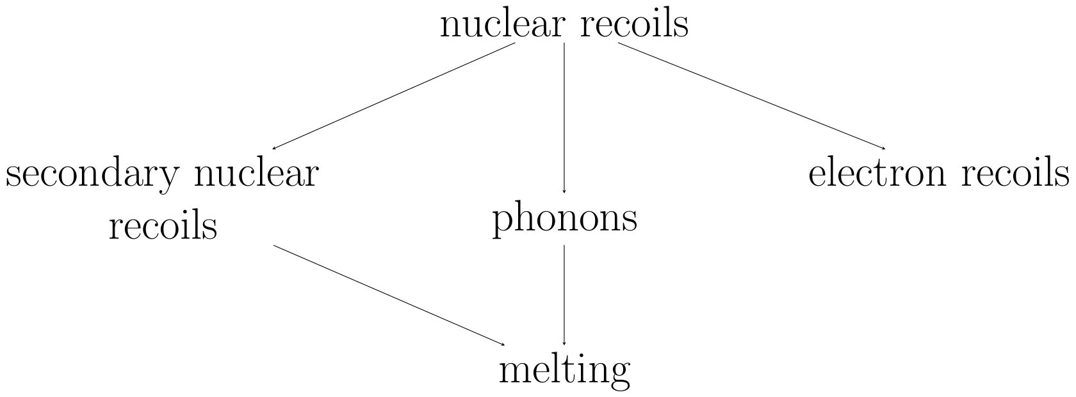


New Bounds: Searching for Melt Tracks
  Large enough DM can make ‘melt tracks’
  Energy from nuclear recoils melts surrounding mica
  Produces a straight track of vitrified mica
  Ongoing experimental program at Queen’s University to search for melt tracks from DM
With $η_{eff}≈0.7:$

Slide 36




Modeling With SRIM
SRIM (Stopping and Range of Ions in Matter) models knock-on nuclear scattering and melting
Models the shower caused by a recoiled nuclei at $v_{recoil}=330$ km/s
Repeated for all nuclei in DM path

Slide 37




Modeling With SRIM
# Border Atoms ~ $R_{D}^{2}$
SRIM does not properly treat damaged mica
Does not model melt shockwave front properly for large $R_{D}$
Underestimates true melt radius
Validity of SRIM: $R_{D}<1$ nm
(half of border atoms are displaced)
# Recoiled Atoms ~ $R_{D}^{2}$

Slide 38

Modeling With SRIM
Not enough
recoils for
continuous defect
SRIM
invalid
SRIM seems to validate
our melt radius estimate

Slide 39

X-Ray Fluorescence
  Non-destructive imaging technique
  Irradiate a sample with X-rays
  Spectrum of subsequent deexcitations are unique to each element
  Provides a spatial map of elemental abundance

Slide 40


Schematic of Imaging Technique
Detector
Why copper?
Not present in mica;
no background Cu
Strong characteristic
emissions:
2p → 1s (8.0 keV)
3p → 1s (8.9 keV)
Light is scattered/
attenuated
Defect
Mica
Fluorescent
X-Rays
Copper

Slide 41




Preliminary Size Calibration with Laser-Damaged Mica
Optical
XRF
$$R_{melt}=75 μm$$
Smallest
observable $R_{melt}$
is 25 microns
Sets sensitivity
threshold
$$R_{melt}=25 μm$$

Slide 42
Astrophysics
  Like Skylab/Ohya, direction of the detector matters
      Daily rotation of Earth
      Axial procession of Earth
      Oscillation of Sun through galactic plane
      Angle between sun orbit and solar system plane
      Plate tectonics changing the mica’s latitude
      Just average like Skylab!

Slide 43
Astrophysics
  Like Skylab/Ohya, direction of the detector matters
      Daily rotation of Earth
      Axial procession of Earth
      Oscillation of Sun through galactic plane
      Angle between sun orbit and solar system plane
      Plate tectonics changing the mica’s latitude
      Just average like Skylab!
Has the DM speed distribution changed over the last 1 Gyr?
        LMC + MW dynamics
        Changing solar distance from galactic centre
Full treatment should include a simulation of velocity distribution.
Preliminary results use unchanging modern values

Slide 44


Direction Matters: Overburden
Mica is parallel
to Earth surface
Mica is perpendicular
to Earth surface

Slide 45
Direction Matters: Overburden
Mica is parallel
to Earth surface
Mica is perpendicular
to Earth surface
  Flux nontrivially depends on overburden
  Mica’s orientation can’t be averaged out
  Needs proper geological modelling
  Only consider these two extremes in prospective bounds
Earth

Slide 46




Projected Sensitivity
two-sided
flux
Mica is parallel
to Earth surface
Mica is perpendicular
to Earth surface
one-sided
flux
20 km
overburden
500 km
overburden
6000 km
overburden
$$R_{melt}=25 μm$$
$$A_{mica}=1{ m}^{2}$$
$$T_{mica}=1 Gyr$$

Slide 47

Refinements to Previous Bounds
  Recast bounds from magnetic monopole search in mica (Price and Solomon 1986)
  Finds tracks with acid etching, like Skylab and Ohya
  Less parameter space is excluded than initially thought

Slide 48


Refinements: Annealing
  Monopole search and DM recast used etching threshold based on alpha bombardment
  Studies suggest damage from alphas anneal over million-year timescales (Yuan et al 2009)
  Likely small DM tracks would also anneal
Alpha Tracks

Slide 49


Refinements: Fission Track Validation
  Spontaneous fission tracks are directly observable
  Occurs over actual lifetime of rock; verifying mica was never hot enough to anneal
  Sets a new threshold for no annealing:
Fission Tracks

Slide 50

Refinements: Selection Cuts
  If DM is too big, its damage would be visible to naked eye
  DM-damaged mica could have been excluded by quality cuts in original monopole search
  Set an upper limit on excluded cross sections by imposing a max melt radius of 10 microns
Optical
Damage
Fission Tracks

Slide 51

Full Mica Sensitivities
2606.02579

Slide 52
Conclusion
  Mineral searches can reach into parameter space with extremely large masses
  Ongoing search at Queen’s looking for melt tracks in muscovite mica
  Preliminary paper out; onto calibration, measurement and more theory work to find final bounds
  Also re-examined old bounds from monopole searches in mica; less parameter space than originally though

Slide 53
Thank you!

Slide 54
Backup Slides

Slide 55


DM Velocity in Galactic Frame
Slightly Anisotropy toward DM wind direction
LMC
DM wind
centred here
HALO

Slide 56



DM Velocity in Equatorial Frame
LMC
HALO

Slide 57

Galactic vs Solar System Speed Distribution
Galactic
Solar System

Slide 58



Handling Simulated Results for LMC
  Only ≈ 50 data points $>750$ km/s in the simulation compared to ≈12600 total
  Robust statistics on the three-dimensional LMC velocity distribution not feasible
  Must treat the distribution as discrete
  Need to interpolate fluxes

Slide 59


Extra Large DM: Boring Bowling Balls
  If $R_{D}>25 μm$ in bowling ball case, not all energy is deposited inside melt radius
  DM will bore through rather than melt mica.
  Requires less energy to make a bore track.
  Melting around bore hole? Closure from pressure? Needs to be considered in proper bounds
Boring
Melting

Slide 60




Extra Large DM: Fluffy Cloud
  In per-nucleon/fluffy cloud can melt inside an inner radius $25 μm<R<R_{d}$
  Requires a choice of optical depth $τ=\frac{σ_{interaction}}{σ_{geometric}}$
  Melt radius set by

Slide 61




DM is Very Fast in Most of Parameter Space
Schematic plot of
fraction of DM
initial speed left
when DM hits mica
$$\log_{10}(σ_{geo}/ 1 {cm}^{2})$$
Assumes constant
$20$ km overburden
$$\log_{10}(m_{χ}/ 1 GeV)$$

Slide 62


Mica Sensitivities in Per-Nucleon Case

