Slide 1
Next Steps & Follow-Up
Continuing the Collaboration

Slide 2
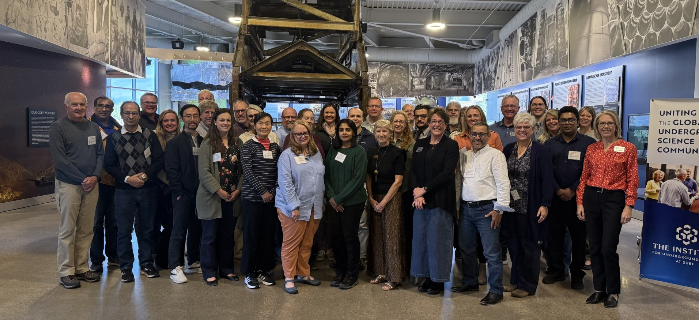
Session Purpose
How do we keep this momentum going?
What does that look like?
When does it happen?
Start with virtual discussion group meetings.

Slide 3
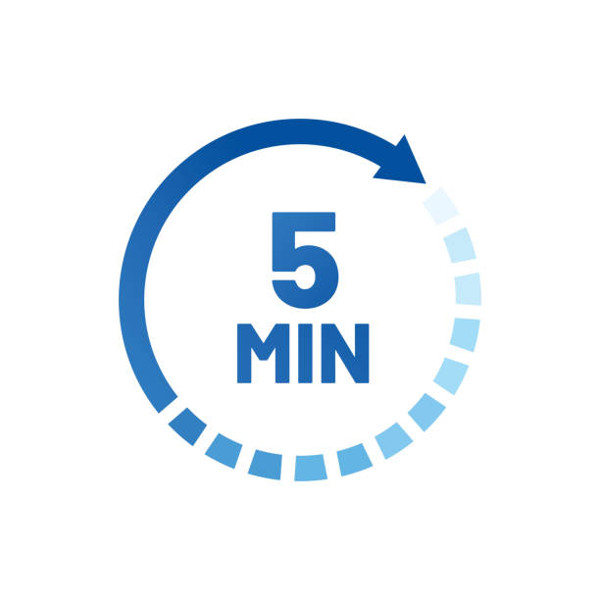
Building the Virtual Sessions
What would make virtual sessions valuable for you and your team?
What types of discussions, updates, or topics would you like to see in those sessions?
How long and structured should these be to fit busy academic calendars?
How can we make these sessions feel like collaboration – not just reporting?
Who from your institution should attend?

Slide 4
Explore SURF and The Institute Support
How can SURF and The Institute best support your institution’s follow-through on ideas from this workshop?
What tools or platforms would help us stay connected and visible to one another?
How can we highlight progress together between now and next year’s workshop?

Slide 5

Close with Commitment
Which one or two ideas from the last session should be prioritized first?
What will success look like by the time we meet again?
Discuss possible dates and times for the first virtual session

