Slide 1
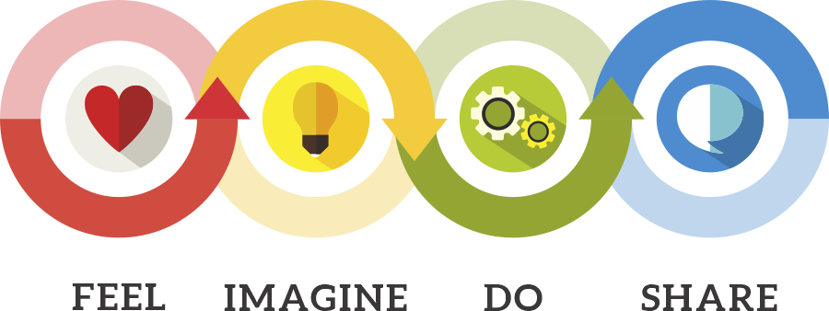
Networking & Working Towards Change

Slide 2

Switch: How to Change Things When Change is Hard

Slide 3
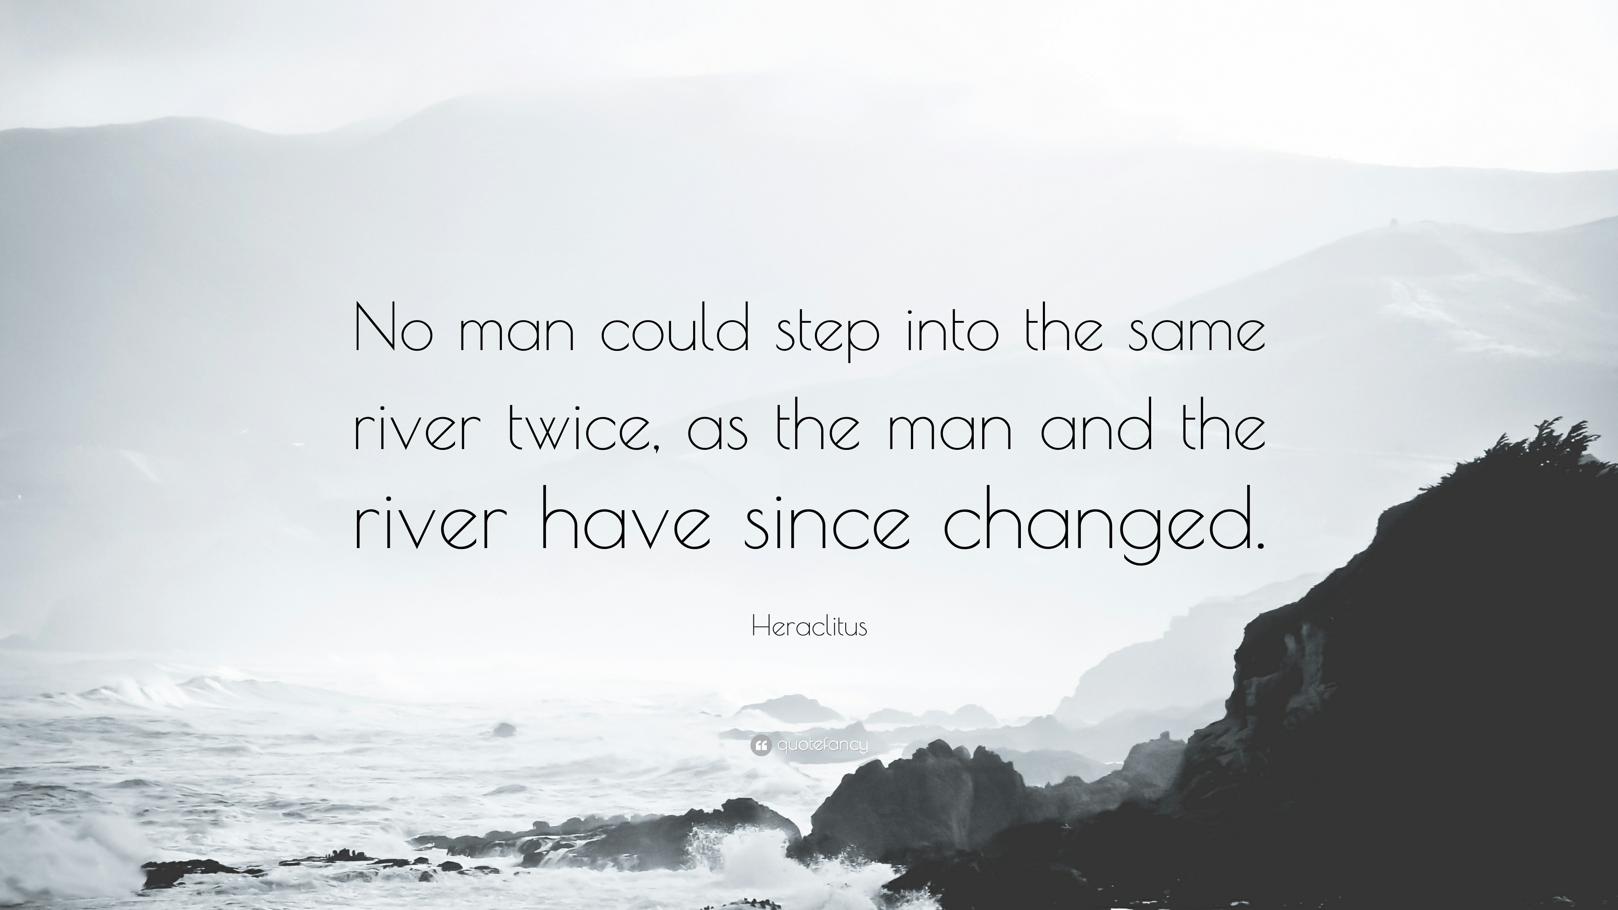

Slide 4

Notes:
https://heathbrothers.com/member-content/switch-16-minutes/

Slide 5
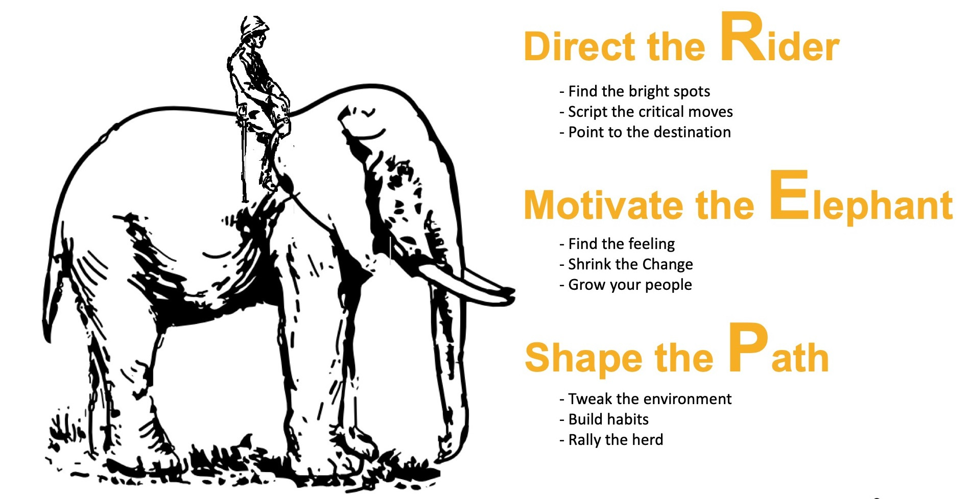

Slide 6

Notes:
https://www.forbes.com/sites/chuckswoboda/2020/08/03/why-thinking-outside-the-box-is-the-wrong-way-to-approach-innovation/

Slide 7
How can a rural, distributed state work smarter together?
Areas of Focus:
Advocacy Strategies for a Robust, Supported Research Ecosystem in SD
Audiences
Learner opportunities K – Post Doc and beyond
Shared Resources
Leveraging Technology

