Slide 1
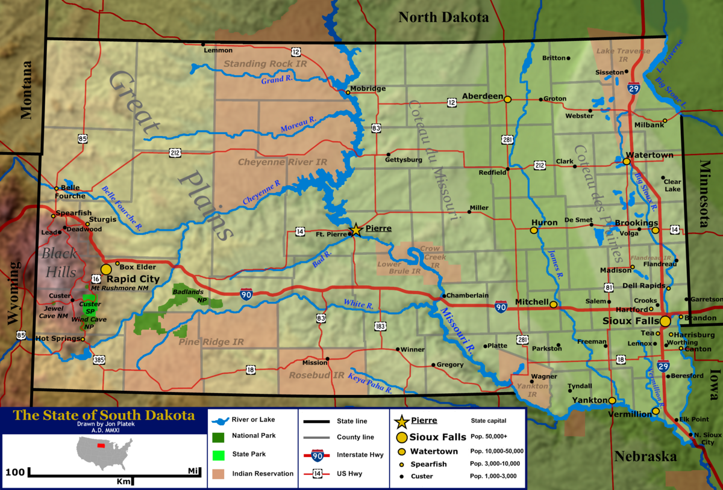
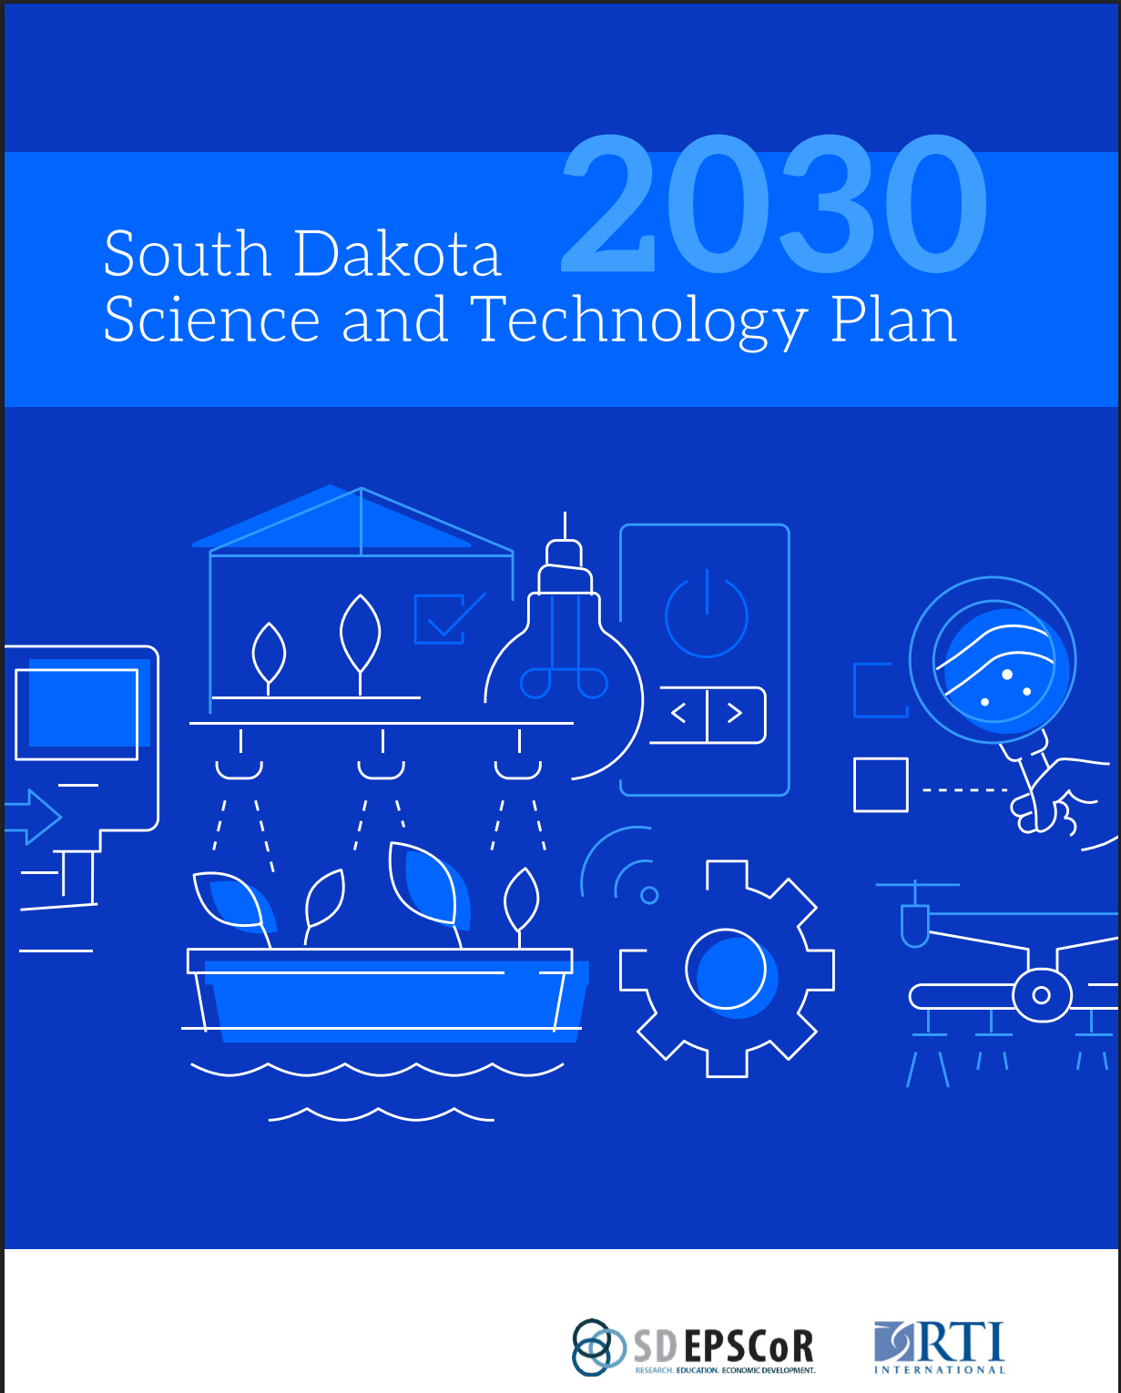


What’s in the Box?
SD ranks 50th in Academic R&D
SD ranks 47th in Business R&D

Slide 2
What’s in the Box?
SD has 28 Post-secondary Institutions – Public, Private, and Tribal
Post-secondary Institutions are incredibly collaborative
Approximately 25% of SD BOR awarded degrees are in STEM
More than 150,000 K-12 students
Investments in STEM research
Just over 16% of the SD workforce is in STEM, including the Skilled Technical Workforce (STW)
Growing employment in STEM-related occupations
SD ranks 50th in Academic R&D
SD ranks 47th in Business R&D

