Slide 1

Quantum Partnership Workshop
Hosted by:
The Institute for Underground Science at SURF
and Great Plains Network

Slide 2



Welcome
Introductions + Updates
SURF Overview
Notes:
Who’s attending for the 1st time?
Who has attended the bi-monthly virtual quantum discussion group?
(if not, we’ll make sure you are added to the reminders that go out, great way to stay in the loop)

Slide 3
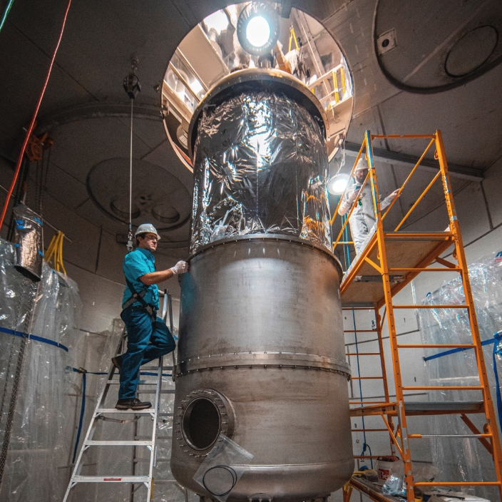
Workshop Schedule:
Monday:
Introductions
SURF Overview
Keynote Speaker
Partnering with IBM
Ohio Quantum Project
Reception
Tuesday:
Underground Tour
Building a Regional Quantum Network
Wednesday:
Reflect on Day 1 & 2
Teaching Quantum Technologies
Working Team Projects
Recap and What’s Next
Lunch after workshop - Optional
Notes:
Underground tour: if not going (~3 people); free morning, meet at VC at 12pm and we’ll shuttle up to SURF for lunch and afternoon sessions

Slide 4


Slide 5
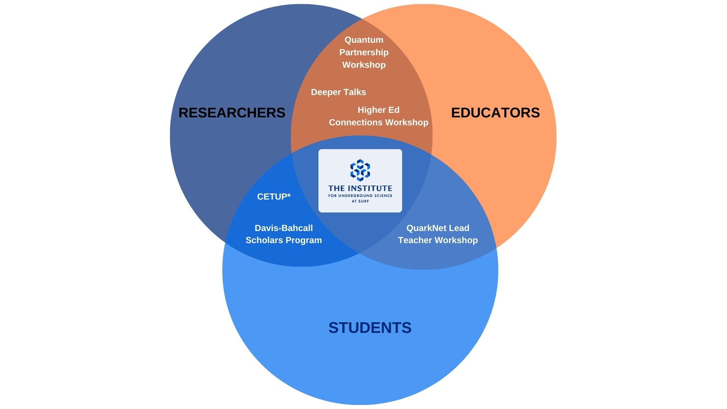

Slide 6

https://vimeo.com/1039112894/39848ada90?share=copy

Slide 7
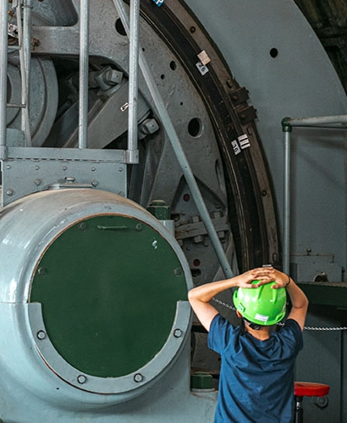
Introductions
Name and Affiliation
Update on Projects and Initiatives
Notes:
Full name and affiliation

Slide 8



CONNECT WITH SURF
@sanfordlab
SUBSCRIBE TO OUR NEWSLETTER

Slide 9



