Slide 1
Status and Physics Reach of DUNE,
A Next Gen ν Experiment
Particle Physics and Cosmology 2025
Dead Wood, South Dakota
June 22 - 28, 2025
Jaehoon Yu
Department of Physics
University of Texas at Arlington
  Outline
Introduction
Status of DUNE, a next gen. ν experiment
Potential Physics Reach
Timeline of DUNE
Conclusions

Slide 2
Over the Past Quarter Century in HEP
Observation of The Top Quark
Higgs-like Scalar Boson Discovery
Neutrino oscillation discovery
Yeah, I know, I am missing the two recent astrophysical discoveries…

Slide 3
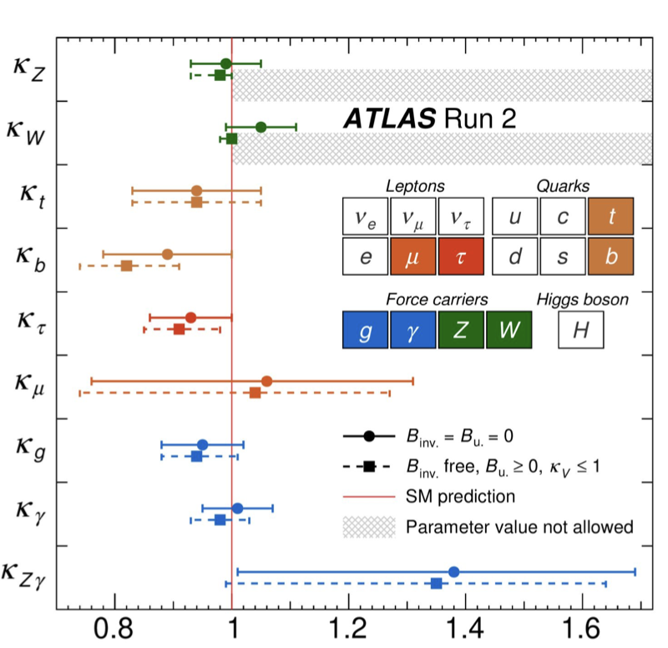
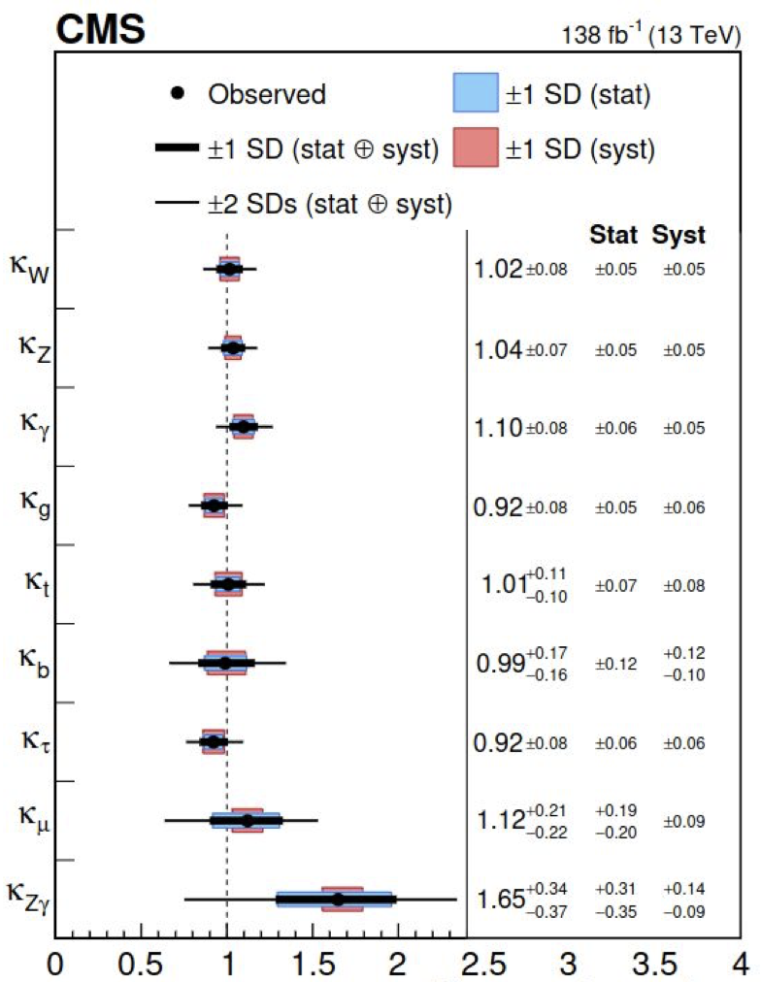
LHC Exp. Combined Higgs Coupling
ATLAS
Nature 607 (2022) 52
Nature 607 (2022) 60
SM
SM

Slide 4
In the Past Quarter Century in HEP
Observation of The Top Quark
Higgs-like Scalar Boson Discovery
Neutrino oscillation discovery

Slide 5
ν Experiment Physics Motivation – I
ν flavor oscillation is a firmly established phenomena
  Happens because flavor and mass eigenstates differ (probability ⍺ θ_{ij}, Δm² & L/E_{ν})
The neutrino sector in SM (m_{ν}=0) needs to reflect m_{ν}!
  Precision measurements of the oscillation parameters
    Mixing angles and mass hierarchy
  Studying and potentially discovering the CPV in ν sector and precisely measuring the CP phase
    Do neutrinos and anti-neutrinos oscillate the same way?
  Can be done thru the 2 experimental parameters
    The baseline distance L and the neutrino energy E_{ν}

Slide 6
ν Experiment Physics Motivation – II
These could lead to a new symmetry
The question of the grand unification, its energy scale & nucleon decay
Understanding particles of astrophysical origin
  Supernova ν, blackhole formation, relic neutrinos, dark matter, etc
Exploration of BSM physics in low mass regime
These require high statistics samples
  Large mass, large volume and highly capable (near and far) detectors
    ND essential for controlling systematic uncertainties
  High intensity neutrino beam facility with a long baseline

Slide 7
Key Elements for Next Gen. ν Exp.
High statistics samples w/ an excellent systematic uncertainty control essential for precision neutrino property measurements
To accomplish the necessary precision measurements
  For high statistics samples
    High flux ν beams ➔ High power proton beams essential to produce large number of secondary mesons for ν production
    Large ν interaction target mass ➔ large mass far detectors (FD)
  For excellent systematic uncertainty control
    Powerful near detector (ND) system w/ the same tech. as FD
    Excellent understanding of ν-N interactions

Slide 8
Current Understanding of ν Oscillation
θ₂₃ & ΔM²₂₃ measurements
  Atm. ν: SK, IceCube, Km³NET, etc
  Long Baseline: K2K, MINOS, Opera, NOvA, etc
θ₁₂ & ΔM²₁₂ measurements
  Solar ν: SNO, SK, Borexino, etc
  Reactor: KamLAND
θ₁₃ measurements
  Long Baseline: MINOS, T2K, NOvA, etc
  Reactor: Daya Bay, RENO, Double Chooz
NH
I H
Apologies for any missing

Slide 9
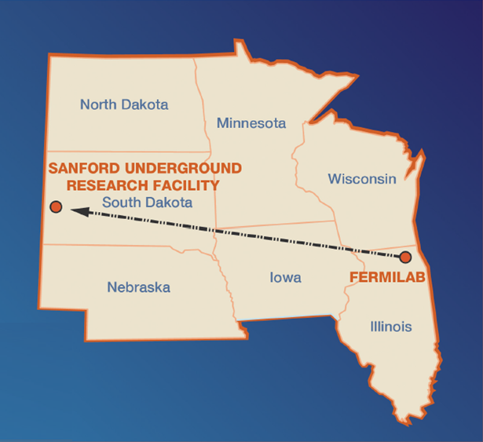
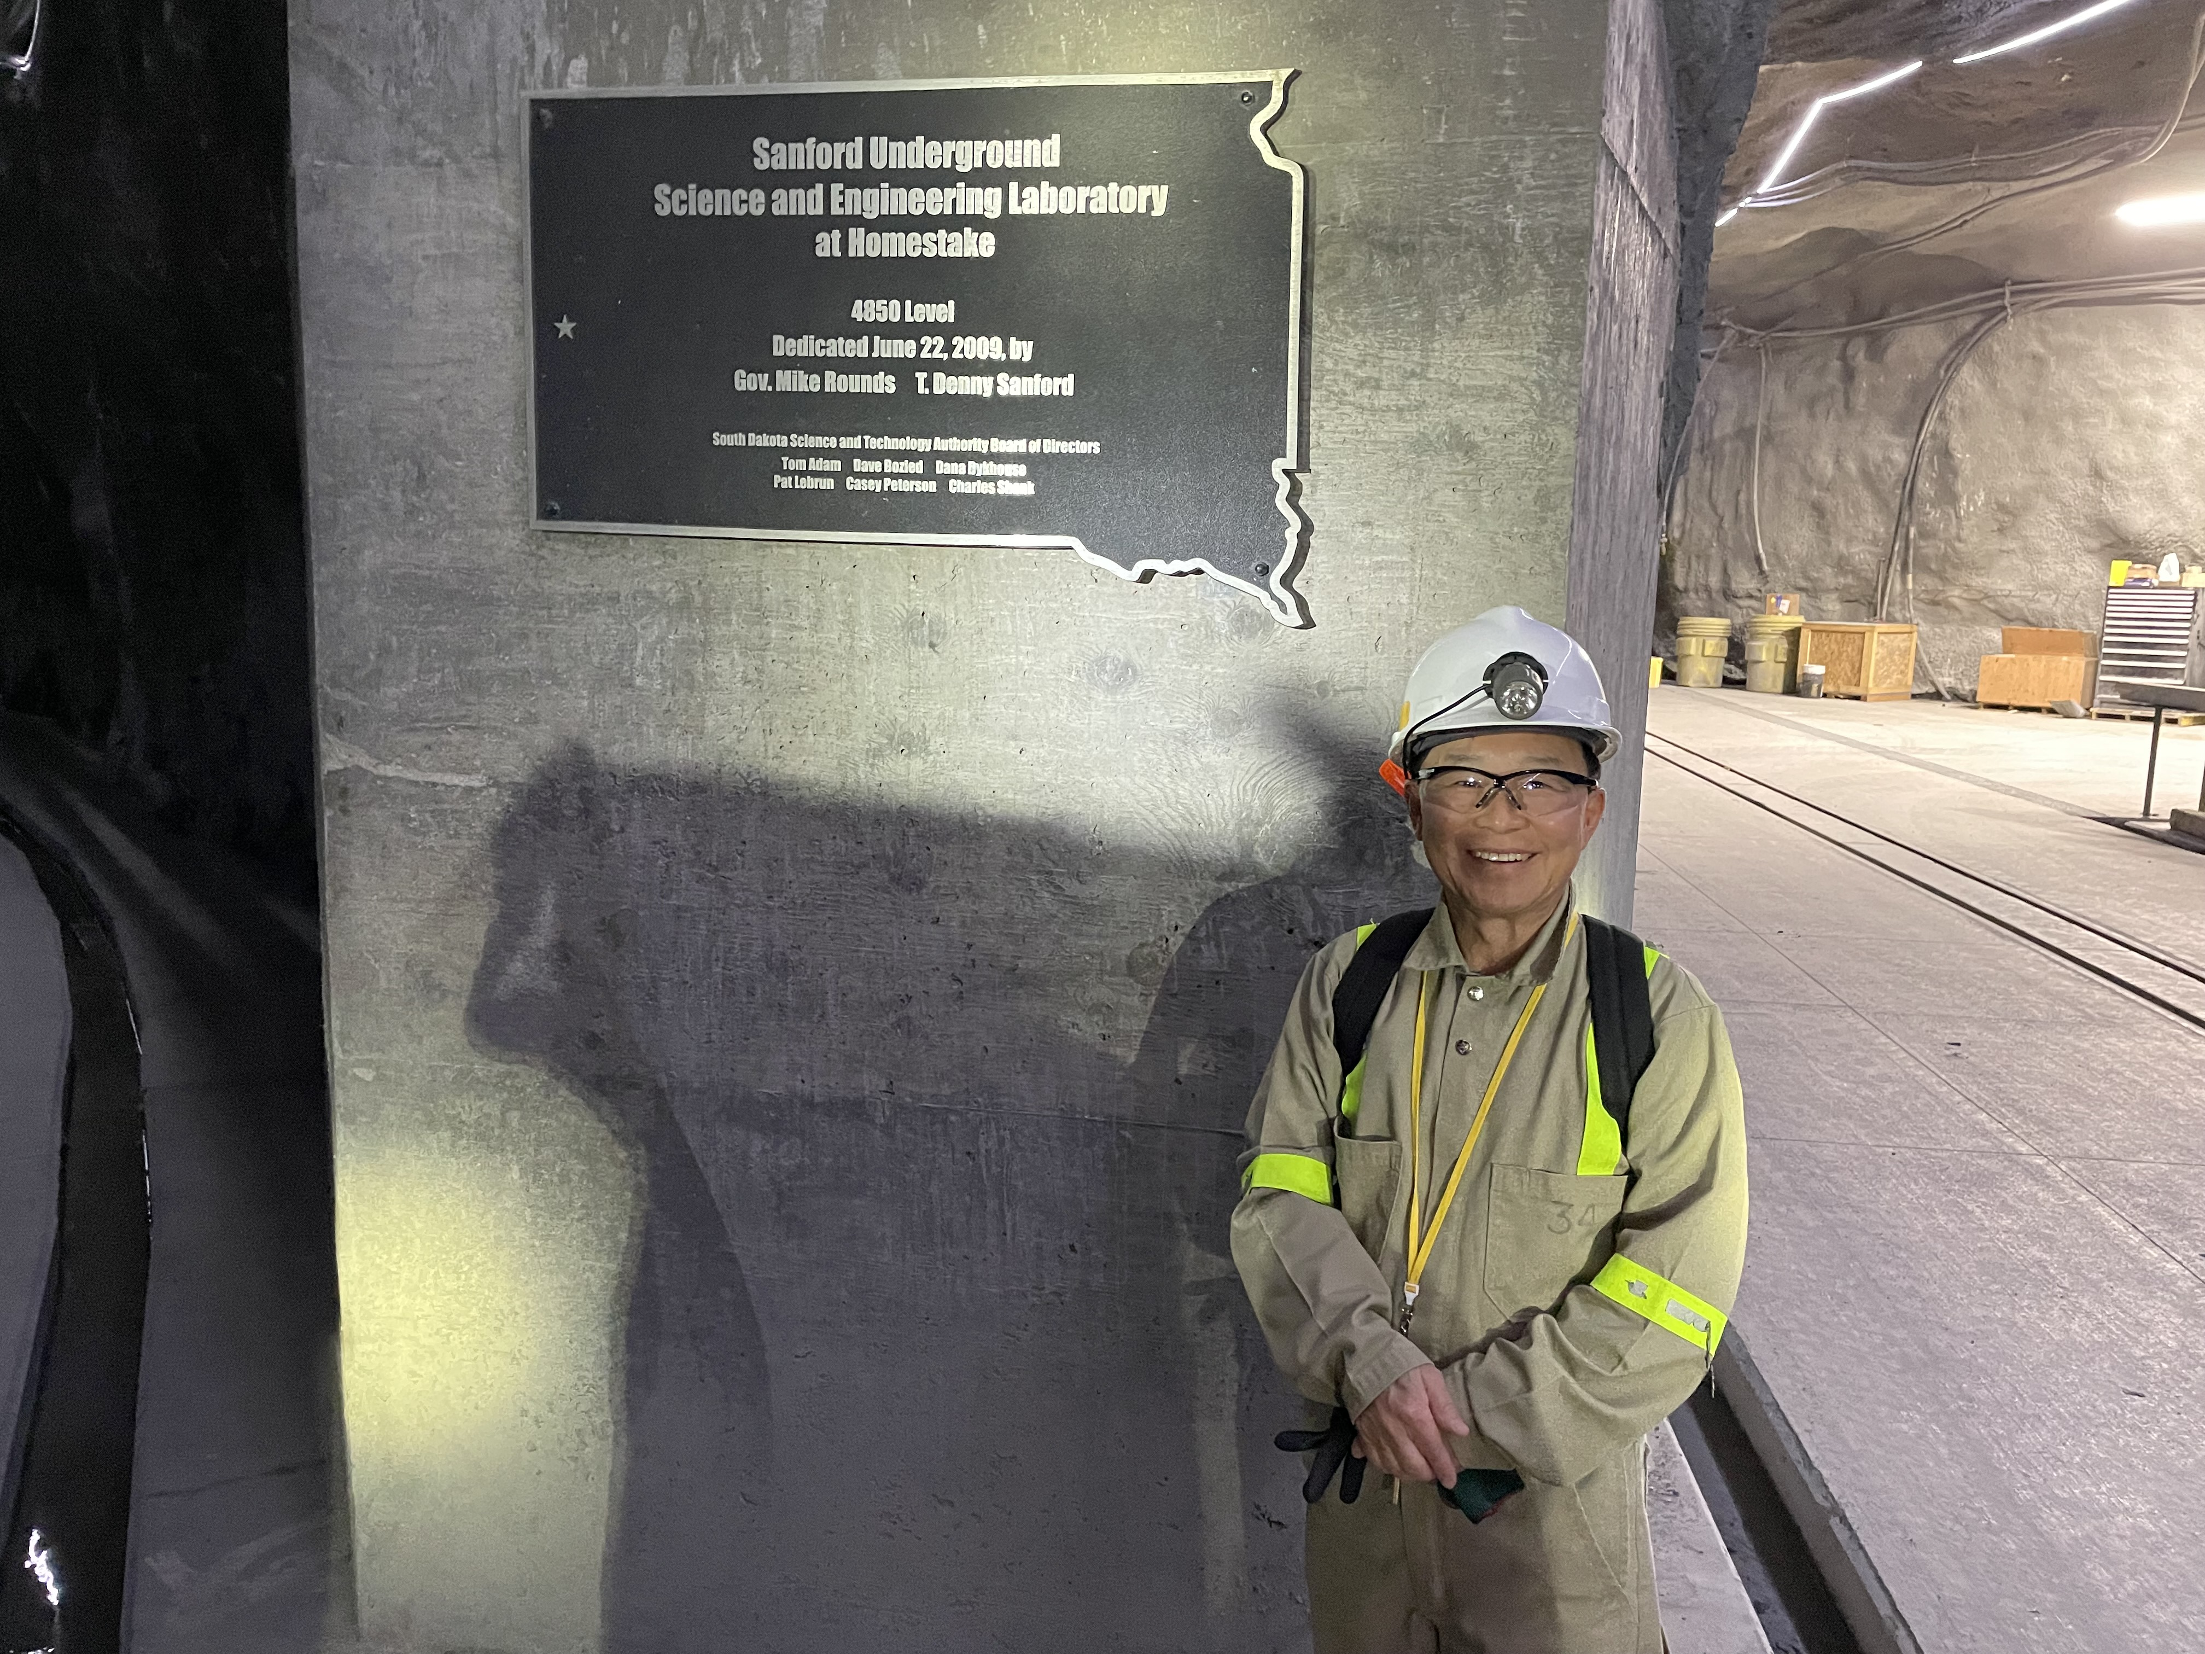

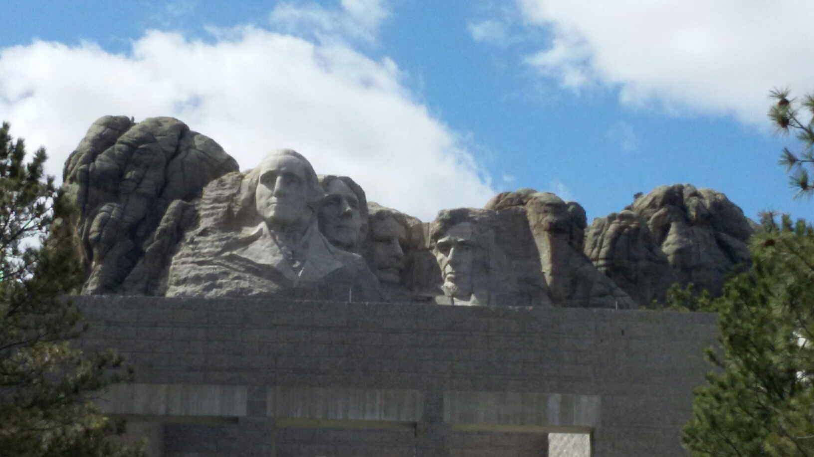
The Next Big Thing - DUNE Experiment
Stands for Deep Under Ground Neutrino Experiment
$3.5B US flagship long baseline (1300km) ν experiment
  1500m underground in an old South Dakota gold mine
June 2024
Yes, you are right, again!
That Sturgis is right next door!
Yes, you are right! Mount Rushmore!!
2002 Nobel Winning solar ν detection by Ray Davis
Many DM experiments ongoing
DUNE area excavation completed Jan. 25, 2024
Cavern outfitting to finish Dec. 2025

Slide 10

The Next Big Thing - DUNE Experiment
Stands for Deep Underground Neutrino Experiment
$3.5B US flagship long baseline (1300km) ν experiment
  1500m underground in an old South Dakota gold mine
Has a very high intensity proton beams (1.2MW → 2.4MW!)
  Result in a large number of ν for precision measurements
  Great potential for BSM physics, including Dark Matter
Large mass (~70kt! total) LArTPC Far Detectors at SURF
  Far detector construction to begin early 2026 for 2029 completion of two far detectors
Powerful near detector complex to control systematics
Was born March 2015 and grown over 1400 collaborators from >209 institutes in >36 countries + CERN

Slide 11
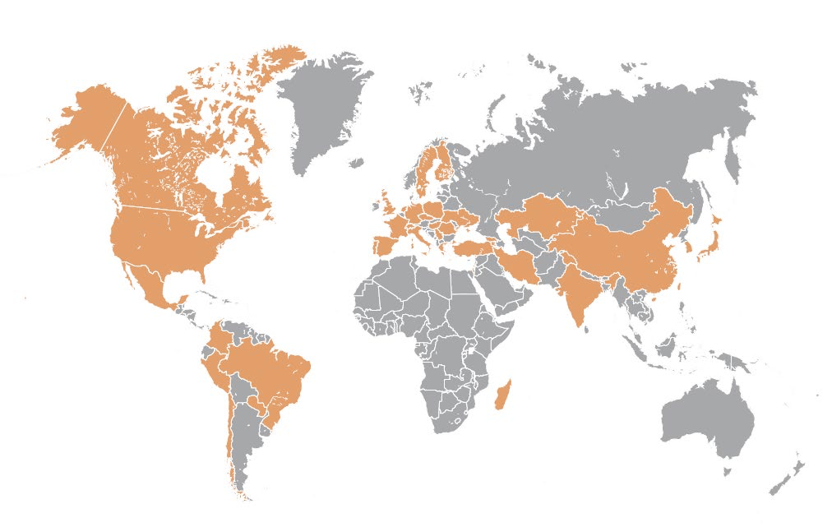
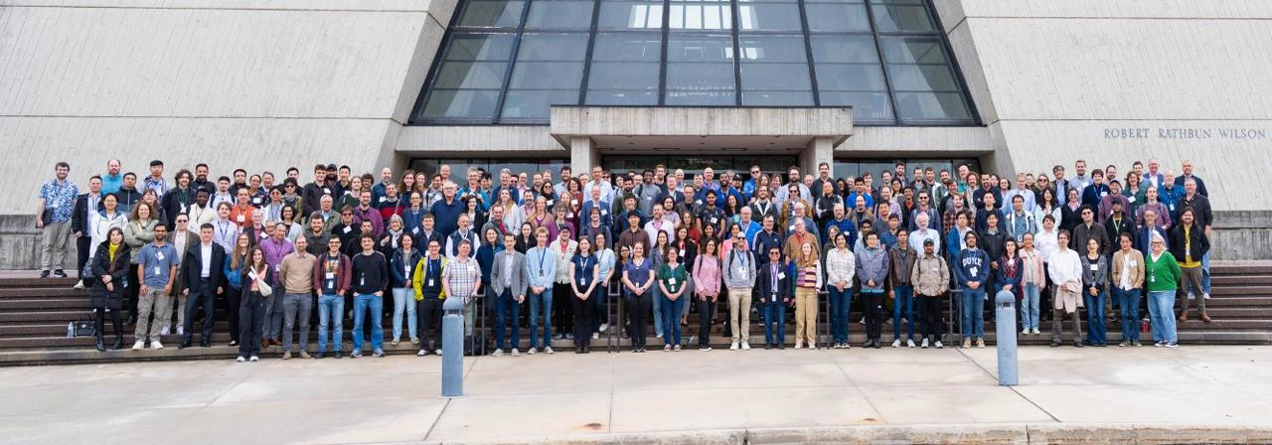
The Map of the DUNE Experiment
>1400 collaborators
>209 institutions
>36 countries + CERN
https://www.dunescience.org/about-the-collaboration/
CM@FNAL/May 2025

Slide 12
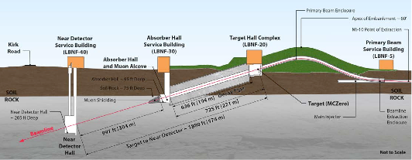
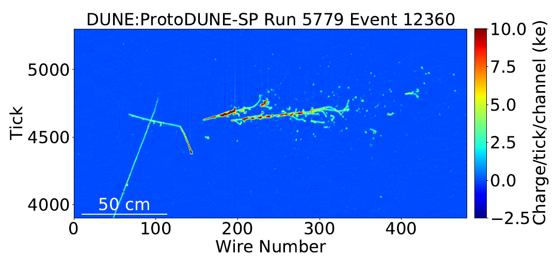
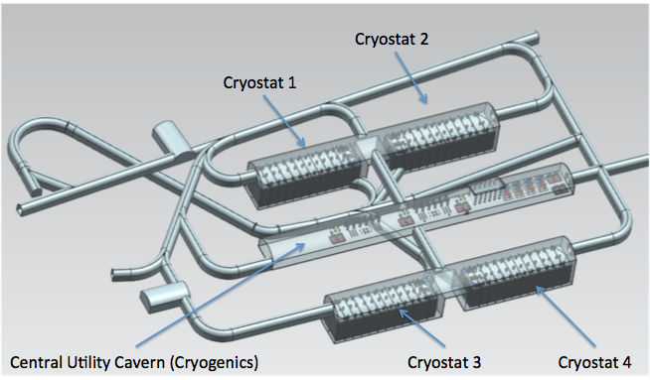
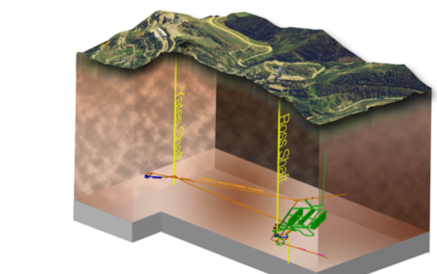
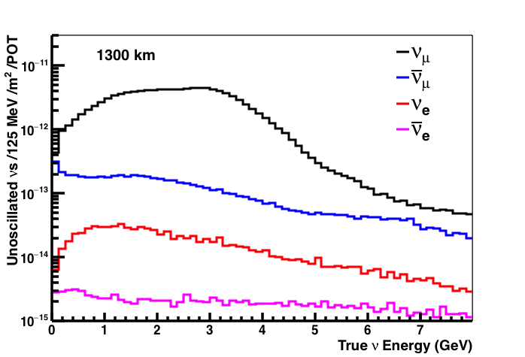
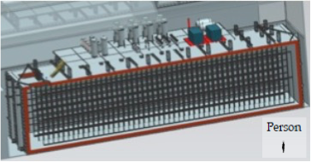
Anatomy of DUNE
Broadband ν from 60 – 120GeV p
LBNF ν Beam
P_{Beam} :1.2MW →2.4MW
Tgt
1300km (800 miles)
π⁺ n→π⁰ p
570m
ND
Long Baseline
3 GeV π⁺
π⁰ →γγ
4 caverns w/ active V_{A}~ 10kt LAr each
cosmic muon
stopping proton
LBNF Far Detector Site, SURF
@1500m Underground
M_{A}~ 17kt LAr
18m
18m
66m

Slide 13
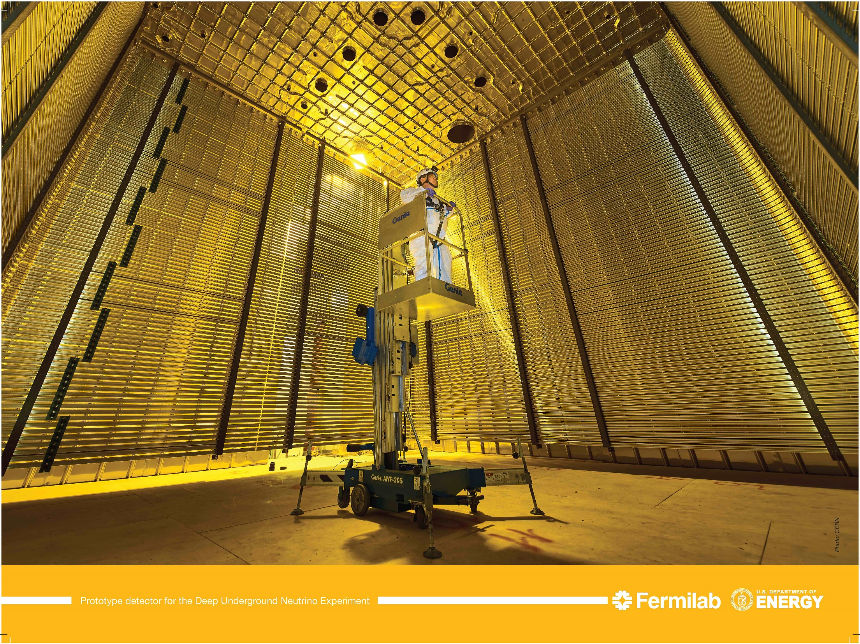
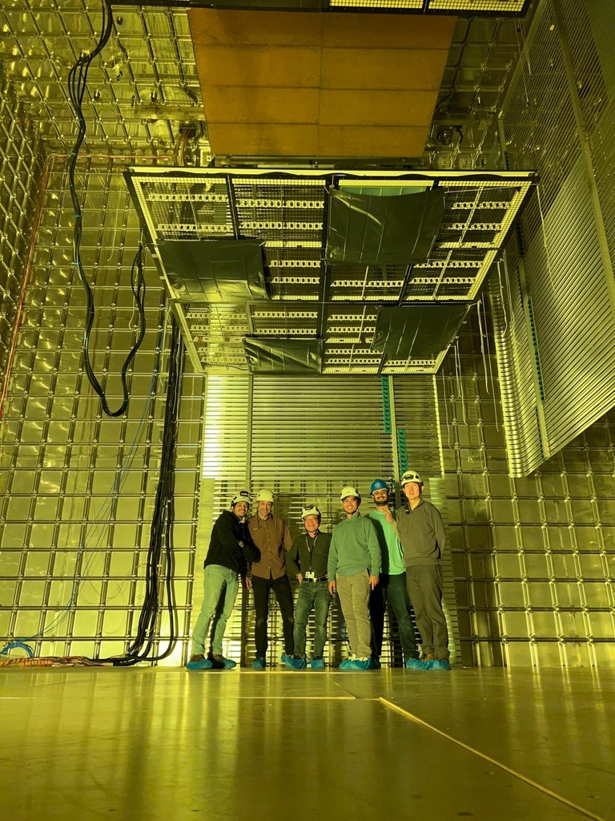
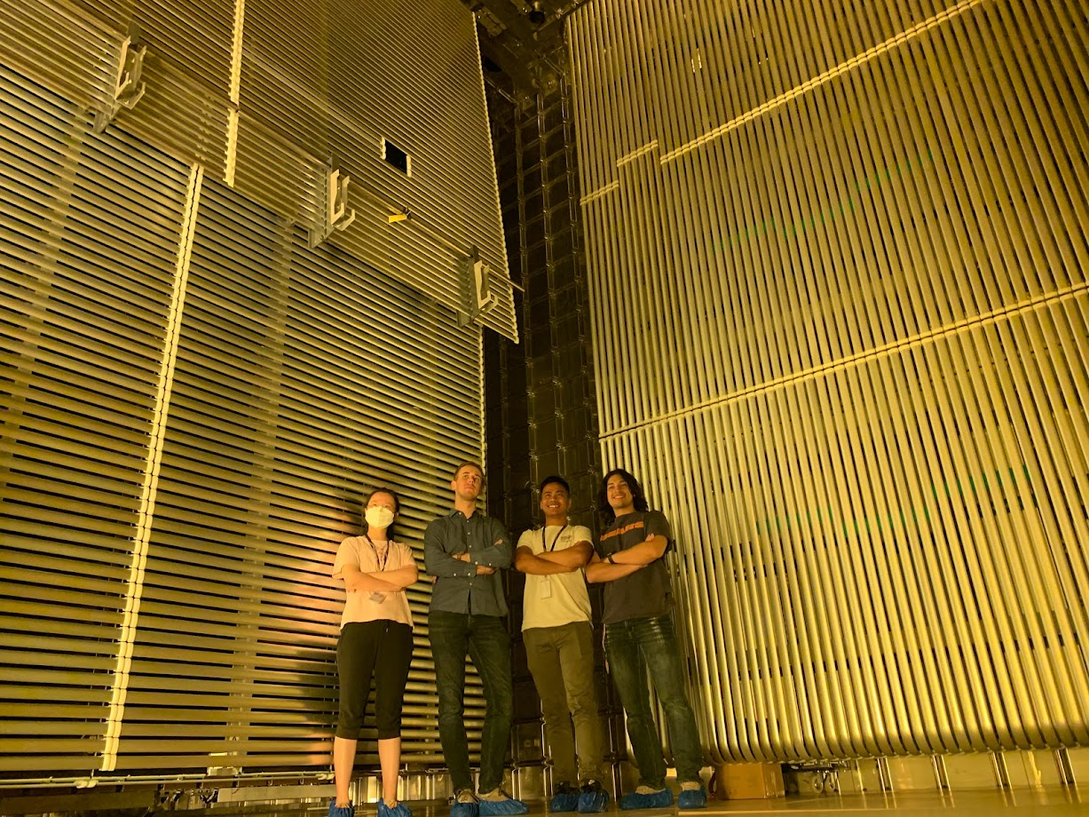
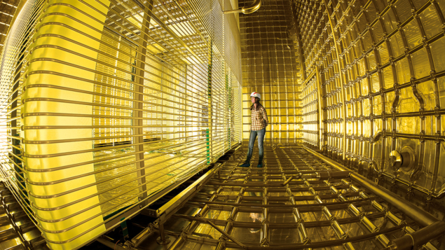
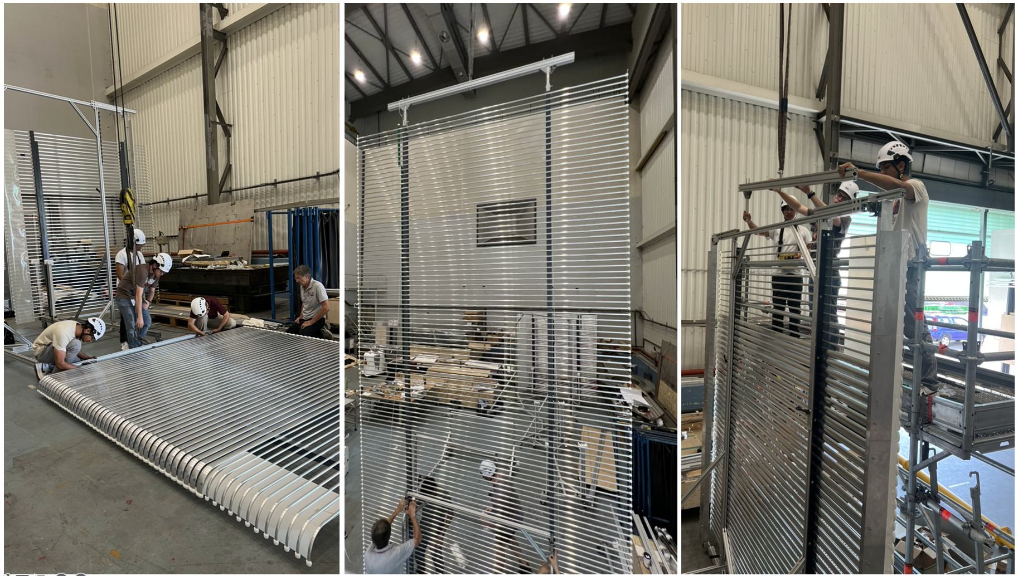
ProtoDUNE HD @ CERN, June 2022
DUNE Prototypes @ CERN ν-Platform
ProtoDUNE VD @ CERN, March 2023
PD-HD beam data being analyzed at present
April 2018
VD Mechanical Mock-up Construction Testing at CERN, Summer 2024
6m
LAr has been x-fered from PD-HD to PD-VD late 2024 and to be taking beam data in 2025
6m
6m
V_{PD}=1/30 V_{FD}

Slide 14
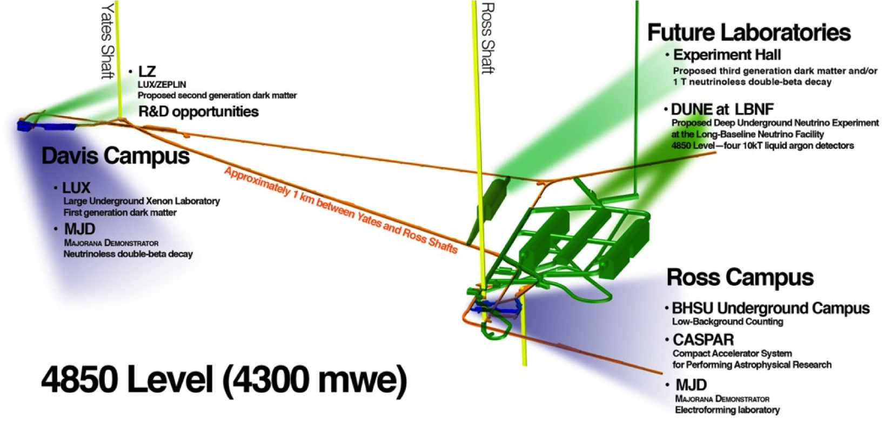
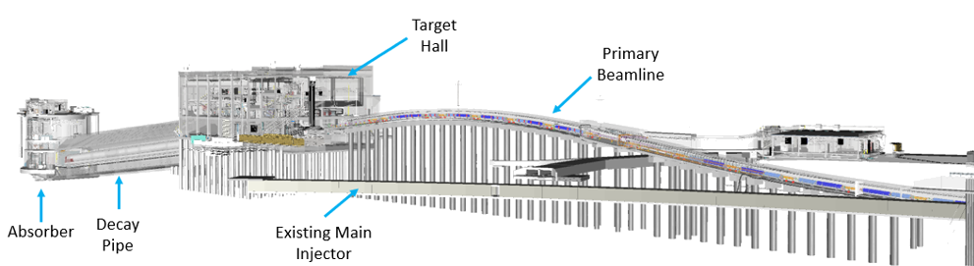
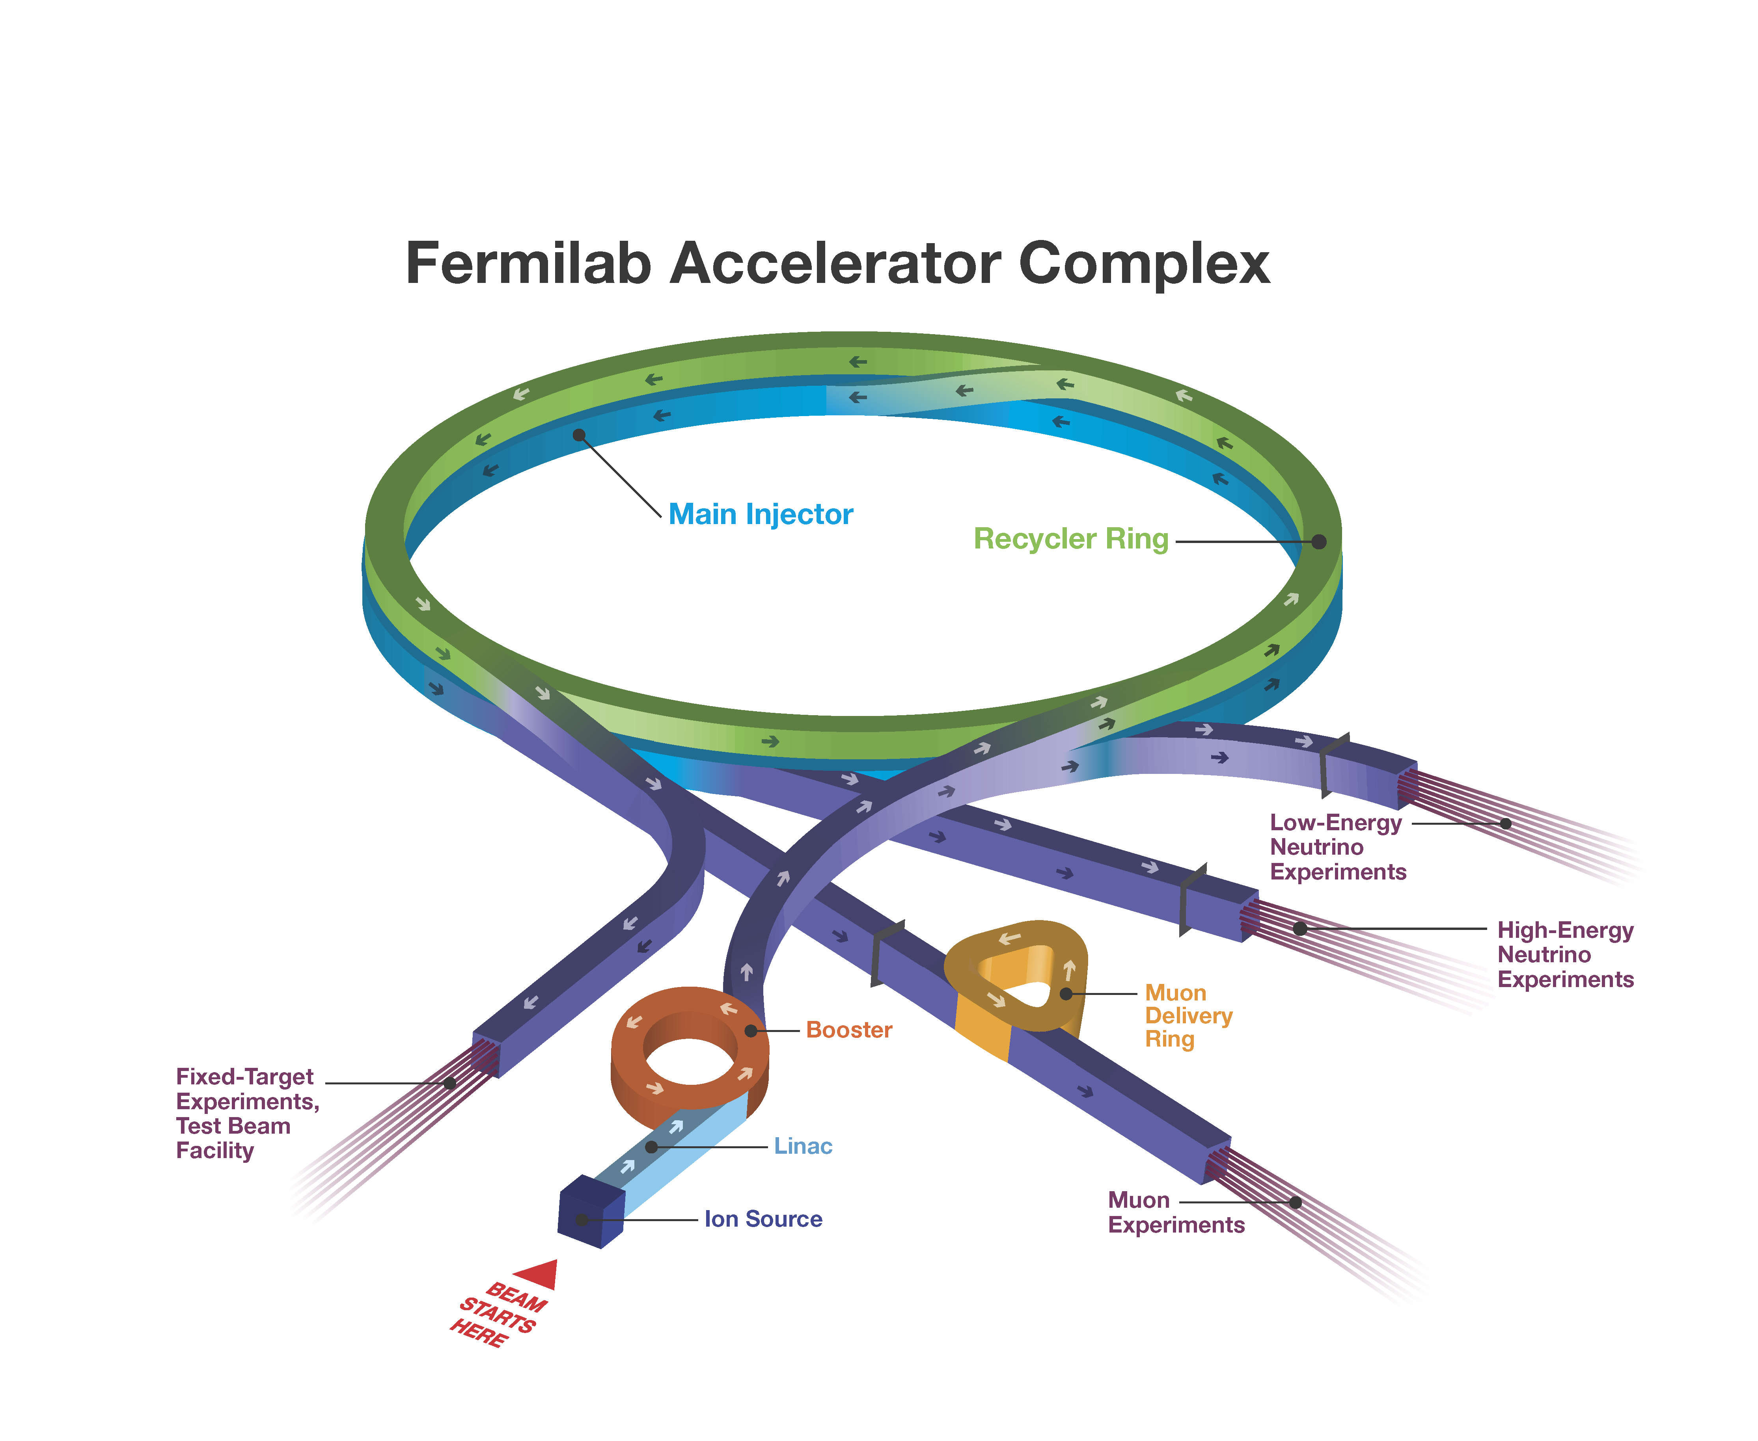
Long Baseline Neutrino Facility (LBNF)
LBNF Consists of 3 elements
  FD site: Sanford Underground Research Facility (SURF), SD
  ND site at Fermilab
  Neutrino Beam Line at Fermilab
    E_{p}=60 – 120 GeV
    1.2MW upgradable to 2.4MW
    Horn focused broadband beams optimized for CPV studies ➔ access to two oscillation maxima
800MeV PIP-II LINAC (I_{P}=2mA) under construction
To complete by 2029

Slide 15
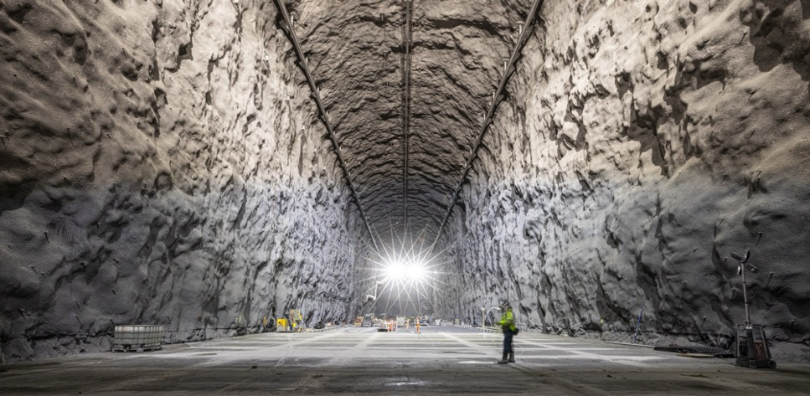
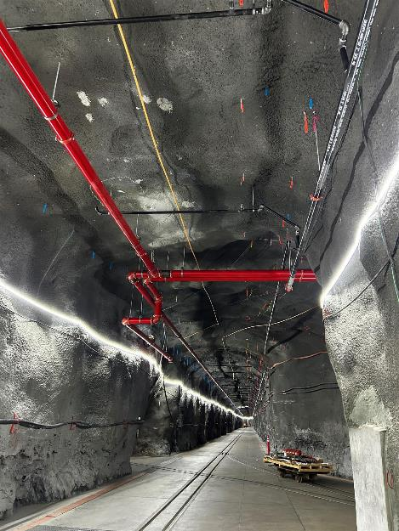
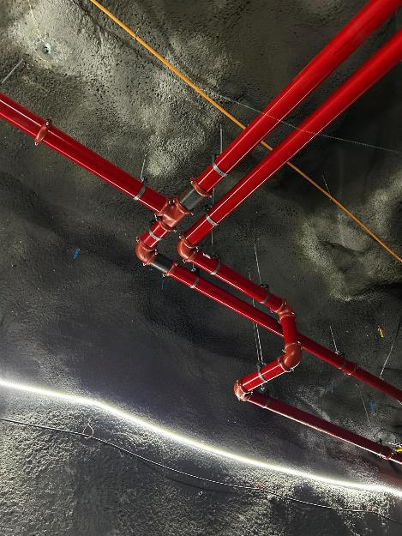
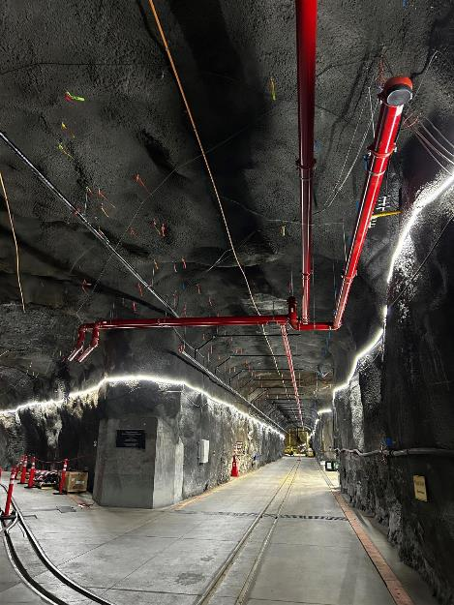
LBNF FD Cavern Construction & Outfitting
Cavern Construction completed Jan. 2024
Outfitting to complete end of 2025
M. Headley

Slide 16
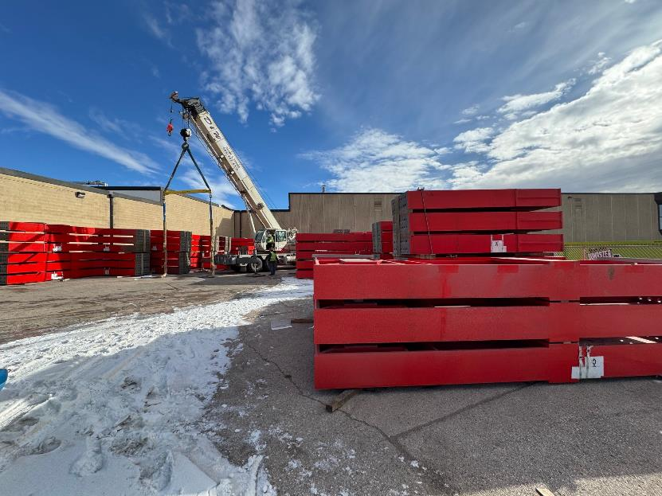
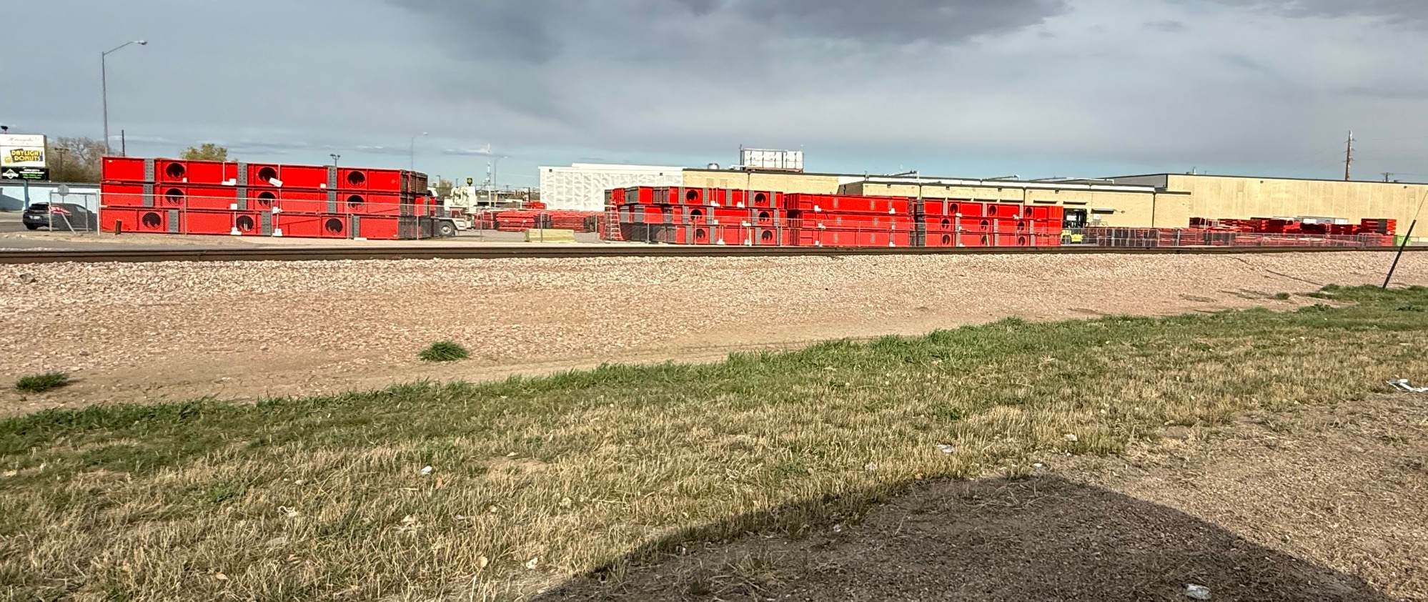
Cryostat Steel for 2 FD in Rapid City
Cryostat construction for VD FD to begin in Early 2026
M. Headley

Slide 17
DUNE Phased Approach
The latest P5 report recommends phased approach to DUNE, depending on funding scenario favorability
Phase I (Baseline)
  Two 17kt LArTPC FD (1 HD + 1VD) – Cryostats supported by CERN
  One 150t LArTPC Near Detector + 1 TMS on prism system for off-axis ν flux measurements
  One on-axis stationary, physics capable beam monitor
  ν beam w/ 1.2MW → 2MW ACE-MIRT (accelerator timing)
Phase II
  3rd 17kt LArTPC FD (vertical drift)
  2.4MW ν beam upgrade
  More capable ND (MCND), potentially the GArTPC
R&D on the 4th 17kt LArTPC FD (VD)

Slide 18
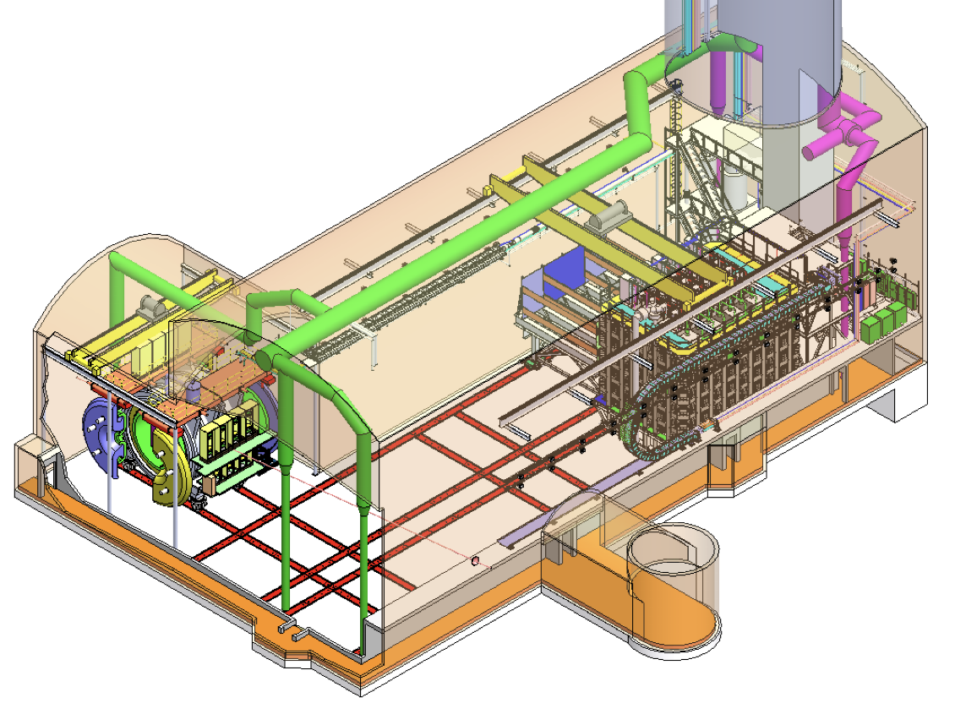
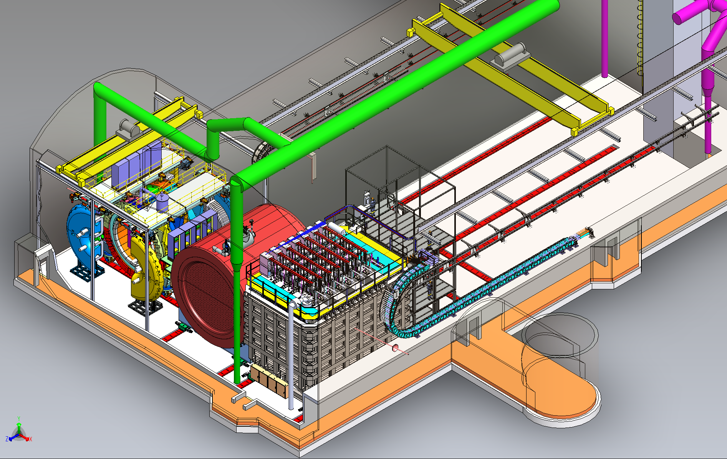
DUNE Near Detector Complex
Phase – I
Phase – II
DUNE-PRISM
TMS
LAr TPC
SAND
GAr
28.5m
SAND
28.5m
LAr TPC
ν beam
ν beam
LAr TPC: The same technology as the FD ➔ reduce systematics from different nuclear effects than FD; ν-Ar interactions (M_{A}=150t, V_{A}=105m³ ) ➔ 1x10⁸ ν_{μ} CC/year on-axis (~1Hz)
TMS: Spectrometer to provide momenta of the μ from ν-LAr interactions in NDLAr
DUNE-PRISM: Off-axis ν spectrum for systematics; takes ND-LAr and TMS (ND-Gar) from on axis up to 28.5m off-axis (~53mrad or 3º)
SAND(System for On-Axis neutrino Detection): Monitors on-axis ν beam flux to the FD; Consists of a straw tube tracker + ECAL equipped with a 0.6T magnet
MCND: Magnetized (0.5T) large volume HPGAr TPC (10atm) w/ ECAL: ν-Ar events with low-threshold tracking; p_{μ} measurements (M_{A}=1t, V_{A}=108m³ ) ➔ 1x10⁶ ν_{μ} CC/year on-axis

Slide 19
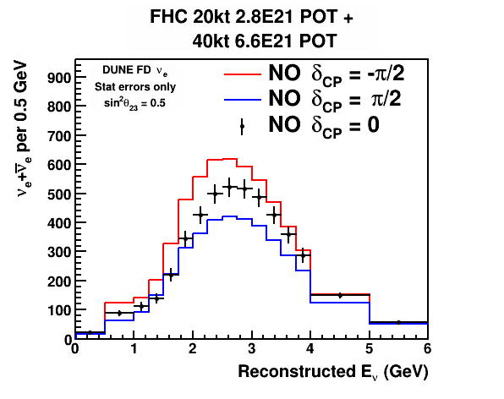
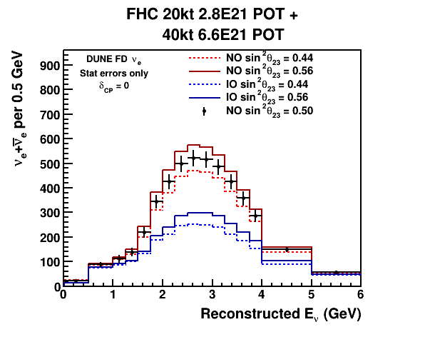

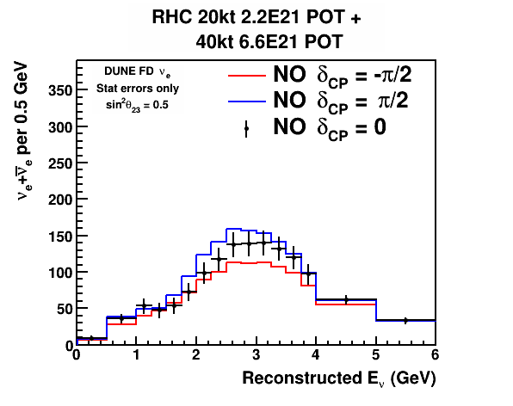
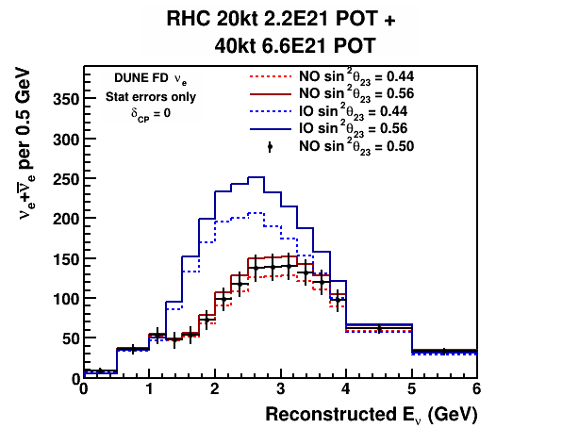
DUNE CPV & MO w/ ν_{e} Appearance
12 years
12 years
ν_{e}
ν
ν mode
ν_{e}
δ_{CP}=+90
12 years
12 years
ν_{e}
ν
ν_{e}
ν mode
ν_{μ}
δ_{CP}=+90
Simultaneous fit could provide info on MO and θ₂₃

Slide 20
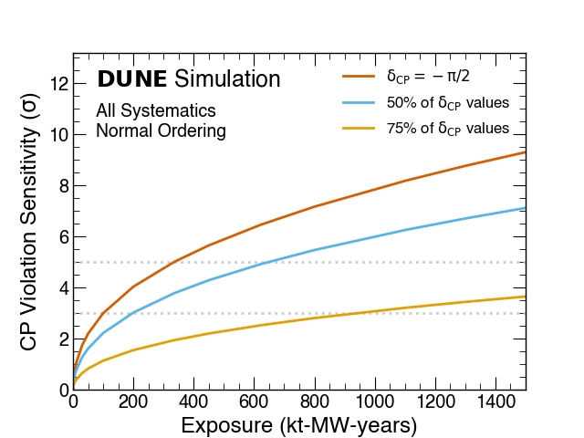
CPV Discovery Potential
DUNE
5σ
DUNE Conceptual Design Report (CDR) arXiv:1512.06148
5σ CPV discovery possible in about a decade of the start of operation!

Slide 21
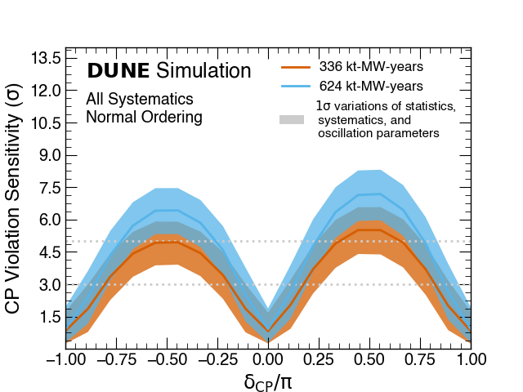
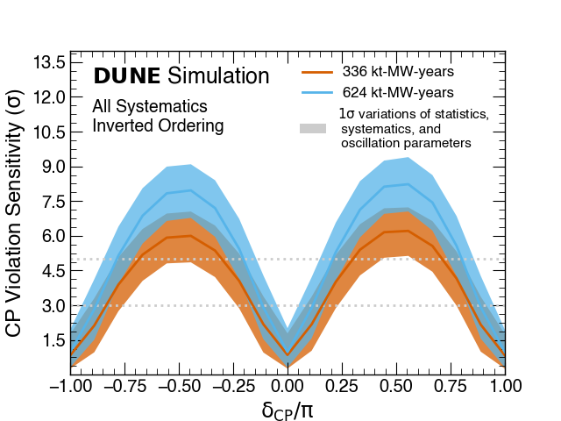
Physics Reach, δ_{CP} Determination
NO
IO
Δδ_{cp} <10º at δ_{cp} =0!
Band: variation of θ₂₃
Δδ_{CP} ~20º @ δ_{CP}=π/2 & <10º@ δ_{CP}= 0 in about a decade of operation

Slide 22
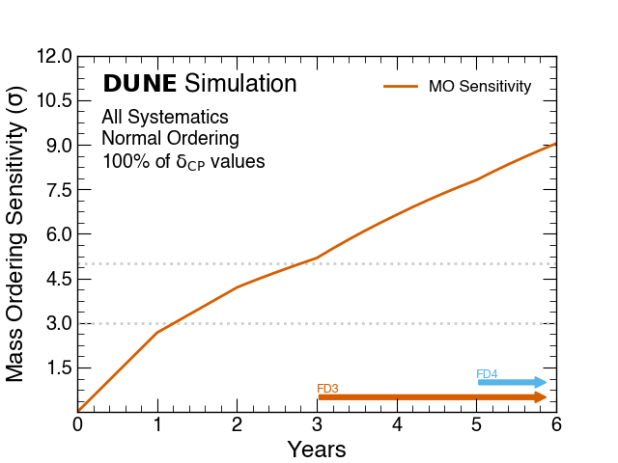
Physics Reach, Mass Hierarchy
5σ
DUNE: Eur. Phys. J. C 80, 978 (2020)
5σ MO determination possible in about half decade of operation!

Slide 23
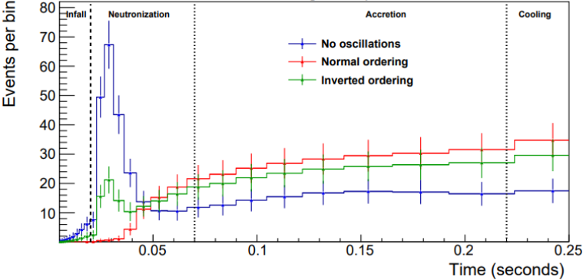
SNB Electron Neutrino Interactions
Eur. Phys. J. C 81, 423 (2021)
DUNE
In LArTPC, SNB signal dominated by ν_{e}
ν_{e} + ⁴⁰Ar → e⁻ + ⁴⁰K*
Observation of early time development yields sensitivity to neutrino mass ordering and details of SNB model.
Notes:
No collective effects

Slide 24
BSM@ν Signature Categories
BSM physics accessible in next gen. ν experiments
Direct Observation Signatures
  Requires high beam flux
  Sufficiently large mass for scattering signatures
  Sufficiently large volume for decay signatures
Inferred Observation Signatures from both beam and cosmogenic sources
  Leverage oscillatory behaviors
  Large target mass, large volume FD for interactions
What do we need to know?
  Signal flux and realistic behaviors in the detector
  Neutrino flux and their interactions in the detector as backgrounds
Close collaboration with theorists essential!

Slide 25
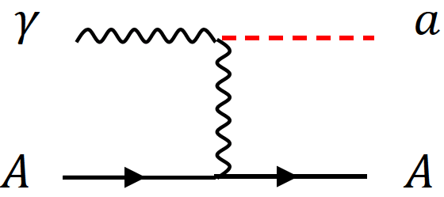
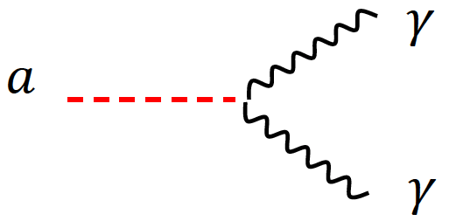
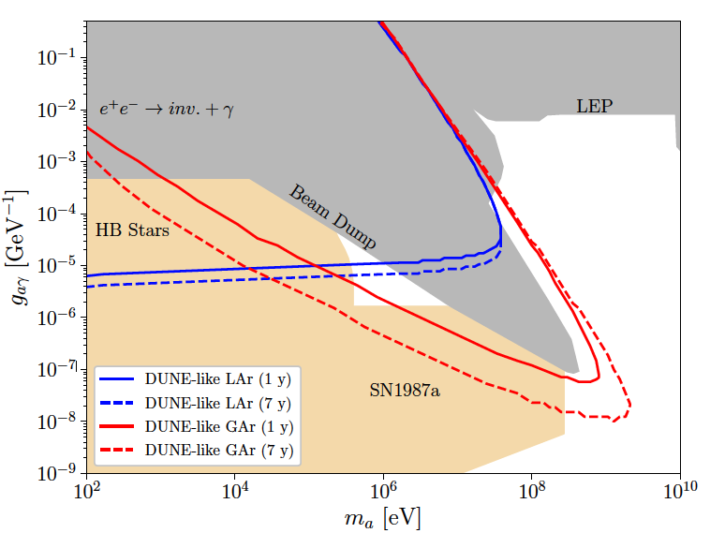
BSM Physics at a ν Experiment?
High beam power, large detector mass + highly capable detectors make BSM physics possible [See DUNE TDR publication, EPJC 81, 322(2021)]
  Direct Observation Signature, ND+Beam power
    Low mass Dark Matter (LDM)
    Heavy Neutral Leptons (See. M. Hosert’s talk)
    Axion-like Particles (ALP)
    Dark Photons (A’→e+e-)
    Milli-charge Particles (mCP)
    Neutrino Trident
  Brdar, Yu, et al., PRL126, 201801 (2021)
  Inferred observation, FD+beam power
    Sterile neutrino searches
    Non-standard Interactions, Non-Unitarity, CPT violation
    Large Extra Dimensions (LED)
    Boosted Dark Matter (BDM) / Inelastic Boosted Dark Matter (iBDM)
  Significant development in last decade

Slide 26
DUNE Timeline
July 2017: DUNE Far Site Groundbreaking
  Start of the DUNE FD cavern excavation
2018 – 2025: ProtoDUNE operations at CERN
Jan. 2024: SURF Cavern excavation complete
Dec. 2025 : Cavern outfitting to complete
2026 – 2027 : FD1 & FD2 cryostat construction
2026 – 2029: DUNE Phase I FD construction 2x10 kt Active volume FD’s – 1 HD and 1 VD
  Start of physics operation w/ FD
2029 – 2032: DUNE Phase I ND and 1.2MW beams ➔ Start ν beam data taking w/ 1.2MW p-beams
>2032 : DUNE Phase II + LBNF for 2.4MW beam

Slide 27
Conclusions!
The SM needs to reflect non-zero m_{ν}
Precise understanding of neutrino properties and discovery of CPV in lepton sector are essential
DUNE, a next generation LBN experiments with large ν target mass, high power beams and highly capable ND about to start construction in earnest
  Provide excellent opportunity to probe BSM physics, including that of dark sector
  Confident on the Phase I detector design
Expect data from DUNE, starting later in this decade

Slide 28
Questions to this crowd
Highly precise detector w/ high density and large active target mass to start operating in 2029
What are the physics topics we can explore with such facility beyond the standard neutrino physics?
What are possible dark matter and dark energy signatures DUNE can provide?
Anything more DUNE can help cosmology?
There is a DUNE working group focused on physics with cosmogenic sources, which can benefit greatly from help of theorists!

