Slide 1
CMS at the LHC: Past, Present, and Future
Alexei N. Safonov
Texas A&M University
(for the CMS Collaboration)

Slide 2
CMS and ATLAS

Slide 3
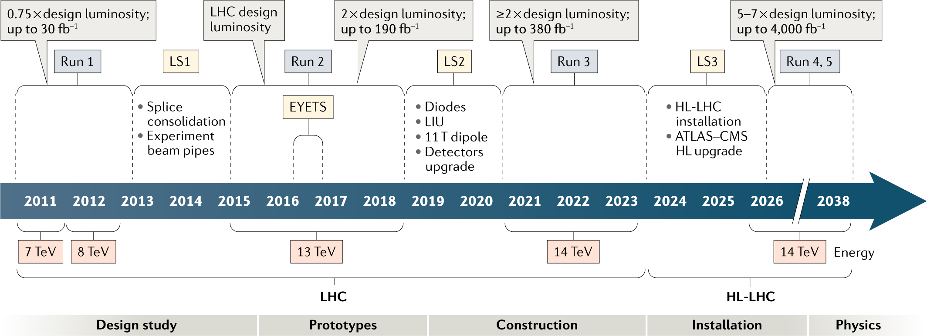
LHC: A Thirty Year Long Journey
Illustration: Brüning, O., Rossi, L. The High-Luminosity Large Hadron Collider. Nat Rev Phys 1, 241–243 (2019)
x

Slide 4
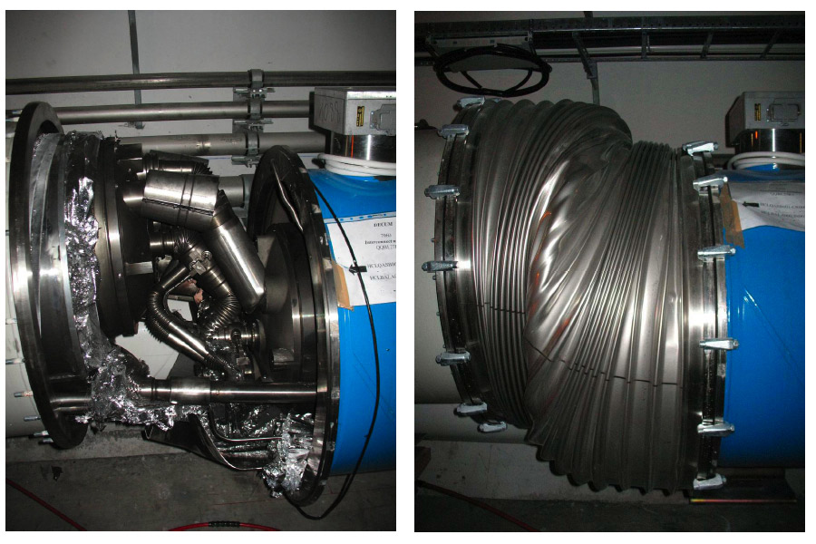
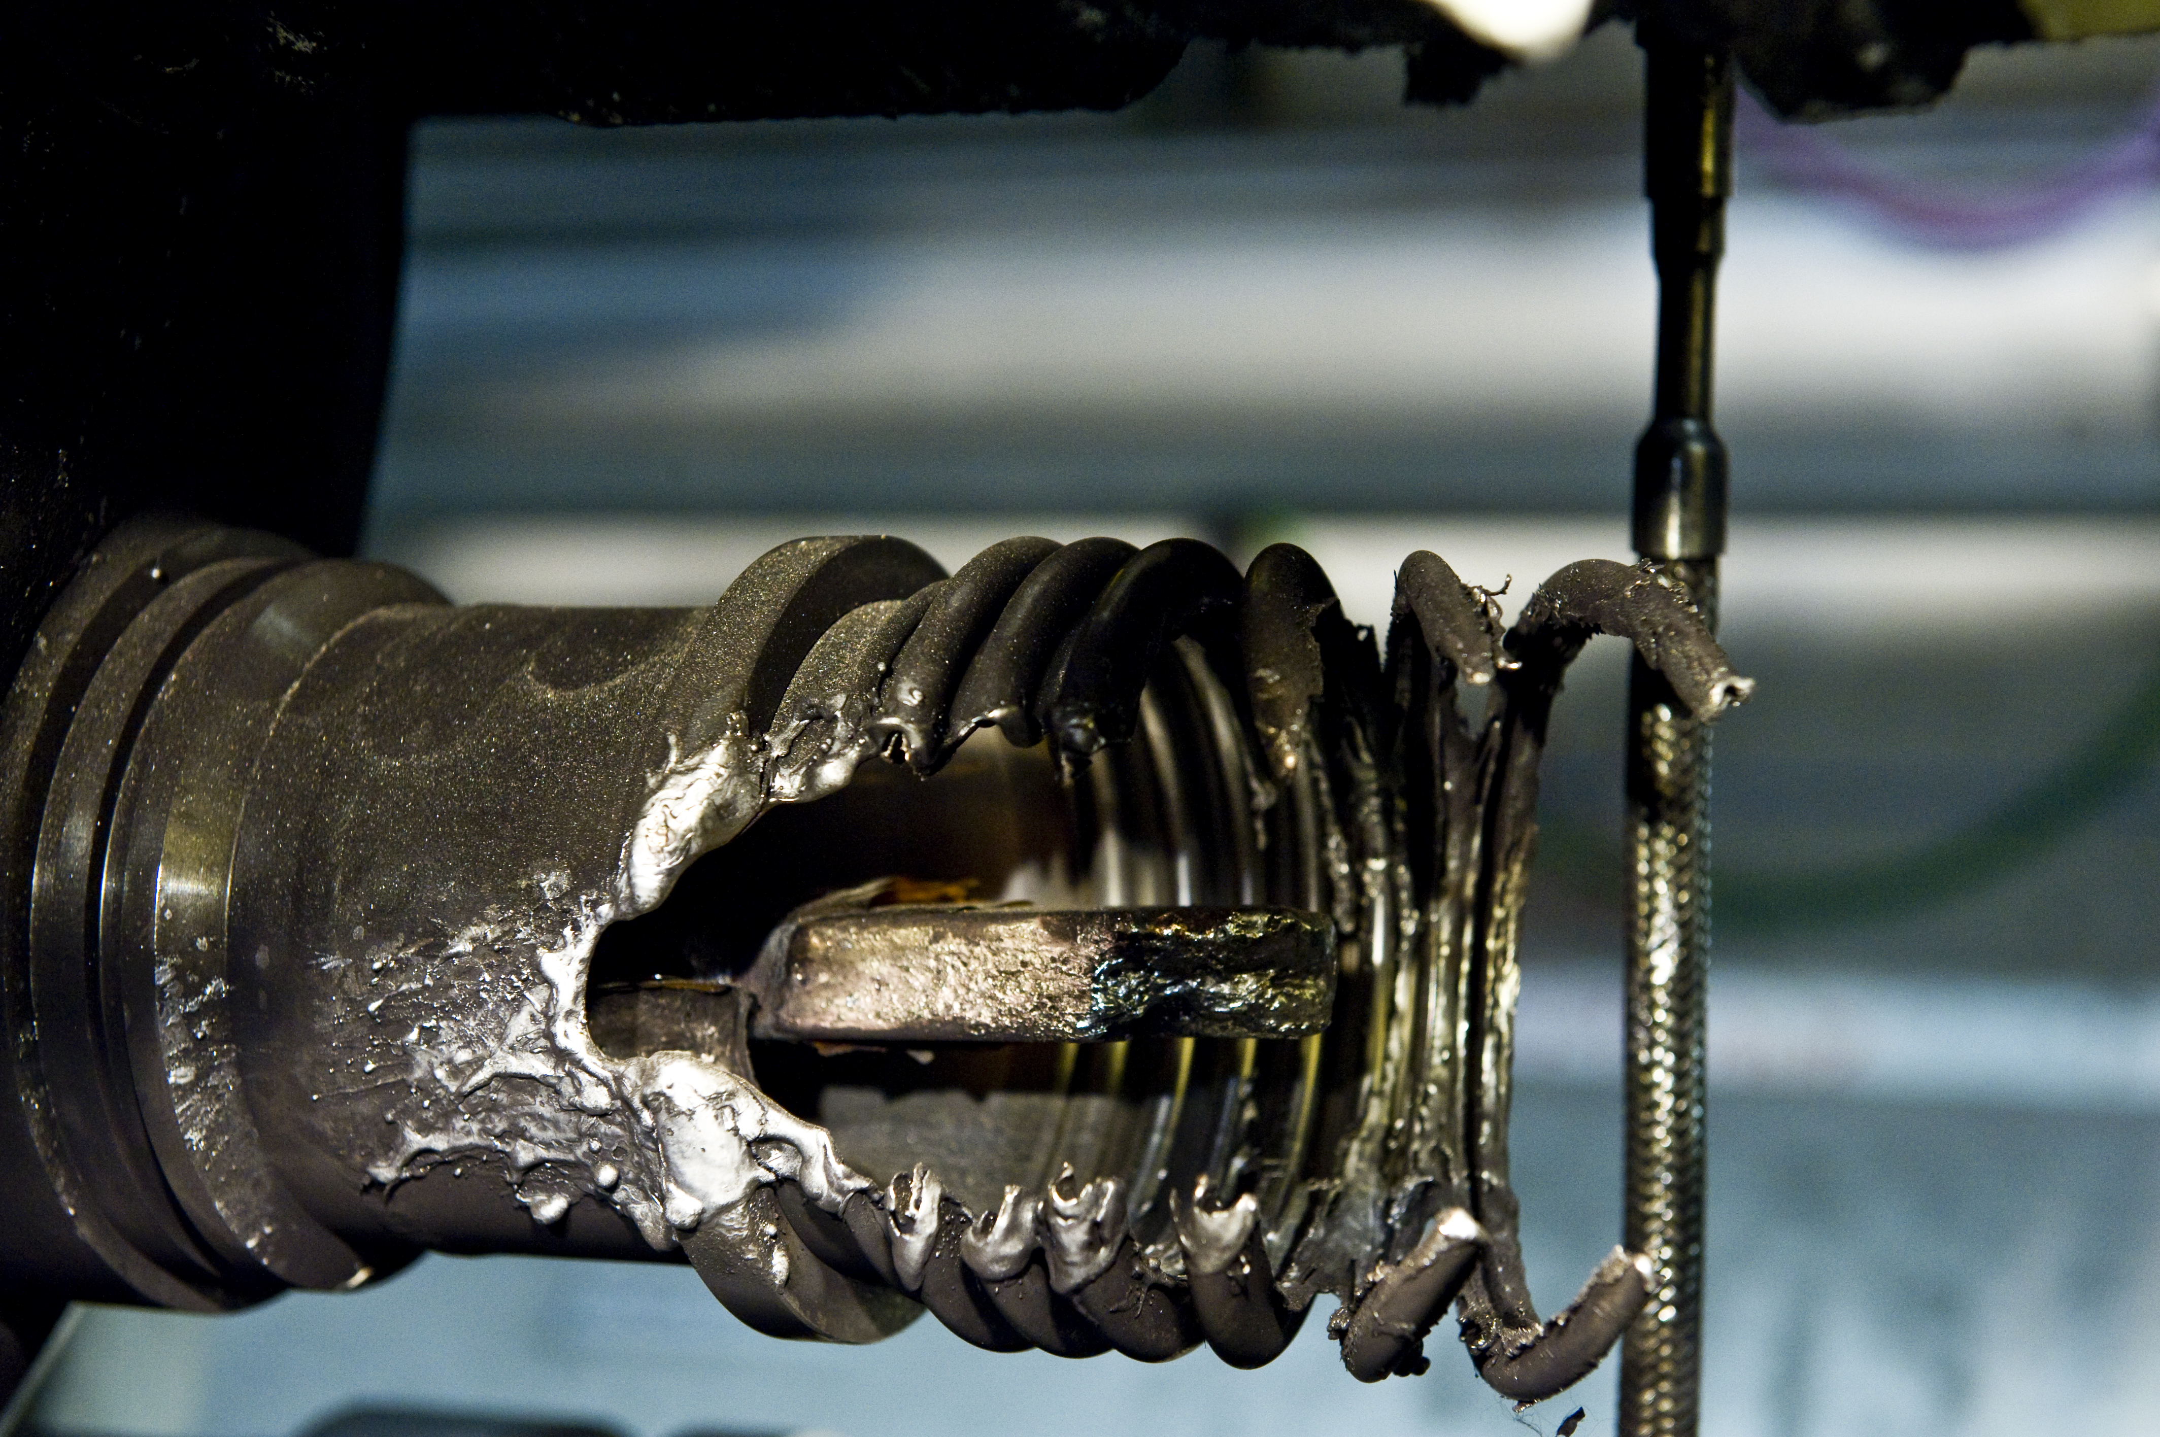
Run 1: High Hopes for Discoveries
https://cds.cern.ch/record/1185822
In Run 1, LHC operated at half of its design beam energy
  A precaution following a 2008 incident involving splices (soldering joints) connecting superconducting cables of neighboring magnets

Slide 5
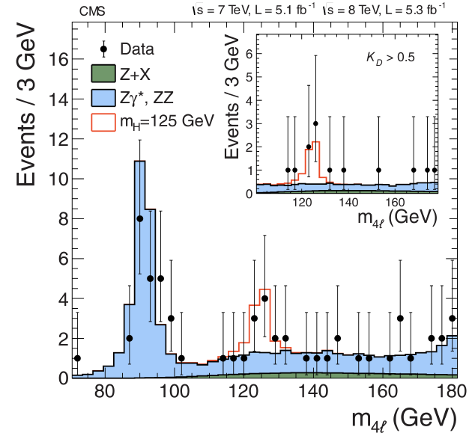
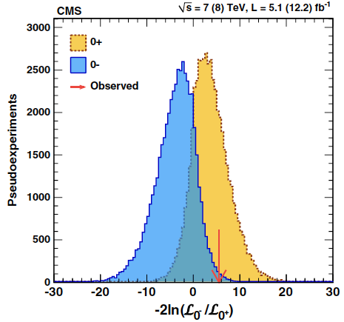
Higgs Discovery
ATLAS and CMS discovered the Higgs boson sooner than anticipated
  With half the design energy and a fraction of the projected data size
  Soon after, measurements confirming this is a CP-even scalar
Phys. Rev. Lett. 110, 081803
Phys. Rev. Lett. 110, 081803

Slide 6
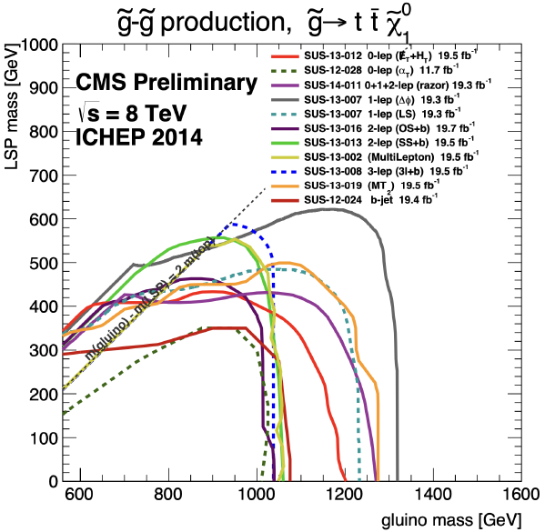
SUSY Anti-Discovery?
A large portion of the EW-scale natural SUSY parameter space have been excluded
  Gluino searches at the LHC have ruled out accessible gluino models and severely constrained most viable SUSY parameter space
The outcome is sad for many, but the impact is monumental affecting the course of particle physics research for decades

Slide 7

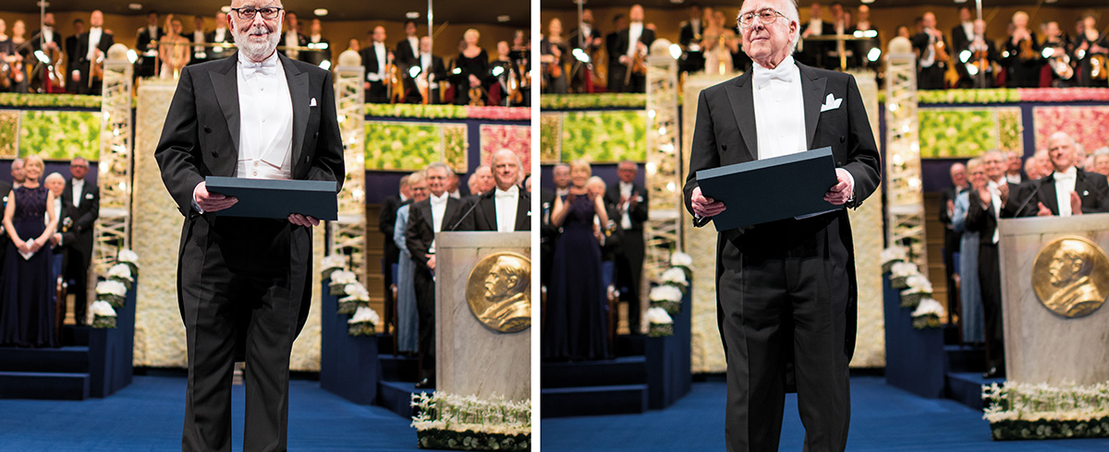
Reflections
The 2013 Nobel Prize in Physics was awarded to Peter Higgs and François Englert for their theoretical work on the Higgs boson.

Slide 8
LHC: A Thirty Year Long Journey
Cartoon schedule depiction: Brüning, O., Rossi, L. The High-Luminosity Large Hadron Collider. Nat Rev Phys 1, 241–243 (2019).
x

Slide 9
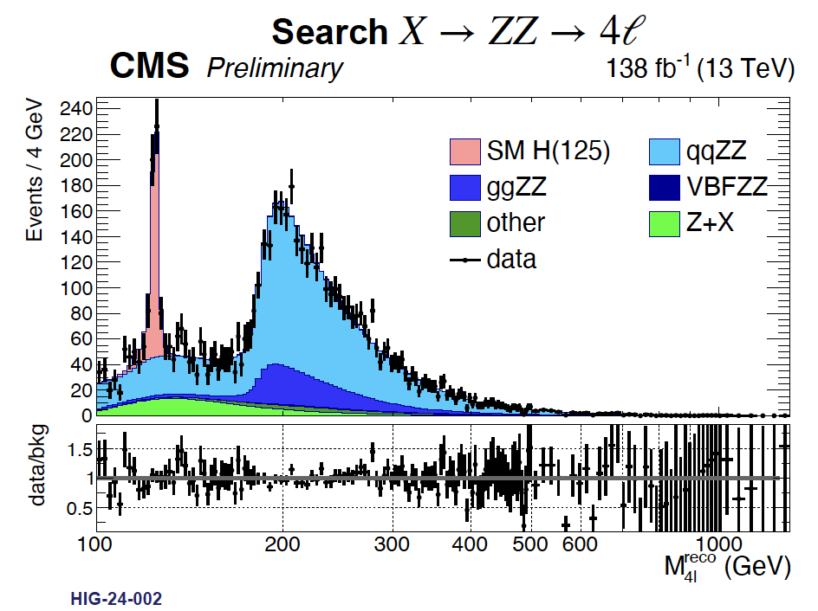
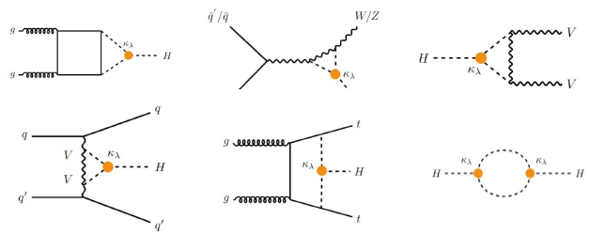
Run-2: Life Past Discovery
Large improvement in precision of Higgs properties
Searches for unexpected ”surprises” with larger datasets and better tools
Searching for new physics we could have missed on the first go
Technologies upsurge:
  Machine learning, GPUs, Parking and Scouting made impossible possible
    Capacity building
  Large improvements in sensitivity and ultimate projected sensitivity with machine learning

Slide 10
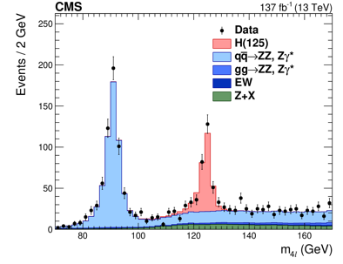
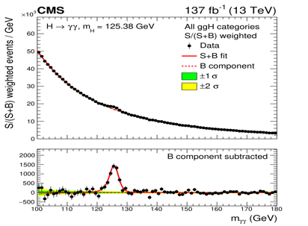
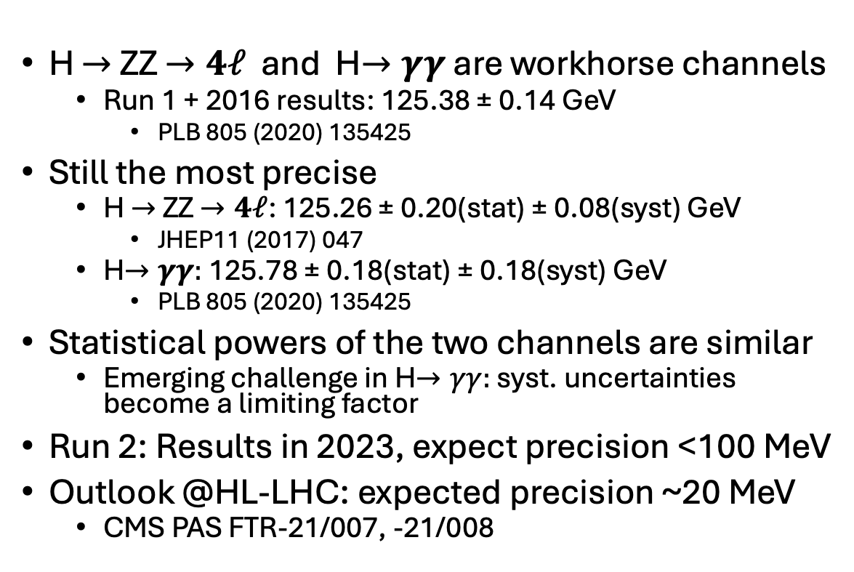


Higgs Boson Stats: Mass
$H→ZZ→4ℓ$ [Run 2]
H $→$ZZ $→4ℓ$ and H$→γγ$ are workhorse channels
  Run 1 + 2016 results: 125.38 ± 0.14 GeV
    PLB 805 (2020) 135425
Still the most precise
  H $→$ZZ $→4ℓ$: 125.26 ± 0.20(stat) ± 0.08(syst) GeV
    JHEP11 (2017) 047
  H$→γγ:$ 125.78 ± 0.18(stat) ± 0.18(syst) GeV
    PLB 805 (2020) 135425
Statistical powers of the two channels are similar
  Emerging challenge in H$→γγ:$ syst. uncertainties become a limiting factor
Run 2: Results in 2023, expect precision <100 MeV
Outlook @HL-LHC: expected precision ~20 MeV
  CMS PAS FTR-21/007, -21/008
$H→γγ$ [Run 2]

Slide 11
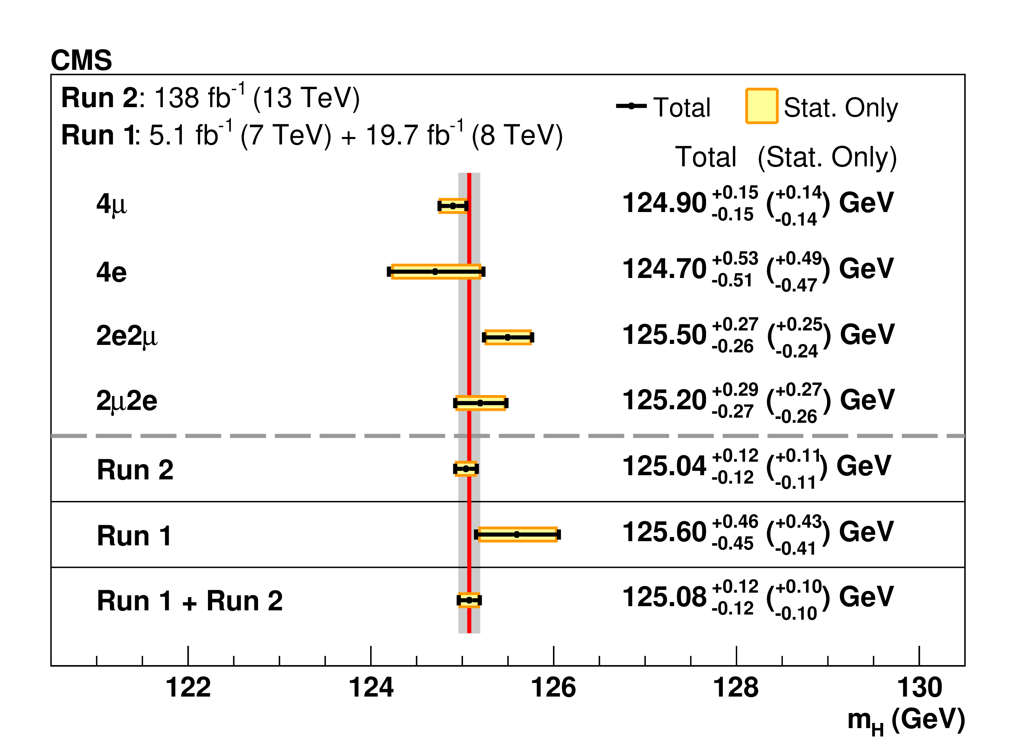
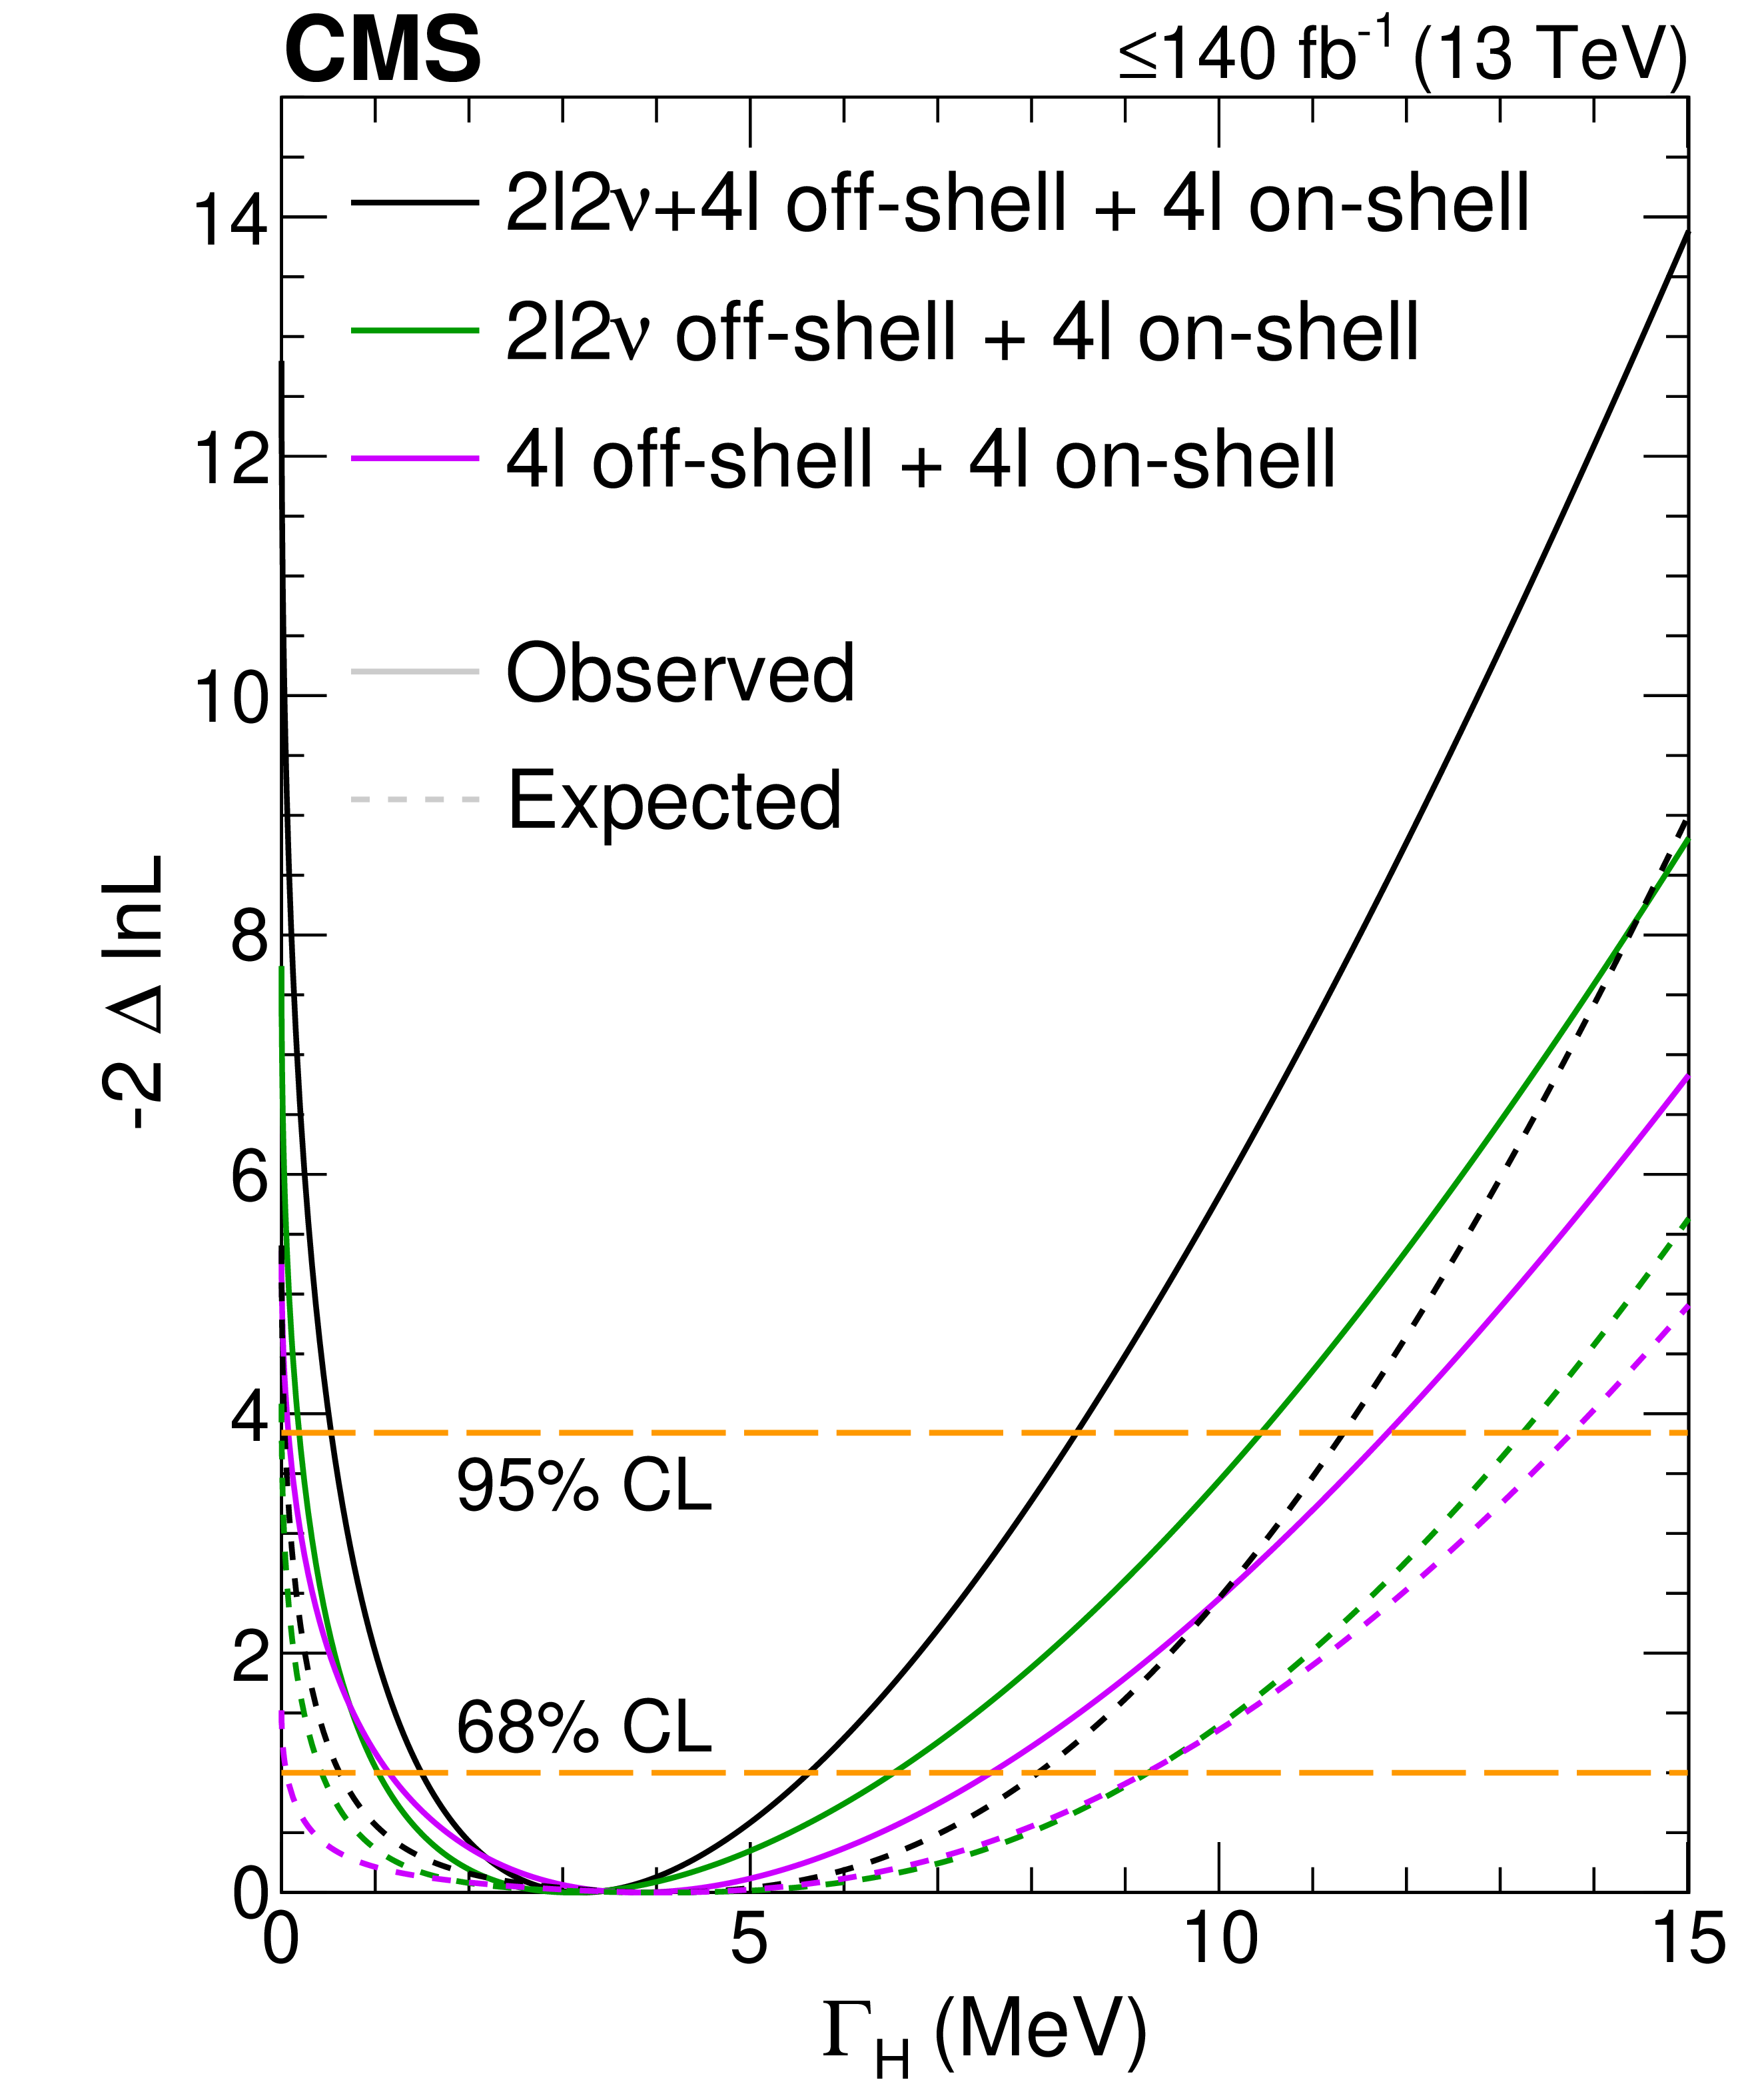
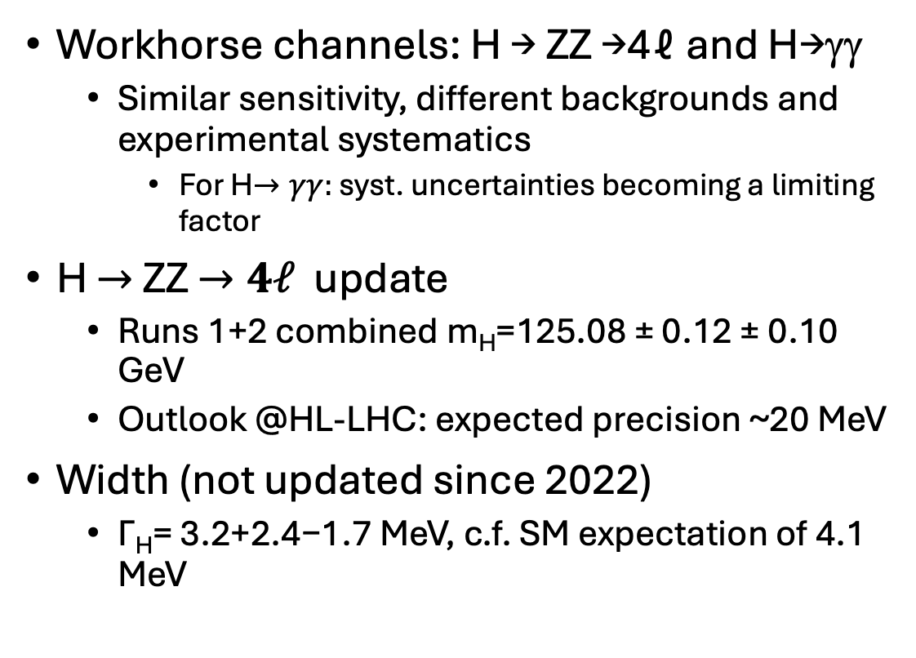
Higgs Boson Stats
Workhorse channels: H → ZZ →4ℓ and H→γγ
  Similar sensitivity, different backgrounds and experimental systematics
    For H$→γγ:$ syst. uncertainties becoming a limiting factor
H $→$ZZ $→4ℓ$ update
  Runs 1+2 combined m_{H}=125.08 ± 0.12 ± 0.10 GeV
  Outlook @HL-LHC: expected precision ~20 MeV
Width (not updated since 2022)
  Γ_{H}= 3.2+2.4−1.7 MeV, c.f. SM expectation of 4.1 MeV
CMS-HIG-21-019
Nat. Phys. 18 (2022) 1329

Slide 12
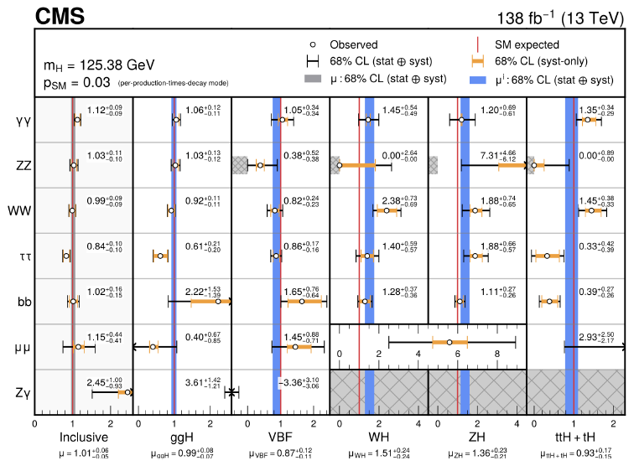
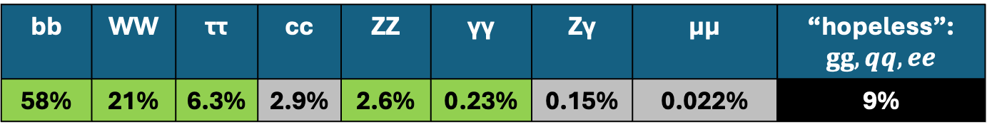
Higgs Boson Stats: Decay Modes
Precision from combining multiple production modes and sub-channels
  Up to O(100) cross sections measured simultaneously in ~1k channels
  All event rates are compatible with the SM predictions
  The overall signal strength µ = 1.1 ± 0.06
Emerging challenge: experimental statistical uncertainties are becoming comparable to experimental systematics and theory uncertainties
  E.g. the overall combined signal strength
  µ = 1.002 ± 0.036(stat) ± 0.029(exp) ± 0.033 (theory)
Nature 607 (2022) 60-68
HIG-21-018
bb | WW | ττ | cc | ZZ | γγ | Zγ | μμ | “hopeless”: $gg, qq,ee$
58% | 21% | 6.3% | 2.9% | 2.6% | 0.23% | 0.15% | 0.022% | 9%

Slide 13
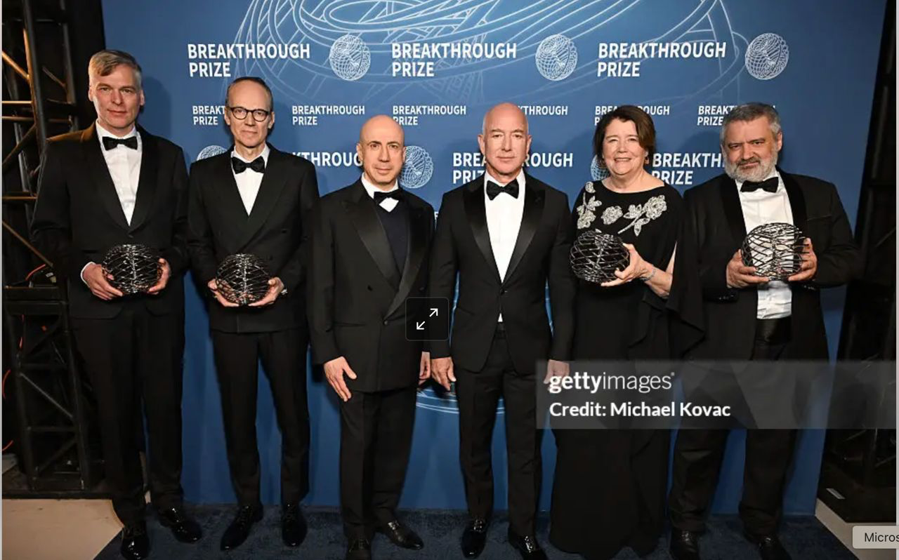
2025 Breakthrough Prize: ATLAS, CMS, ALICE and LHCb
The four experiments are recognized for testing the modern theory of particle physics – the Standard Model – and other theories describing physics that might lie beyond it to high precision. This includes precisely measuring properties of the Higgs boson and elucidating the mechanism by which the Higgs field gives mass to elementary particles; …

Slide 14
LHC: A Thirty Year Long Journey
x

Slide 15
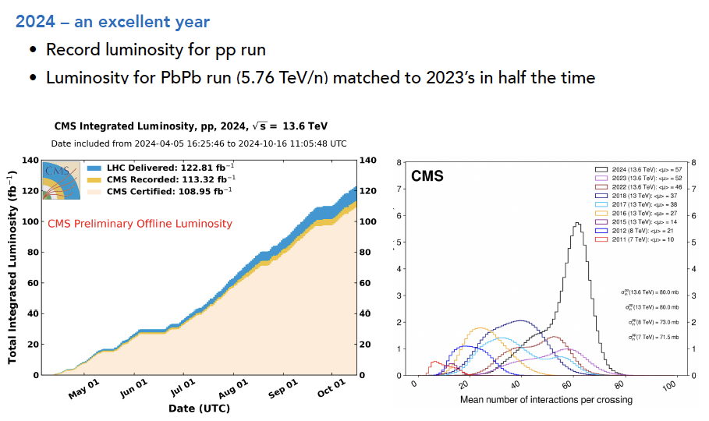
Run 3: Collecting More Data Faster
Analyzing data to the fullest takes time
  CMS is just now done with the Run-2 analyses
  Working hard on the Run-3 data, first wave of analyses completed later this year
Heavy focus on data quality and collection
  CMS data taking efficiency in 2024 92%
  Certified for physics 96%

Slide 16
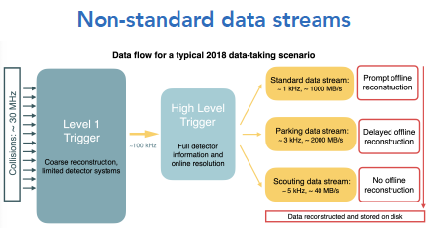
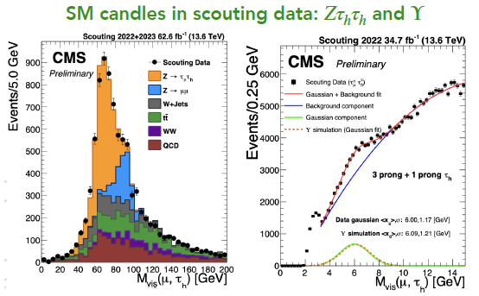
And Using It More Efficiently
Efficient processing via heterogeneous computing
  CMS High Level Trigger (HLT) computing farm has 40% GPUs allowing 80% increase in throughput compared to Run-2
Non-standard data streams:
  Scouting data stream: save only minimal (HLT) information per event, which allows collecting low threshold
Novel identification algorithms, e.g. advanced machine learning techniques in trigger and offline reconstruction
  Including NN implemented in FPGAs

Slide 17
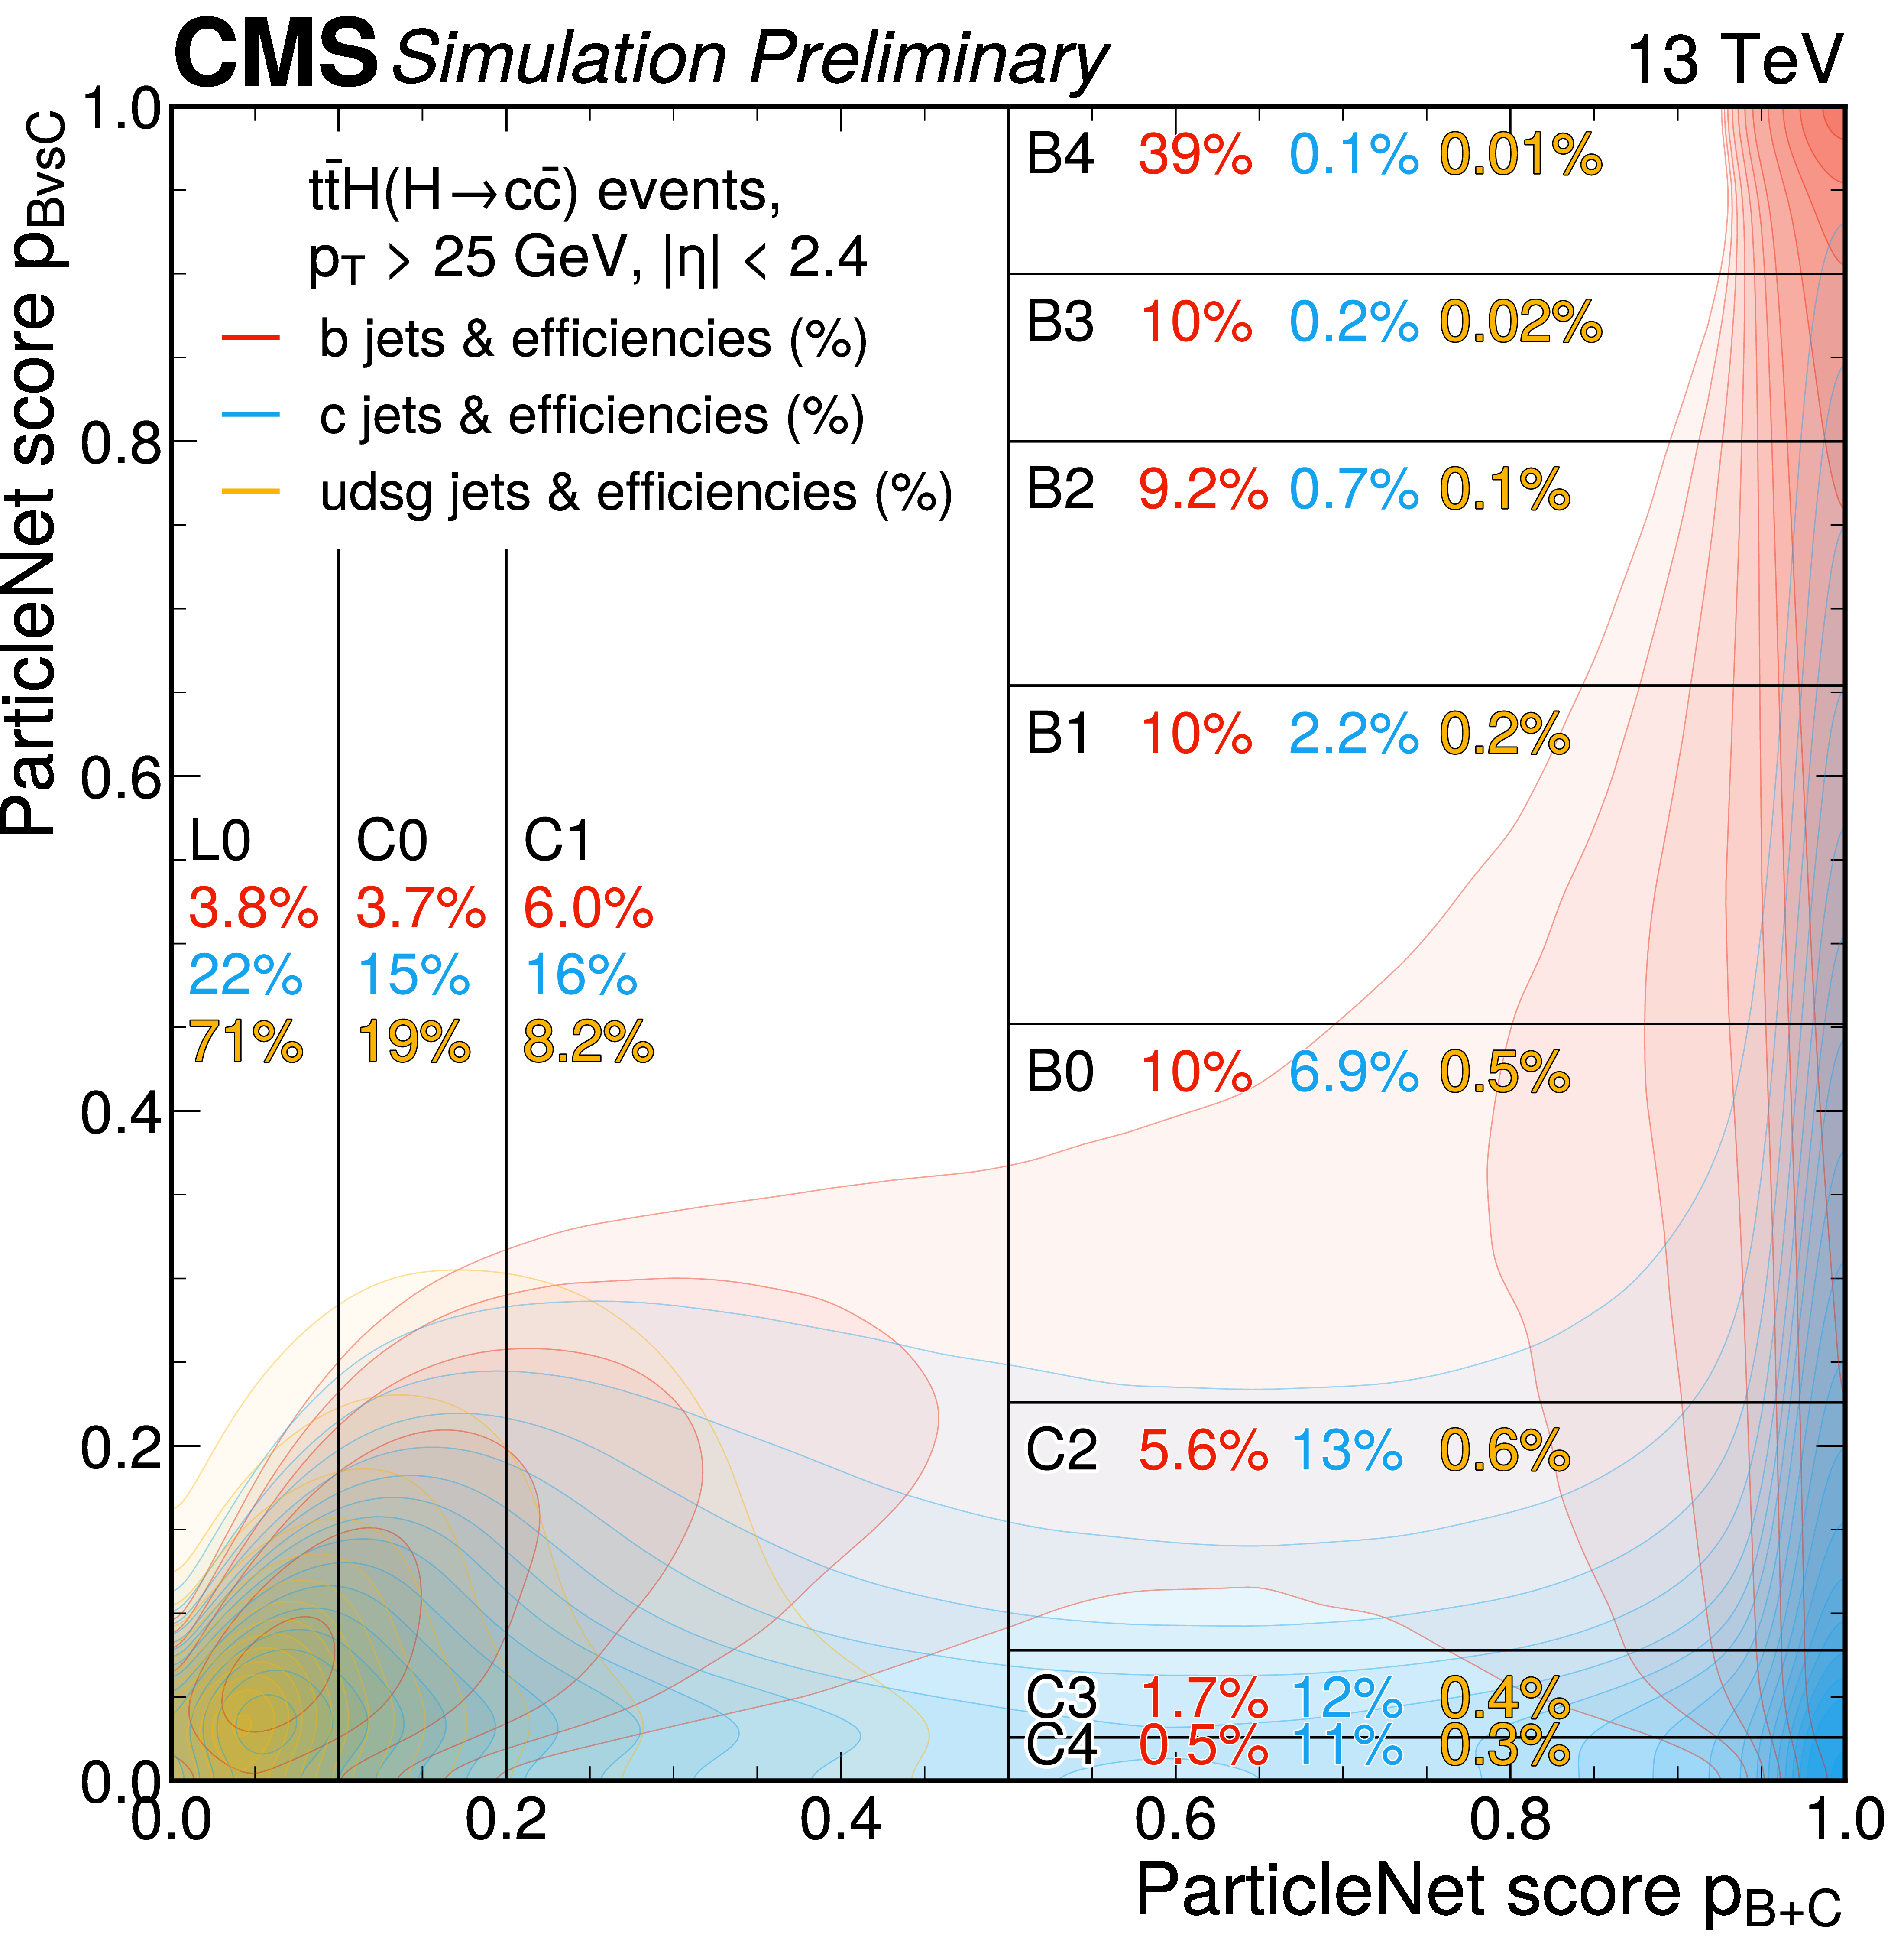
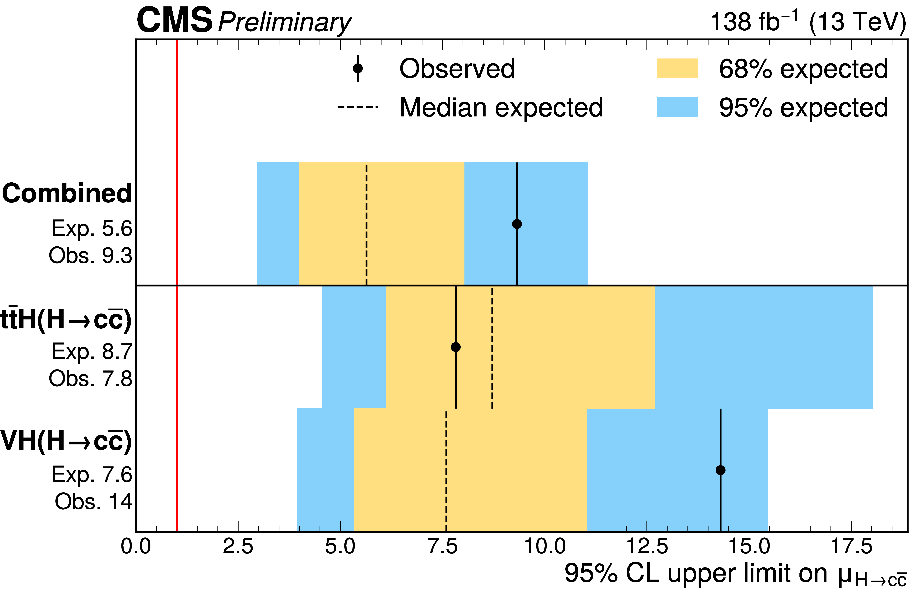
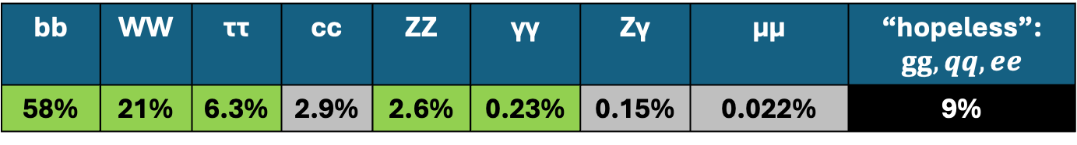
Moving on Higgs: 2nd Generation
Higgs coupling to cc:
  A straight search for gg or VBF production of Higgs decaying to cc-bar is hopeless due to too much background
    Earlier VH search
    A new search in ttH production topology
    Deploy many innovative tools and techniques to separate signal from the background
      Still run-2 analysis, an important focus for Run-3
Higgs coupling to muons:
  Also work in progress building on Run-2 3σ observation
bb | WW | ττ | cc | ZZ | γγ | Zγ | μμ | “hopeless”: $gg, qq,ee$
58% | 21% | 6.3% | 2.9% | 2.6% | 0.23% | 0.15% | 0.022% | 9%
CMS-PAS-HIG-24-018

Slide 18
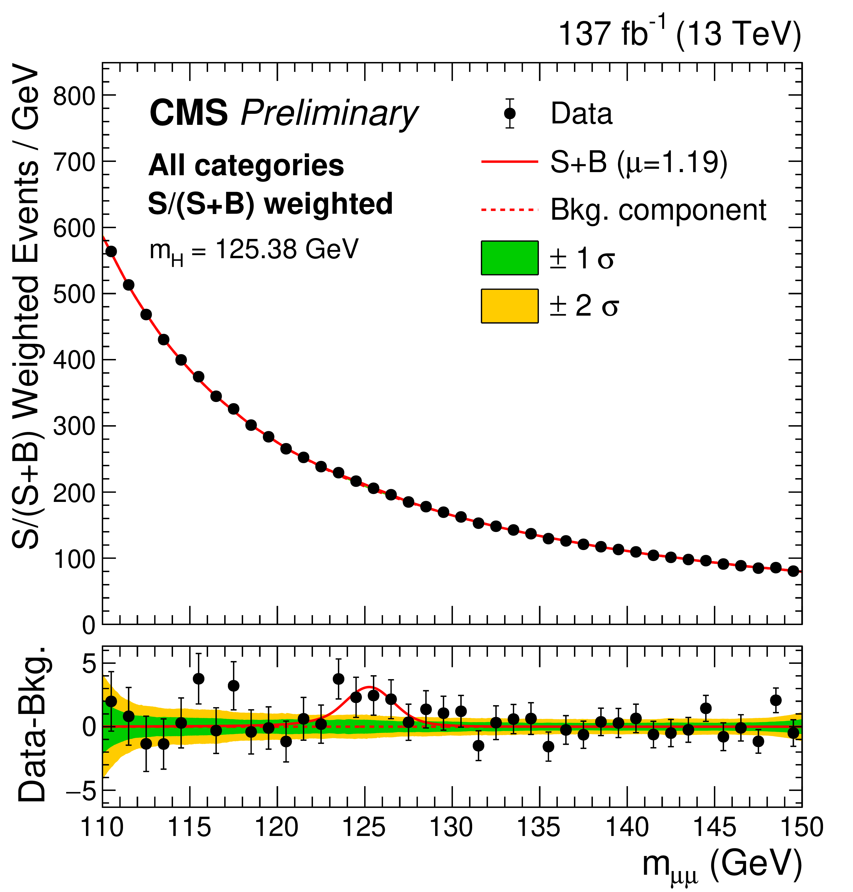
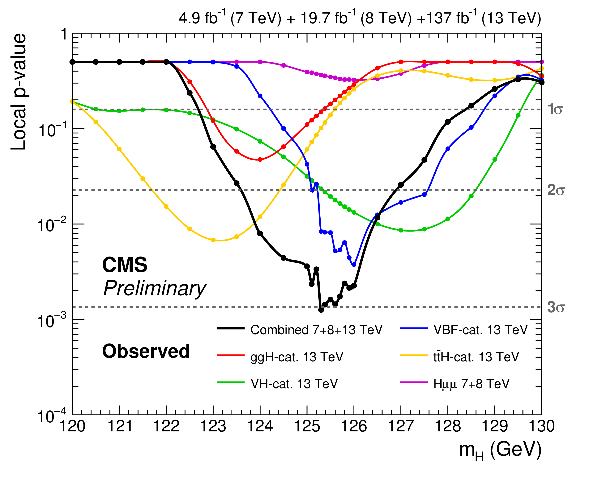
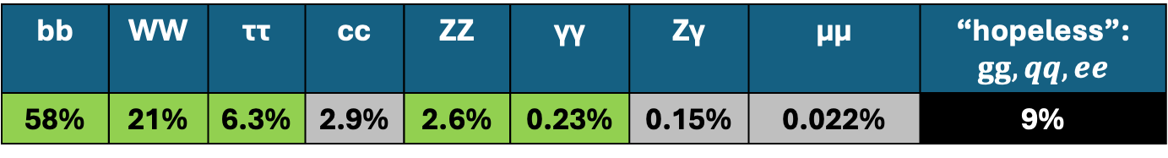
Moving on Higgs: 2nd Generation
Higgs coupling to cc:
  A straight search for gg or VBF production of Higgs decaying to cc-bar is hopeless due to too much background
    Earlier VH search
    A new search in ttH production topology
    Deploy many innovative tools and techniques to separate signal from the background
      Still run-2 analysis, an important focus for Run-3
Higgs coupling to muons:
  Also work in progress building on Run-2 3σ observation
bb | WW | ττ | cc | ZZ | γγ | Zγ | μμ | “hopeless”: $gg, qq,ee$
58% | 21% | 6.3% | 2.9% | 2.6% | 0.23% | 0.15% | 0.022% | 9%
JHEP 01 (2021) 148

Slide 19
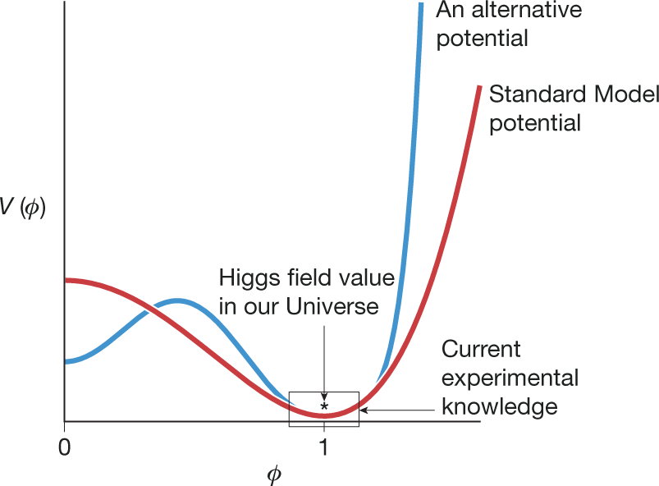
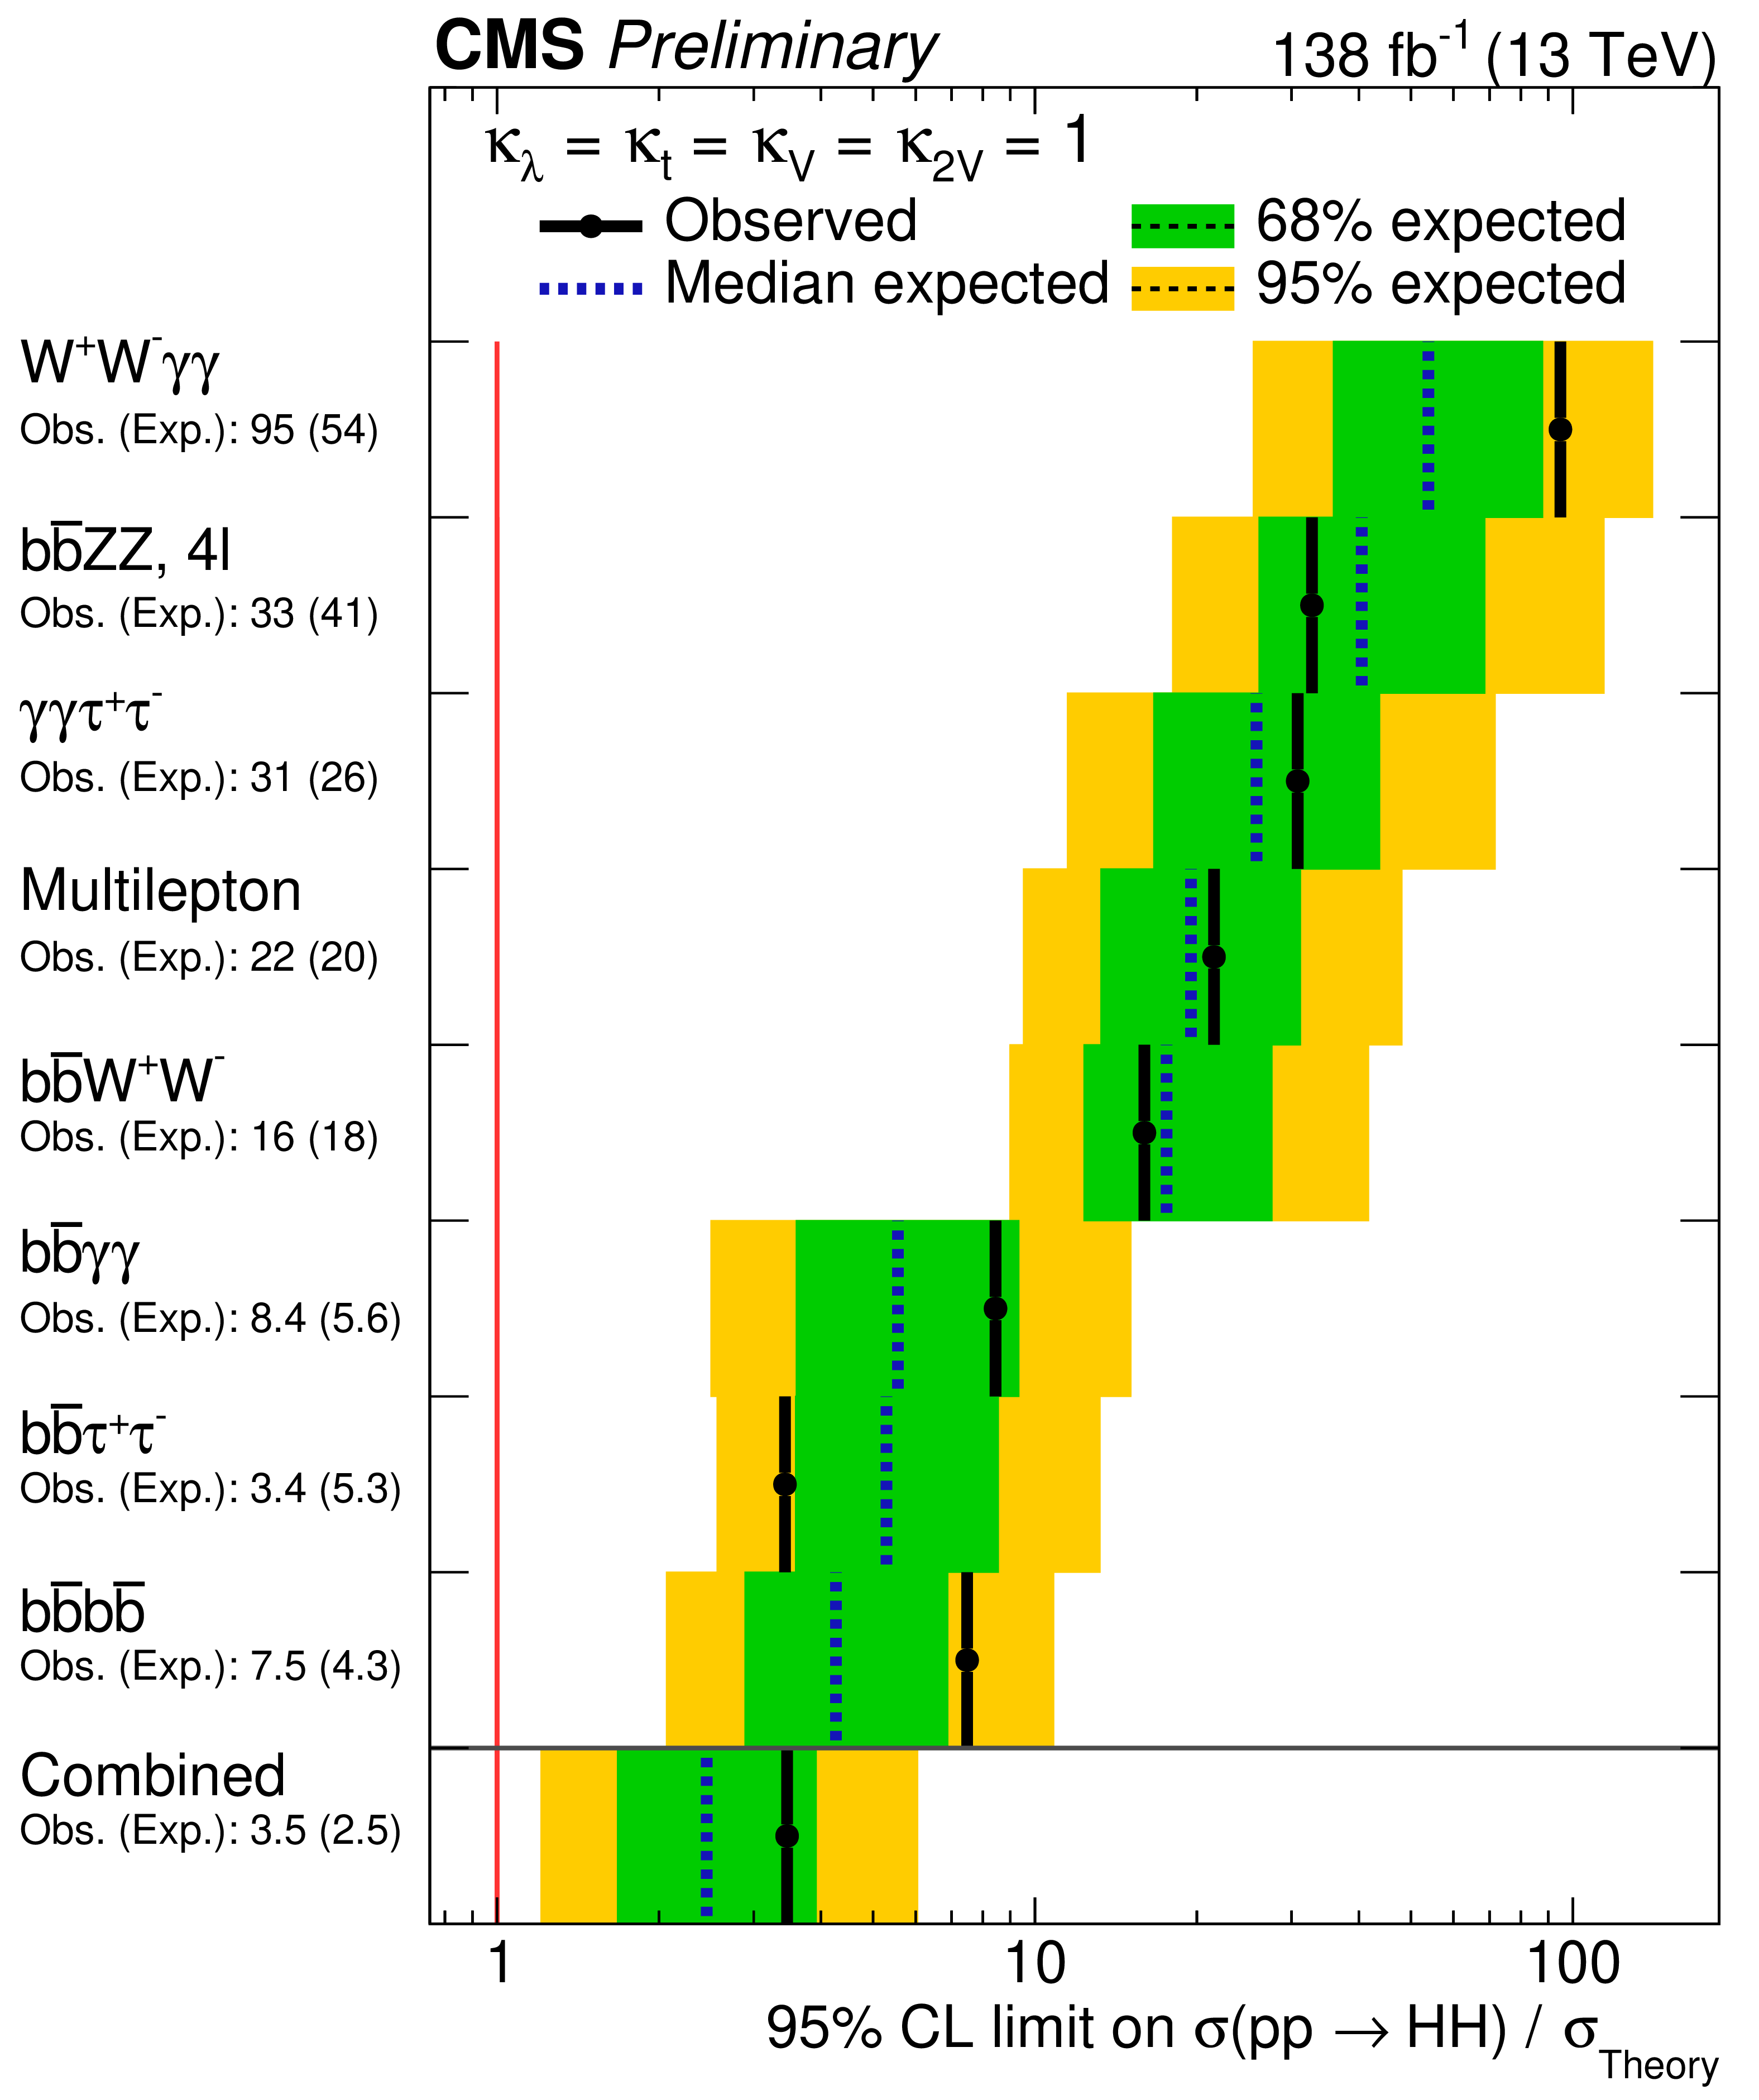
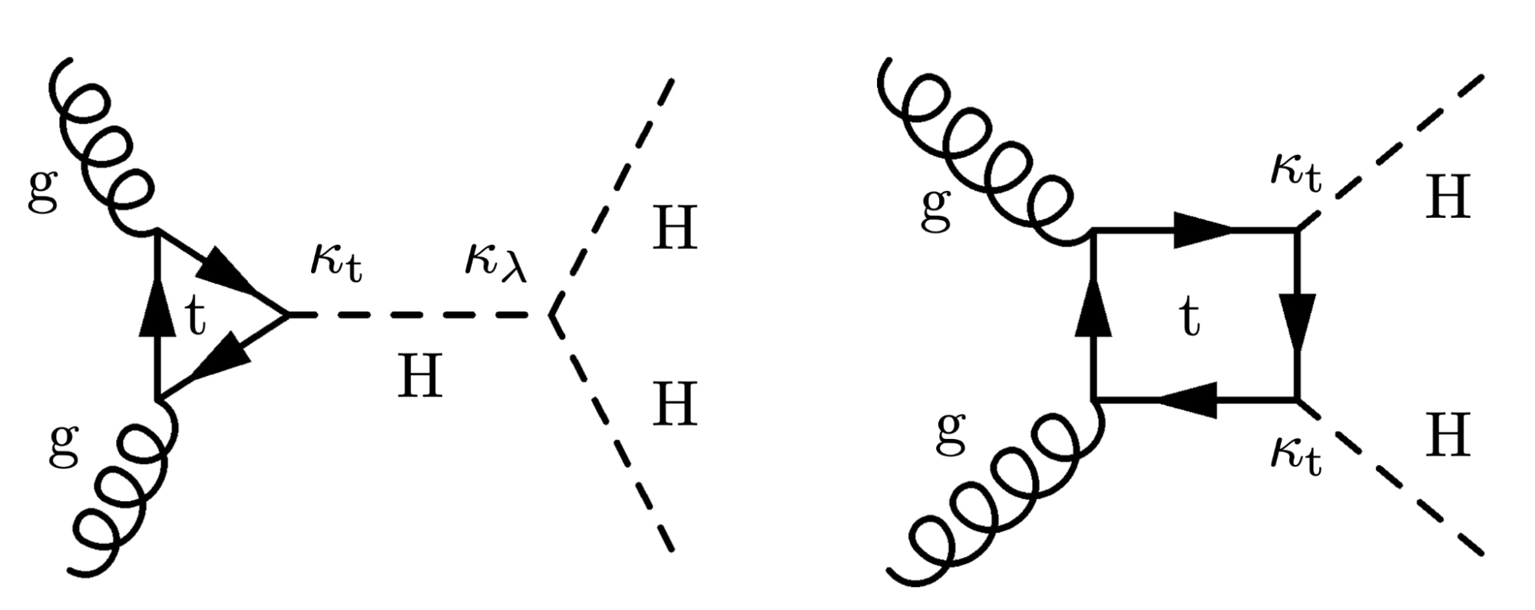
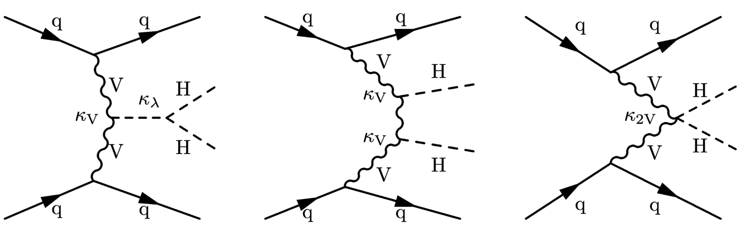
Mapping the Higgs Potential
Nature volume 607, pages 41–47 (2022)
LHC Higgs measurements fixed Higgs VEV in our Universe
  We don’t truly know much about the shape of the potential
  Understanding the shape better requires studies of Higgs self-couplings HHH and HHHH
Difficult measurements on the edge of what we can do (unless there is an excess):
  A lot of hard and tedious work on sub-channels, extracting every bit of sensitivity, combinations for best sensitivity
  Continues in Run-3 and will continue through the lifetime of (HL-)LHC

Slide 20
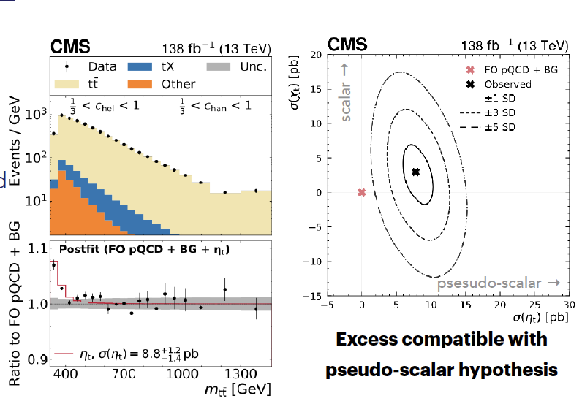
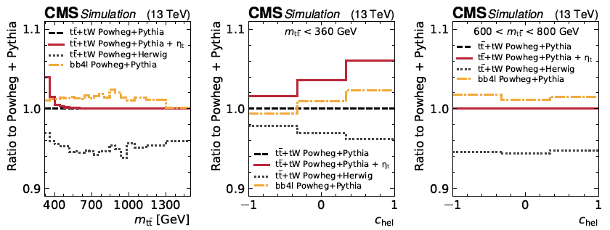
Bumping into Unexpected
arXiv:2503.22382
Search for H/A resonances into tt-bar observed an excess of data at threshold
  Dilepton decays of top quarks
Signal from a 3D profile likelihood
  Fit to m_{tt}, c_{hel}, c_{han}
σ(η_{t})=8.8+1.2-1.4 pb
  C.f. NRQCD prediction is 6.43 pb (Maltoni et al., Fuks et al.)
Modeling the threshold region is challenging and requires further theoretical investigation
  E.g. Nason, Re, Rottoli (Apr ’25)

Slide 21
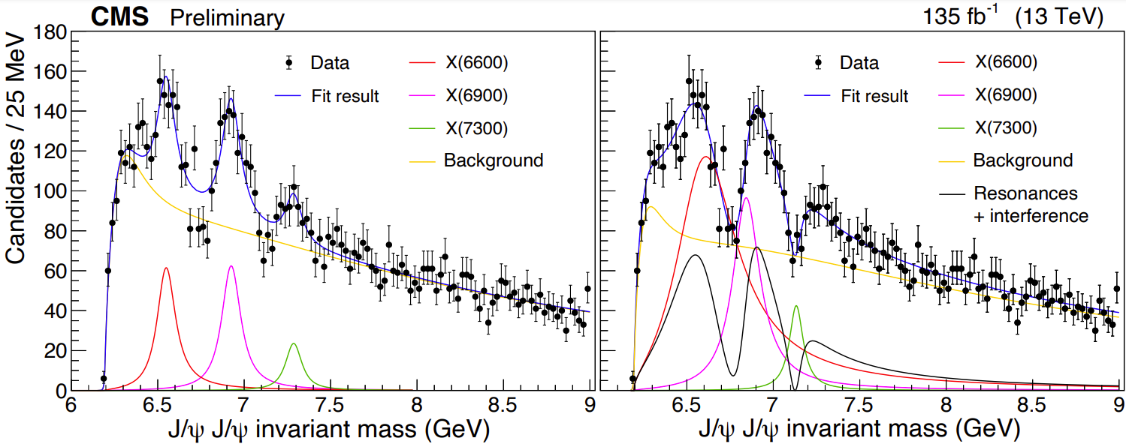
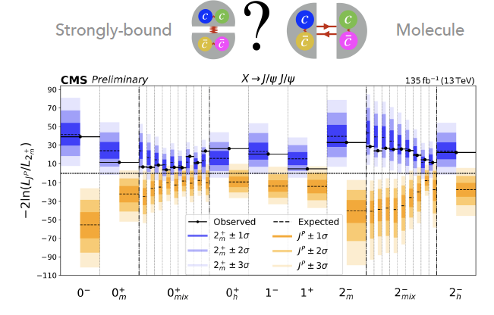
All-Charm Tetraquarks
Mass spacings following a radial Regge trajectory plus interference pattern → three particles part of a family of (cccc) states with the same quantum numbers
Phys. Rev. Lett. 132 (2024) 111901
New: a full angular analysis to determine nature of the structures
  PC = ++ established
  Data consistent with 2+m (strongly bound), inconsistent with others
CMS PAS BPH-24-002

Slide 22
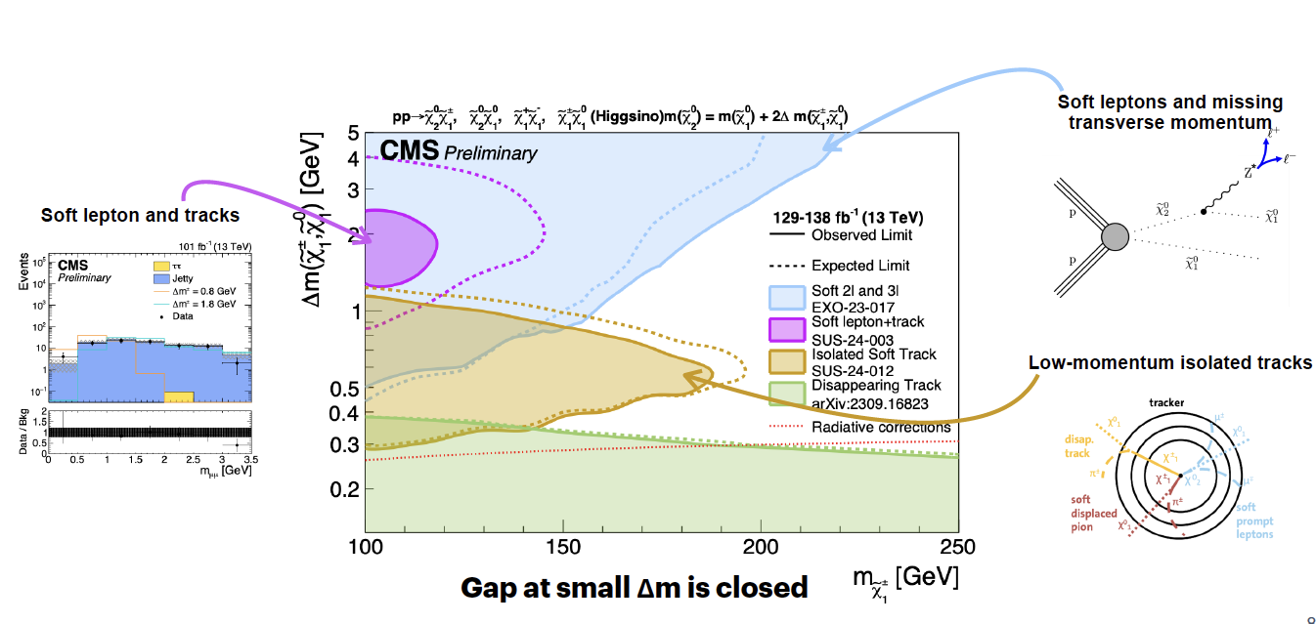
Stealth SUSY
In the electroweak sector, gauginos mix to form neutralinos and charginos, which are relevant in natural SUSY scenario.
New analyses to probe compressed electroweak spectrum, mass difference O(1 GeV)

Slide 23
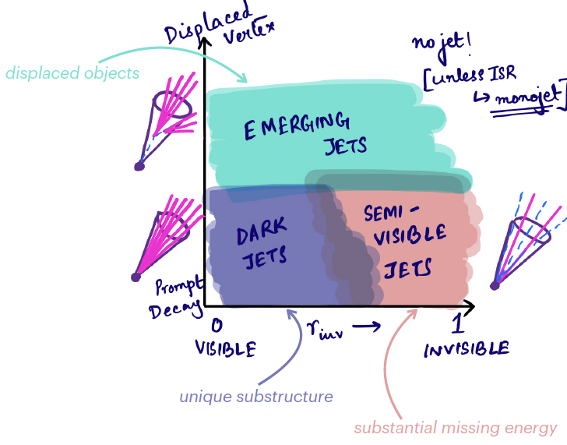
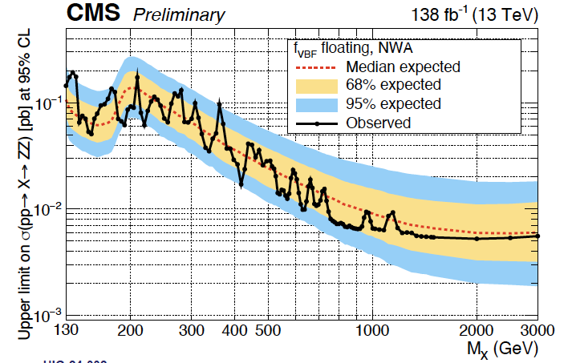
Not Included in This Talk
Hidden Valleys and Dark Sectors:
  Qualitative Predictions
    Masses may be below 100 GeV
    Lifetimes may be much longer
    Production and decay can be complex
  Search for dark hadrons decaying promptly in a QCD-like fashion, fully or partially to the visible sector undergoing displaced decays
New boson searches
  Many channels covering a broad range of well motivated scenarios, on the left: X->ZZ->4l
Flavor physics
  E.g. B(D0 → μ+μ−) limits using parked data
EFT interpretations of the existing data
Heavy ion physics

Slide 24
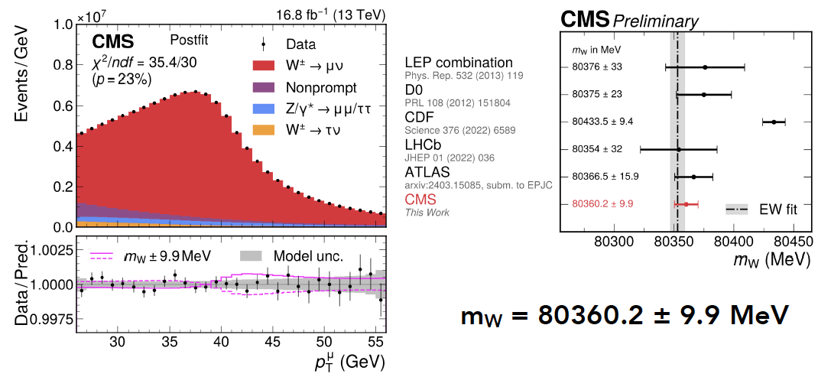
New Precision in Old Measurements: M_{W}
M_{W} extracted via 3D profile likelihood fit to muon kinematics (p_{T} , η) and muon charge
  Lepton p_{T} sensitive to m_{W} and p_{T W}
  η and q sensitive to PDFs
arXiv:2412.13872, submitted to Nature

Slide 25
LHC: A Thirty Year Long Journey
x
Brüning, O., Rossi, L. The High-Luminosity Large Hadron Collider. Nat Rev Phys 1, 241–243 (2019).

Slide 26

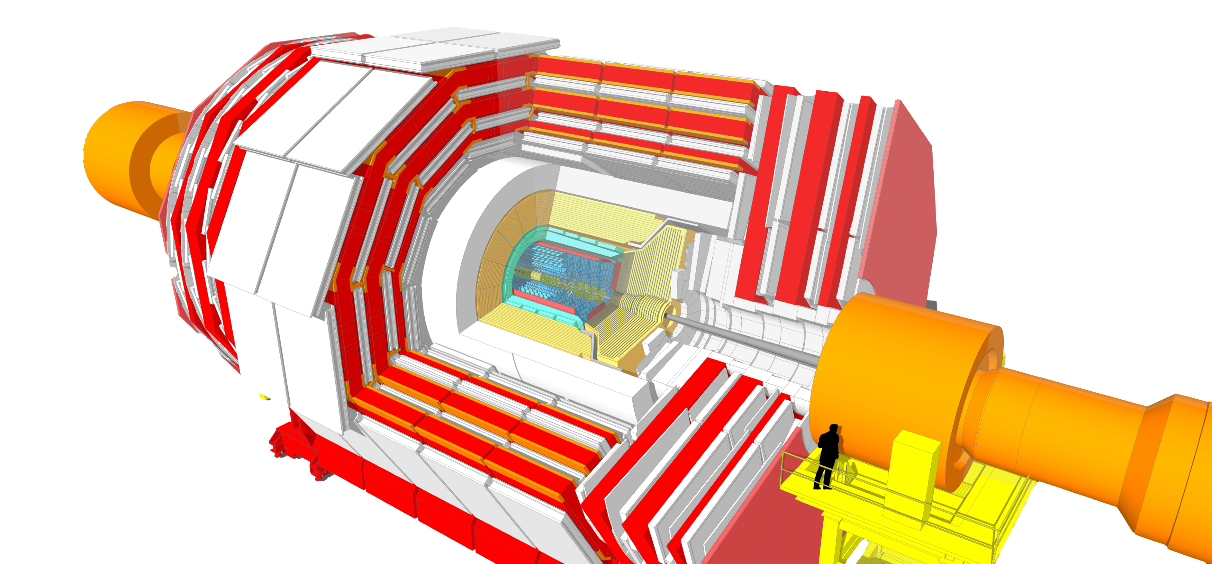
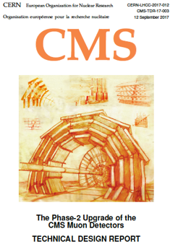
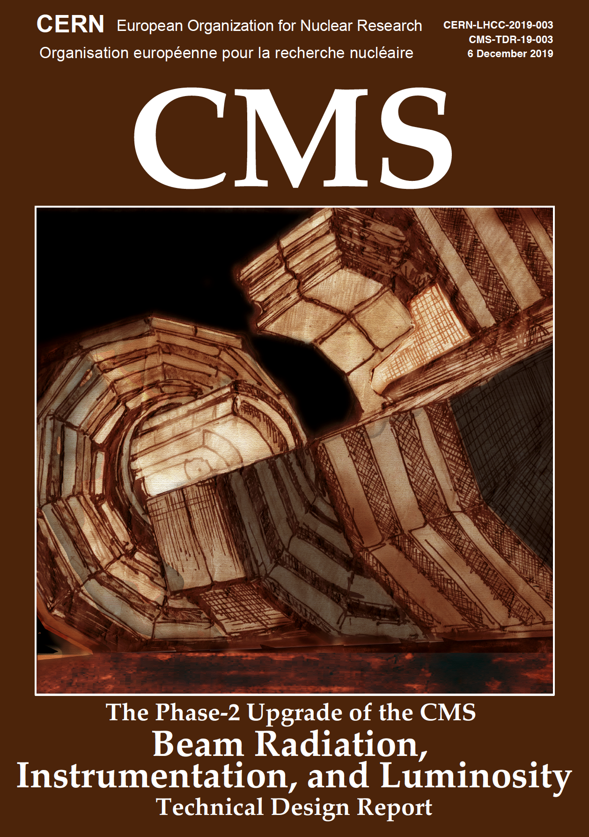


The CMS Upgrade
Replace 100% electronics
  Increase bandwidth
New Tracker (incl. trigger)
New high granularity endcap CALO
  Extend Tracker & Muon in forward direction
Add Timing Detector (mitigate pile-up)
  Add timing in Muon and calorimeter
L1-Trigger
https://cds.cern.ch/record/2714892
Tracks in L1-Trigger at 40 MHz
Particle Flow selection
750 kHz L1 output
40 MHz data scouting
Barrel Calorimeters
https://cds.cern.ch/record/2283187
ECAL single crystal granularity at L1 trigger
with precise timing for e/γ at 30 GeV
ECAL and HCAL new Back-End boards
Calorimeter Endcap
https://cds.cern.ch/record/2293646
3D showers and precise timing
Si, Scint+SiPM in Pb/W-SS
Also known as HGCAL
Muon systems
https://cds.cern.ch/record/2283189
DT & CSC new FE/BE readout
RPC back-end electronics
New GEM/RPC 1.6 < η < 2.4
Extended coverage to η ≃ 3
DAQ & High-Level Trigger
https://cds.cern.ch/record/2759072
Full optical readout
Heterogenous architecture
60 TB/s event network
7.5 kHz HLT output
Tracker
https://cds.cern.ch/record/2272264
Si-Strip and Pixels increased granularity
Design for tracking in L1-Trigger
Extended coverage to η ≃ 3.8
MIP Timing Detector
https://cds.cern.ch/record/2667167
Precision timing with:
Barrel layer: Crystals + SiPMs
Endcap layer:
Low Gain Avalanche Diodes
Beam Radiation Instr. and Luminosity
http://cds.cern.ch/record/2759074
Beam abort & timing
Beam-induced background
Bunch-by-bunch luminosity:
1% offline, 2% online
Neutron and mixed-field radiation monitors
Also known as Timing Layer ‘TL’
Mitigate by
Rate – new electronics
Occupancy – high granula
Rad tolerance (SI)
Notes:
Replace 100% electronics
Increase bandwidth
New Tracker (incl. trigger)
New high granularity endcap CALO
Extend Tracker & Muon in forward direction
Add Timing Detector (mitigate pile-up)
Add timing in Muon and calorimeter

Slide 27
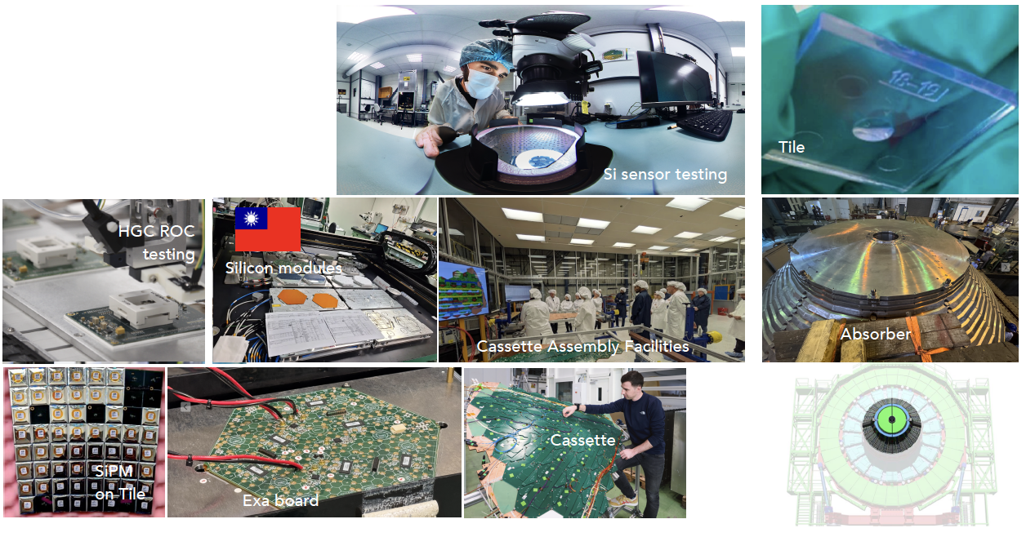
CMS High Granularity Calorimetry
(Almost) all sensors received
Module production started
Progress on system test
On the way to assembling first EM and HAD cassettes
1st absorber ready

Slide 28
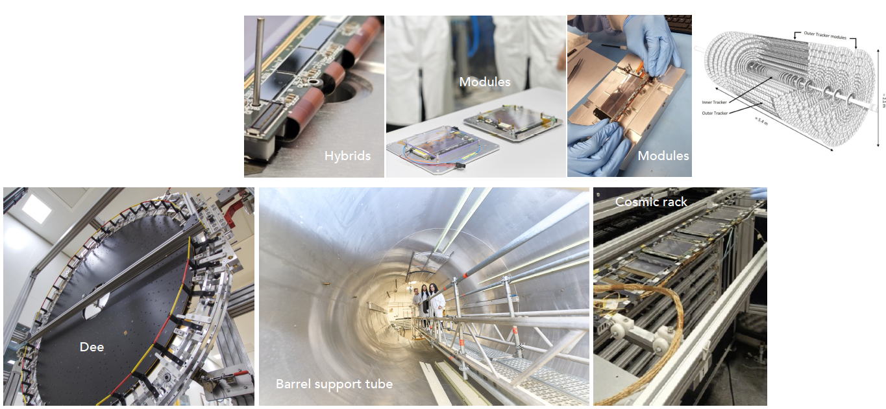
Tracking
All sensors received
Module production started
First large structures assembled
Tracker Support Tube received
System tests available

Slide 29
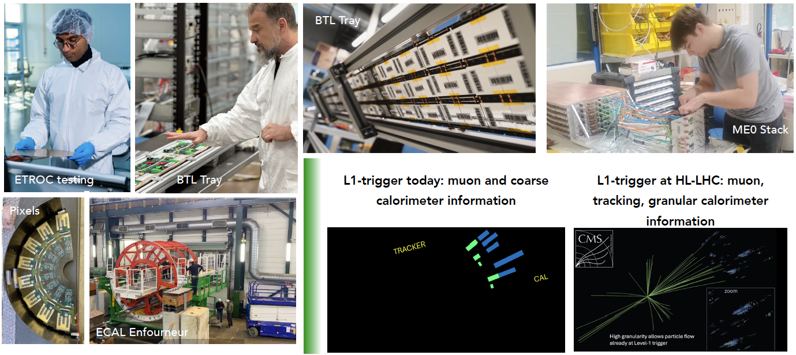
Muons, ECAL, Timing Layer, Trigger

Slide 30
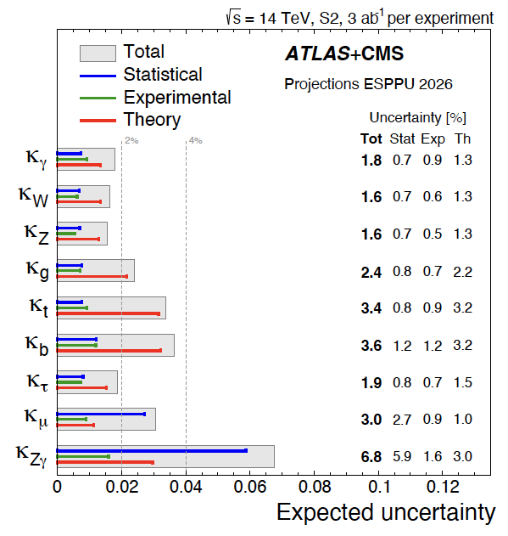
HL-LHC Physics Projections
Large improvements compared to early projections:
  Takes into account (some of the) large improvements in Run-2 analyses sensitivity, improved triggering and detector capabilities
Recent developments for the 2026 European Strategy Particle Physics Update:
  “Highlights of the HL-LHC physics projections by ATLAS and CMS”, arXiv:2504.00672

Slide 31
Summary
CMS continues to advance our understanding of Nature by harnessing the unprecedented data delivered by the LHC
  Comprehensive precision program
  BSM and flavor physics programs beyond design
  Exploitation of the LHC data through statistical combinations
Technology breakthroughs as catalyzers for modern AI
  Innovative trigger strategies enabling exciting physics opportunities
Significant progress on the HL-LHC Upgrade
  Major improvement to CMS capabilities for this new regime
Lots of hard work ahead to fully exploit the full LHC potential

