Slide 1
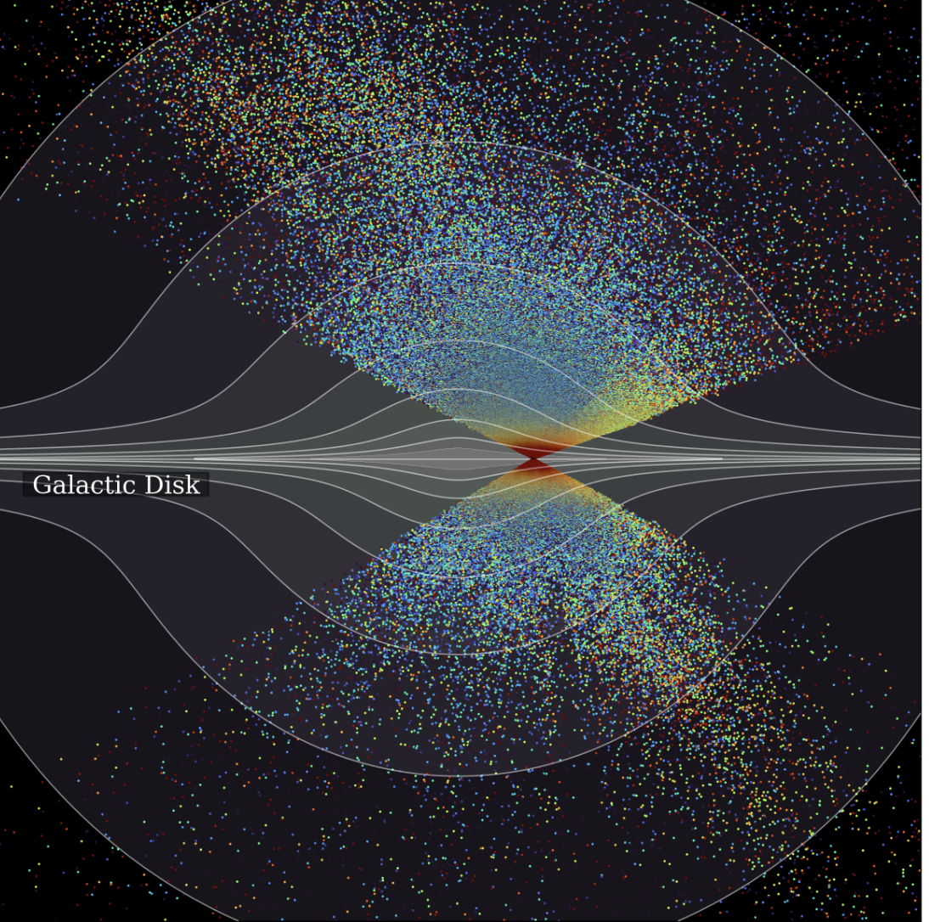


XVIIIth International Conference on the Interconnections
between Particle Physics and Cosmology, (PPC2025)
Cosmology From DESI
James W. Rohlf
Boston University
(for the DESI Collaboration)
June 23, 2025
Image: DESI, M. Abdul Karim et al., 2503.14745

Slide 2
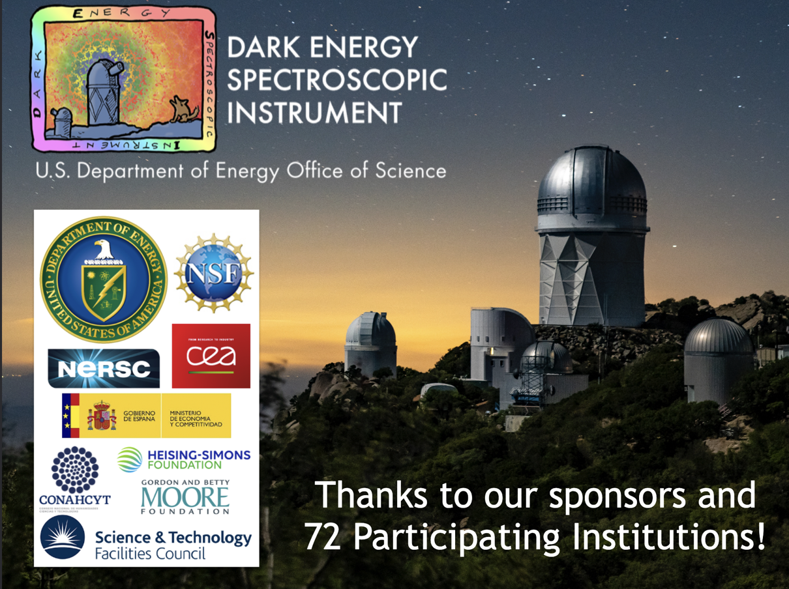

Slide 3
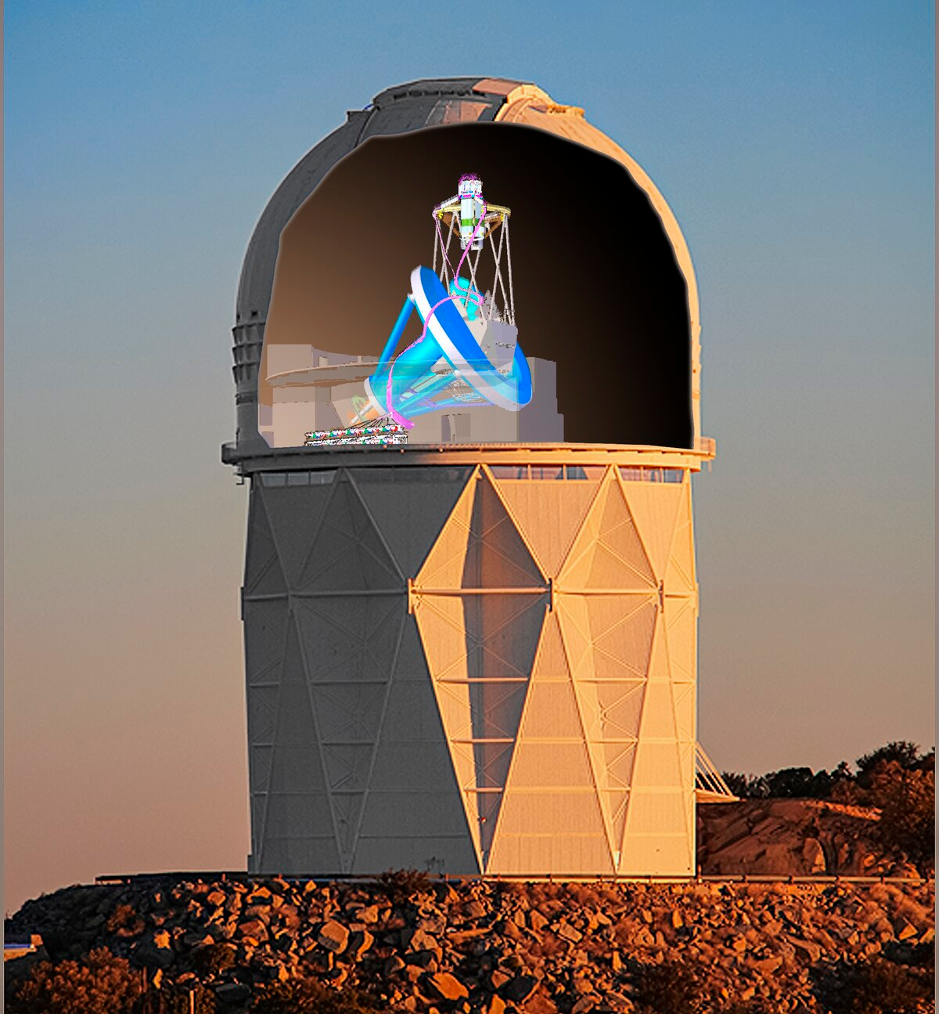
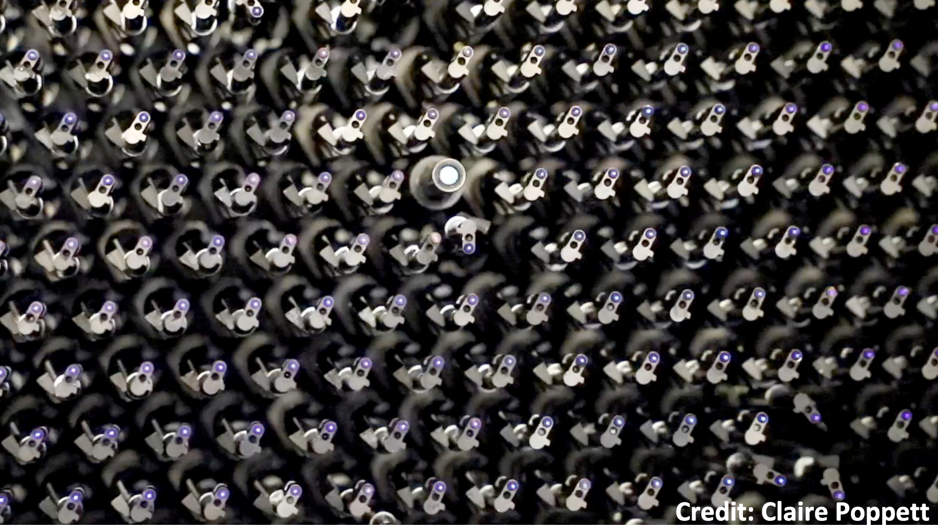
Dark Energy Spectroscopic Instrument (DESI)
Introduction III: Cosmological tensions
DESI focal plane
3.8m primary mirror
First Stage-IV experiment of a panoply of new surveys coming up!
Nominal 5-year survey (2021-2026) now to 2028
5000 robotic fibers
10 spectrographs
5000 spectra every ~15 min
Slide courtesy of Cristhian Garcia-Quintero

Slide 4
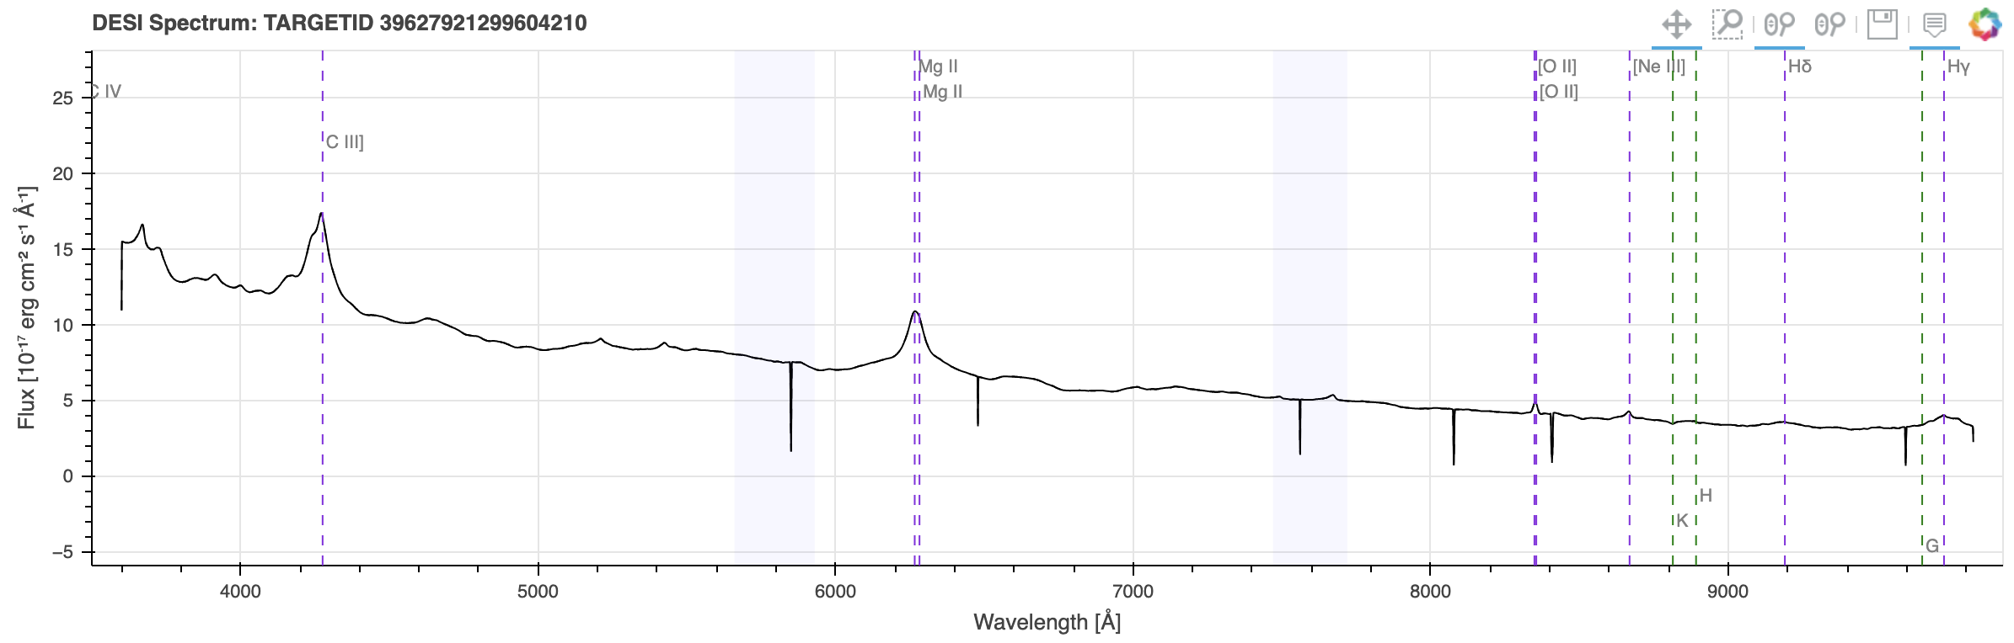
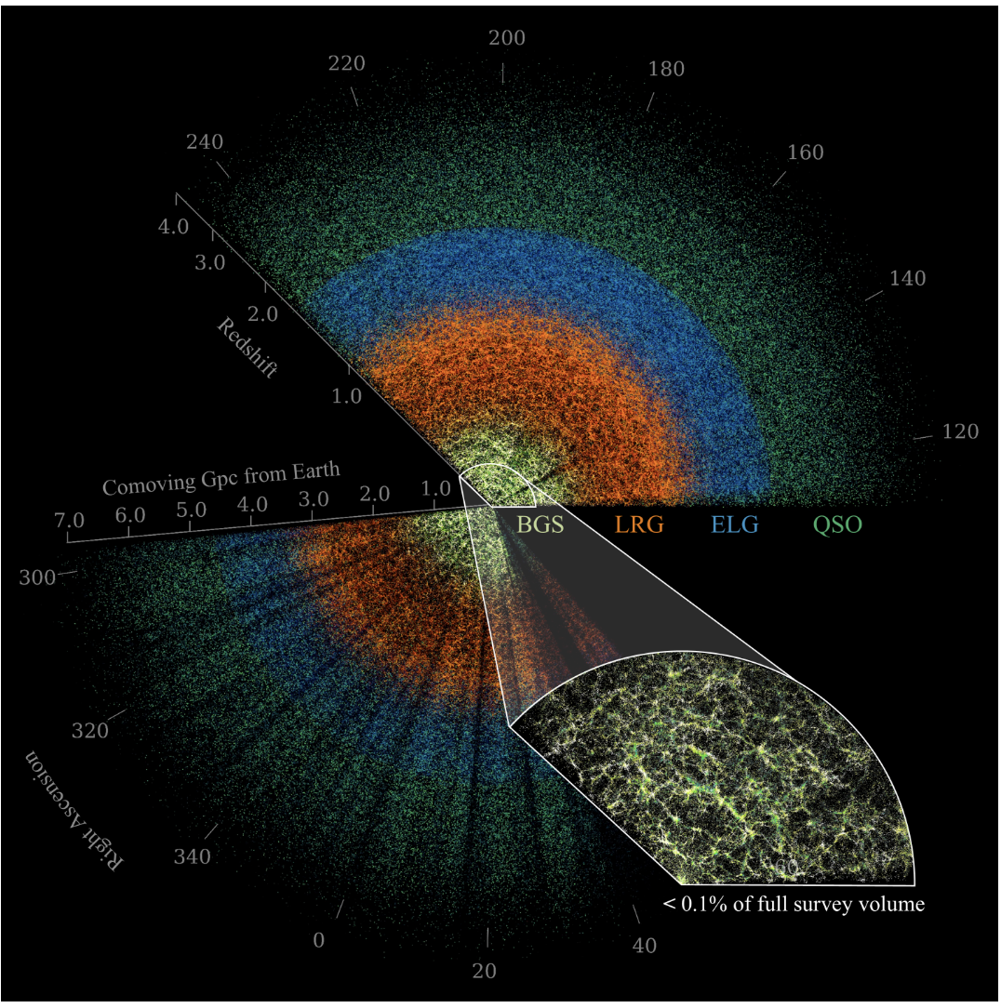
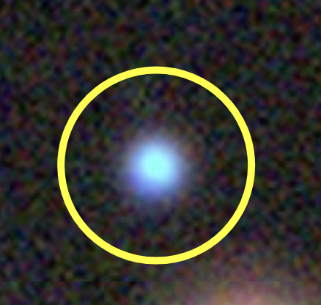
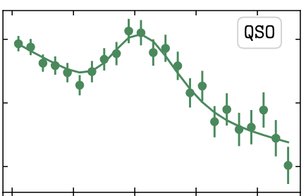
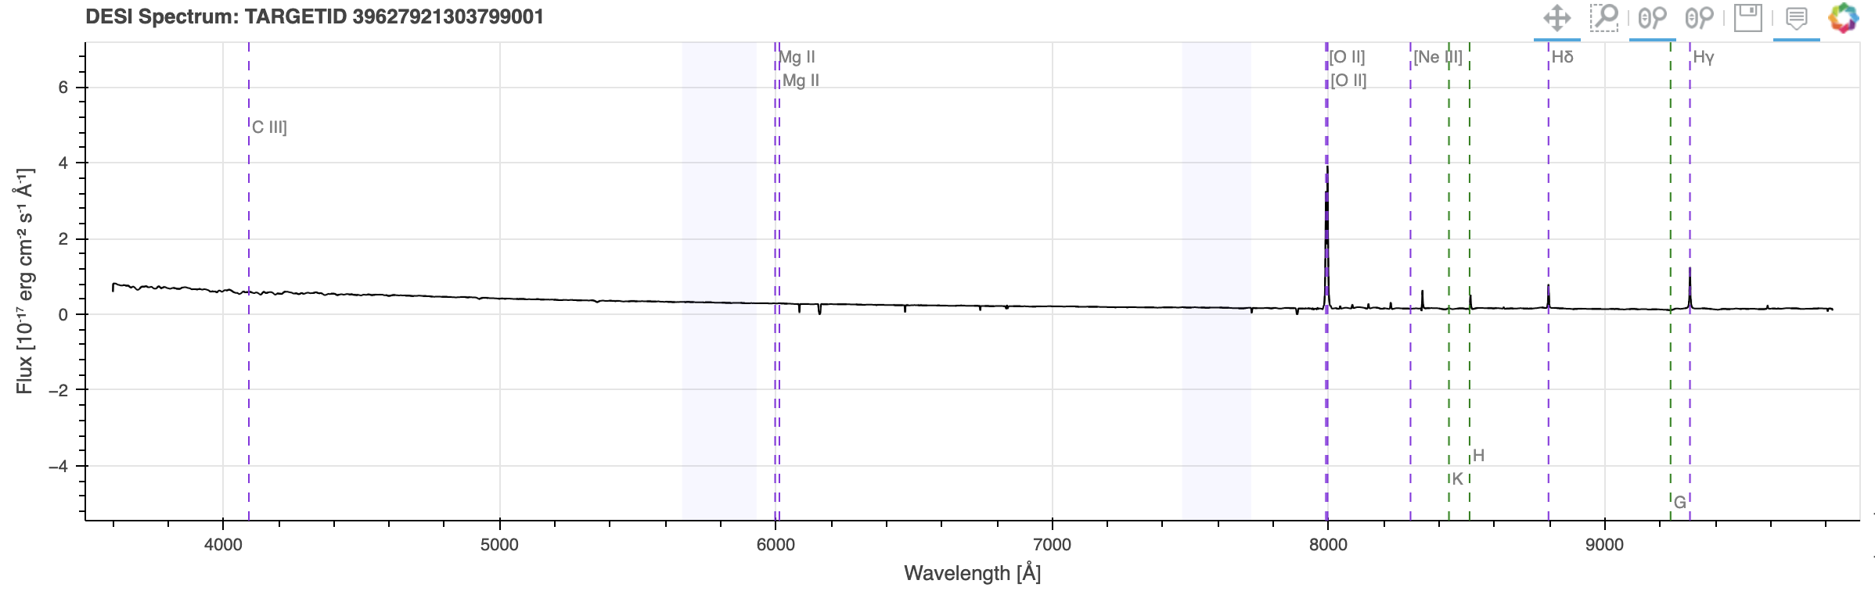
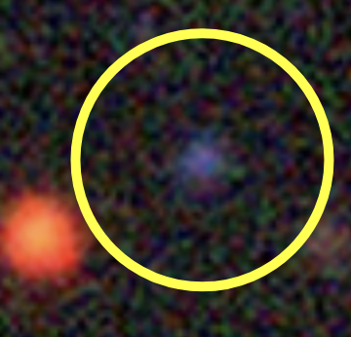
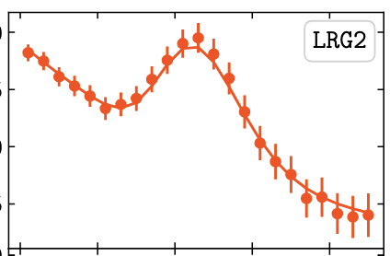
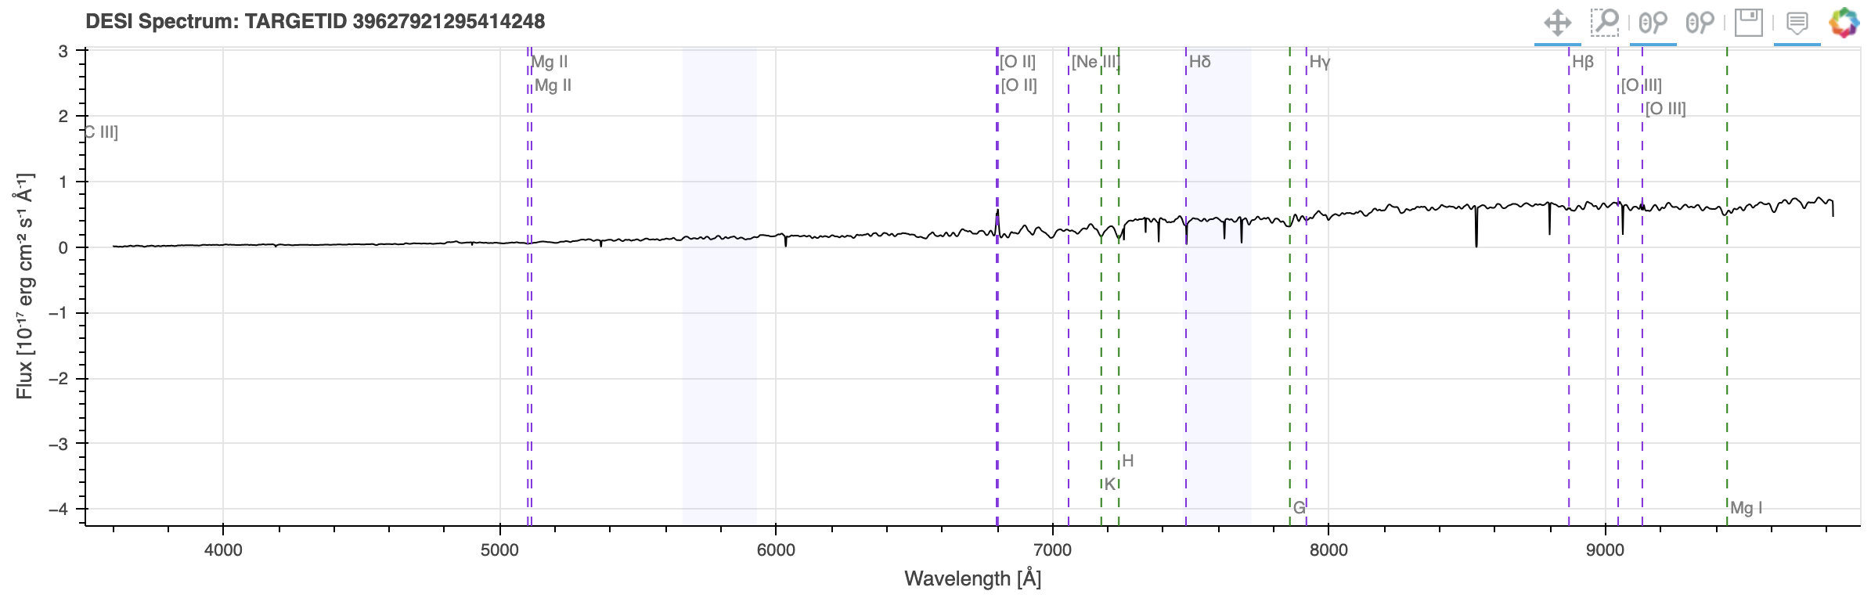
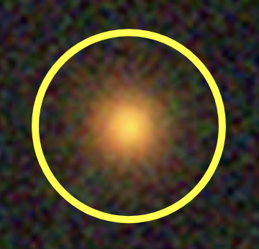
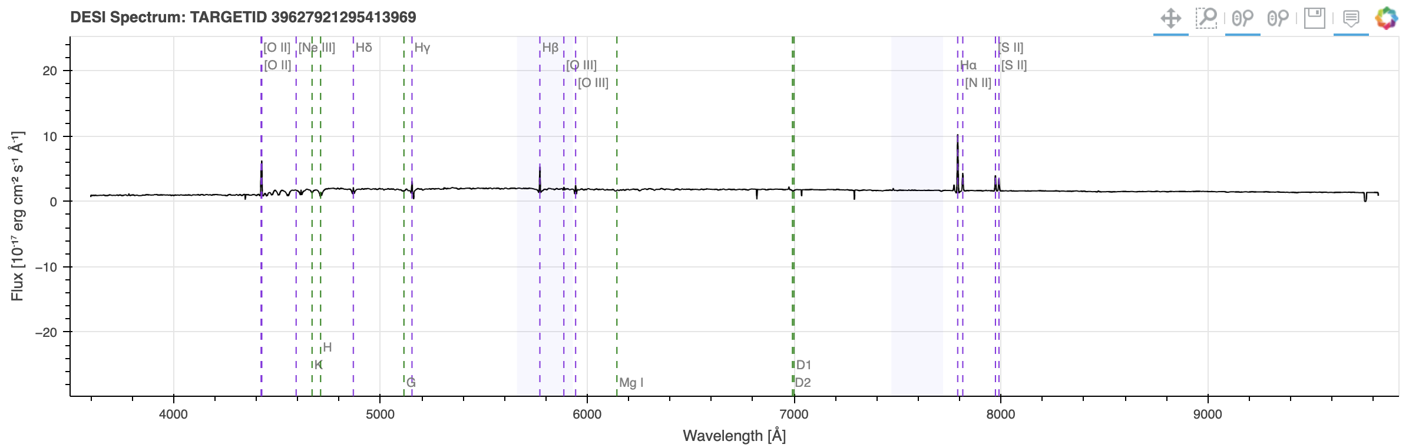
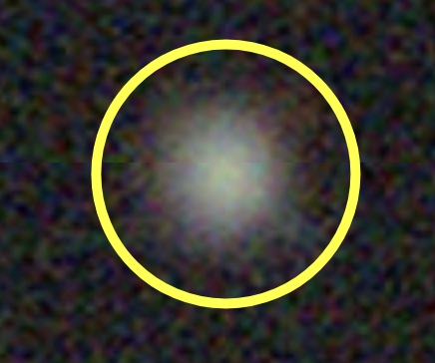
DESI Spectra
Legacy Survey DR9
DESI fiber
Quasar
(QSO)
BAO fit
(DR2)
z = 1.24
D_{M}/r_{d} ~ 30
Mg⁻ doublet:
MgII
5 p elec.,
l =1, s = ½
J=1/2, 3/2
₂P^{3/2}
₂P^{1/2} → ₂S^{1/2}
l=0, s=1/2, j =1/2
[OII]
D_{M} ~ 4.5 Gpc
Emission Line
Galaxy (ELG)
z = 1.14
D_{M} ~ 2.5 Gpc
O⁻ doublet:
[OII]
D_{M}/r_{d} ~ 17
3 p electrons
l =2, s=1/2,
j =3/2, 5/2
₂D^{3/2}
₂D^{5/2} → ₄S^{3/2}
→
BAO scale
l=0, s=3/2, j=3/2
z = 0.82
DESI tracers (+Lyα)
Luminous Red
Galaxy (LRG)
[OII]
z = 0.19
14M tracers
High-resolution redshift
Robust distance scale
Bright Galaxy
(BGS)
BAO scale
[OII]
Hα
Balmer
3 → 2
Image: DESI, M. Abdul Karim et al., 2503.14745

Slide 5
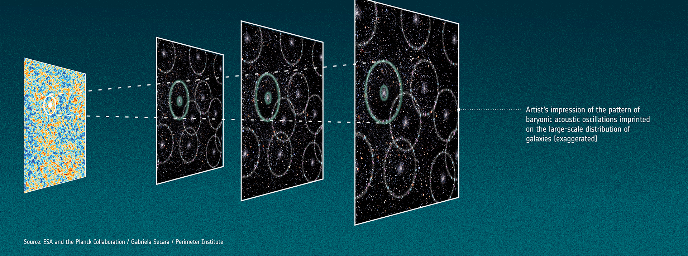

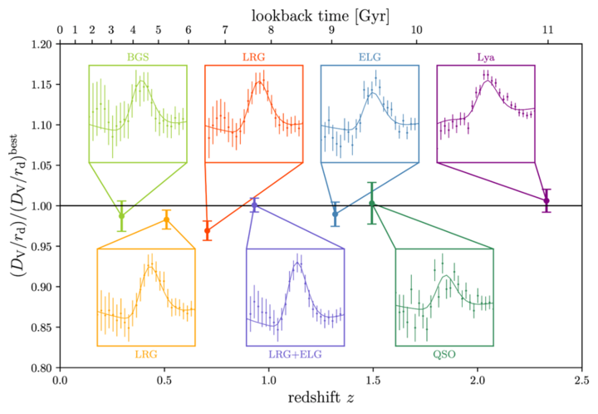
Planck Coll., G. Secara
ΛCDM
DESI measures 6+6 of these commoving distances:
And one of these:
For BGS, DM and DH are not independently determined due to statistics.
DESI, M. Karim et al., 2503.14738v2

Slide 6
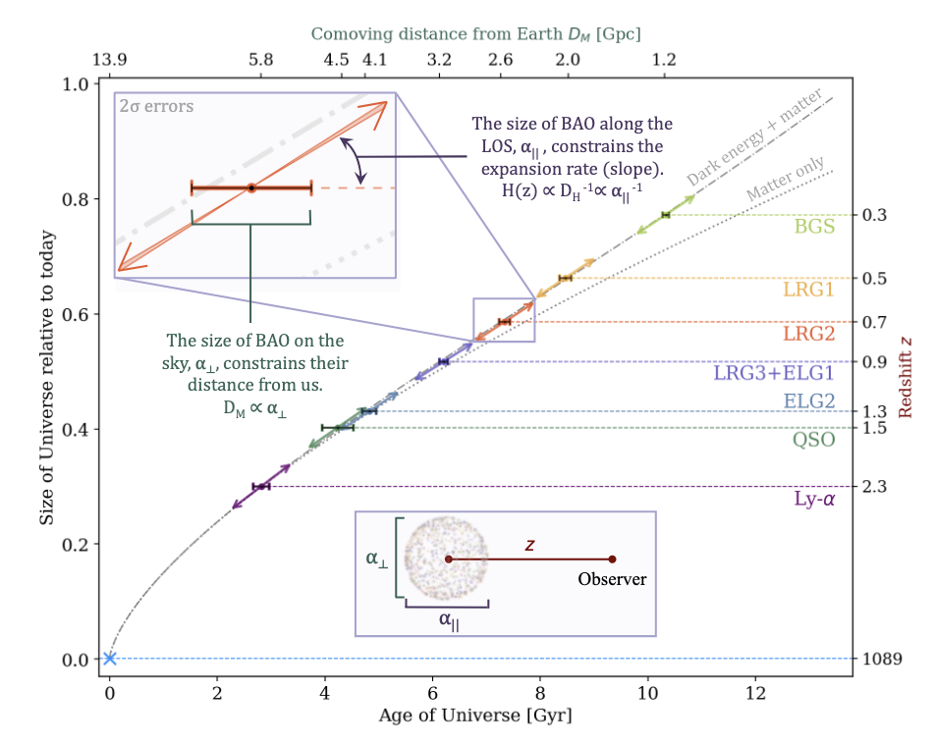
Matter + dark energy
matter only
DESI, M. Karim et al., 2503.14738v2

Slide 7
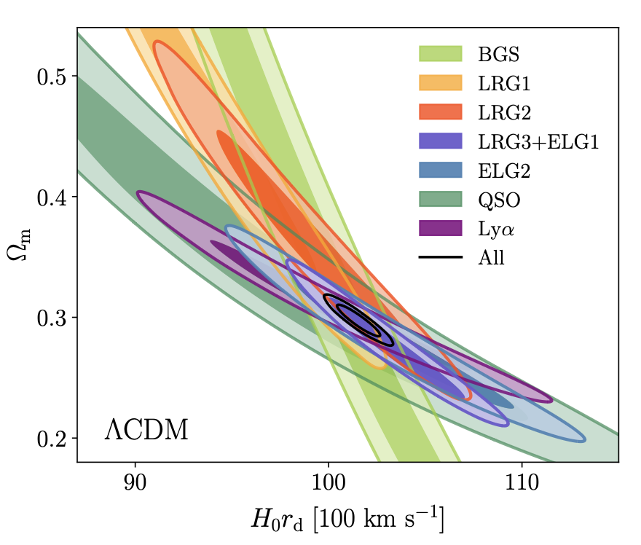
DESI tracers compliment each other in resolving power
Redshift
0.1 – 0.4
0.4 – 0.6
0.6 – 0.8
0.8 – 1.1
1.1 – 1.6
D_{H} constrains H(z),
0. 8– 2.1
Therefore, Ω_{m} anti-correlates with H₀:
1. 8– 4.2
0.1 – 4.2
For fixed H(z),
Therefore, a change in H₀ makes
a smaller change in Ω_{m} when z is larger ,
so that higher z tracers have less
negative slopes.
DESI, M. Karim et al., 2503.14738v2

Slide 8
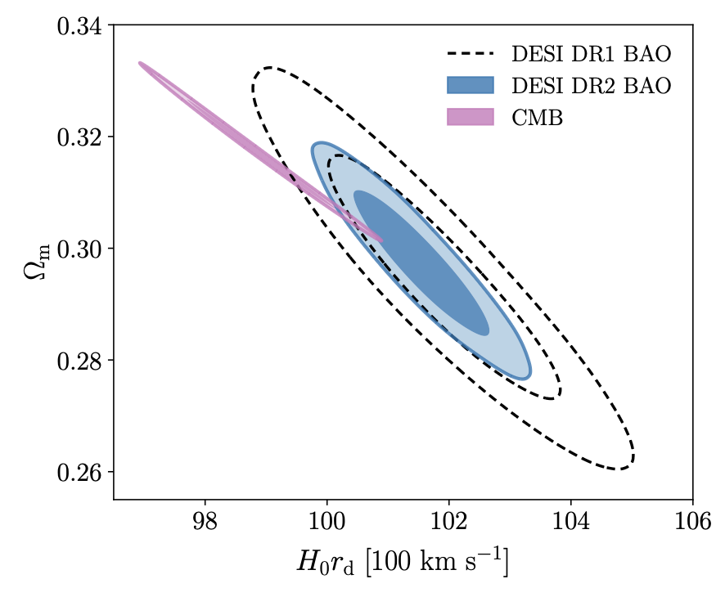
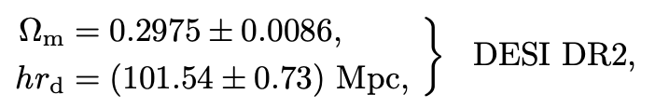
ΛCDM
2.3 sigma tension
The BAO scale gives the energy densities
r_{d} = 147.07 Mpc (Planck)
DESI, M. Karim et al., 2503.14738v2

Slide 9
w₀w_{a}CDM (Chevallier, Polarski, Linder)
ΛCDM
2.8 σ
CPL eq. of state
3.8 σ
4.2 σ
Dark energy gets a z dependence:
No SNe
DESI DR2
DESI, M. Karim et al., 2503.14738v2
M. Chevallier and D. Polarski,
Int. J. Mod. Phys. D 10, 213 (2001).
E. V. Linder,
Phys. Rev. Lett. 90, 091301 (2003).

Slide 10
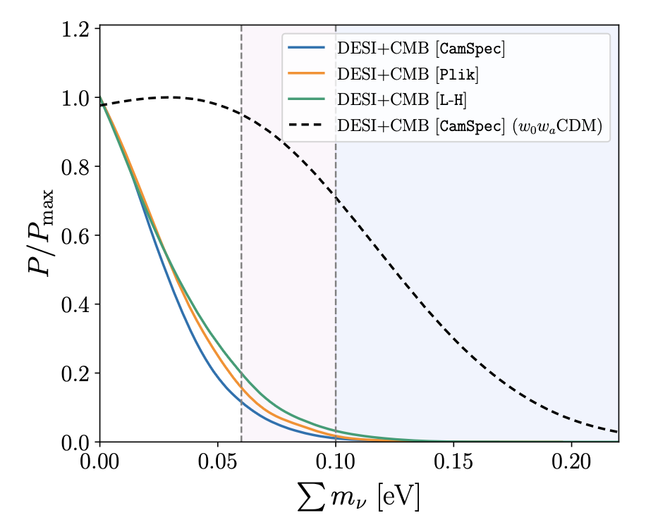
Neutrinos
340 cosmic neutrinos per cm³
DESI alone cannot determine the neutrino mass
ΛCDM prefers a negative neutrino mass
DESI, M. Karim et al., 2503.14738v2

Slide 11
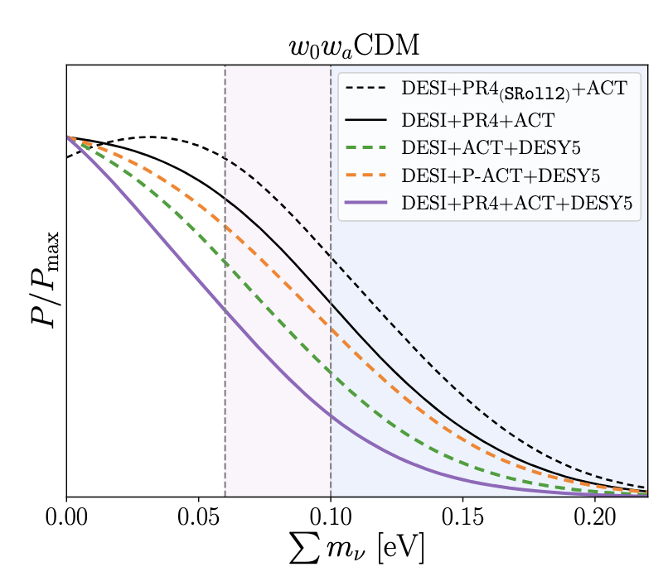
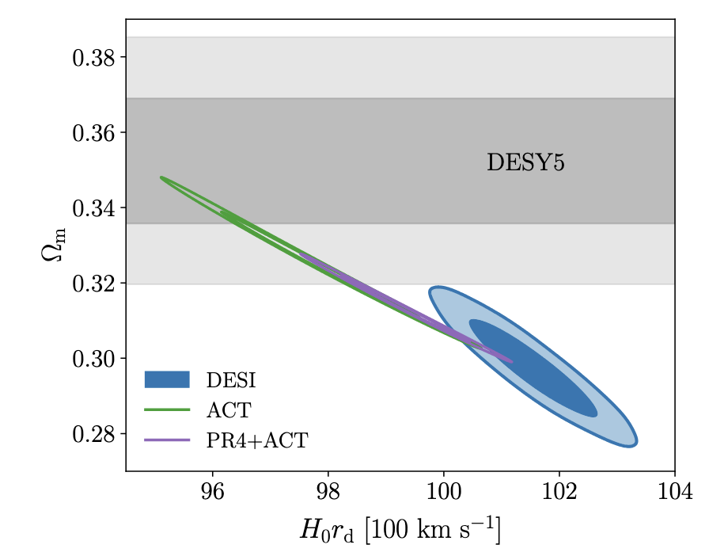
New CMB data from the Atacama Cosmology Telescope (ACT) analyzed with Planck
ACT has complementary coverage at small distance scales (so called high-ℓ)
DESI, C. Garcia-Quintero et al., 2504.18464v2

Slide 12
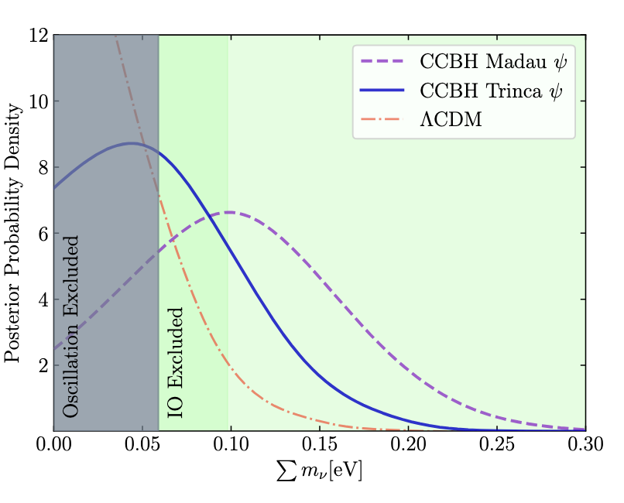
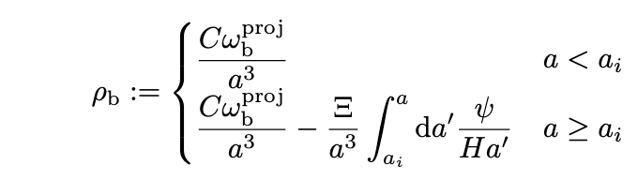
Cosmologically Coupled Black Holes
BHs are formed via the collapse of massive stars, which have lifetimes short compared to the expansion rate after star formation begins at a_{i} ∼ 1/20, the DE density will grow, tracking the star formation rate.
Trinca can account for the “baryon deficit” and make room for neutrino mass.
DESI, S. Ahlen et al., 2504.20338v1

Slide 13
Summary
There is mounting evidence that dark energy is dynamic
There is a growing “neutrino” tension, in which ΛCDM fits prefer negative mass
It seems that the 3 issues for ΛCDM (Hubble tension, neutrino mass, and the cosmological constant) are not going away so easily

Slide 14
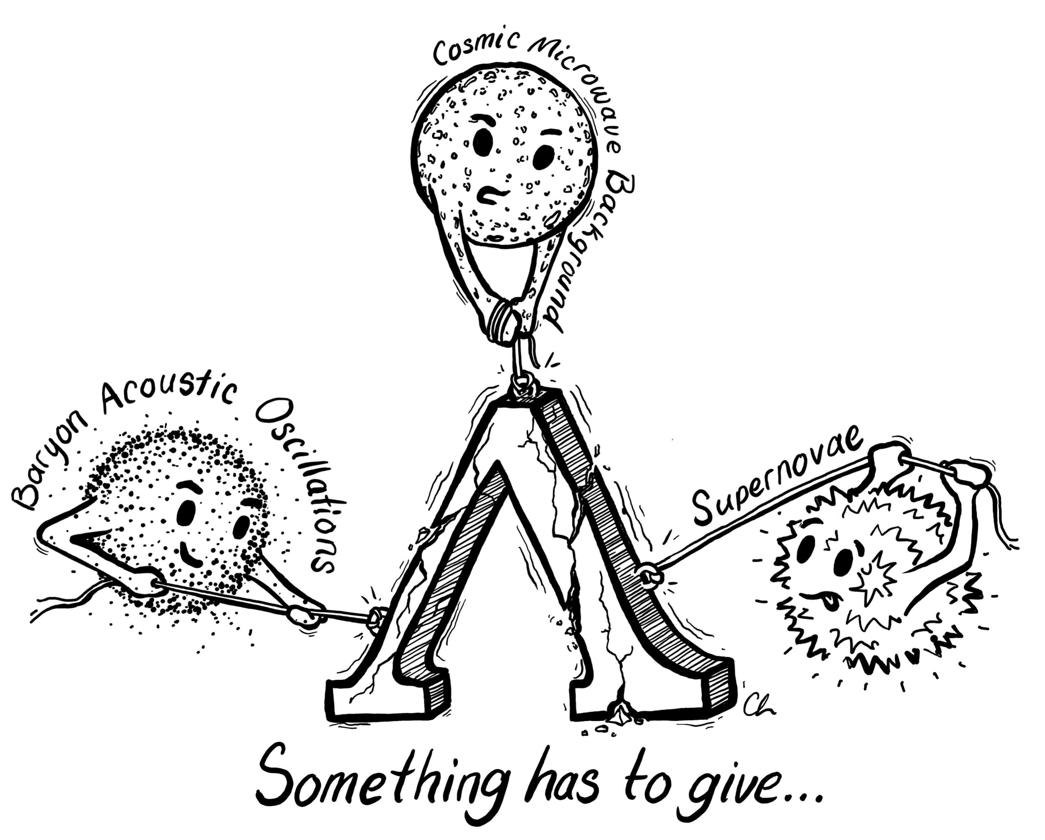
Claire Lamman (DESI)

Slide 15
Backup slides

Slide 16
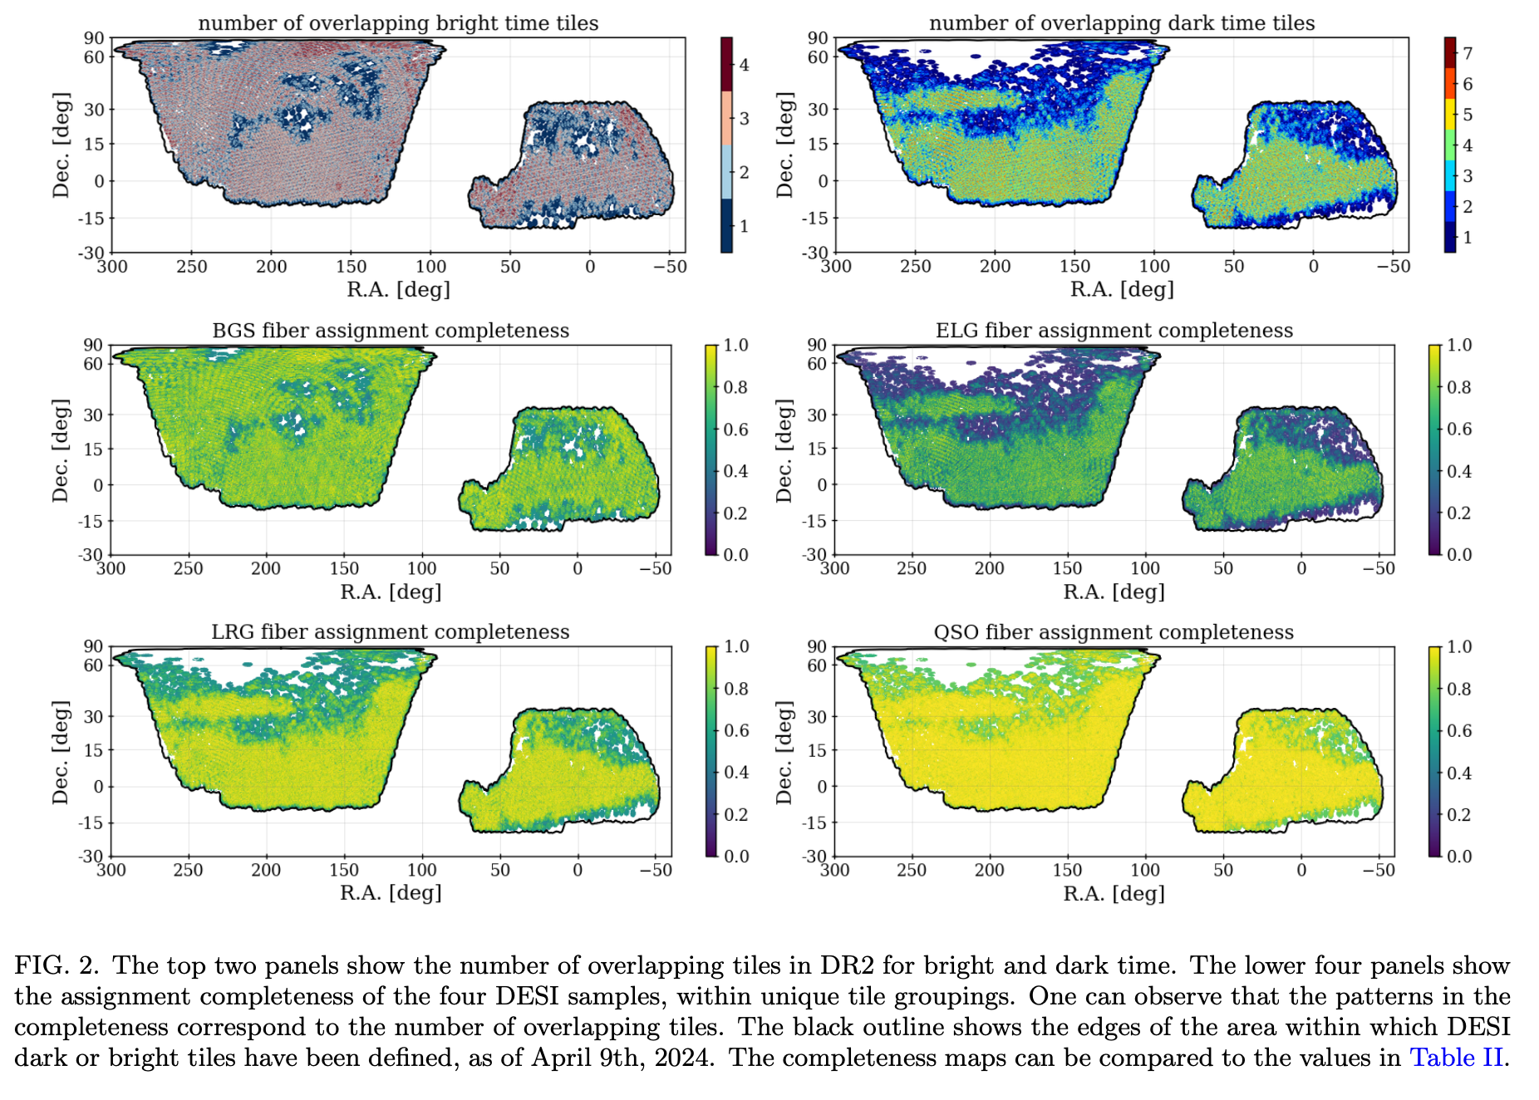

Slide 17
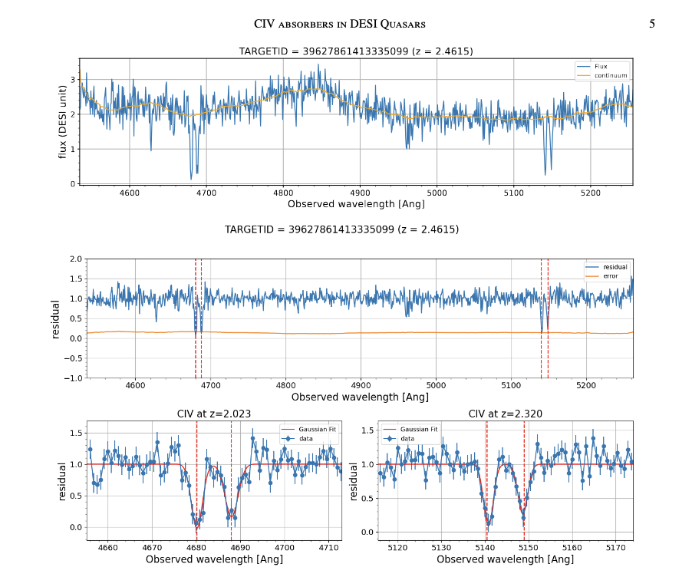
DESI Collaboration, Abhijeet Anand et al., arxiv 2504.20299

Slide 22
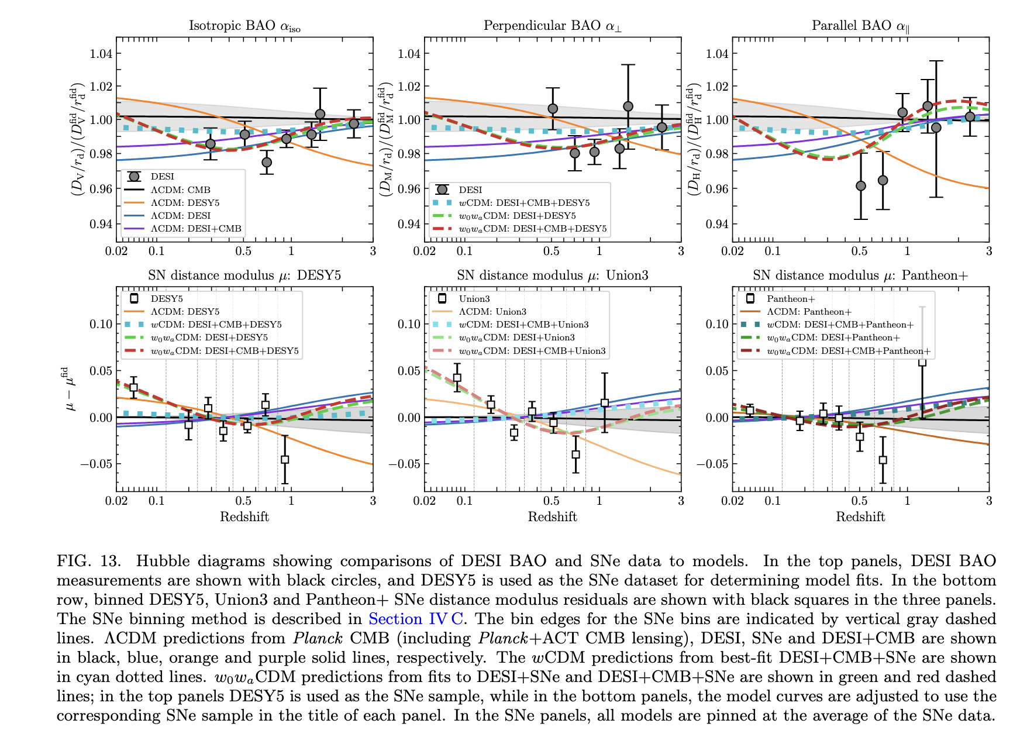

Slide 25
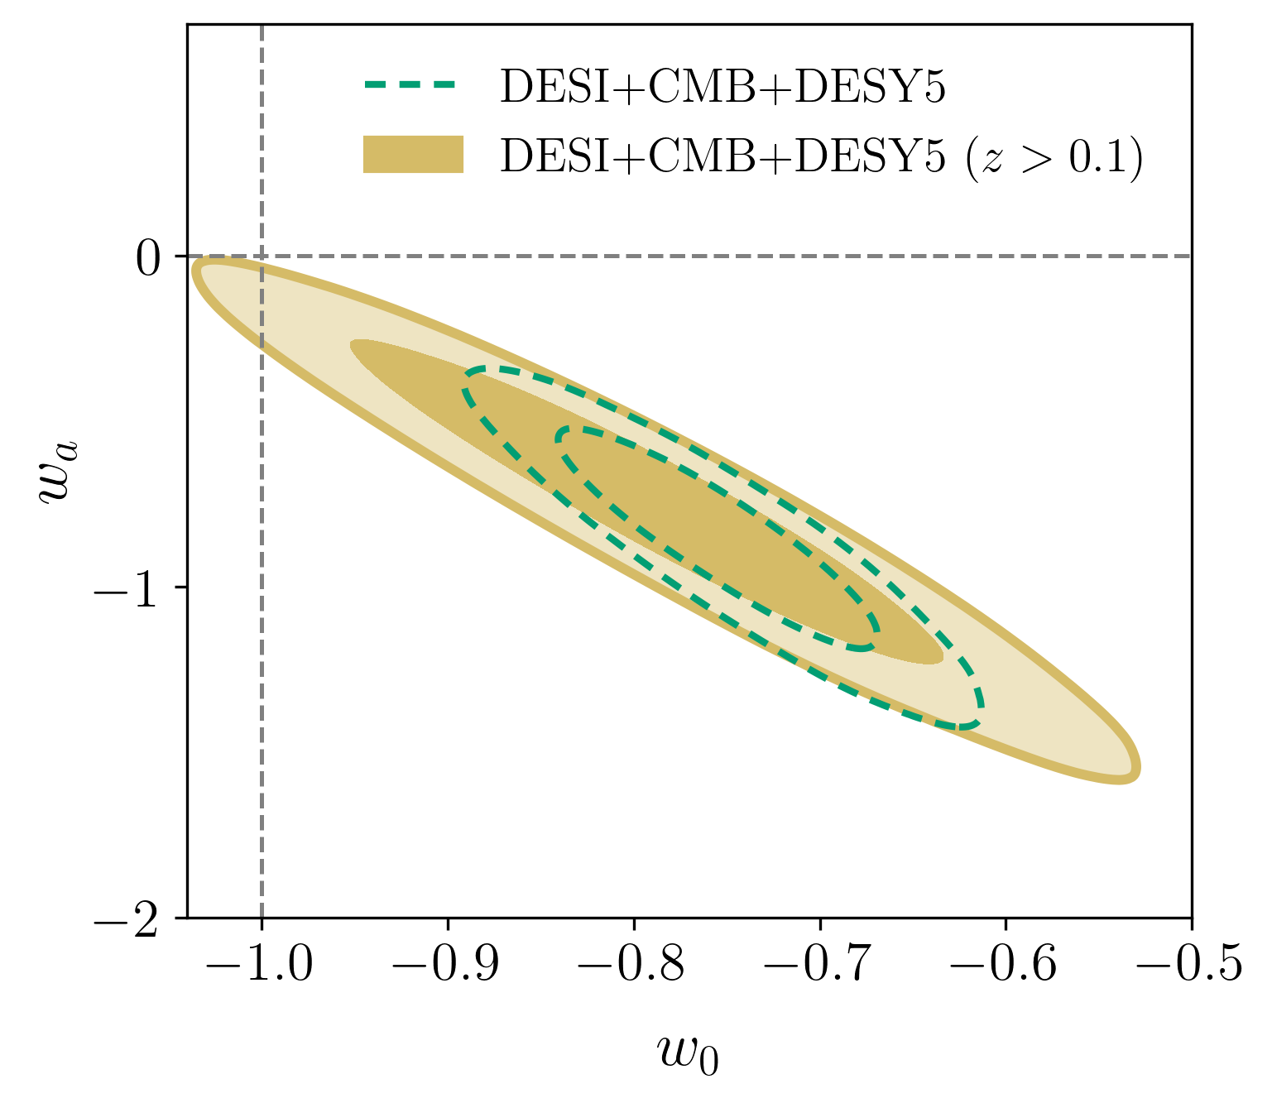
Constraints on evolving dark energy
Removing low-redshift SNe Ia data
Recovering of BAO feature
Introduction III: Cosmological tensions

Slide 28
DESI DR2 Results II: Measurements of Baryon Acoustic Oscillations and Cosmological Constraints, Phys. Rev. D (in press).

Slide 29
DESI DR2 Results II: Measurements of Baryon Acoustic Oscillations and Cosmological Constraints, Phys. Rev. D (in press).

Slide 30
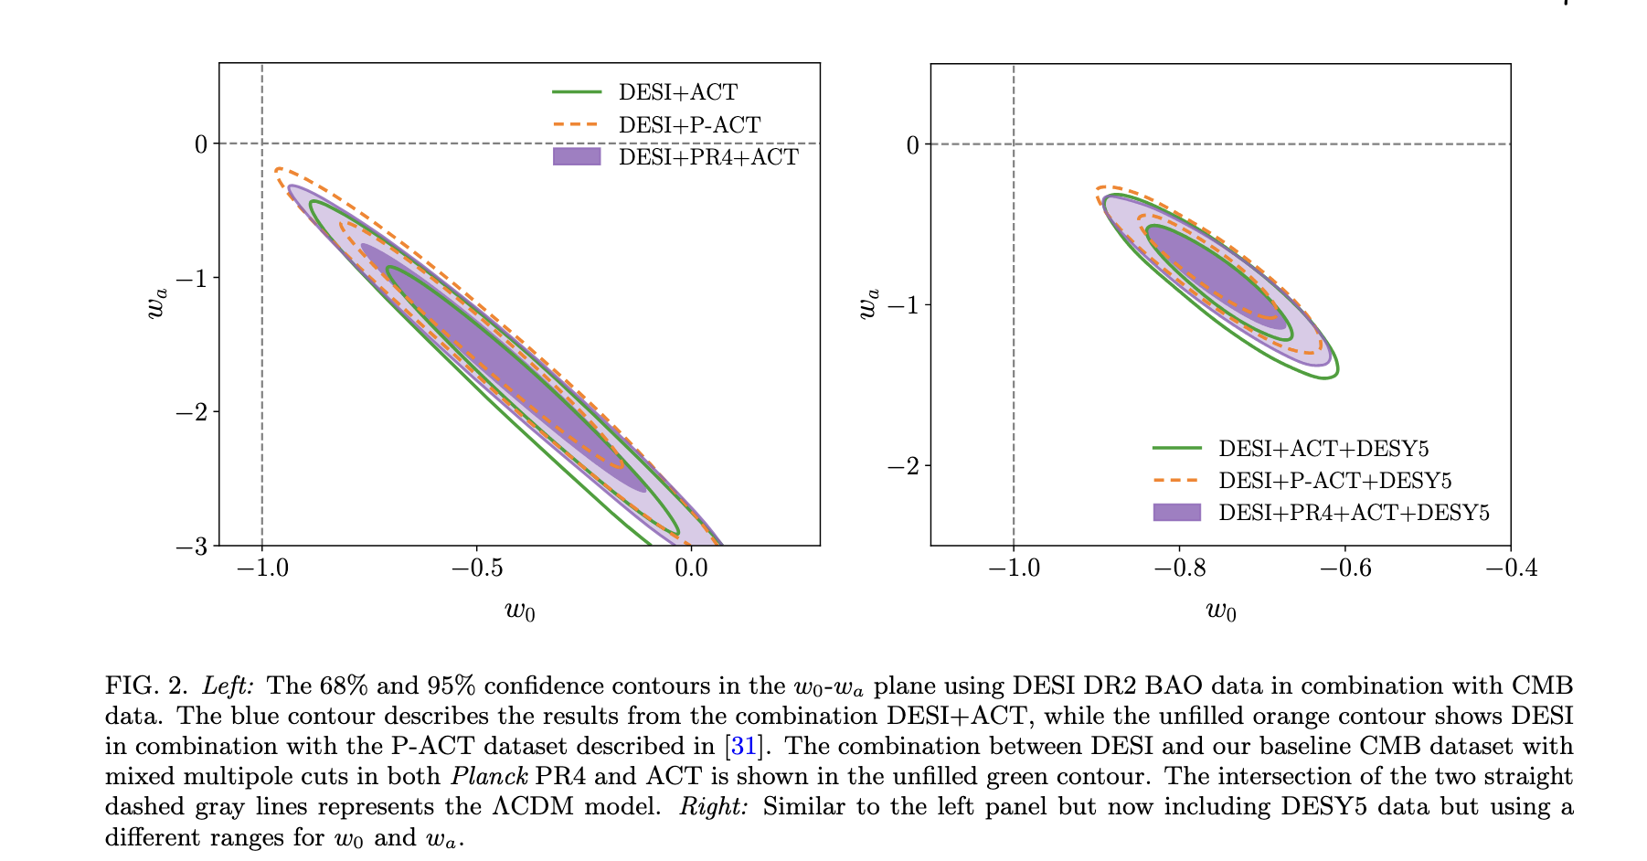

Slide 31
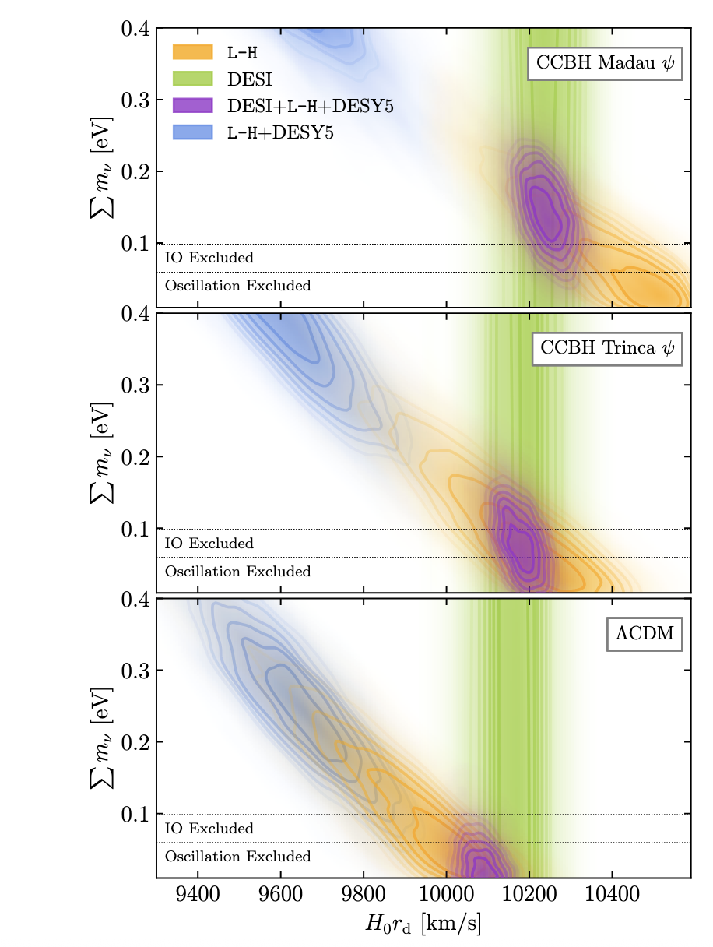

Slide 32
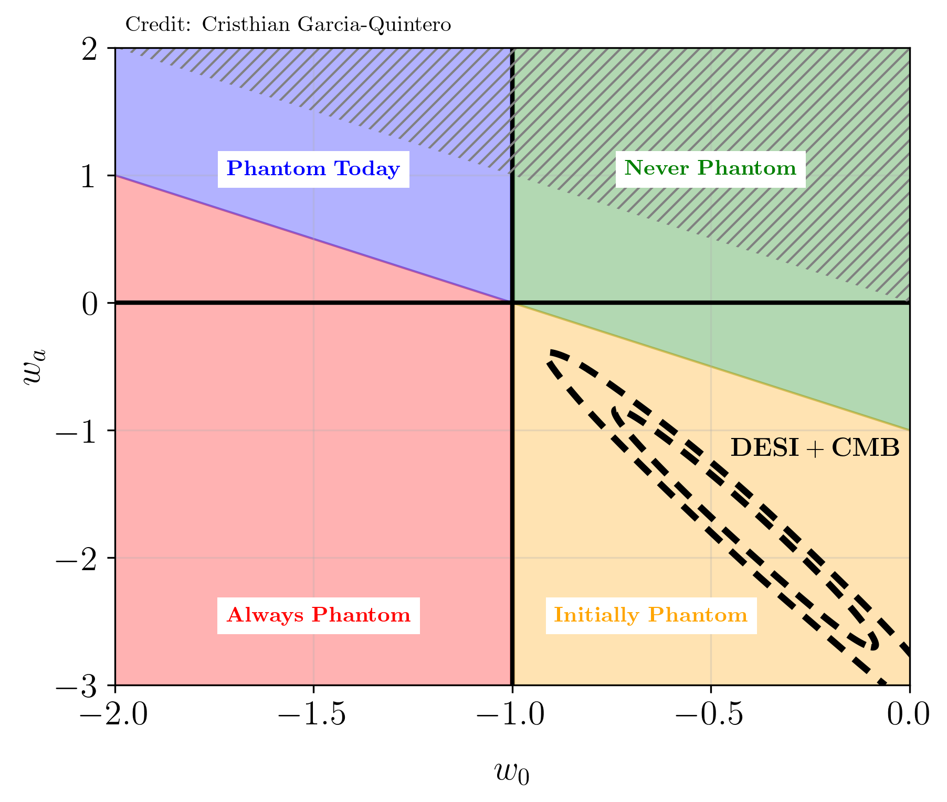

Constraints on evolving dark energy
Deviations from the standard model
Recovering of BAO feature
Introduction III: Cosmological tensions

Slide 33
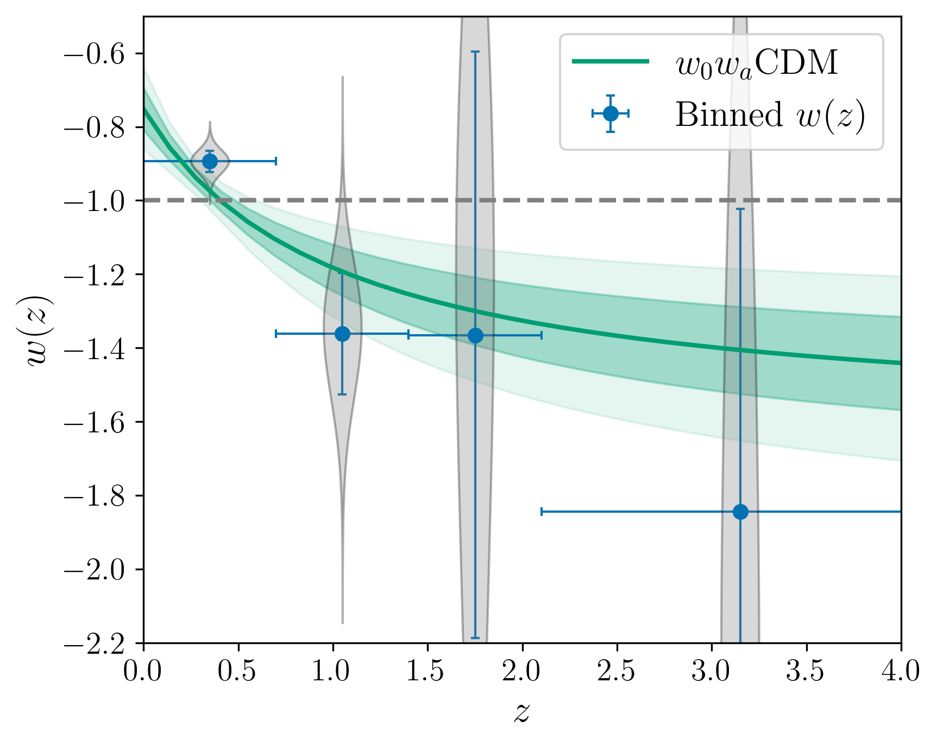
Constraints on evolving dark energy
Robustness against evolving dark energy (parametrization)
Recovering of BAO feature
Introduction III: Cosmological tensions
Binning in w(z)
See more extended tests and details on:
K. Lodha et al. 2025
(Dark Energy supporting paper)

Slide 34
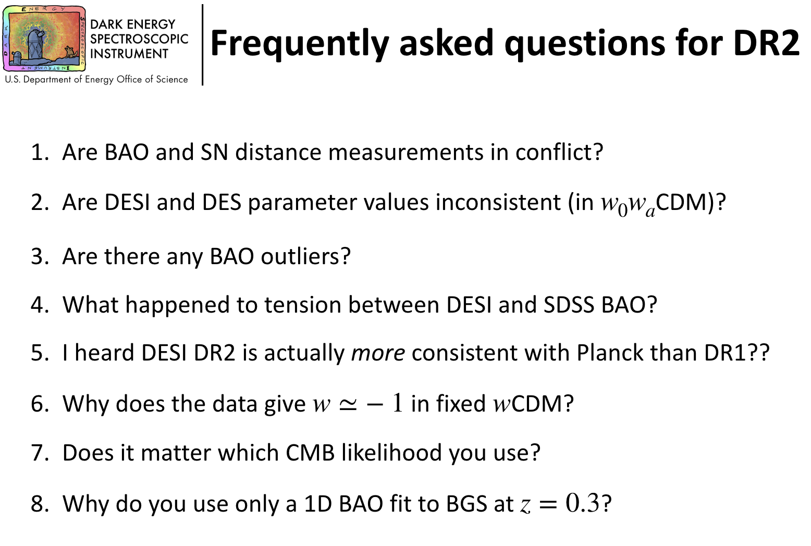

Slide 35
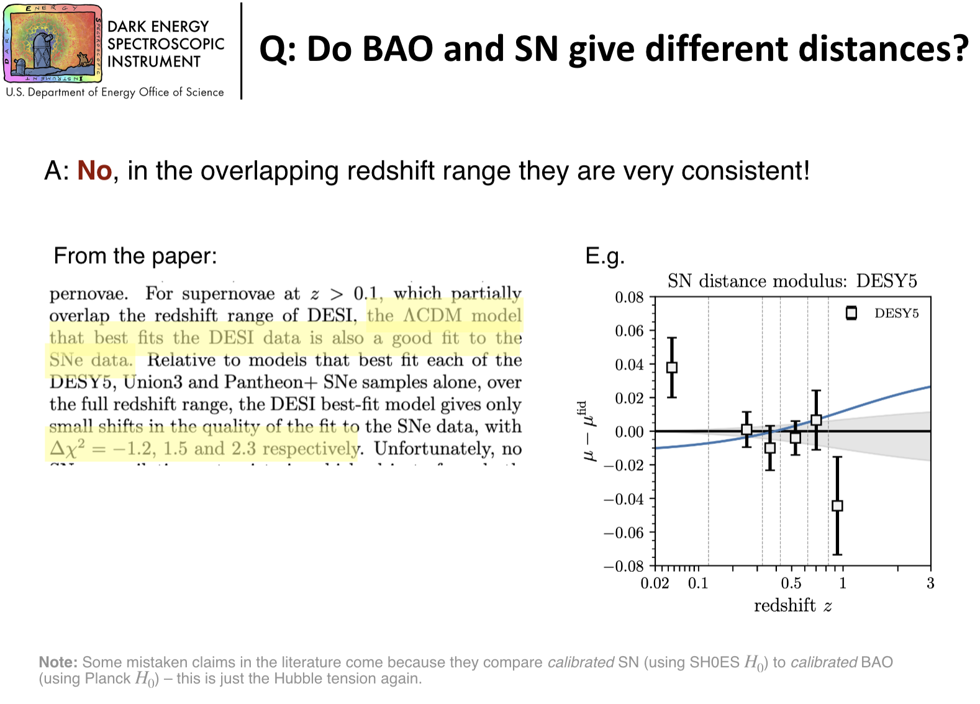

Slide 36
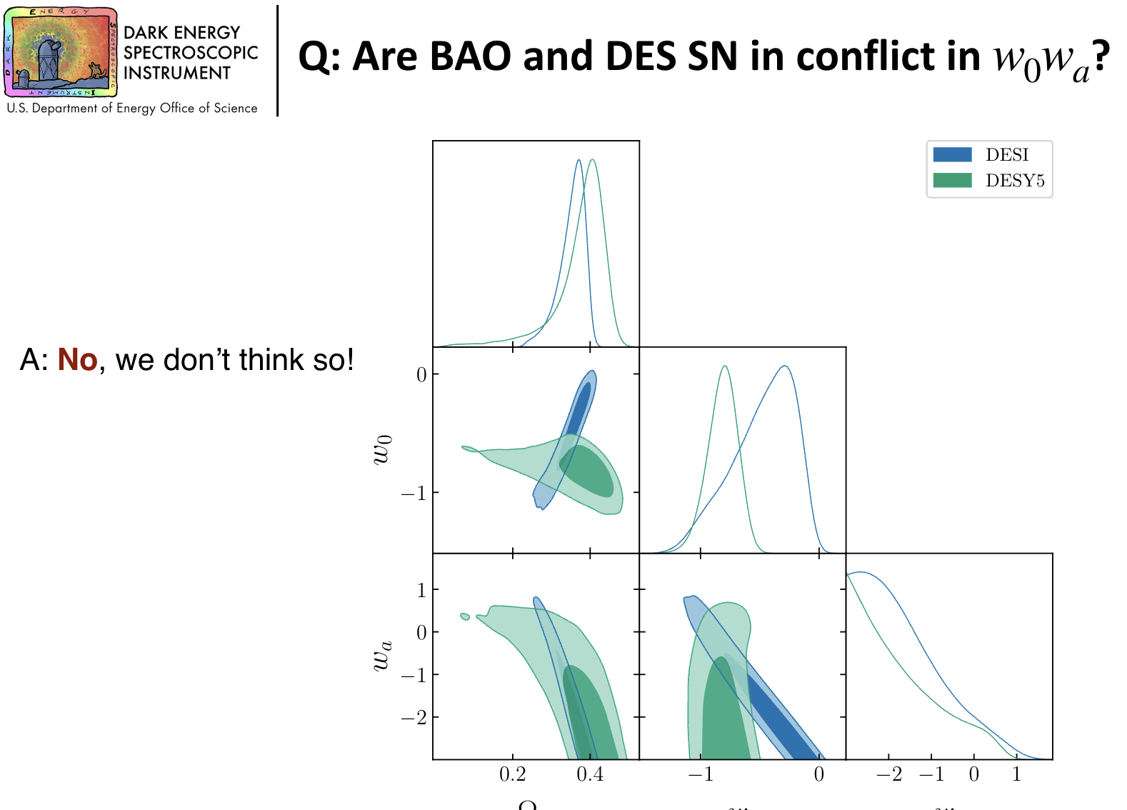

Slide 37
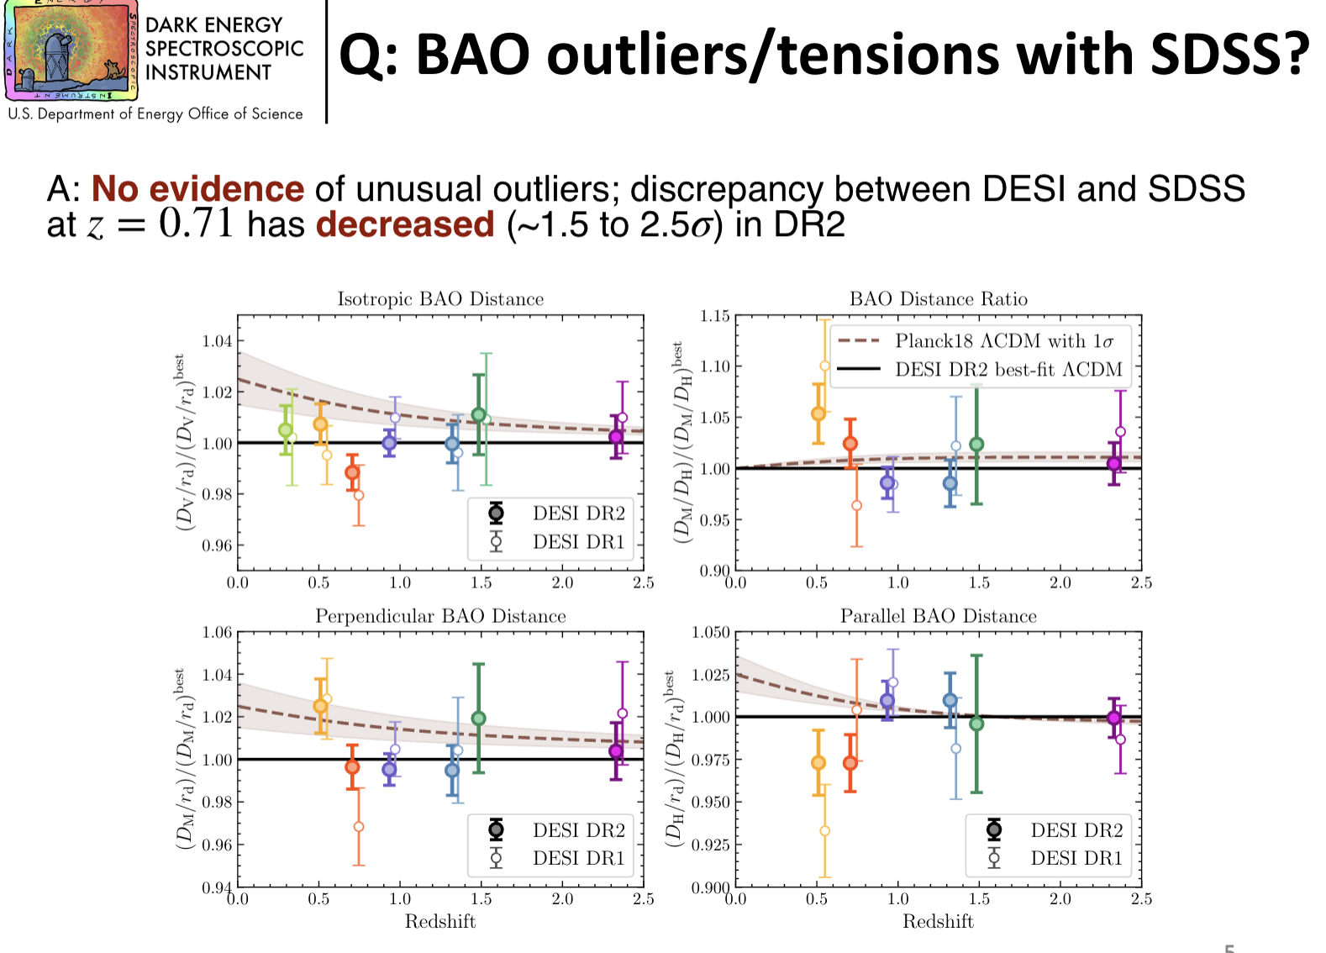

Slide 38
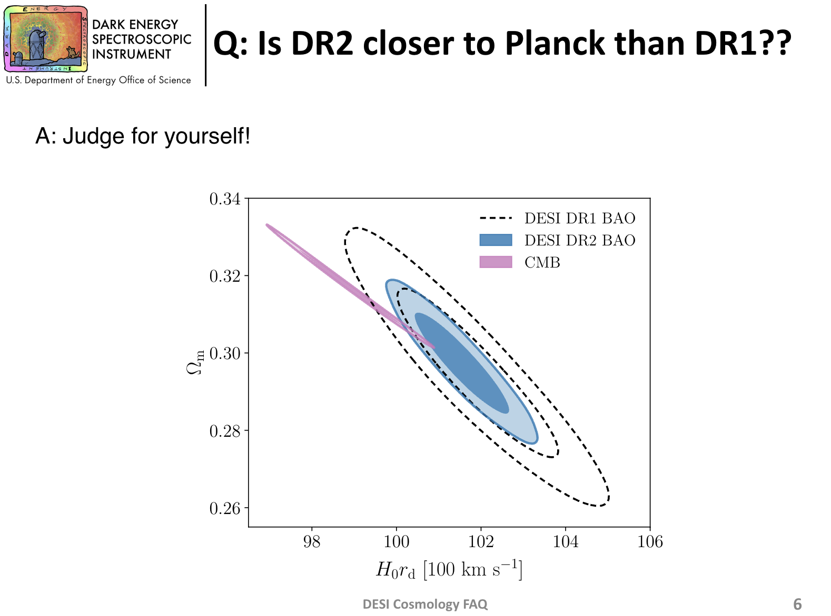

Slide 39
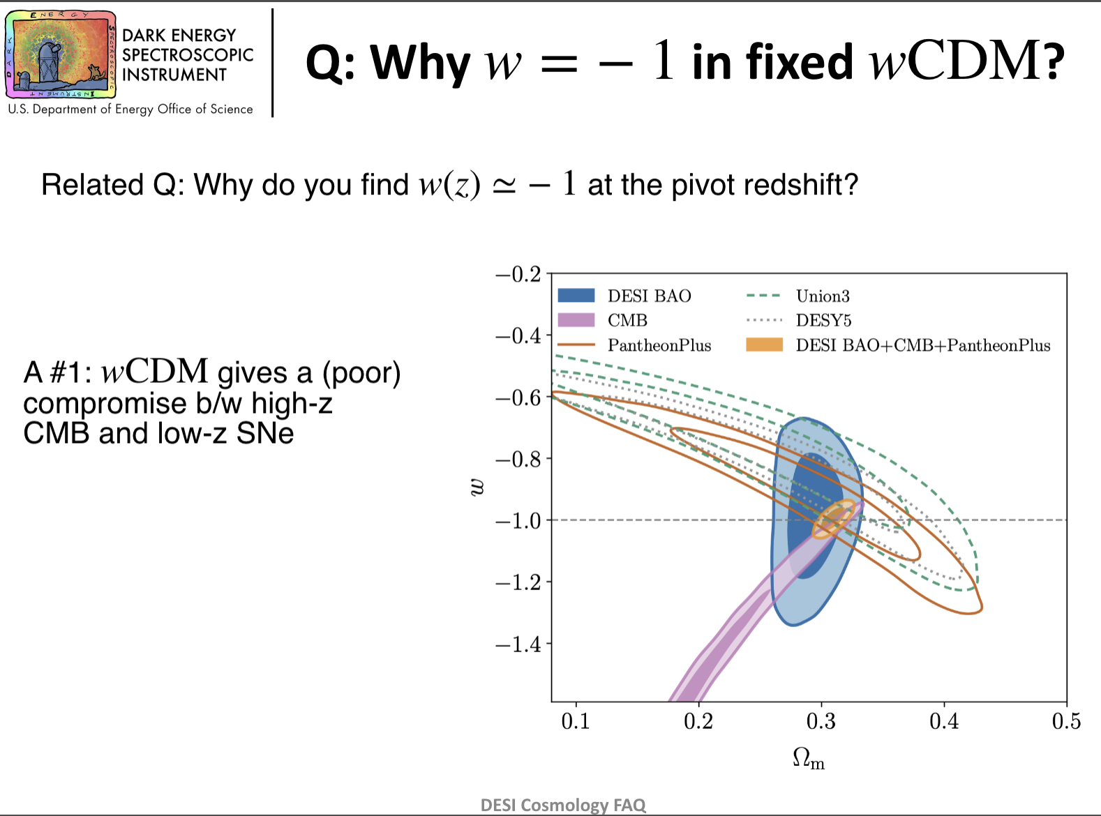

Slide 40
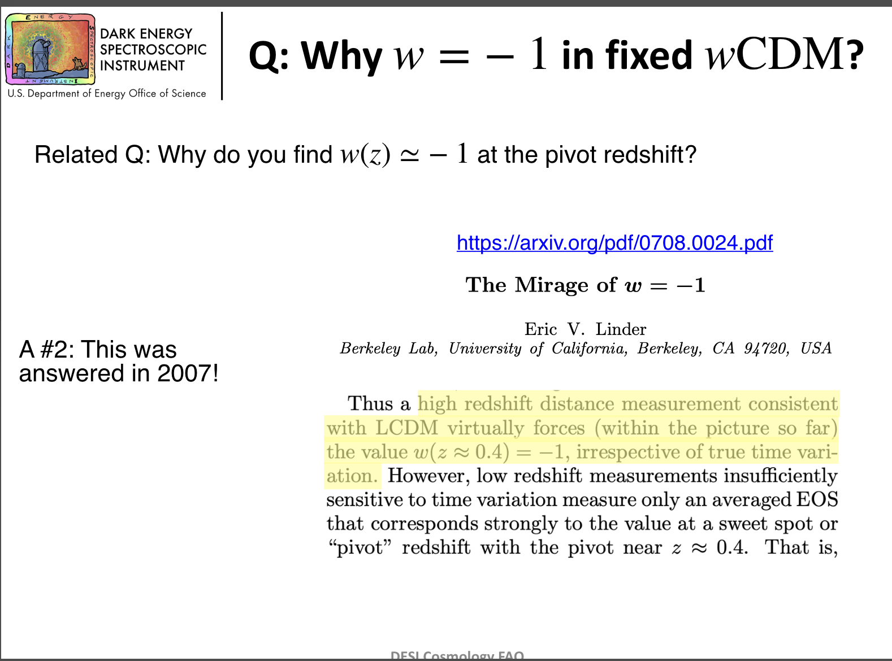

Slide 41
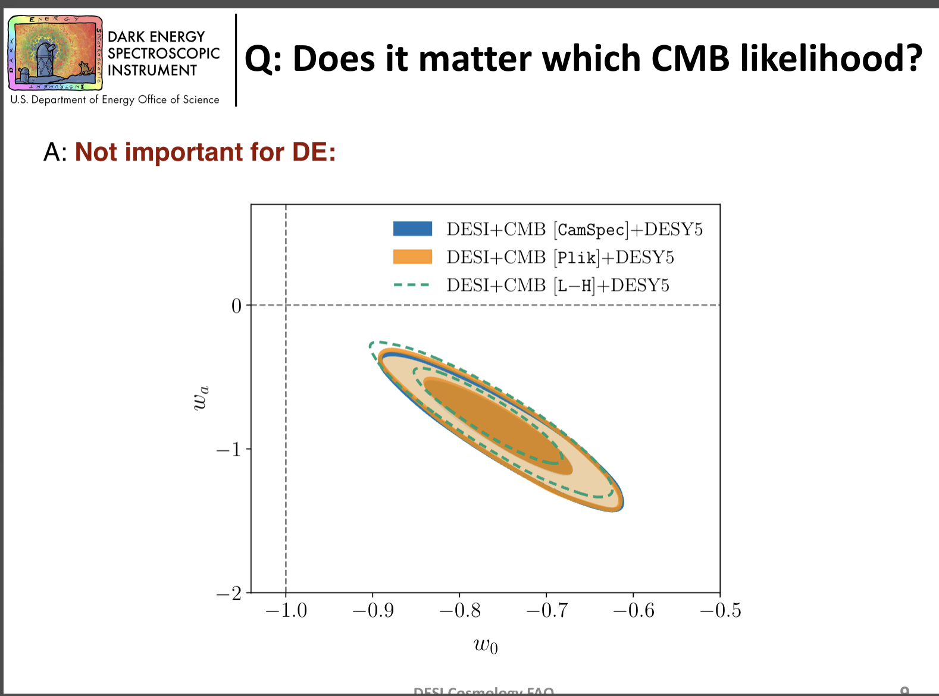

Slide 42
