Slide 1

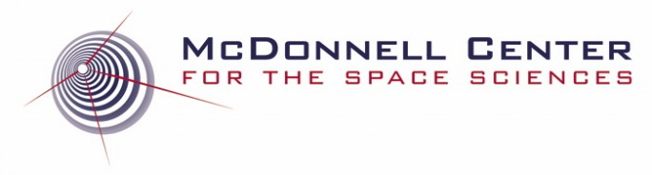
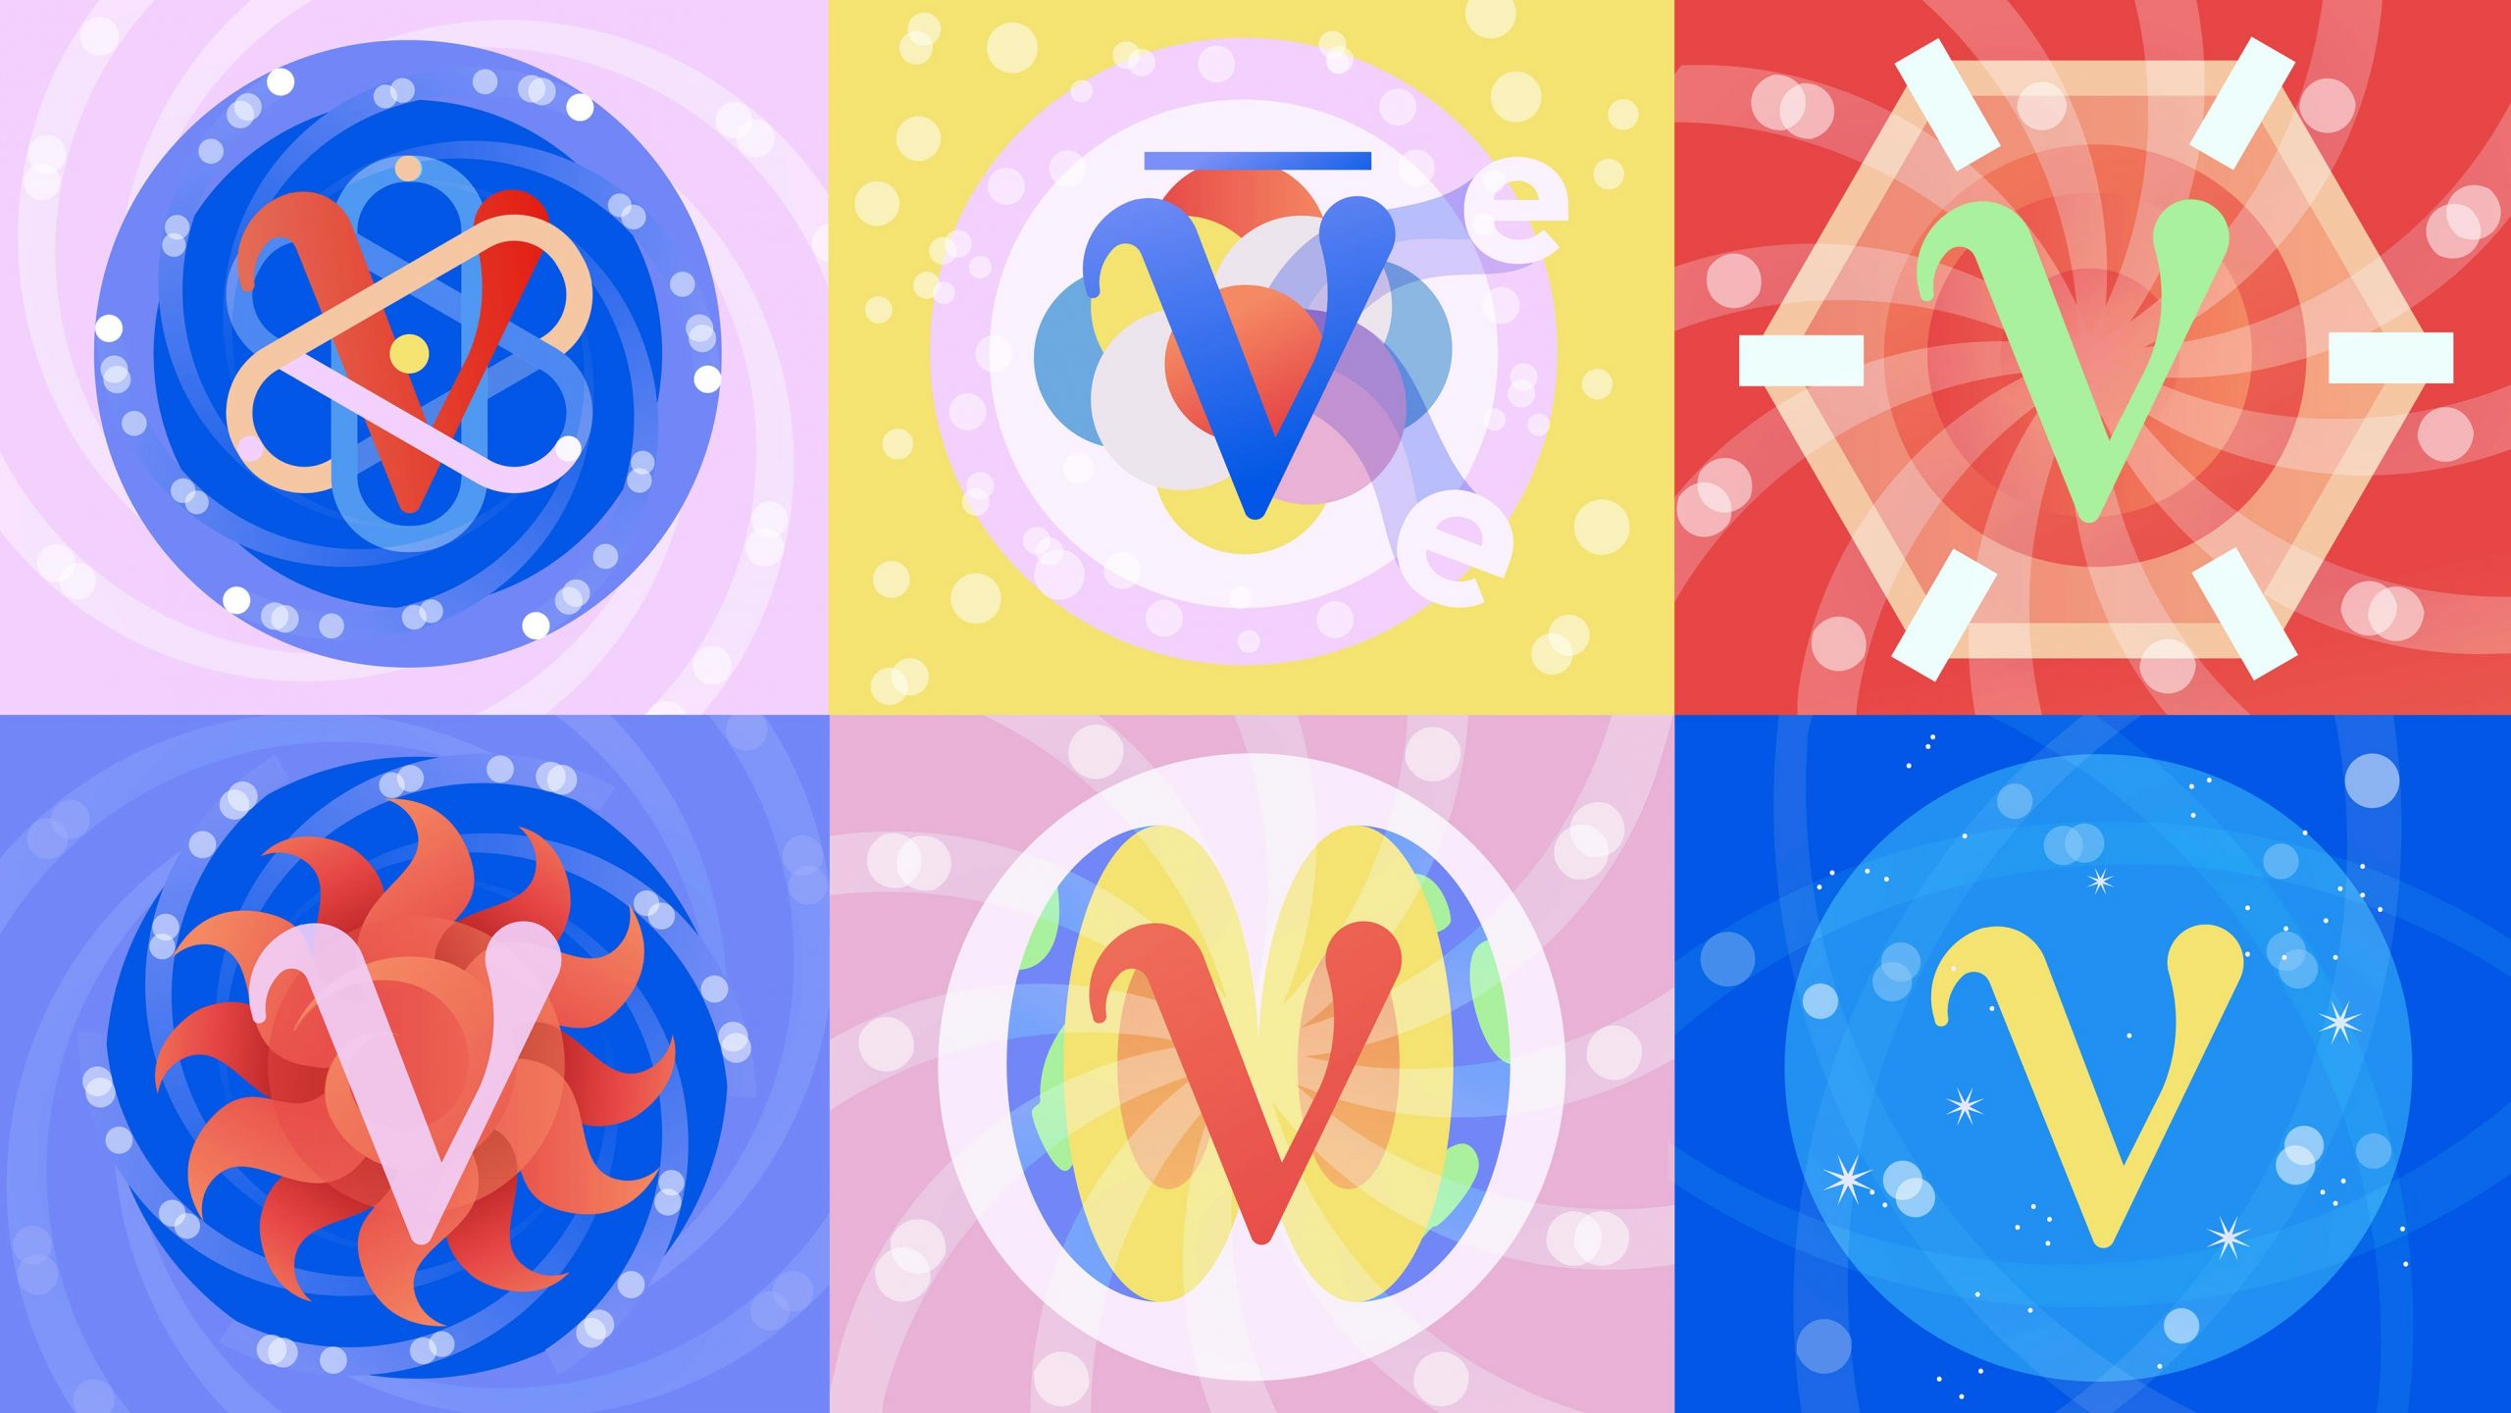


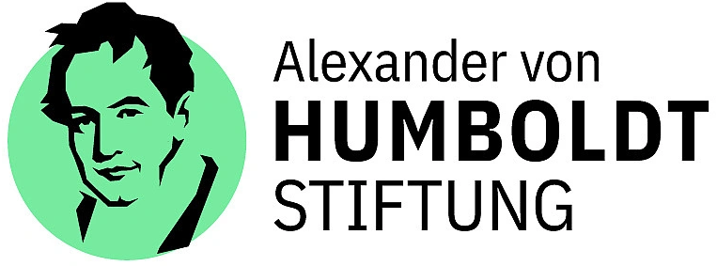
Testable Neutrino Models
Bhupal Dev
Washington University in St. Louis
PPC 2025
The Institute for Underground Science at SURF
June 27, 2025

Slide 2
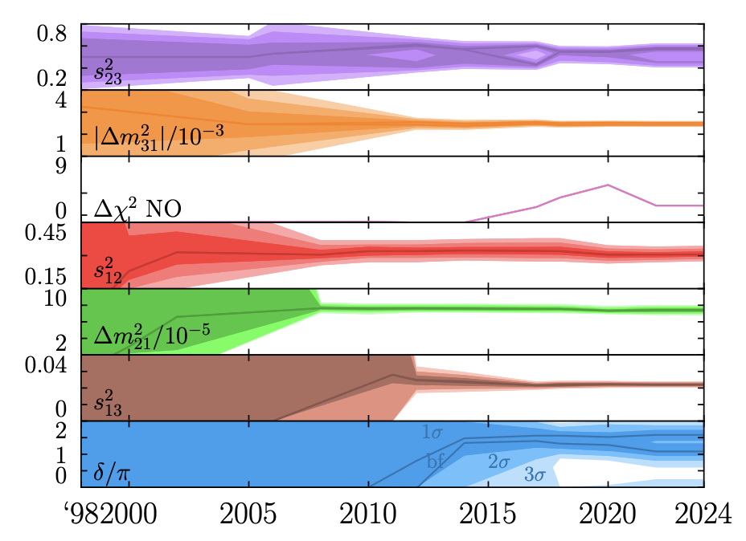
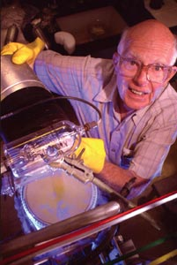
Neutrinos: The Least Known Sector of the SM
Lots of progress since the Homestake experiment.
Next-generation experiments will resolve the sub-dominant effects in the 3-neutrino oscillation paradigm.
What’s next?
Denton, 2501.08374

Slide 3
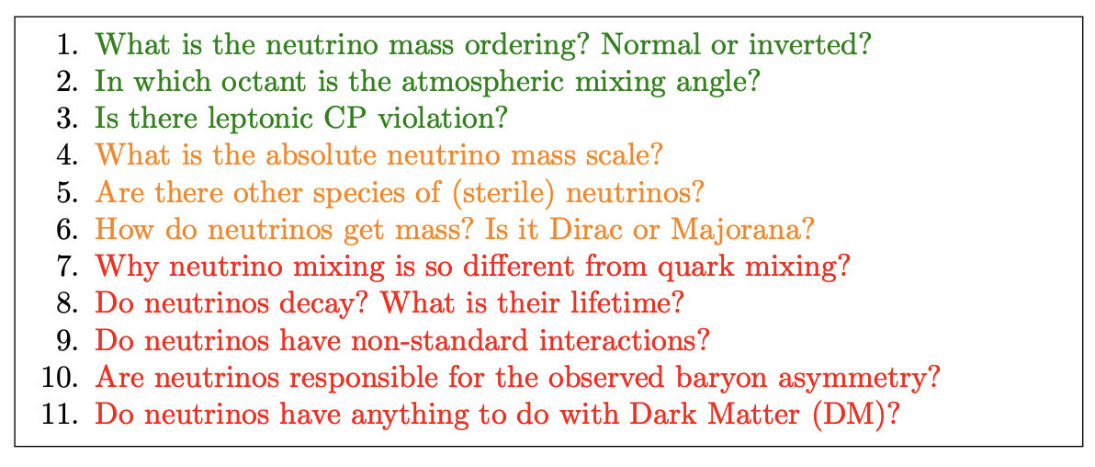
Open Questions in Neutrino Physics
JUNO, Hyper-K, DUNE
Cosmology, β decay
DAR, DIF, Reactor, Atm,…
0νββ, Collider, CνB, LArTPC?
Cosmo, Astro, Lab
BD, 2503.21212

Slide 4
Nature of Neutrino Mass
Majorana or Dirac?
From A. de Gouvea
Why is it a difficult question?
Because the Majorana nature is suppressed by the tiny neutrino mass itself.
Two ways around:
Find non-relativistic neutrinos (CνB) – see talk by G. Herrera.
Find a process that violates L.

Slide 5
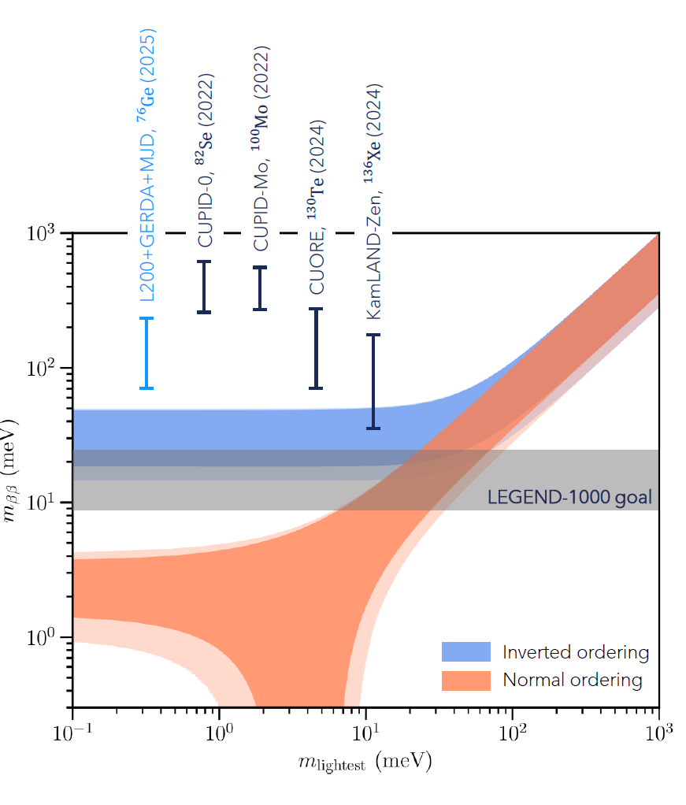
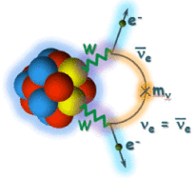
How to find Lepton Number Violation
Flavored 0νββ at high energy colliders
/LEGEND
See talks by A. Mazumdar (LEGEND), T. Kroupova (SNO+) and J. Huang (PandaX)
Fuks, Neundorf, Peters, Ruiz, Saimpert, 2012.09882

Slide 6
Dirac, Majorana or Quasi-Dirac?
Simplest way to generate neutrino mass is by adding SM-singlet sterile neutrinos.

Slide 7

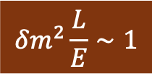
How to Probe Quasi-Dirac Neutrinos (QDinos)
Active-sterile oscillations suppressed, unless
$$δm^{2}\frac{L}{E}∼1$$
Need astrophysical baselines
(for maximal mixing)
Barbieri, Dolgov (PLB 1990);
de Gouvea, Huang, Jenkins, 0906.1611;
Ansarifard, Farzan, 2211.09105

Slide 8
Probing QDinos using High-Energy Neutrinos
Carloni, Martinez-Soler, Arguelles, Babu, BD, 2212.00737

Slide 9
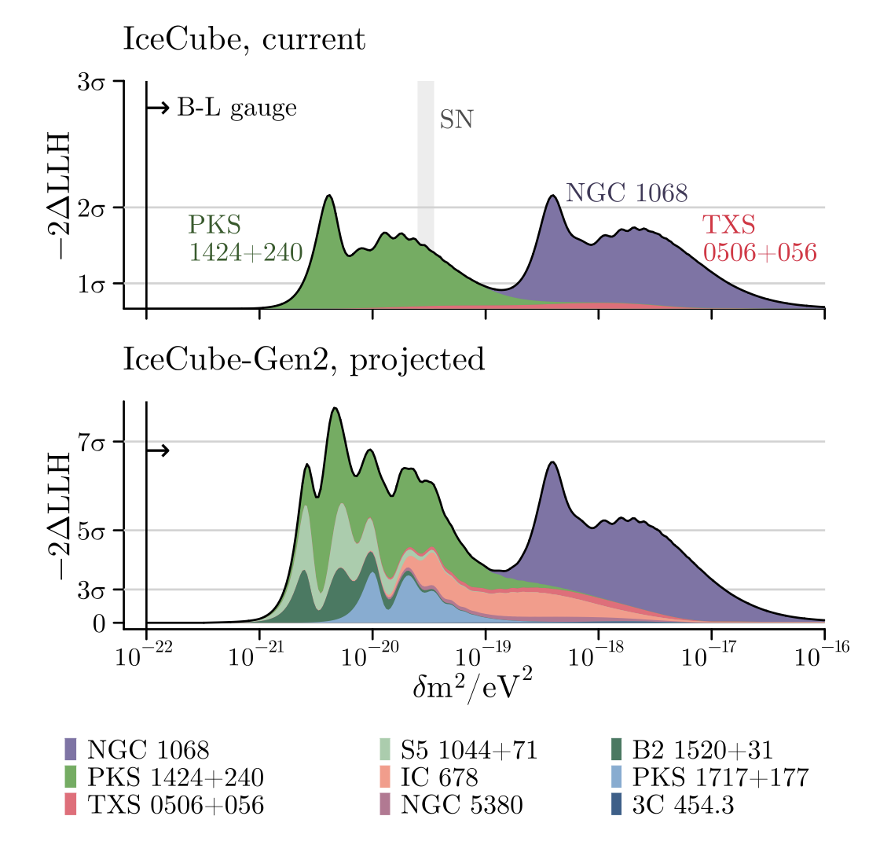
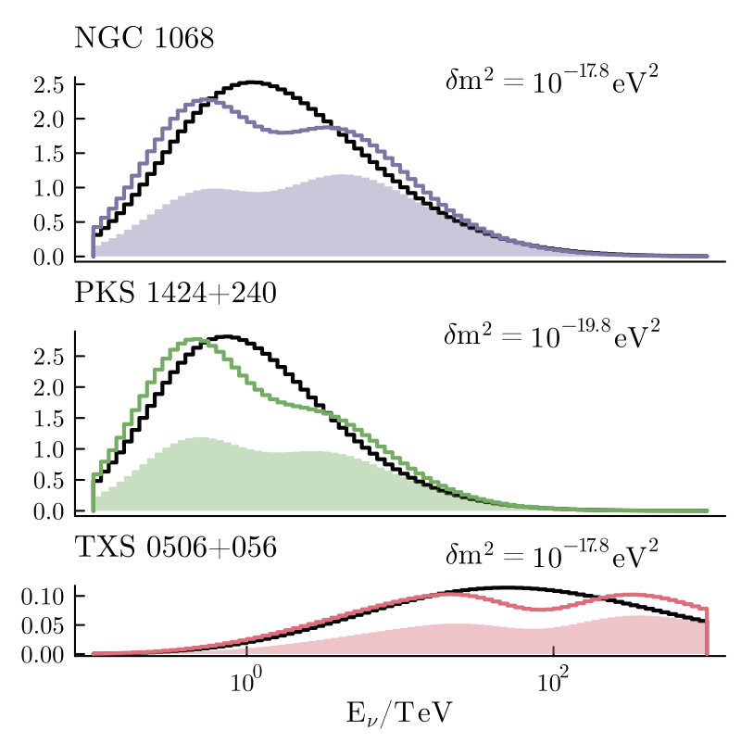
QDino Constraints from IceCube Point Source Data
Carloni, Martinez-Soler, Arguelles, Babu, BD, 2212.00737

Slide 10
Hint of QDino in IceCube Diffuse Neutrino Data?
Carloni, Porto, Arguelles, BD, Jana, 2503.19960

Slide 11
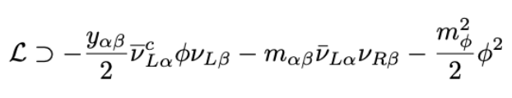
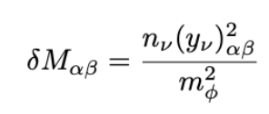
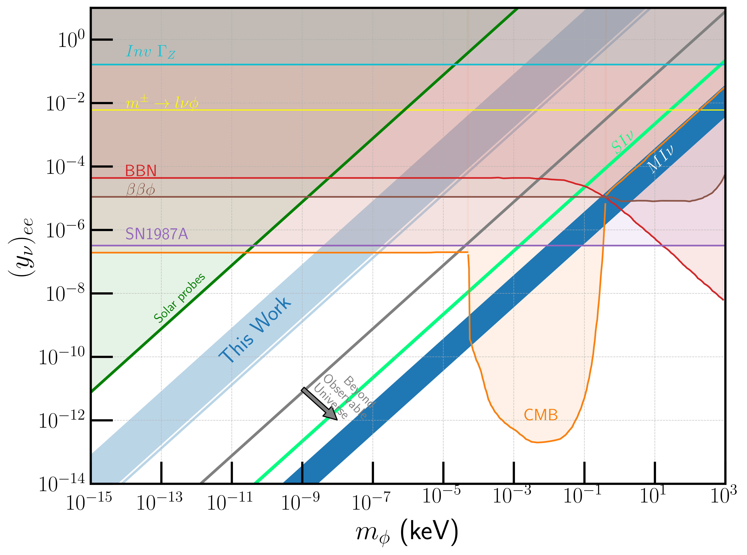
QDinos from Scalar NSI
Ge, Parke, 1812.08376
Babu, BD, Chauhan, 1912.13488;
Smirnov, Xu, 1909.07505
preliminary
See also Fong, Porto, 2406.15566;
BD, Machado, Martinez-Soler, 2406.18507
Verma, Arguelles, BD, Dutta, Martinez-Soler (in preparation)

Slide 12
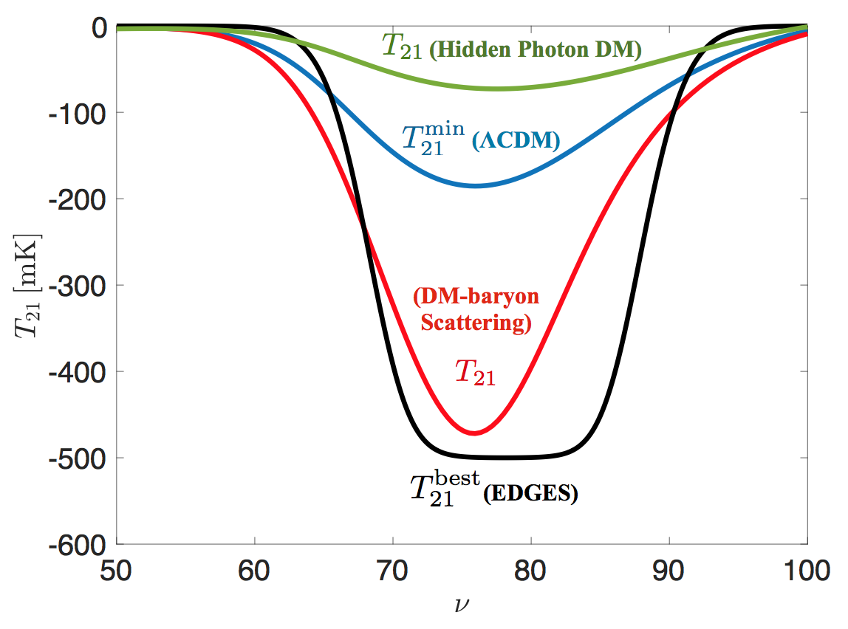
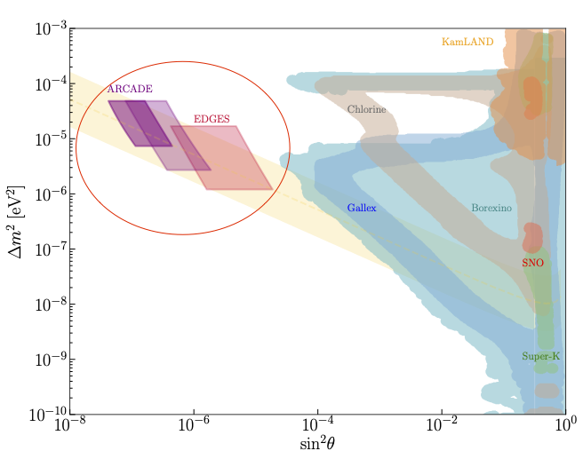
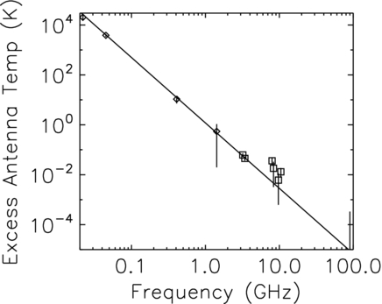
QDino Decay and Radio Anomalies
Bowman et al,
Nature (2018)
Fixsen et al, ApJ (2011)
BD, Di Bari, Martinez-Soler, Roshan,
2312.03082 and work in progress
How to avoid the neutrino magnetic moment constraint?

Slide 13

Neutrino-Dark Sector Interactions
See also Cline et al, 2209.02713;
Ferrer, Herrera, Ibarra, 2209.06339;
Bertolez-Martınez et al, 2506.08993;
Mondal et al, 2506.19910
How to see the ‘invisible’?
Campo, Boehm, Palomares-Ruiz, Pascoli, 1711.05283
Arguelles, Kheirandish, Vincent, 1703.00451
BD, Kim, Sathyan, Sinha, Zhang, 2506.abcde

Slide 14
Dark Radiation Mimicking Self-Interacting Neutrinos
Das, BD, Gao, Ghosh, Kim, 2506.08085
Resonant conversion of ν to χ
Free-streaming ν
Free-streaming ν +Free-streaming χ
Behaves as flavor-specific or flavor-universal neutrino self-interactions, depending on n_{χ .}
Ameliorates tension between cosmology and neutrino oscillation experiments, while avoiding lab constraints.

Slide 15
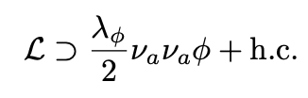


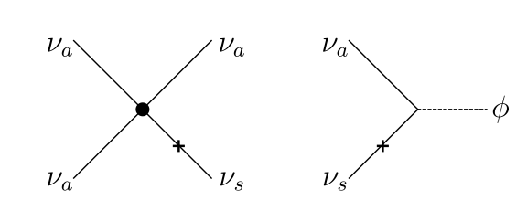
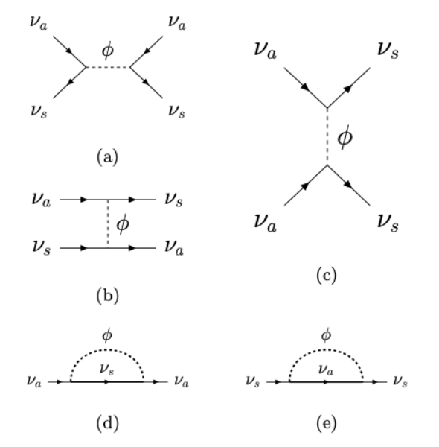
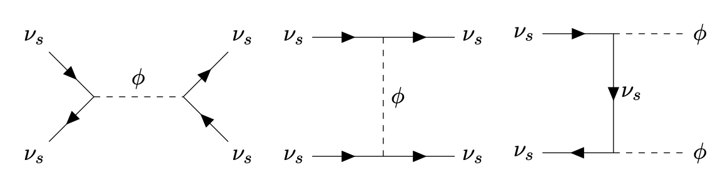
Sterile Neutrino DM Production in Early Universe
Minimal Dodelson-Widrow mechanism is ruled out by X-ray constraints.
Neutrino NSI can enhance the DM production.
Active self-interaction
Sterile self-interaction
Active-sterile NSI
de Gouvêa, Sen, Tangarife, Zhang, 1910.04901
Kelly, Sen, Tangarife, Zhang, 2005.03681;
Alonso-Alvarez, Cline, 2107.07524;
An, Gluscevic, Nadler, Zhang, 2301.08299
Johns, Fuller, 1903.08296;
Bringmann, Depta, Hufnagel, Kersten, Ruderman, Schmidt-Hoberg, 2206.10630;
Astros, Vogl, 2307.15565
BD, Dutta, Goswami, Tang, Ramachandran, 2505.22463
See talk by V. Gluscevic

Slide 16
DM Production from Active-Sterile NSI
BD, Dutta, Goswami, Tang, Ramachandran, 2505.22463

Slide 17
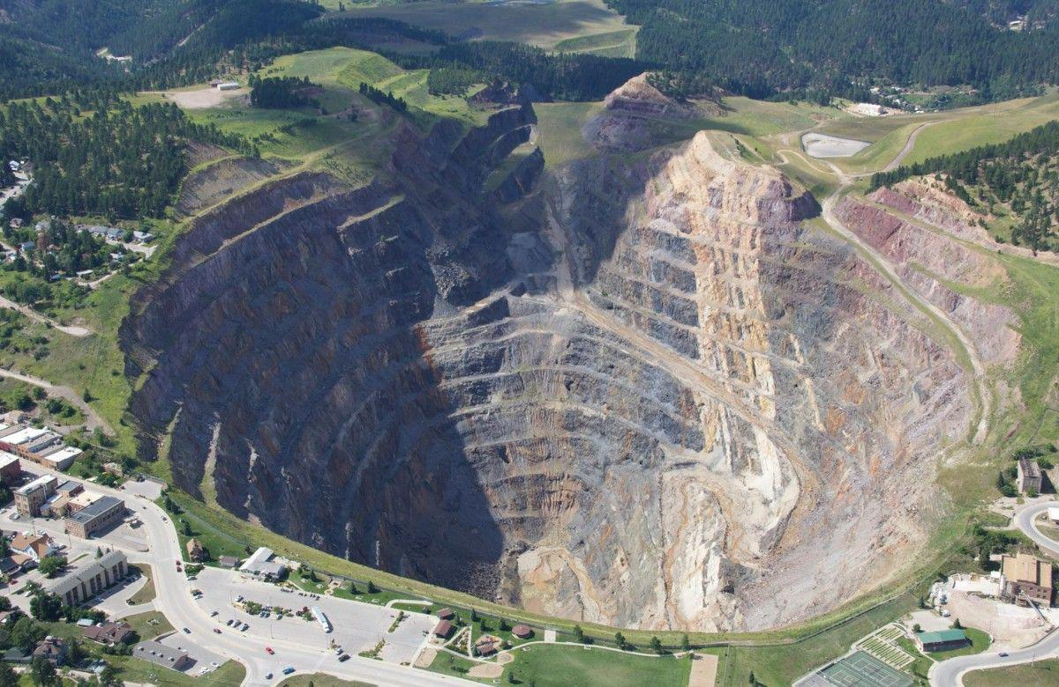
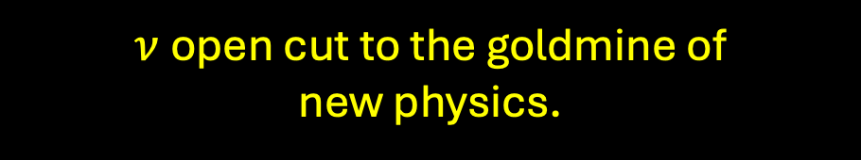
Conclusions
Precision era of 3-neutrino oscillation paradigm.
Lot of progress but still many open questions in the neutrino sector.
E.g., nature of neutrino mass, stability of neutrinos, non-standard interactions, neutrino-dark sector connection,….
Novel cosmological, astrophysical and laboratory probes.
Can address some tensions in current data. Testable in near future.
$ν$open cut to the goldmine of
new physics.

