Slide 1
IceCube - The Experiment, Its Data and Science
Bai Xinhua, for the IceCube Collaboration
South Dakota Mines
XVIII International Conference on Interconnections between Particle Physics and Cosmology (PPC 2025)
23–28 Jun 2025, Deadwood, SD

Slide 2
Abstract
Abstract: IceCube, a cubic kilometer neutrino observatory at the South Pole has accumulated an unprecedented amount of data since its completion in 2010-2011. Besides its primary science goal of neutrino astronomy, IceCube data support a variety of cutting-edge research in high-energy cosmic rays, particle interactions, neutrino physics, dark matter searches and more. This presentation will review the status of the experiment and its scientific merits by highlighting several recent science results in the cosmic and energy frontiers. The on-going Upgrade and future IceCube Gen2 will be briefly introduced.

Slide 3
Outline
IceCube Experiment and Data
IceCube Science
Some recent science results – since PPC 2024:
Atmospheric neutrino (ν) oscillation parameters
Inelasticity distribution of ν-nucleon interactions for 80 GeV<Eν<560 GeV
Search for eV-scale sterile neutrinos
Search for neutrinos > PeV in IceCube & ν-constrains in UHE cosmic rays
(Indirect dark matter search – if time allows → backup slides)
Upgrade and Gen2

Slide 4
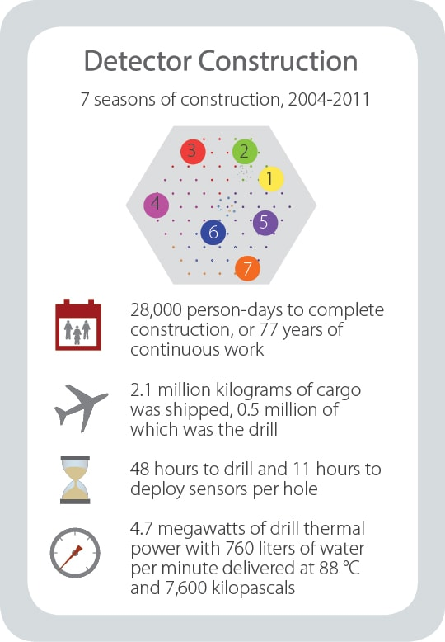
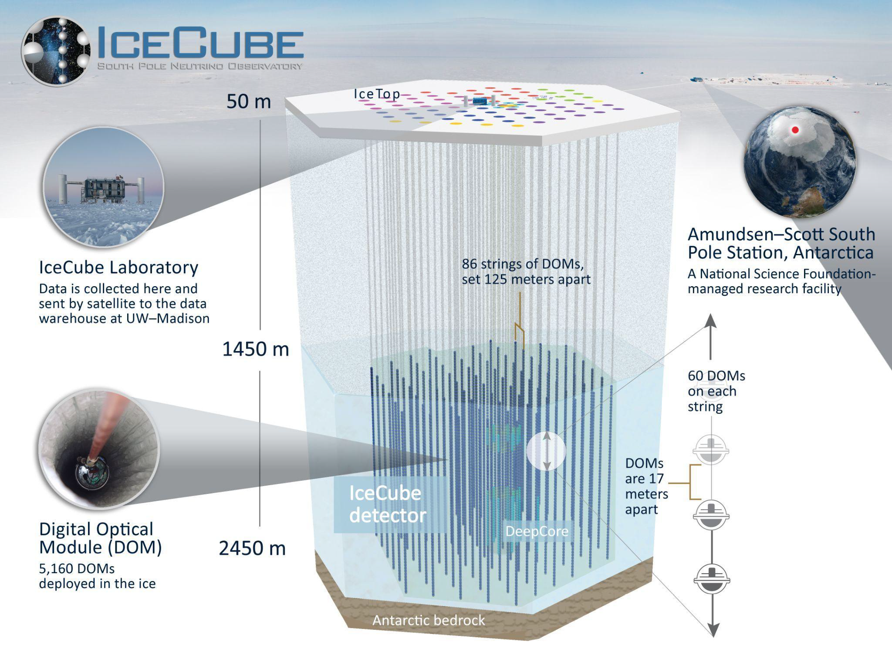
IceCube Experiment and Data
IceCube + DeepCore (IC96)
Geographic South Pole
km³ clear ice instrumented with an array of digital optical modules (DOMs)
Neutrino telescope: GeV – PeV neutrinos
Cosmic rays: tens of TeV – EeV
Any particles and processes that produce light in ice that are sensitive to PMTs + trigger condition.

Slide 5
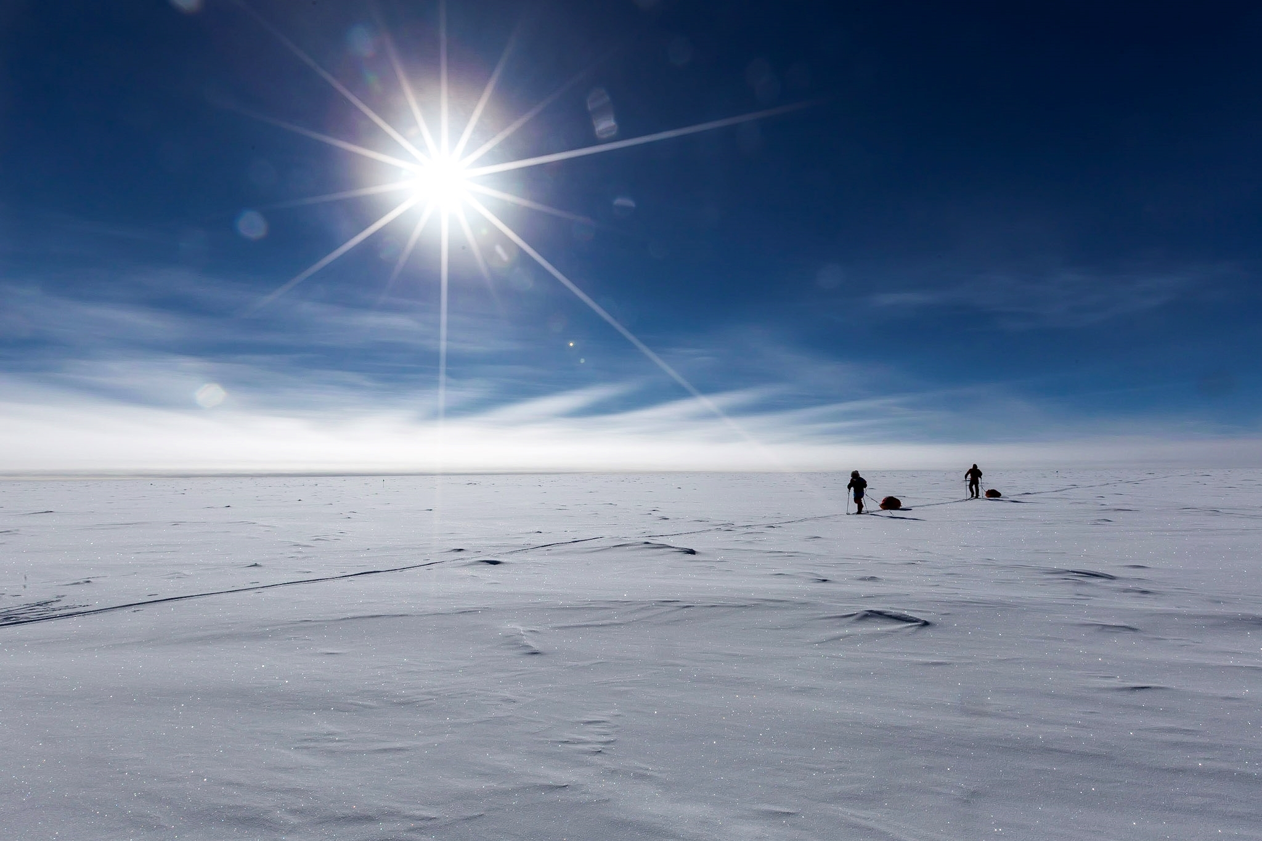
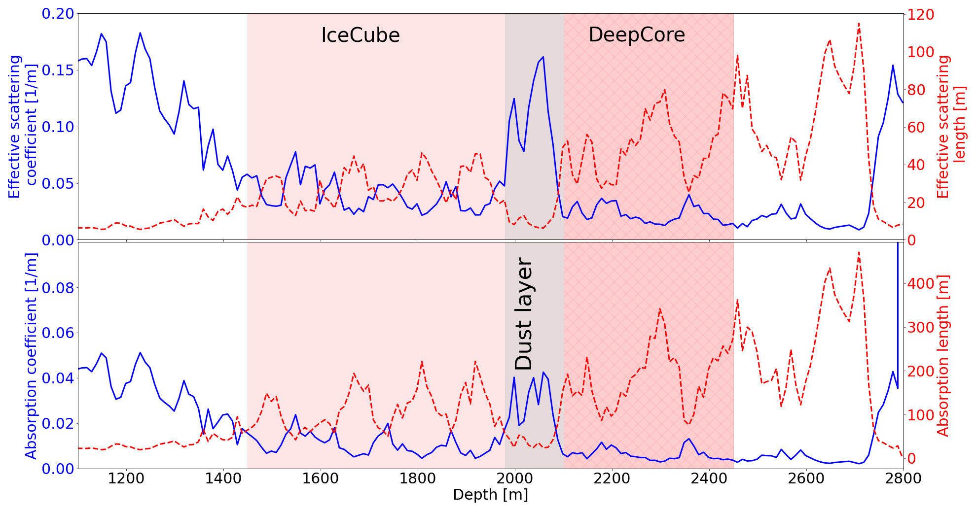
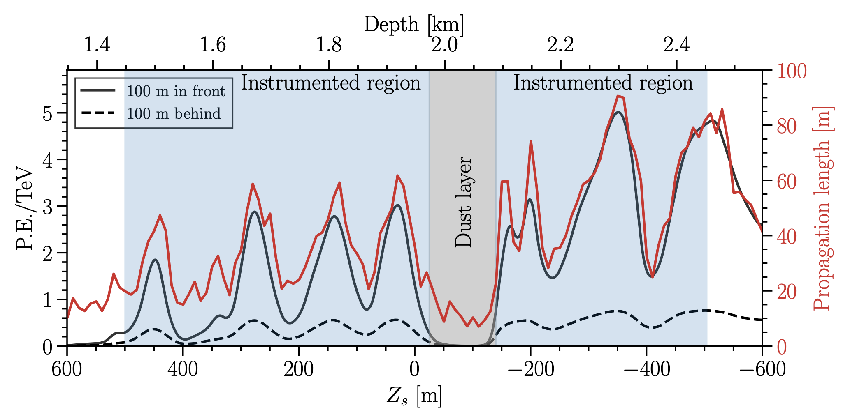
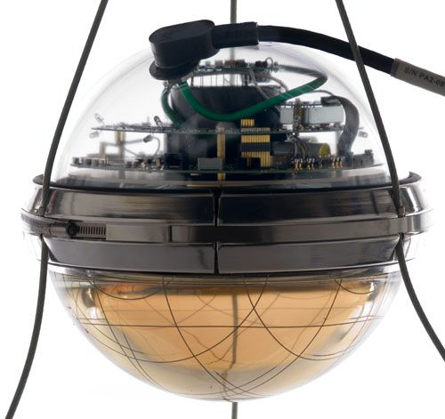
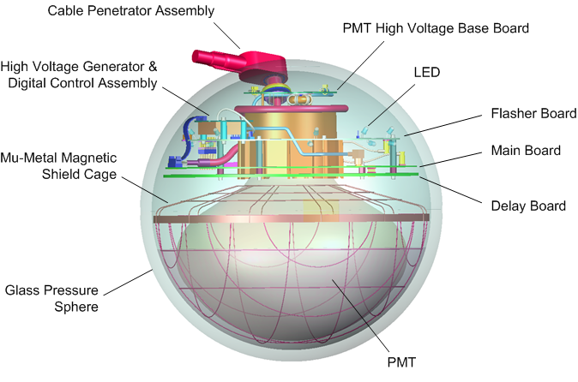
IceCube Experiment and Data
The Ice and the DOM
Ice: free and clear enough for a large observatory which is affordable
DOM: sensitive to single photon
2024 JINST 19 P06026

Slide 6
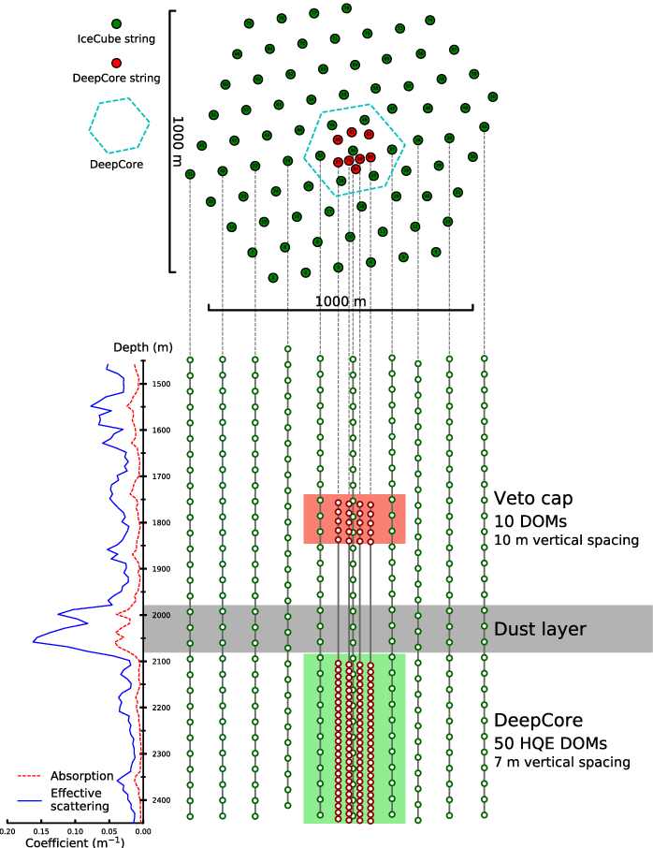
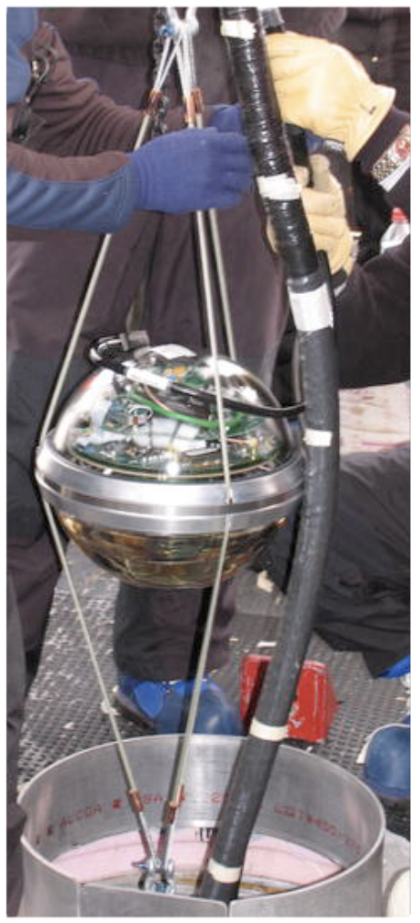
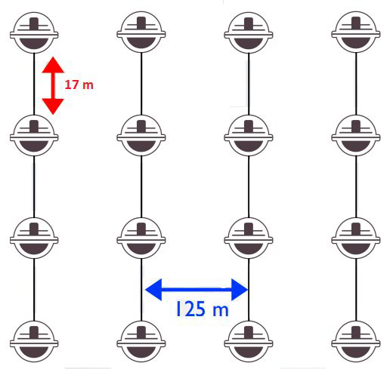
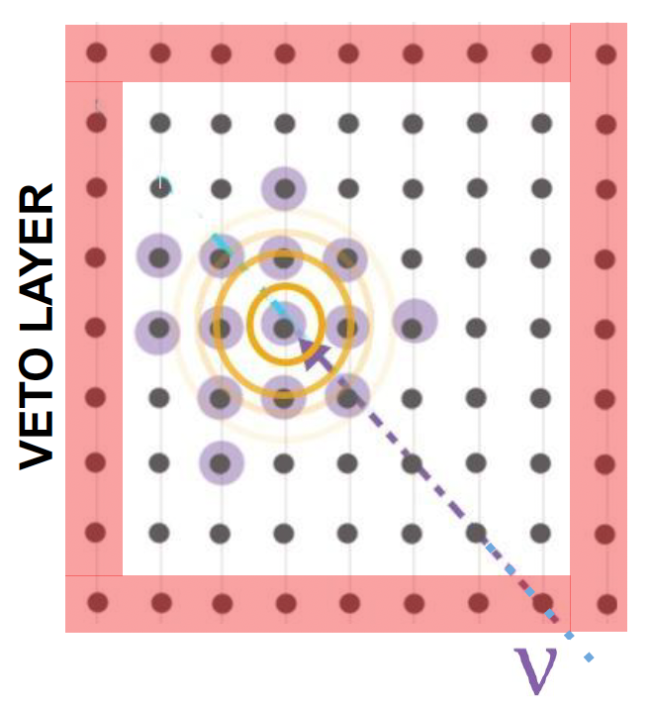
IceCube Experiment and Data
The in-ice array
86 strings (including 8 DeepCore strings) 5160 DOMs
Neutrino threshold >500GeV
DeepCore: 8 strings, 480 DOMs
Neutrino threshold >10 GeV

Slide 7
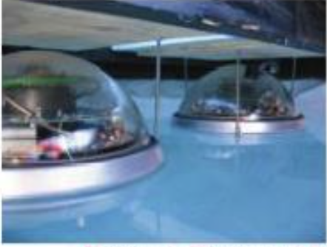
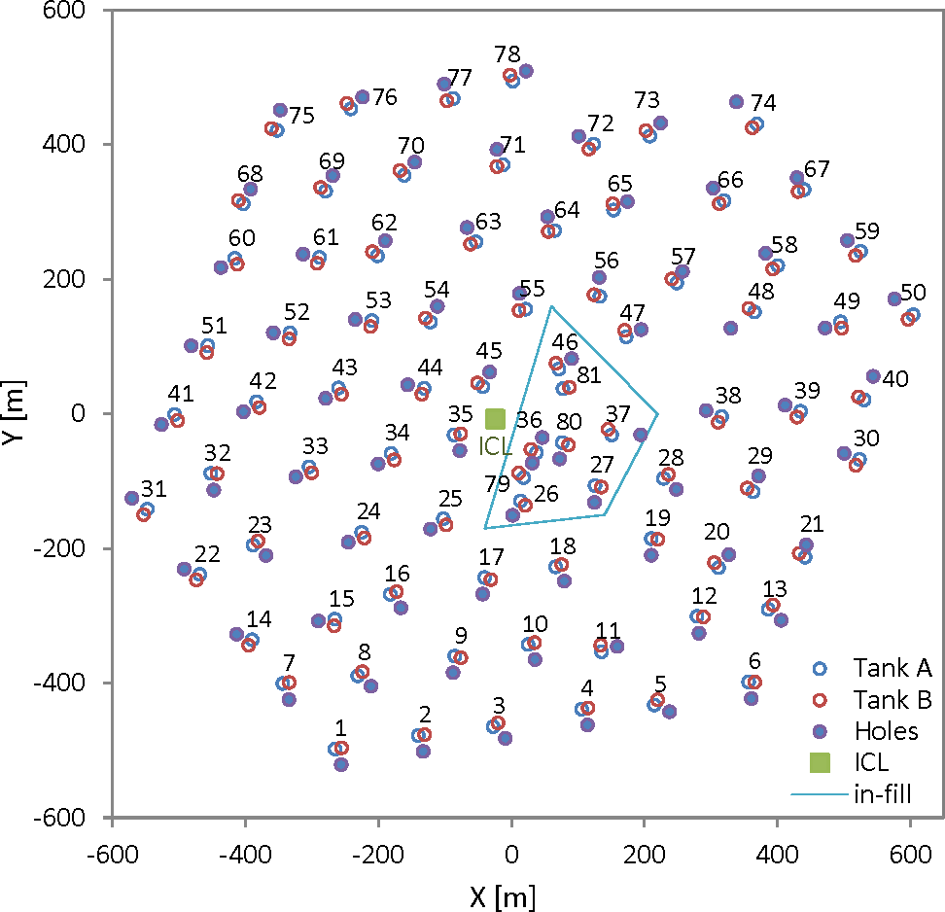
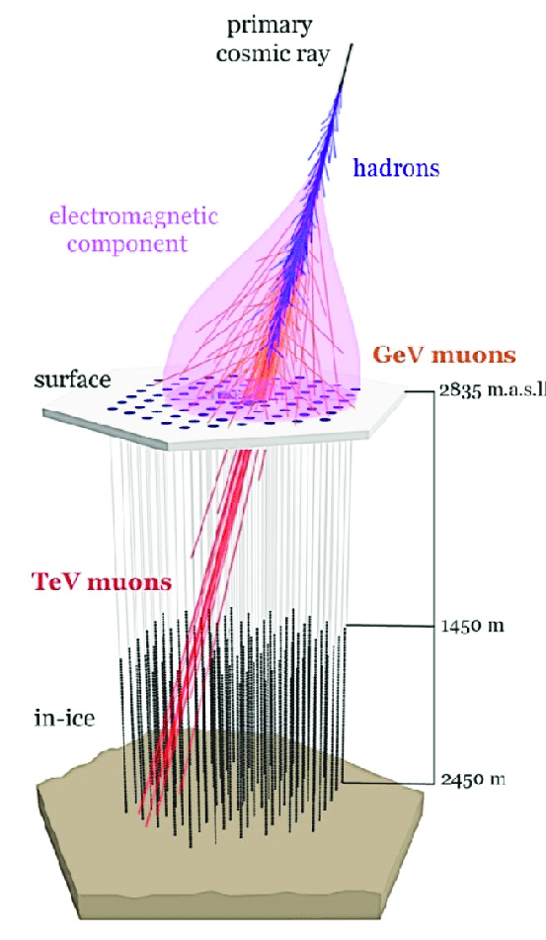
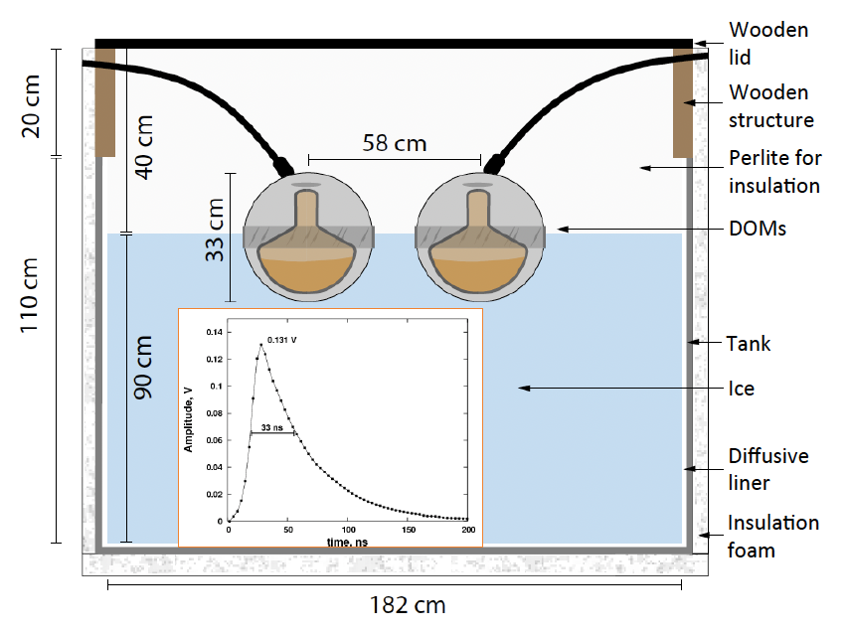
IceCube Experiment and Data
The surface array
Surface array atm. depth ~690 g/cm²
81 stations covering ~km²
One station has two ice Cherenkov detectors
Each ice Cherenkov detector has two DOMs
Air shower threshold: 300 TeV (100 TeV in-fill)

Slide 8
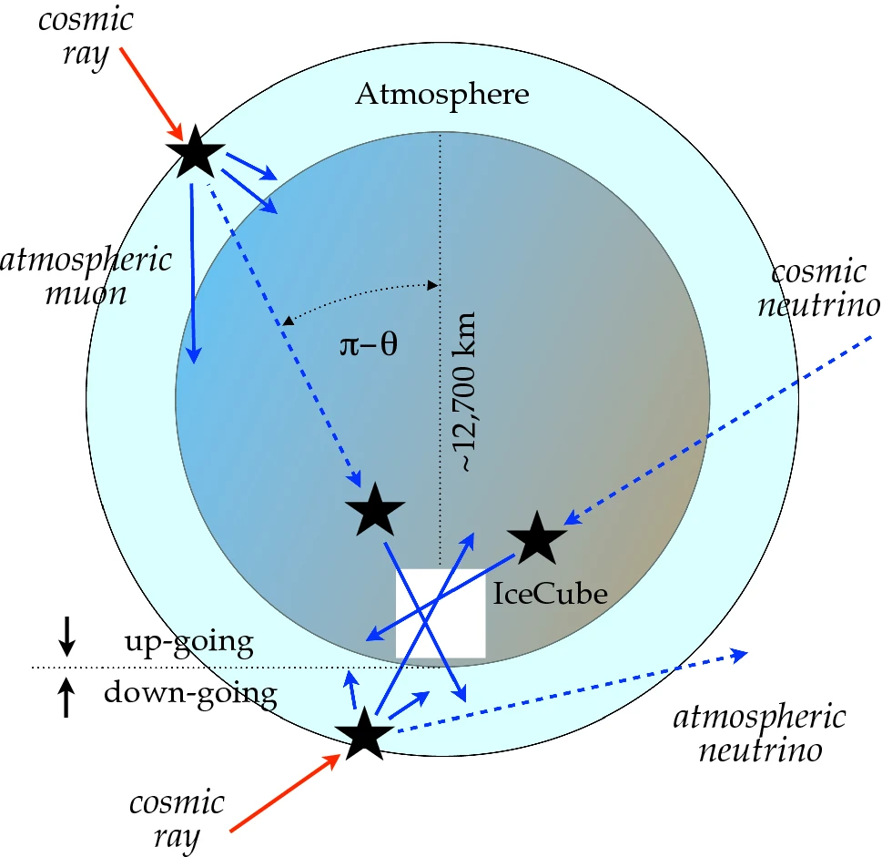
IceCube Experiment and Data
Rates of Different Types of Events
IceTop:
Cosmic ray induced air showers (30.2 Hz in 2012 → 5.5 Hz in 2025)
- Decreases due to snow accumulation on IceTop detectors
- Dominated by those at threshold energy
In-ice array:
Atmospheric muons (~3000Hz)
- Cosmic ray nuclei interact with the atmosphere
- Down-going muons from air showers reach IceCube
Atmospheric neutrinos (~10/hour)
- Conventional atmos. neutrinos (E^{-3.7}) from π/K
- Prompt atmos. neutrinos (E^{-2.7}) from charmed mesons
Astrophysical neutrinos (~100/year)
- Produced in astrophysical objects
- Harder energy spectrum + different angular distribution
Cosmogenic neutrinos (~up to few/10 years)
- Produced during UHECR propagation
June 15, 2025 report

Slide 9
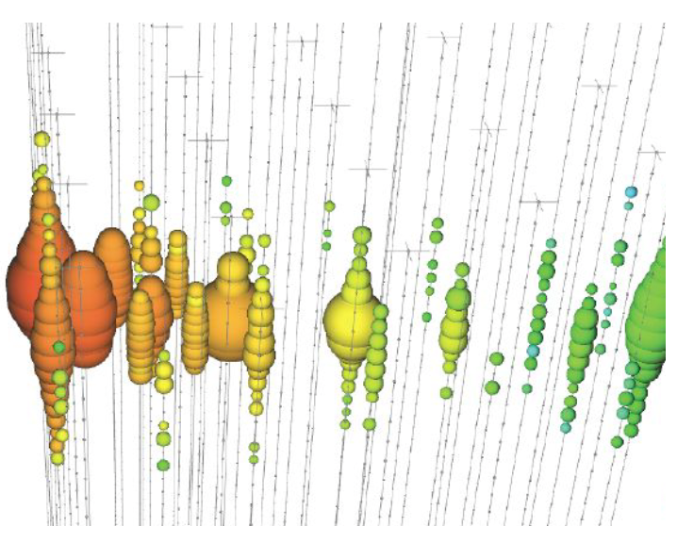
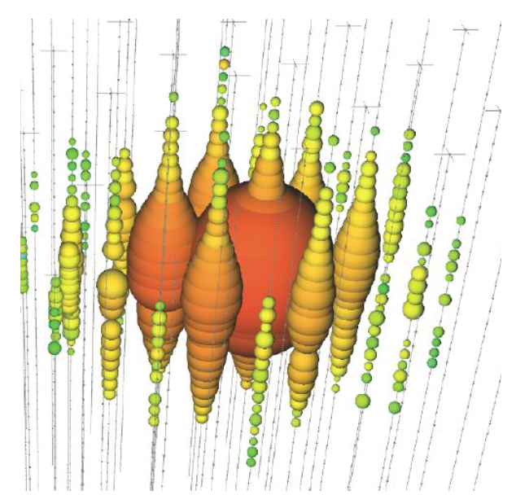
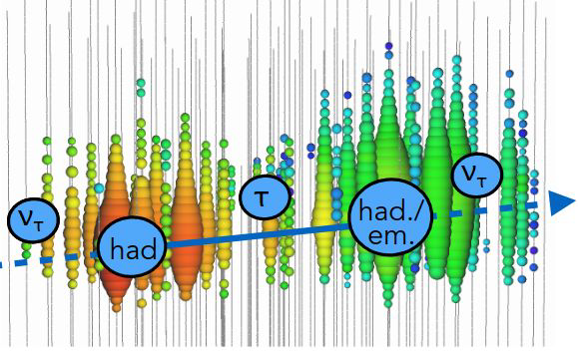
IceCube Experiment and Data
Neutrino events
CC or NC:
$$ν_{e}+X→e^{−}+hadrons$$
$$ν_{l}+X→ν_{l}+hadrons$$
CC:
$$ν_{τ}+X → τ^{−}+hadrons$$
$$50m/PeV{: τ}^{−}→ν_{τ}+xyz$$
CC:
$ν_{μ}+X→μ^{−}+hadrons$
data
data
Monte Carlo sim.
Energy res. ~ $0.3 in \log{\frac{E}{TeV}}$
Angular res. ~ ${0.3}^{o}$
Energy res. ~ $8\% at 100 TeV$
Angular res. ~ $4^{o}$
Energy res. ~ two cascades
Angular res. < $4^{o}$ & energy dependent

Slide 10
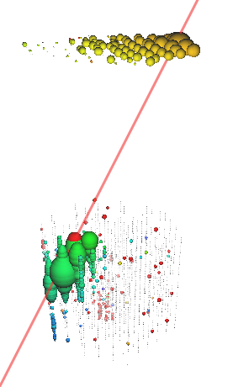
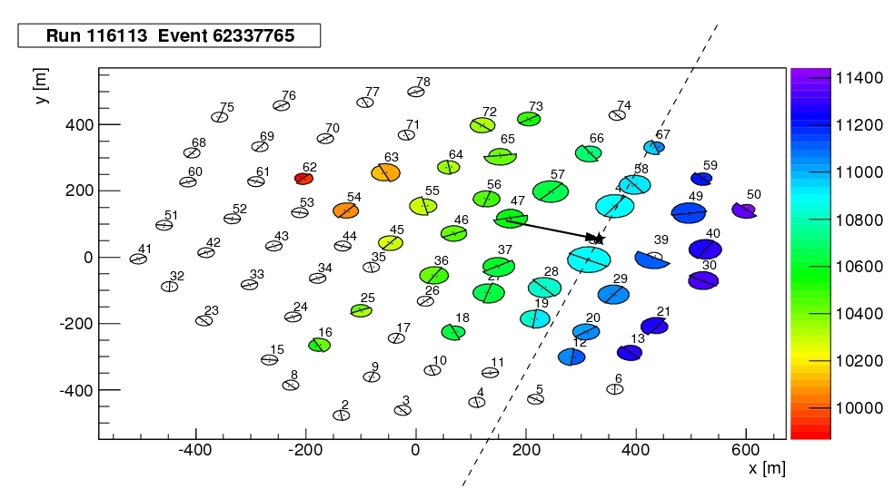
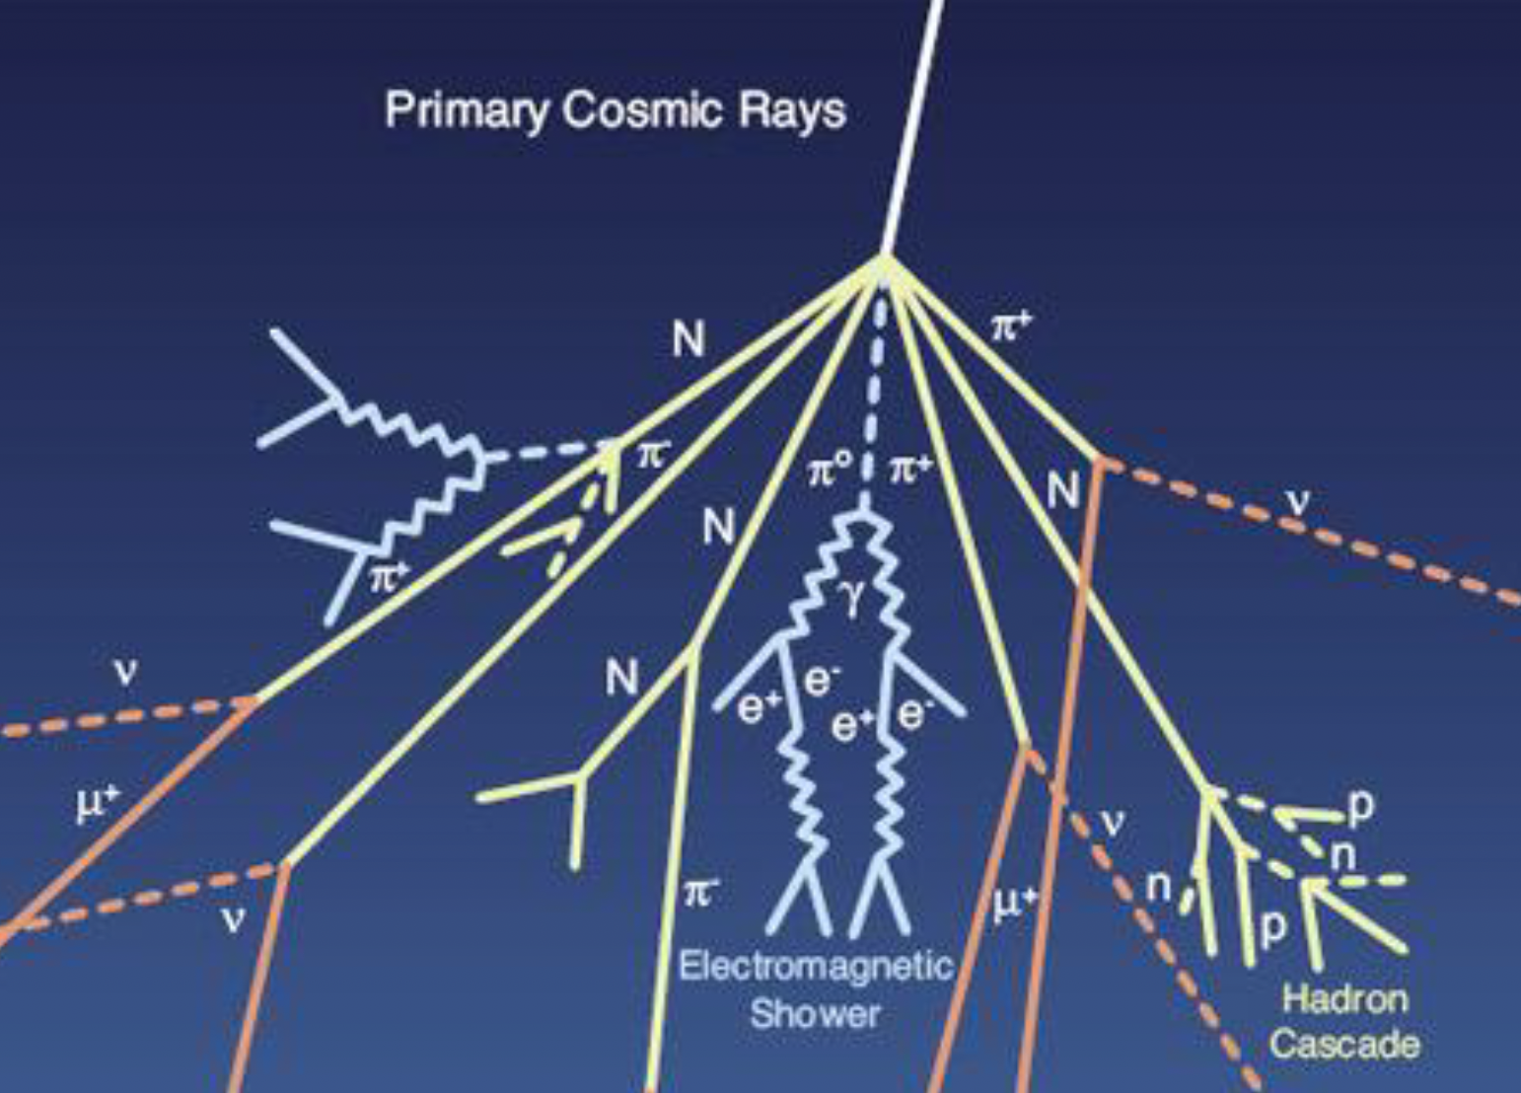
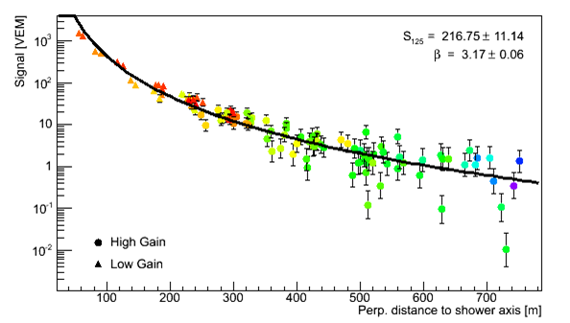
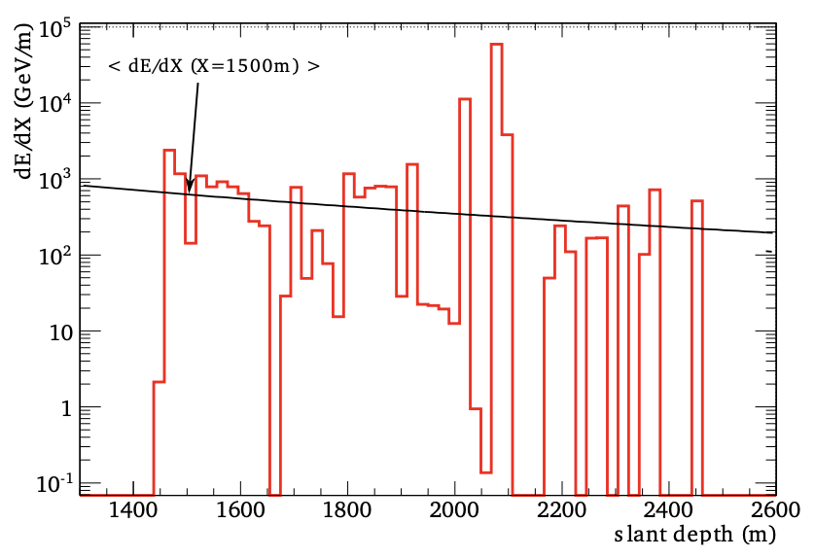
IceCube Experiment and Data
Cosmic ray events

Slide 11
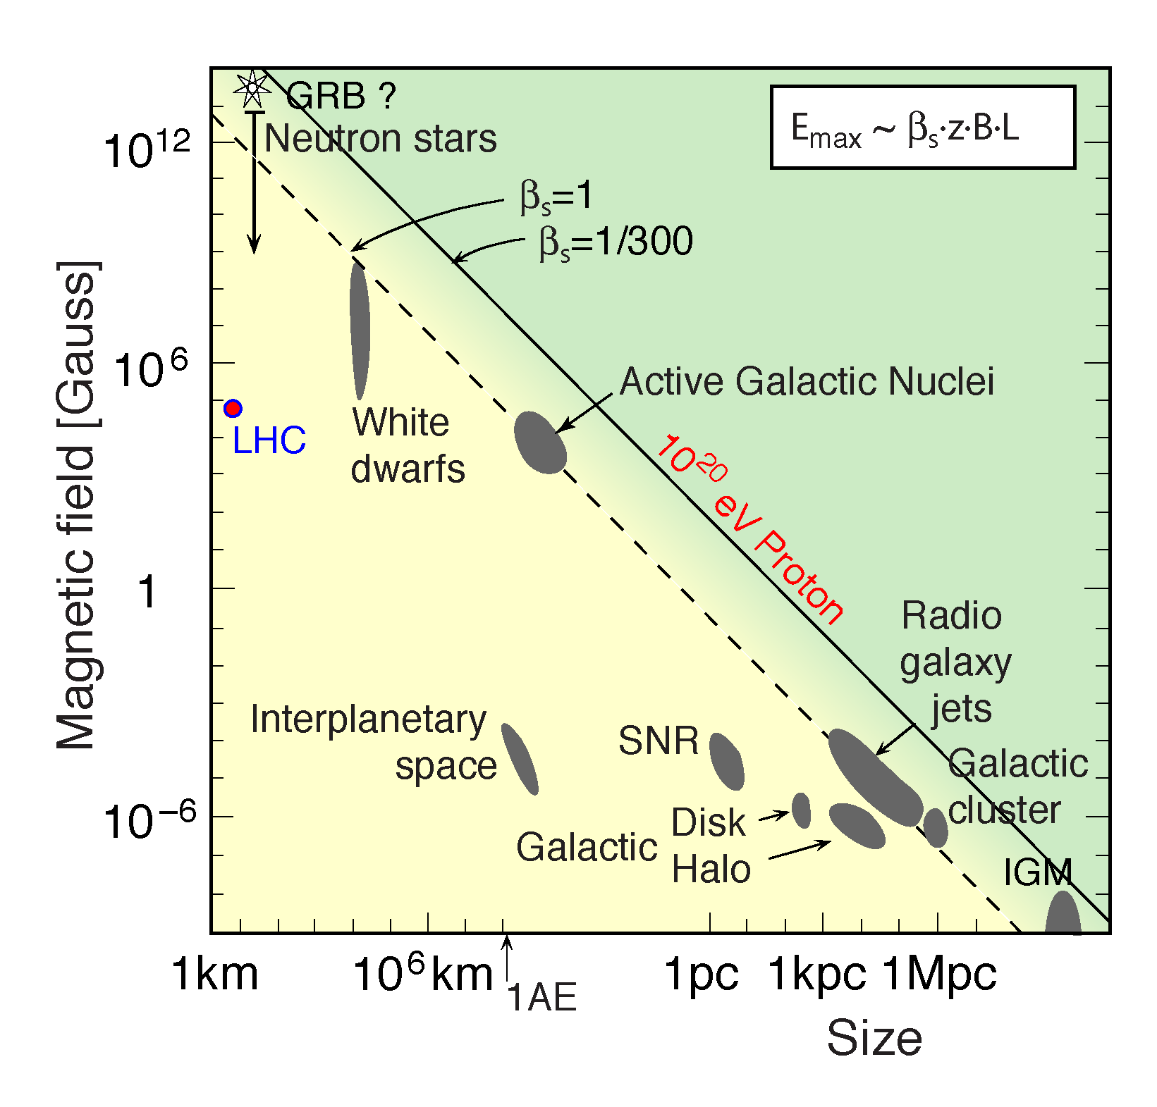
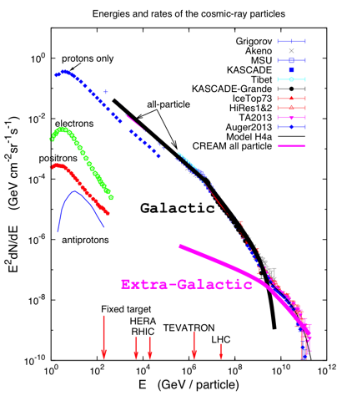
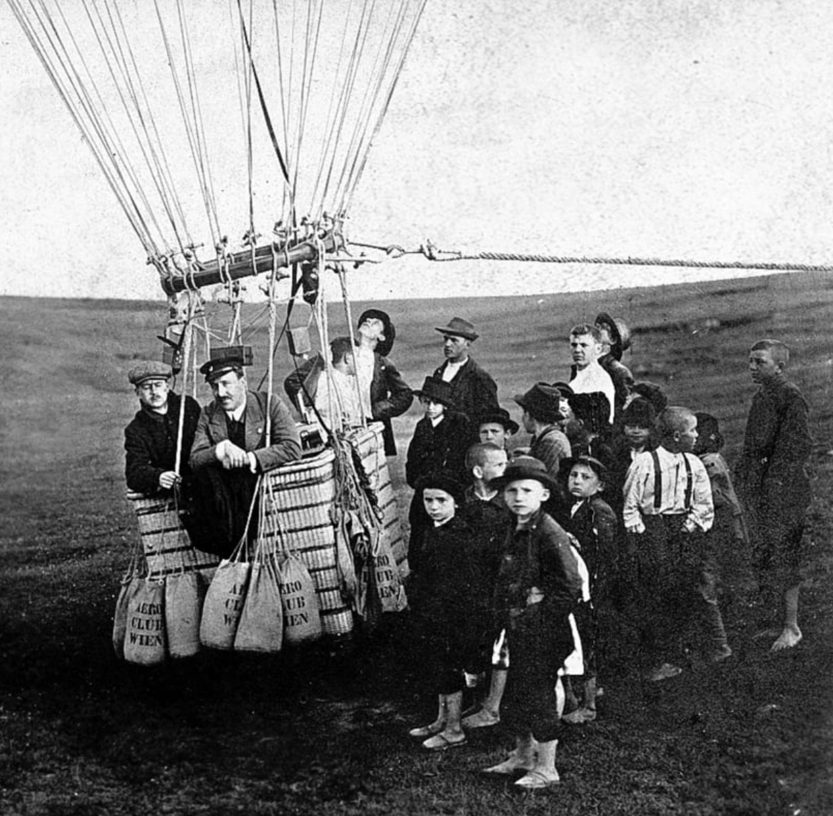
IceCube Science
Primary science – neutrino astronomy and the origin of H.E. cosmic rays

Slide 12
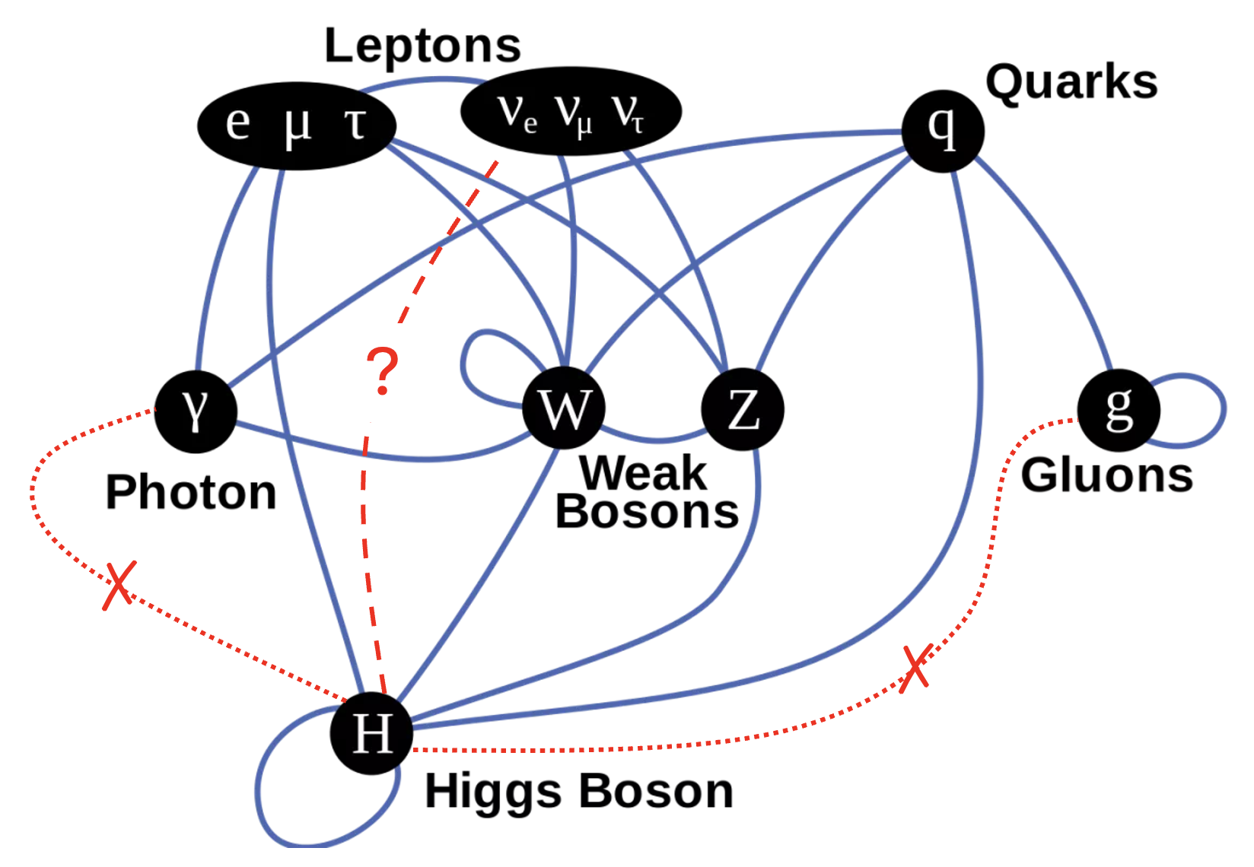
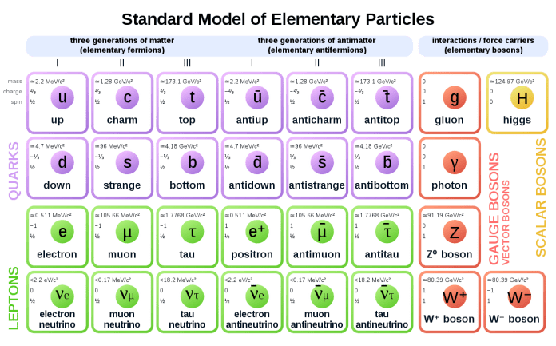
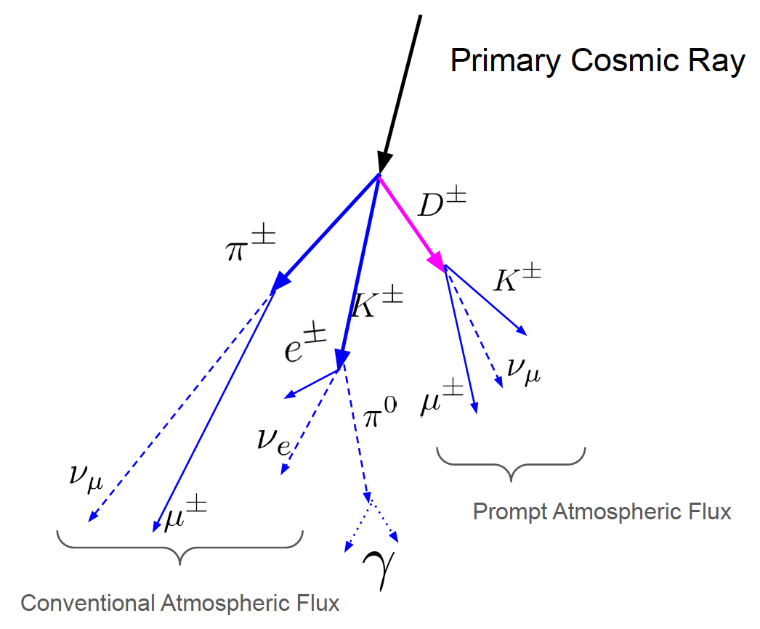
IceCube Science
Particle & Interactions
CR: hadronic interactions and decays
WIMP annihilation → neutrinos:
$χχ→τ^{−}τ^{+} /W^{−}W^{+}(→hard υ)/b^{−}b^{+}(→soft υ)$

Slide 13
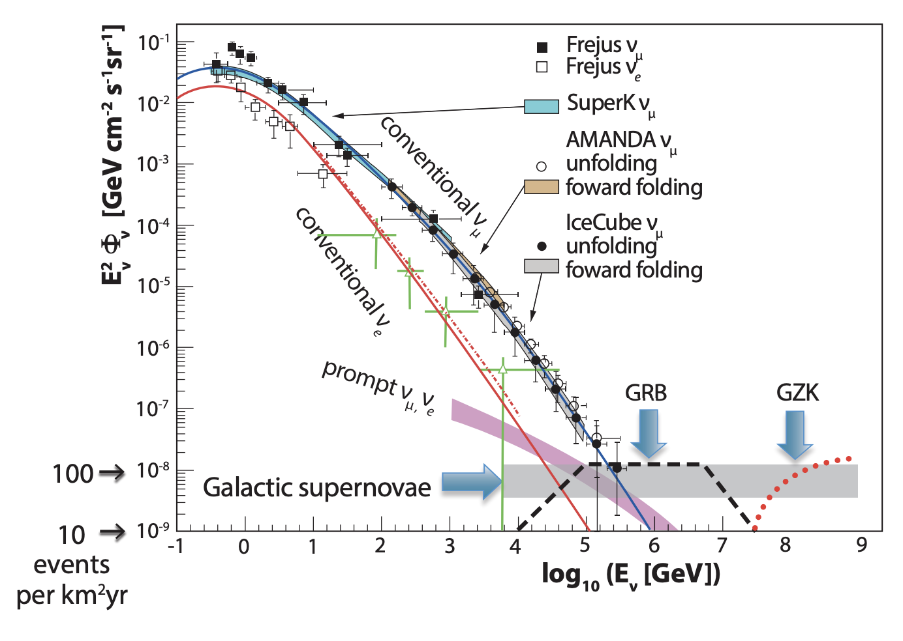
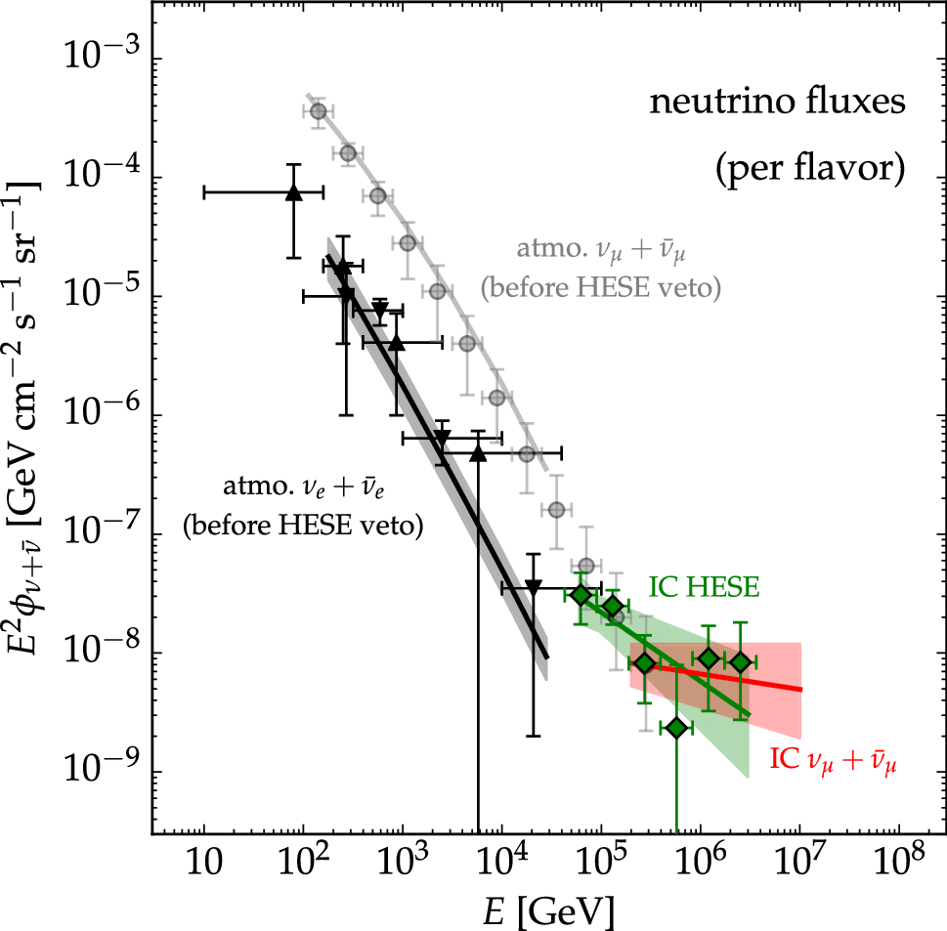
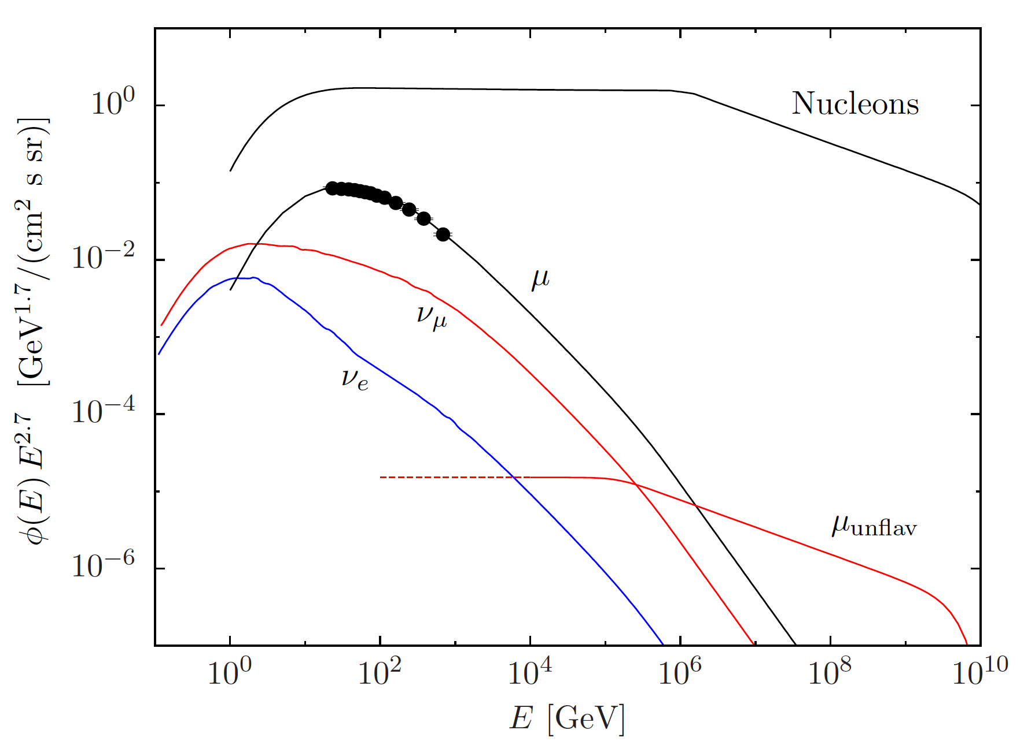
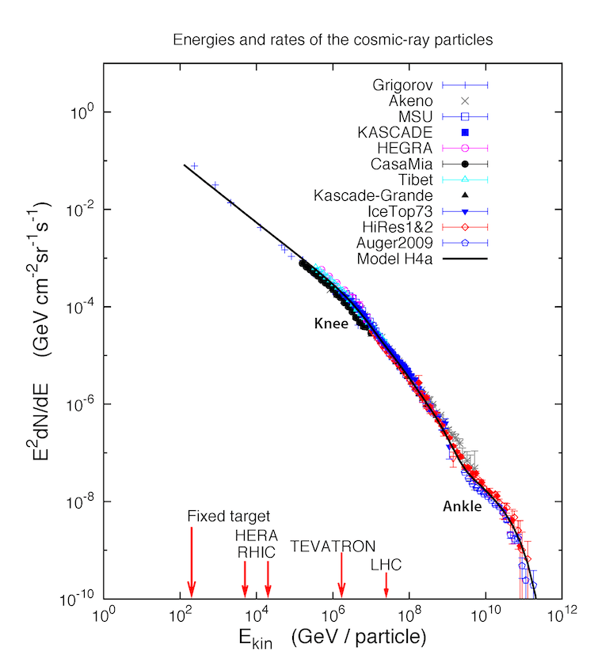
IceCube Science
Particles and Interactions beyond LHC
2010: 1010.5084v1-PPC12.pdf
with contributions
from $η, η^{′}, ρ^{0}, φ$

Slide 14
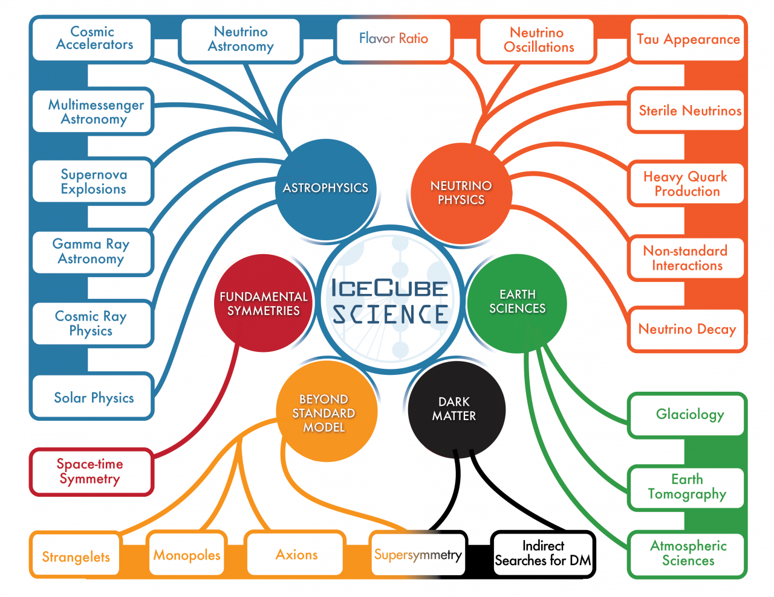
IceCube Science
A story of discoveries and more
IceCube Contributions to PPC 2024 (October 14 -18, 2024, Hyderabad, India)
Neutrino Astrophysics to Particle Physics with IceCube
Exploring Flavor Dependent Long-Range Interactions in Atmospheric Neutrino Oscillation at IceCube DeepCore
Measuring the mass of Earth and mass of Core using neutrino oscillations at IceCube DeepCore
Validating Layered Structure Inside Earth Using Atmospheric Neutrino Oscillations at IceCube DeepCore
Establishing Earth's Matter Effect in Atmospheric Neutrino Oscillations at IceCube DeepCore
First Search for High-Energy Neutrino Emission from Galaxy Mergers

Slide 15
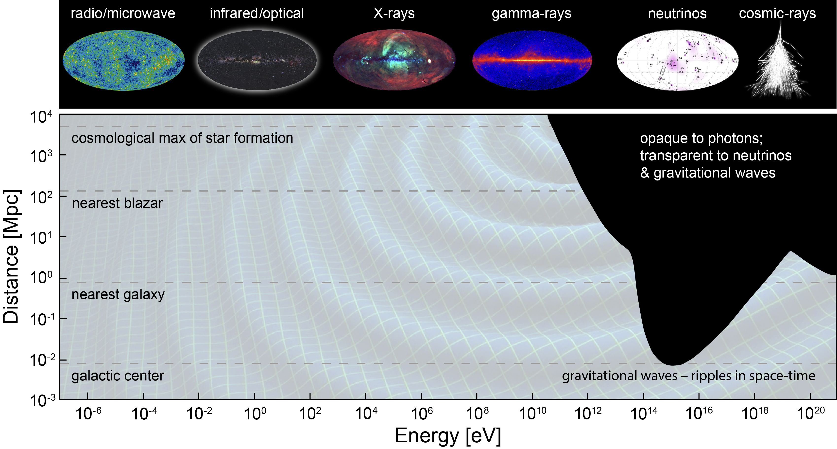
IceCube Science: PUSHING through Cosmic & energy frontiers
& cosmic rays
~99.999999% of the universe
~99% of the universe
TXS 0506+056
IceCube-170922A
Highest observed gamma ray (LHAASO) and neutrino (IceCube, KM3Net) energies
$$p+γ(3K bkg)→Δ^{+}→π^{+}→υ$$
$$γ+γ(IR+3K bkg)→e^{−}e^{+}$$
NGC 1068
IceCube2022
1.5–15 TeV4.2$σ$
Highest observed cosmic ray energy (Fly’s Eye/HiRes, Auger, TA)
Galactic plane
IceCube astro. $υ$ energy range
Notes:
NGC 1068 IceCube paper: https://arxiv.org/pdf/2211.09972, neutrino energy: 1.5 TeV to 15 TeV , 14 Mpc
TXS 0506+056: IceCube “The most probable neutrino energy was estimated to be 290 TeV, with a 90% confidence level lower limit of 183 TeV (20)”, 1.75 Gpc

Slide 16
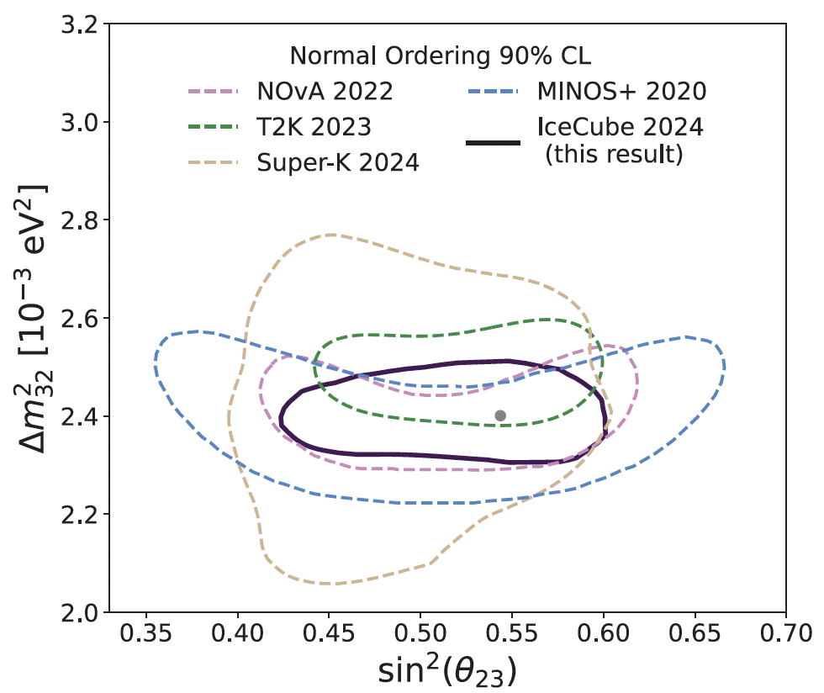
Recent science results
PHYSICAL REVIEW LETTERS 134, 091801 (2025)
Atmospheric Neutrino Oscillation Parameters
Atmospheric neutrino oscillation parameters $∆m_{32}^{2}$ and $\sin^{2}θ_{23}$.
Atmospheric ν_{μ} disappearance analysis
CNN with DeepCore data from 2012 and 2021 (3387 days)
> 150,257 neutrino-candidate events from 5
GeV and 100 GeV
Results:
> $∆m_{32}^{2}={2.40}_{−0.04}^{+0.05}×{10}^{−3} {eV}^{2}$
> $\sin^{2}θ_{23}={0.54}_{−0.03}^{+0.04}$
> most precise to date using atmospheric
neutrinos
Contours showing Feldman-Cousins 90% CL assuming
neutrino normal mass ordering of this analysis

Slide 17
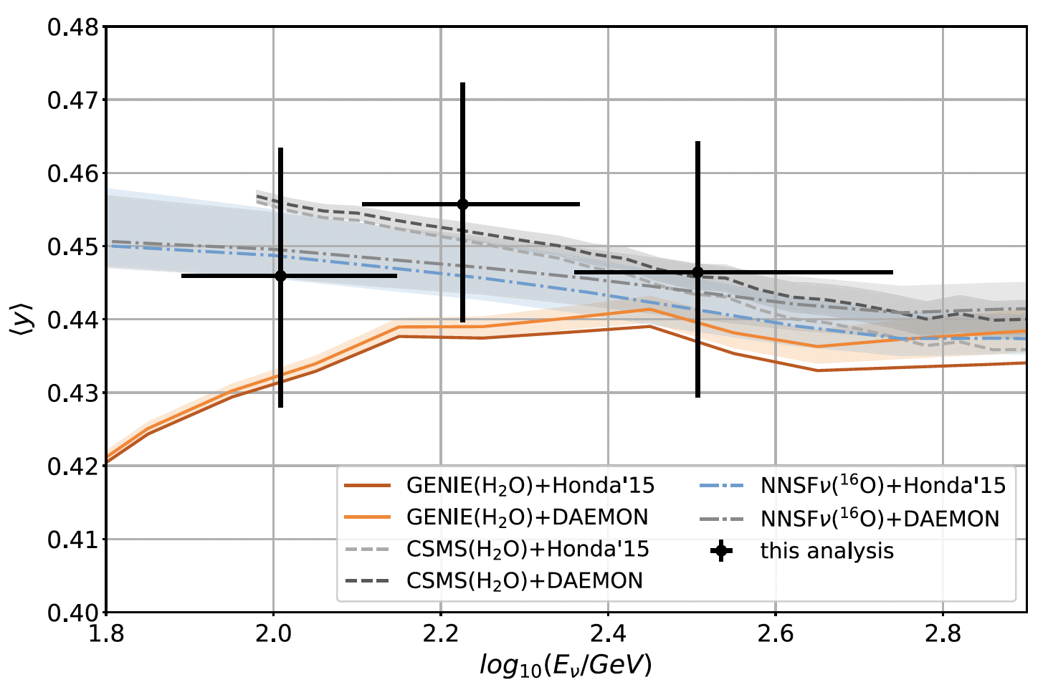
Recent science results
PHYSICAL REVIEW D 111, 112001 (2025)
Inelasticity distribution of ν-N interactions in 80 GeV < E_{ν} < 560 GeV
The Standard Model: MeV → 340 MeV (ex. NuTeV/CCFR, CDHSW) → 1760 GeV (FASERν)
IceCube has studied > PeV neutrinos and interactions
This work:
> 80 - 560 GeV atmospheric muon
neutrinos in IceCube DeepCore
from 2012 to 2022
> The inelasticity $y=1−E_{lepton}/E_{ν}$
→ the fraction of E_{ν} transferred to
hadrons
Measured mean inelasticity <y> as a function of E_{ν} in comparison with model predictions.

Slide 18
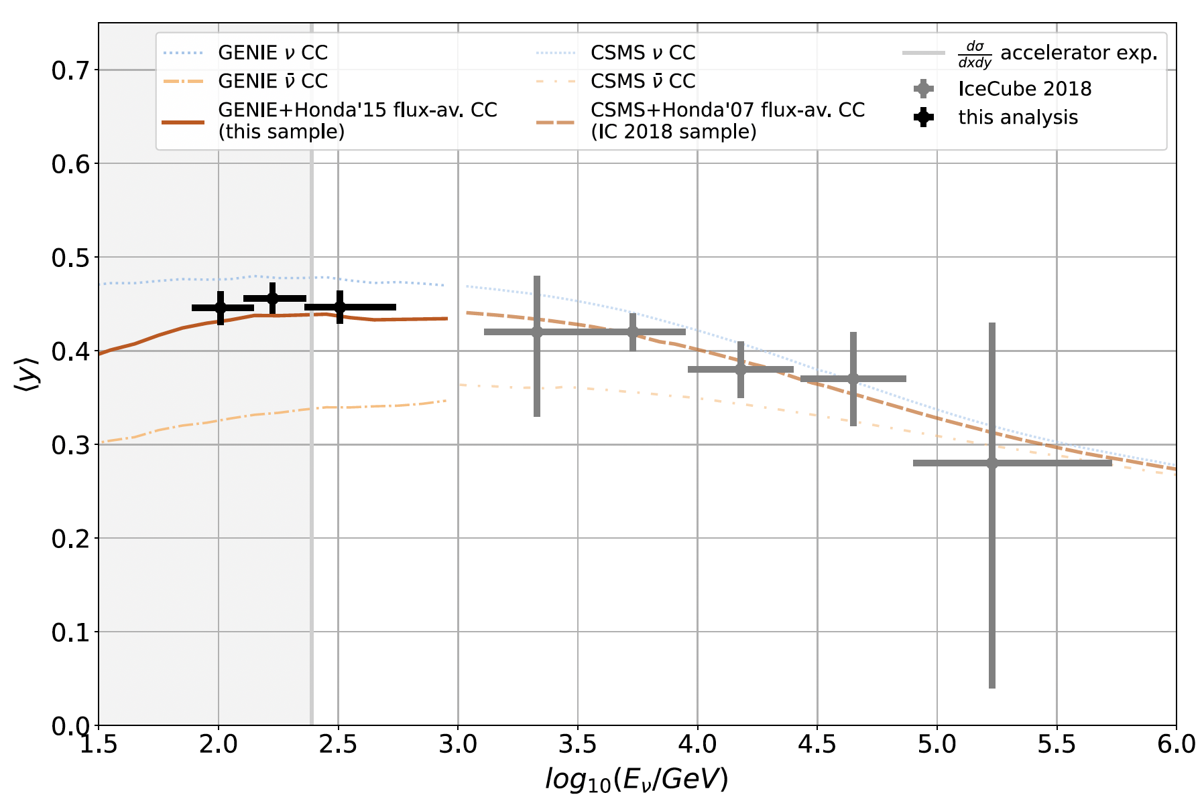
Recent science results
Physical Review D111, 112001 (2025)
Physical Review D99 (2019) 032004
Inelasticity distribution of ν-nucleon interactions for 80 GeV < E_{ν} < 560 GeV
Note: inclusive inelasticity – dominant by DIS with contributions from RES+QES
> DeepCore inter-module spacing ~
hadronic cascade sizes → hard to
separate QE, RES from DIS events
IceCube 2025 + 2018 (DIS, 10^{2.5} to 10⁷ GeV - - - see Slide 40): Measured mean inelasticity <y> as a function of E_{ν} in comparison to model predictions.

Slide 19
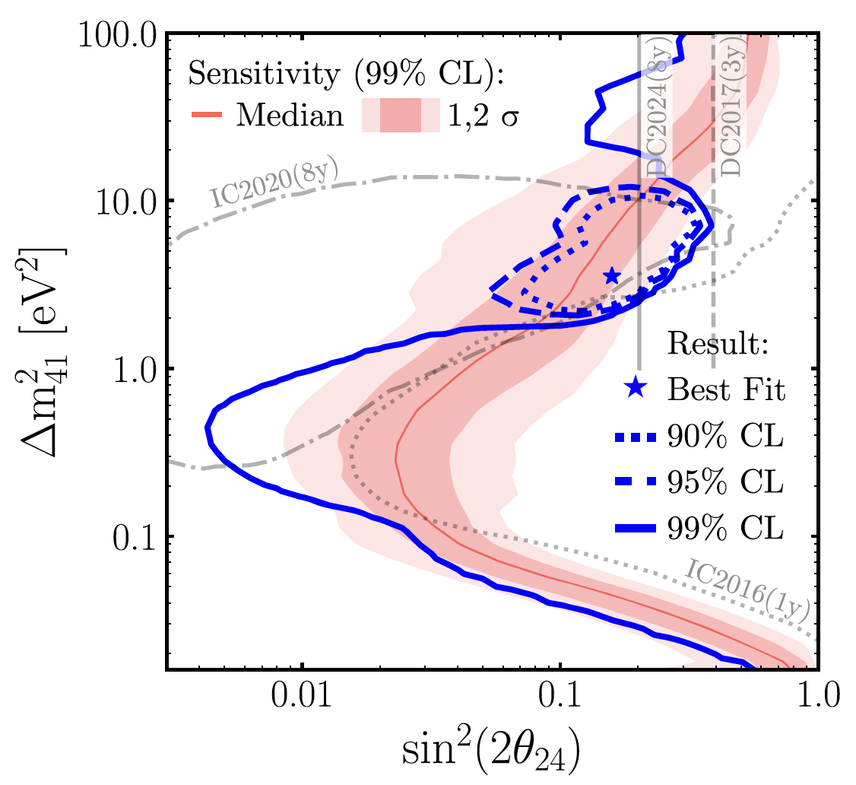
Recent science results
PHYSICAL REVIEW LETTERS 133, 201804 (2024)
Search for eV-Scale Sterile Neutrino
Anomalies in short-baseline oscillation experiments observed in $ν_{μ}→ν_{e}$ appearance and $ν_{e}→ν_{e}$ disappearance
3+1 sterile neutrino search: $ν_{μ}→ν_{μ}$ disappearance.
10.7 years of IceCube atmospheric muon neutrinos from 0.5 to 100 TeV,
Results:
> Best fit point at $∆m_{41}^{2}=3.5 {eV}^{2}$ and
$\sin^{2}{2θ}_{24}=0.16$
> No sterile neutrinos with a p value of
3.1%, or a significance of $\sim 2.2 σ$.
Frequentist analysis.

Slide 20
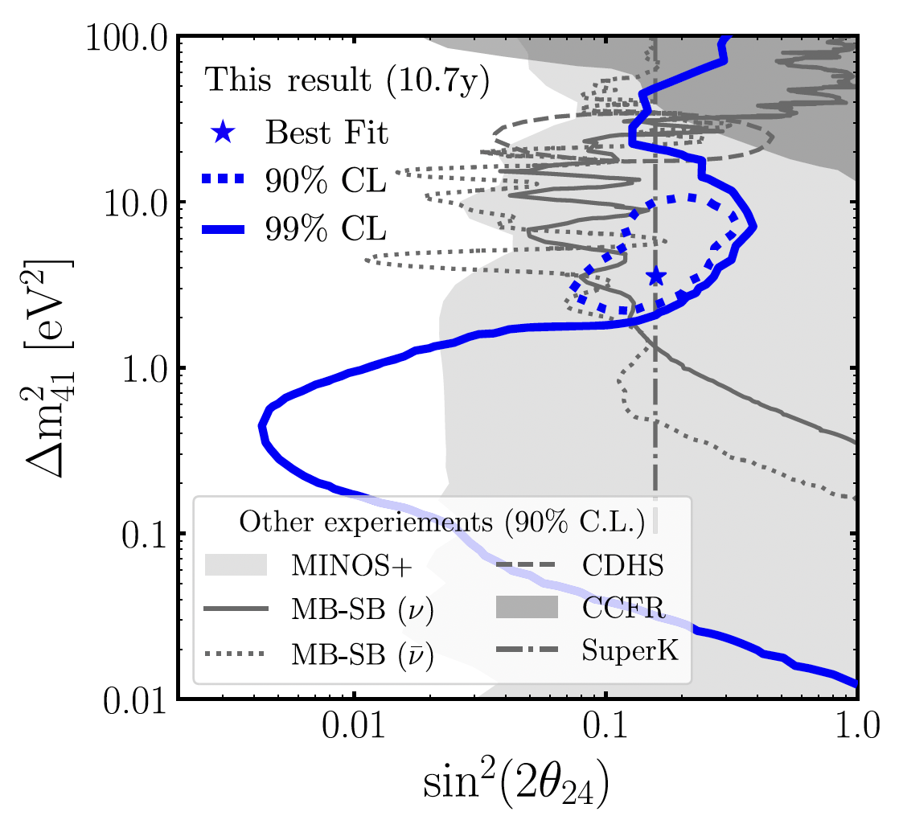
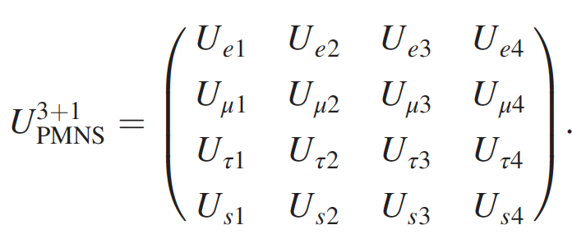
Recent science results
PHYSICAL REVIEW LETTERS 133, 201804 (2024)
Search for eV-Scale Sterile Neutrino
Compare to other experiments.
PR D 110, 072007 (2024)
“Search for a light sterile neutrino with 7.5 years of IceCube DeepCore data”
Results: at 90% C.L. assuming $∆m_{41}^{2}≥1 {eV}^{2}$.
- PMNS matrix elements:
${\left[U_{μ4}\right]}^{2}<0.0534$ and
${\left[U_{τ4}\right]}^{2}<0.0574$
* Also ref. MicroBooNE results in PRL 130, 011801 (2023)

Slide 21
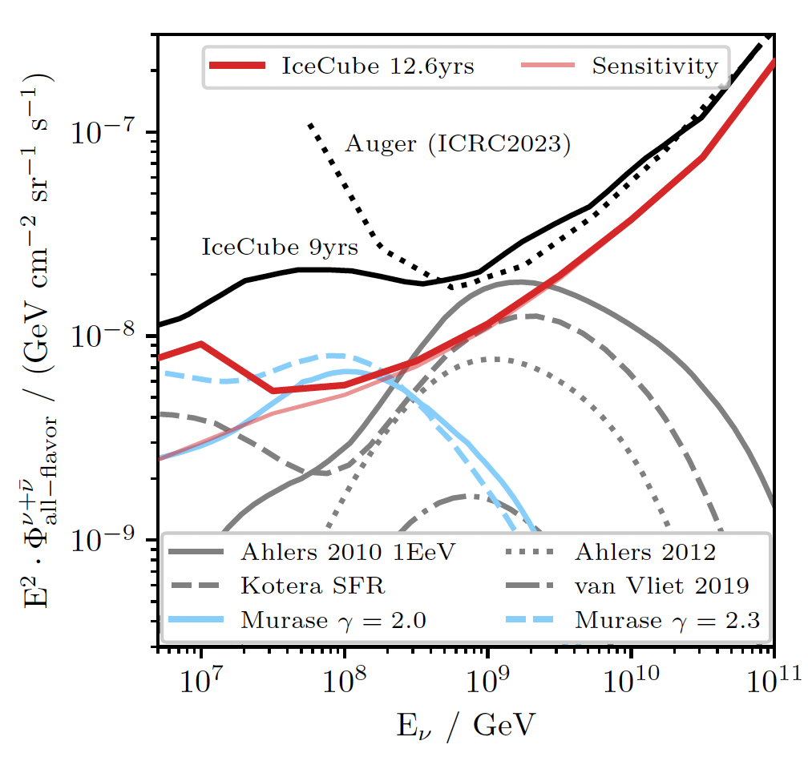
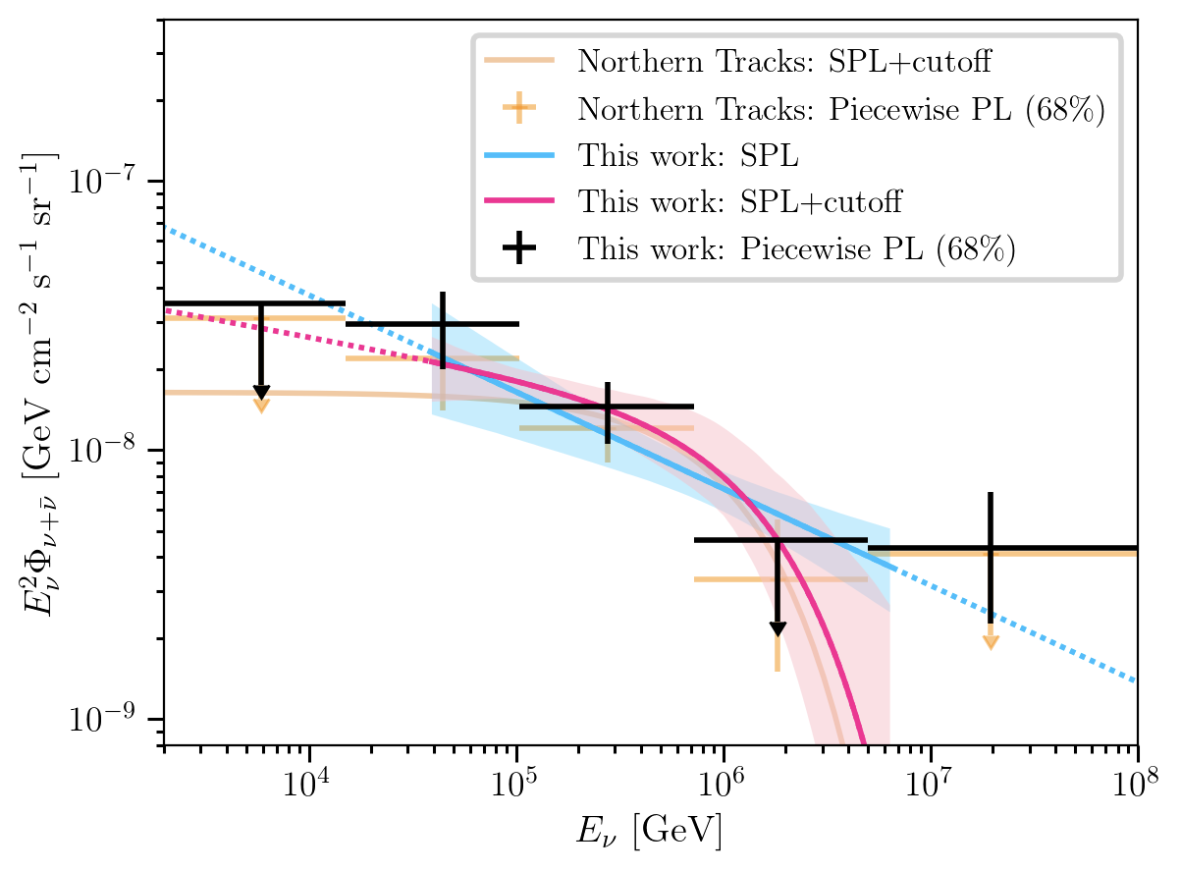
Recent science results
arXiv:2502.19776v1 [astro-ph.HE] (1 – 10 PeV) Accepted to PRD
arXiv:2502.01963v1 [astro-ph.HE] (>10 PeV) Accepted to PRL
Search for Neutrinos > PeV in IceCube
cosmogenic
neutrino flux models
Best-fit per-flavor astrophysical neutrino flux as a function of neutrino energy under model assumptions (9 years of data, southern sky)
Differential upper limit (90% CL) on the neutrino flux & comparison to model predictions (12.6 years of data)
Notes:
BBB-2-1PeV 2502.19776v1.pdf
BBB-1-10 PeV 2502.01963v1.pdf

Slide 22
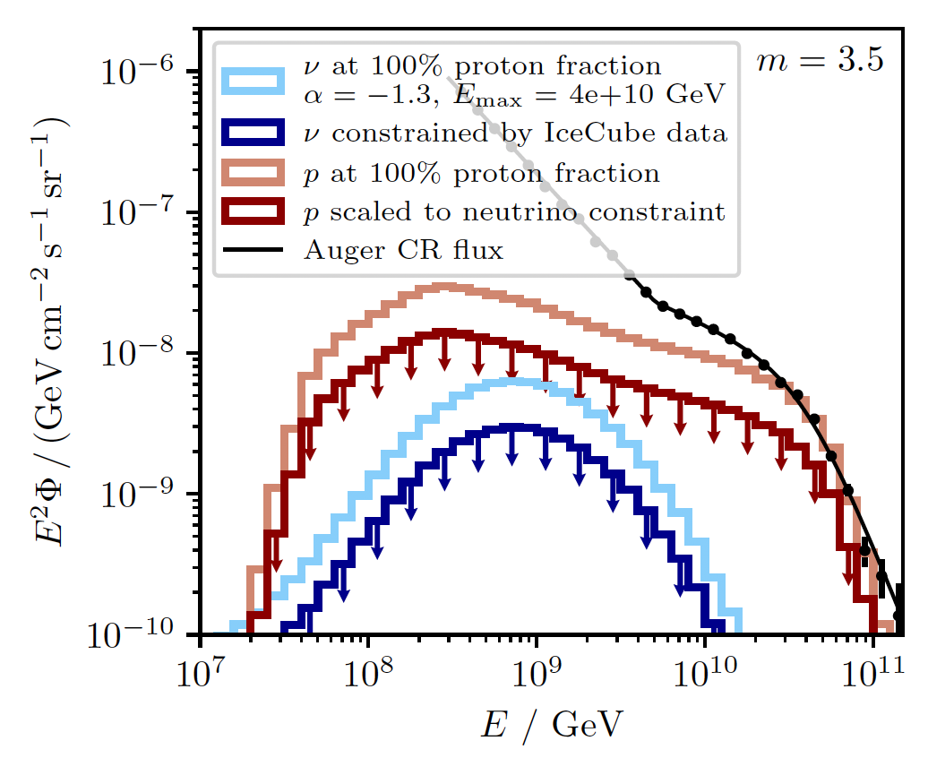
Recent science results
arXiv:2502.01963v1 [astro-ph.HE] (>10 PeV) Accepted to PRL
Constraints on the
ultra-high-energy cosmic-ray proton fraction by E.H.E. neutrinos
Proton flux allowed to saturate the Auger measurement at 10^{10.55} GeV.
And the corresponding neutrino flux
There exists a tension!!!
Method: Arjen van Vliet, et al. “Determining the fraction of cosmic-ray protons at ultrahigh energies with cosmogenic neutrinos”, Phys. Rev. D 100, 021302(R)
- - - see details in backup slide (Slide 39)
Notes:
BBB-2-1PeV 2502.19776v1.pdf
BBB-1-10 PeV 2502.01963v1.pdf
BBB-1-2-ref-1901.01899v2.pdf

Slide 23
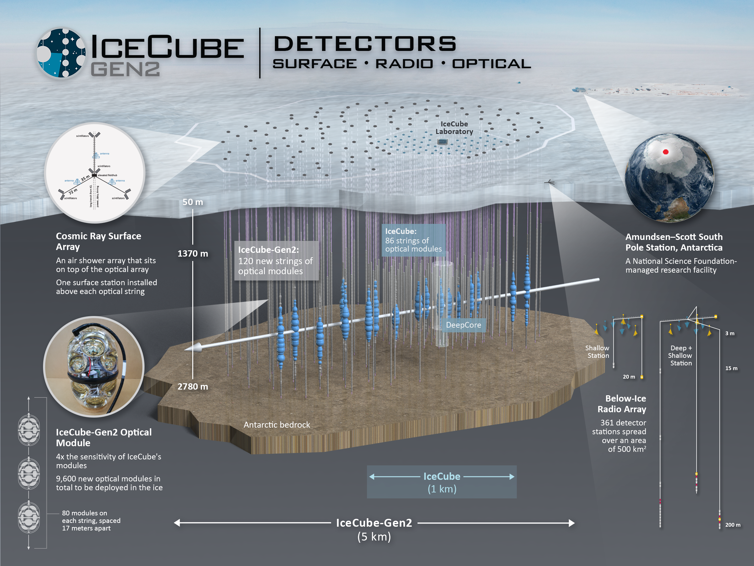
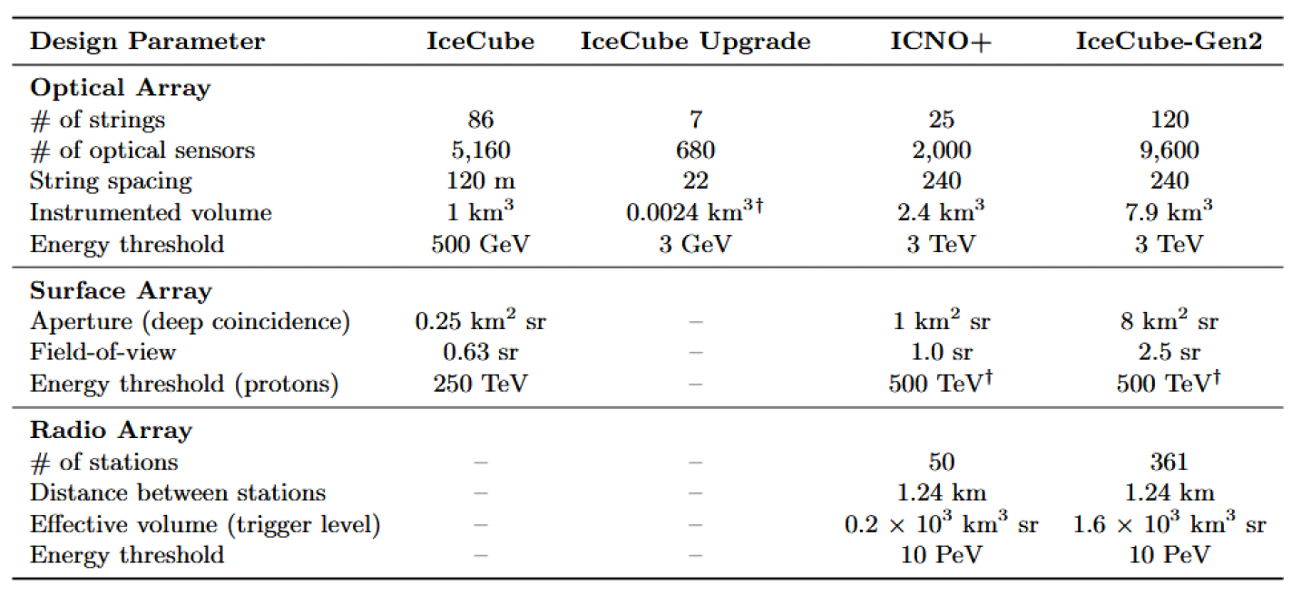
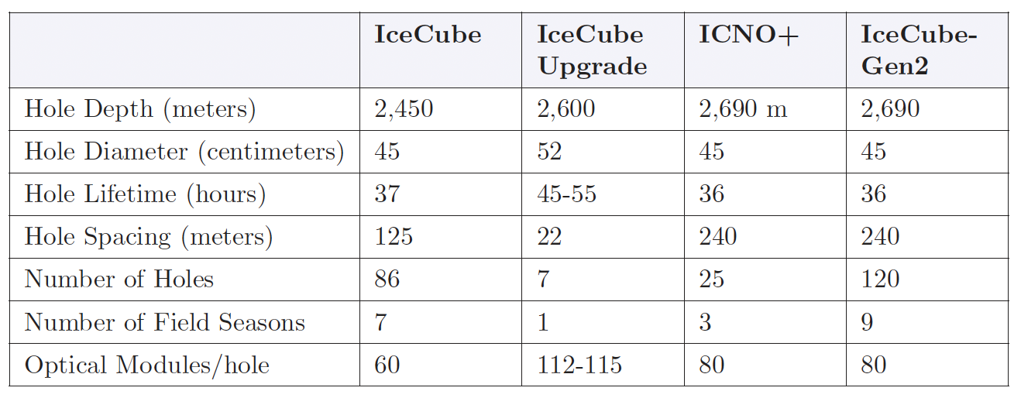
ICNO →Upgrade, ICNO+and Gen2
Design and drilling parameters
Drilling parameters

Slide 24
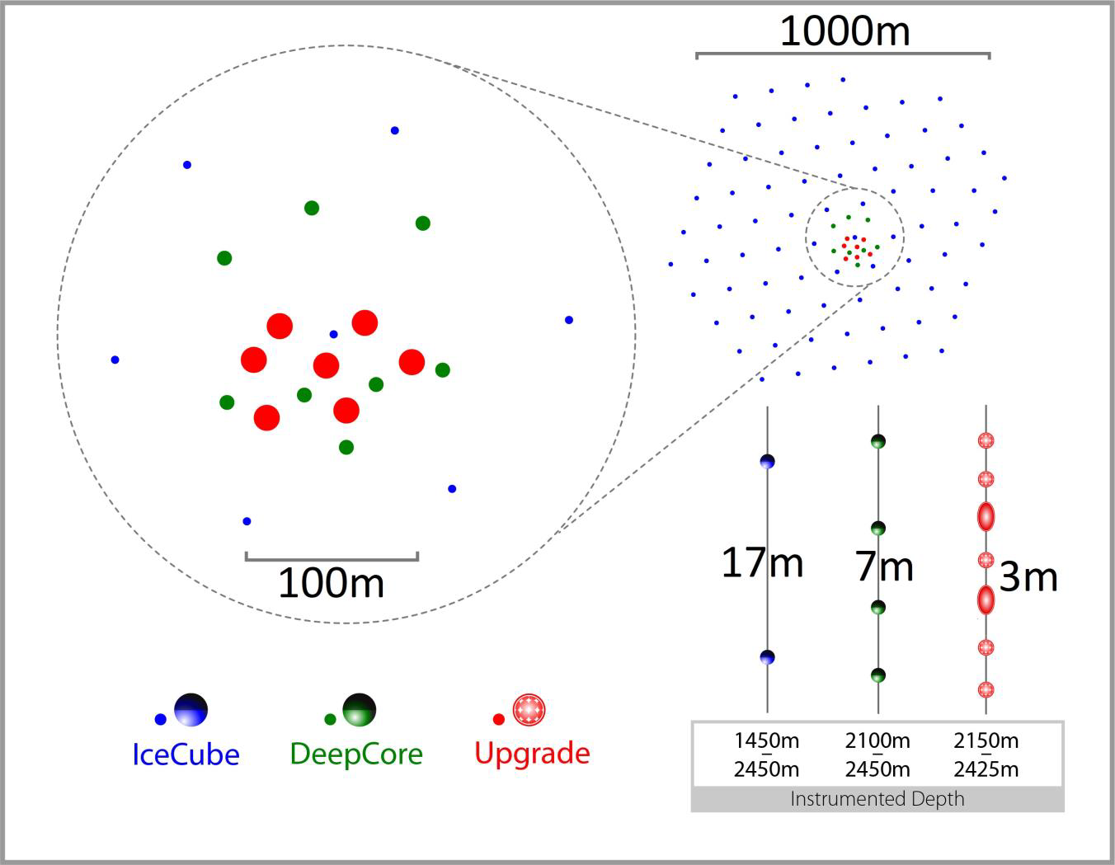
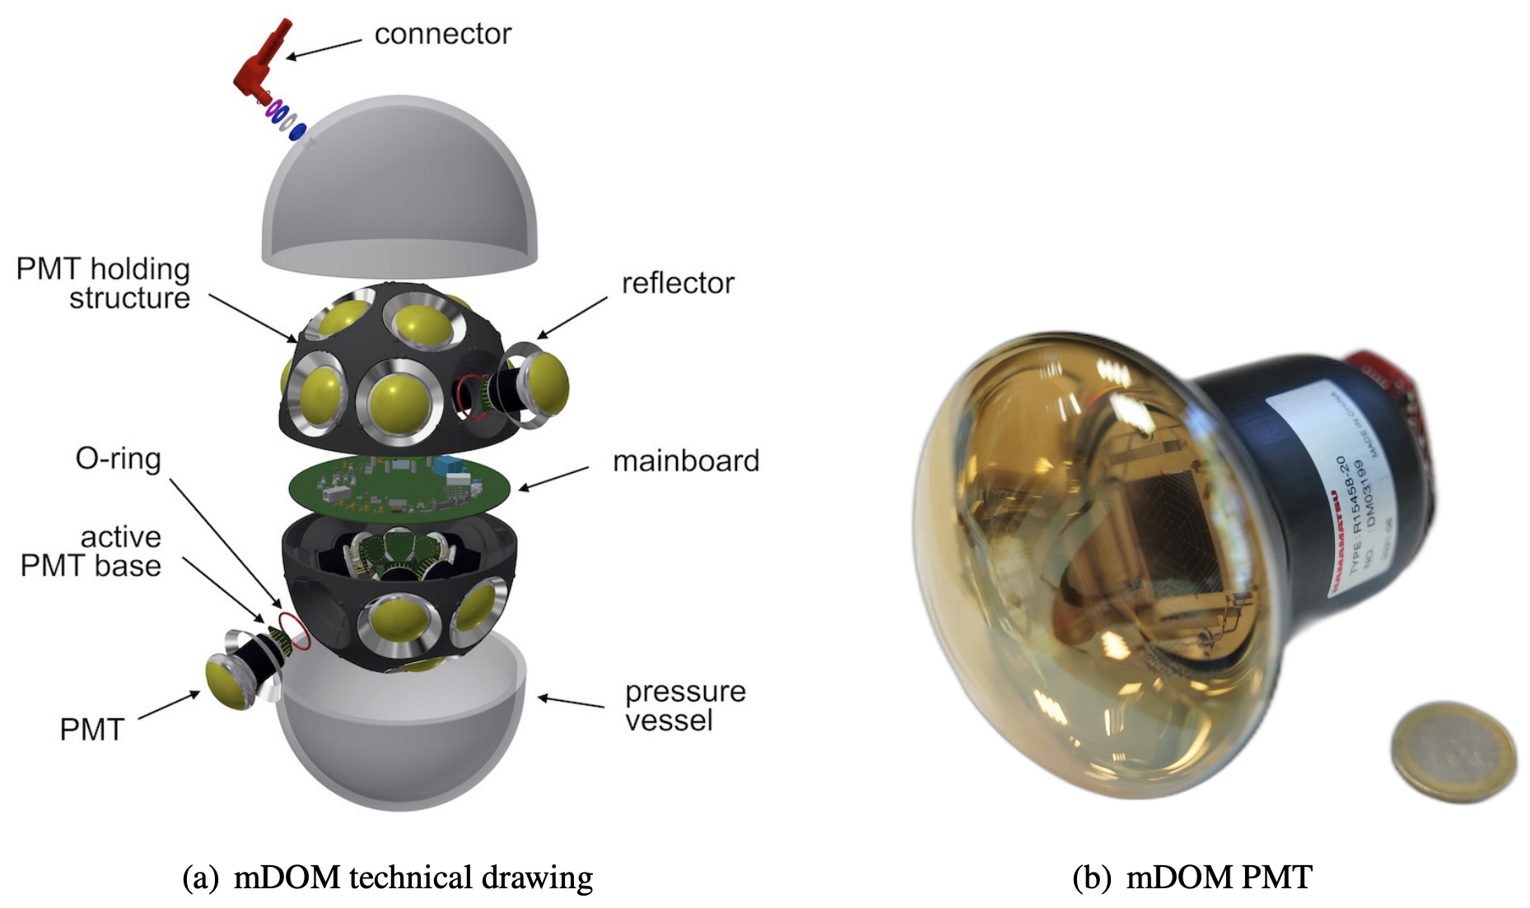
Upgrade , ICNO+and Gen2
Upgrade – Detector unit and string layout

Slide 25
Upgrade , ICNO+and Gen2
ICNO+

Slide 26
Upgrade , ICNO+and Gen2
Gen2
- IceCube-Gen2 Technical Design Report:
https://icecube-gen2.wisc.edu/science/publications/tdr/
Gen2 radio array: hybrid and shallow

Slide 27
Upgrade , ICNO+and Gen2
Gen2 Surface Extension
- IceCube-Gen2 Technical Design Report:
https://icecube-gen2.wisc.edu/science/publications/tdr/
- PoS(UHECR2024)055

Slide 28
Upgrade , ICNO+and Gen2
Science potential in energy/particle frontier

Slide 29
Upgrade , ICNO+and Gen2
Science potential in cosmic frontier

Slide 30
Upgrade , ICNO+and Gen2
Science potential in cosmic frontier - surface extension:
- Enhancing neutrino astronomy with veto
from CRs (Fig. on the right)
- PeV photon search with veto from surface
& in-ice coincidence events (Fig. below)
- Cosmic rays: hybrid measurement & high
precision
- Particle physics with air showers

Slide 31
Gen2 Science: PUSHING through Cosmic & energy frontiers
& cosmic rays
~99.999999% of the universe
~99% of the universe
TXS 0506+056
IceCube-170922A
?
NGC 1068
IceCube2022
1.5–15 TeV4.2$σ$
Galactic plane
Notes:
NGC 1068 IceCube paper: https://arxiv.org/pdf/2211.09972, neutrino energy: 1.5 TeV to 15 TeV , 14 Mpc
TXS 0506+056: IceCube “The most probable neutrino energy was estimated to be 290 TeV, with a 90% confidence level lower limit of 183 TeV (20)”, 1.75 Gpc

Slide 32
Thank you. Questions?
ICL in the moon light, June 2025

Slide 34
Recent science results
Chung-Lin Shan, JCAP 1107:005,2011
Search for dark matter in IceCube
Earth – heavy elements
Sun – light elements
Jodi Cooley’s summary
Notes:
AAA-2c-WIMPcrosssection paper-1103.0482v2.pdf

Slide 35
Recent science results
Eur. Phys. J. C (2025) 85:490
Search for dark matter from the center of the Earth
WIMP annihilation: $χχ→τ^{−}τ^{+} /W^{−}W^{+}(→hard υ)/b^{−}b^{+}(→soft υ)$
This work: a search for $ν_{μ}$ from the center of the Earth
> 10 years of IceCube data: May 2011 to May 2020; 3266 days of data for search + 353 days for method development
> Mass range: 10 GeV - 10 TeV
Total capture rate:
Muon neutrino volume flux:
Mass channels used in the analysis

Slide 36
Recent science results
Eur. Phys. J. C (2025) 85:490
Results:
> No significant excess over background
> Spin-independent cross-section
Spin-independent DM-nucleon cross section 90% C.L. upper limits
Comparison with results from other direct detection experiments.

Slide 37
Not-so-Recent science results
PRD 105 (2022) 062004
Search for GeV-scale Dark Matter Annihilation in the Sun with IceCube DeepCore
- 2022 analysis
- Spin-dependent cross section

Slide 38
Recent science results
arXiv:2502.19776v1 [astro-ph.HE] (1 – 10 PeV) Accepted to PRD
Search for Neutrinos > PeV in IceCube
Single power law (SPL) model: Φastro (per-flavor) has a flavor ratio of (νe : νμ : ντ ) =(1 : 1 : 1) at Earth
Single power law with a cutoff
Piecewise flux
Best-fit per-flavor astrophysical neutrino flux as a function of neutrino energy under model assumptions (9 years of data, southern sky)
Notes:
BBB-2-1PeV 2502.19776v1.pdf

Slide 39
Recent science results
Method: Arjen van Vliet, et al. “Determining the fraction of cosmic-ray protons at ultrahigh energies with cosmogenic neutrinos”, Phys. Rev. D 100, 021302(R)
The sources are assumed to have an injection spectrum
The source evolution (SE) is a combination of the evolutions of both the source number density and luminosity:
Notes:
.pdf

Slide 40
Recent science results
Physical Review D99 (2019) 032004
Inelasticity distribution of ν-nucleon interactions
2019 (DIS, 10^{2.5} to 10⁷ GeV): Measured mean inelasticity <y> as a function of E_{ν} in comparison to model predictions.

