Slide 1
Detecting Exotic Particle Interactions in ¹³⁷Cs Decay Through Photon-Magnetic Field Coupling
Presented by : Gunjan K. Akbari
Guided by : Dr. Carol Scarlett
Indiana University Indianapolis
XVIII International Conference on Interconnection
between Particle Physics and Cosmology (PPC 2025)

Slide 2
Talk Overview
Motivation and theoretical context
Experimental design and measurement strategy
Gamma spectrum analysis and BH/BV comparison
Summary of ²⁴¹Am experiment results
Cross-section estimates and systematics
Current progress and future plans
Applying the method to ¹³⁷Cs decay

Slide 3
1
Why Explore Photon-Magnetic Coupling Effects of Nuclear Decay?
Axion searches → Nuclear vs. Optical effects (rotation, disappearance)
No confirmed detection to date
Primakoff effect: photon → axion in magnetic field
New approach: observe nuclear decay modulation
Look for changes in gamma emission rates
Potential signal from axion-like particle interaction
Relevant to ALPs, dark matter, decay control

Slide 4
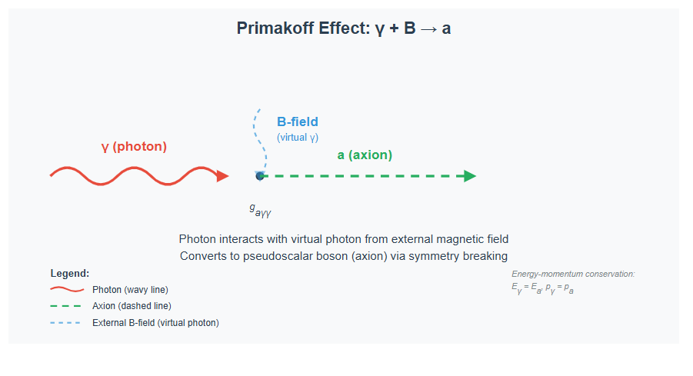
Primakoff Effect & Optical Searches
Proposed by Henry Primakoff (1951)
Photon interacts with virtual photon from external B-field
Converts into a pseudoscalar boson (e.g., axion)
Process allowed due to symmetry breaking by B-field
Efficient at high field strength and long interaction length
Forms basis of many axion search experiments (e.g., PVLAS, BMV)

Slide 5
Primakoff Effect & Optical Searches
Detect axion signal: $I_{L}$= $I_{0}$ −$I_{F}$
${ I}_{L}$ = Incoming laser intensity
$I_{0}$ = Light conversion to axions
${ I}_{F}$ = outgoing laser field
Optical Experiment: $I_{0}$ ≈ 10¹⁸/s, ∆$I$(Shot noise) ≈ 10⁹/s
Cross-section limit : c₁·g²ₐγγ ∝ 10⁻⁹ × Integrated Time
Nuclear measurements not limited by shot noise,
only √(Decay Rate)
If c₁·g²ₐγγ ⁓${ 10}^{−(12 to 14)}$ × Integrated Time, then $I_{L}$ ⁓ ${ 10}^{+(4 to 6)}$detectable for gₐN ⁓ ${10}^{−(5 to 6)}$

Slide 6
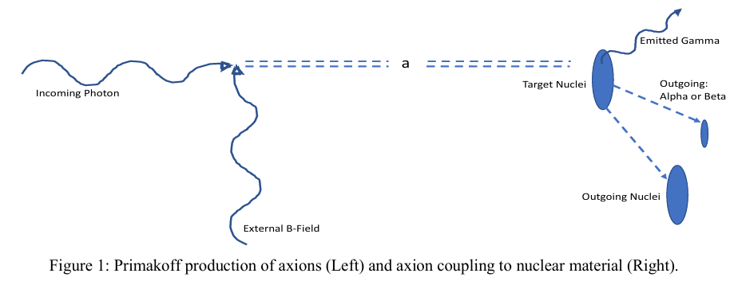
Primakoff Mechanism as a Path to Detect Exotic Particles
Photon + B-field → ALP (Primakoff effect)
ALPs: weakly interacting, long-lived
ALP reaches radioactive target
(²⁴¹Am or ¹³⁷Cs)
May slightly alter decay rate (via nuclear interaction)
Observable: count difference in gamma lines (e.g., 59.54 keV / 661.7 keV)

Slide 7
Expected Observables from ALP Nucleus Coupling
Primary signal: change in gamma count rate
Focus energy: 59.54 keV line from ²⁴¹Am
Compare sP (light on) vs sD (light off) modes
Significant difference implies ALP–nuclear interaction
Orientation dependence (BH vs BV) expected
Signature: consistent ∆counts beyond statistical noise

Slide 8
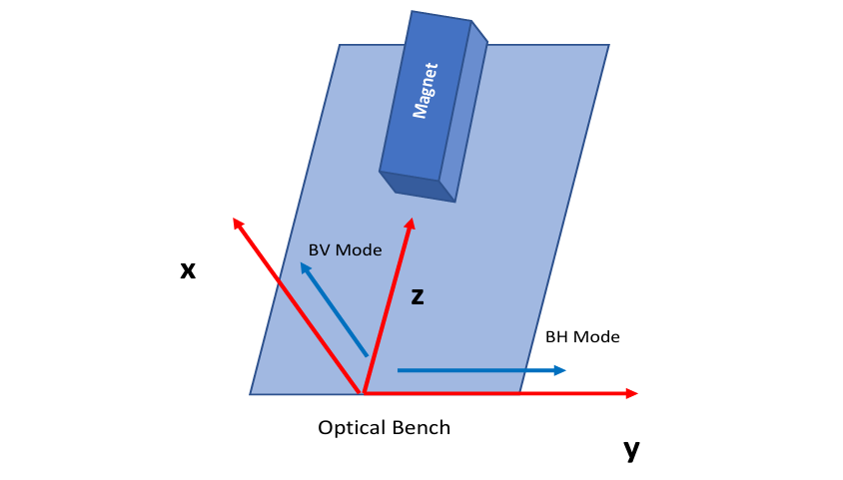
Experimental Overview
Laser source directed through magnetic cavity
Static B-field: ~50–80 mT (NdFeB magnets)
Photons converted to ALPs (sP mode) or blocked
(sD mode)
ALPs propagate toward ²⁴¹Am radioactive source
Gamma emission measured using NaI detector
Background monitored with secondary detector
Alternating sP/sD every 1 hour (to cancel drift)

Slide 9
Laser and Magnetic Field Configuration
Laser wavelengths: 632 nm (Exp 1), 445 nm (Exp 2)
Continuous beam; no power cycling between modes
Magnetic field orientations: ▪ BH – B-field ∥ polarization (high signal case) ▪ BV – B-field ⟂ polarization (null test)
Polarization aligned with optical bench (y-direction)
B-field rotated once, fixed per run (no switching during scan)

Slide 10
Detector Setup and Background Control
Primary detector: NaI scintillator for gamma detection
Calibrated for 59.54 keV (²⁴¹Am gamma line)
Secondary detector: monitors environmental background
“No source” mode used for background subtraction
Experimental detector runs in both sP and sD modes
Counts integrated over alternating intervals (e.g., 1 hour)

Slide 11
Modes of Operation: sP vs sD
sP (System–Photons): laser photons enter magnetic cavity
sD (System–Dark): photons blocked before cavity
Laser beam always on → avoids electronic switching artifacts
Only optical path changed (mechanical shutter or block)
Run schedule: alternating sP and sD every 1 hour (or 15 min in Exp 2)
Equal time exposure ensures drift cancellation

Slide 12
Decay Scheme of ²⁴¹Am
Alpha decay: ²⁴¹Am → ²³⁷Np* + α (5.49MeV)
²³⁷Np* de-excites via gamma emission
Key gamma lines: ▪ 59.54 keV (primary target) ▪ 26.32 keV (secondary, lower intensity)
Long half-life: ~432 years
Stable, well-characterized calibration source

Slide 13
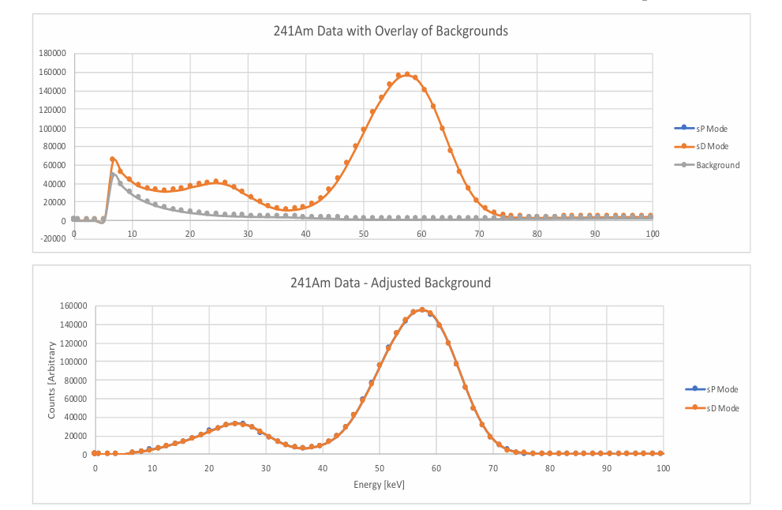
²⁴¹Am Gamma Spectrum with Background Subtraction
NaI detector spectrum: sP and sD modes overlaid
Strong peak at 59.54 keV (²³⁷Np gamma)
Secondary peak: 26.32 keV
Background subtracted using “No Source” mode
Visual difference between sP and sD not obvious at this scale
∆(sD − sP) emerges after statistical processing
Raw and background-subtracted spectra for ²⁴¹Am with main gamma peak at 59.54 keV

Slide 14
Magnetic Field Orientation BH and BV
Laser beam direction z-axis
Photon polarization y-axis
BH mode → B-field ∥ polarization (along y-axis)
BV mode → B-field ⟂ polarization (along x-axis)
BH enables $\vec{E}$‧$\vec{B}$ ≠0 → ALP production allowed
BV gives $\vec{E}$‧$\vec{B}$ =0 → null test configuration

Slide 15
Experimental Conditions and Parameters
Magnetic field strength 50–80 mT
Field length approximately 1 meter
Laser wavelength 632 nm (Exp 1) and 445 nm (Exp 2)
Laser intensity 1 mW (per beam)
sP and sD alternated every 1 hour (Exp 1) or 15 minutes (Exp 2)
Total integration time 60 hours (Exp 1) and 48 hours (Exp 2)
NaI detector calibrated at 59.54 keV
Target material ²⁴¹Am pressed source

Slide 16
Background Control Strategy
Secondary detector monitors room background
“No source” mode used for baseline measurements
Experimental detector run with source removed for background spectrum
Subtracted background from both sP and sD modes
Same timing structure applied during background collection
Minimizes influence of drift, temperature, and electronics
Confirms signal not due to environmental variation

Slide 17
Spectrum Comparison sP and sD Modes
Gamma spectra overlaid for sP and sD (Exp 1)
Integration time 60 hours total
Peak at 59.54 keV present in both modes
Maximum statistical significance approximately 6.49σ
Slight excess in sP counts near 59.54 keV
Sets stage for statistical subtraction and significance analysis
Overlay of gamma spectra in sP and sD modes with background subtracted

Slide 18
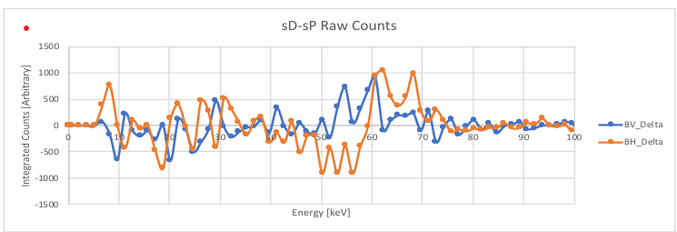
BH and BV Modes Compared
sD − sP difference plotted for both BH and BV modes
BH shows strong positive deviation near 59.54 keV
BV remains flat across the spectrum
Confirms effect tied to $\vec{E}$‧$\vec{B}$ ≠0 condition
Strong support for ALP-mediated interaction hypothesis
Suggests controlled, repeatable, orientation-dependent effect
Comparison of gamma count differences in BH and BV modes showing signal only in BH

Slide 19
Second Experimental Setup with Blue Laser
New configuration for independent validation
Single laser at 445 nm (blue)
Mirror cavity replaces multi-laser alignment
Different NaI detectors used
sP and sD alternated every 15 minutes
Total integration time 48 hours
²⁴¹Am used again as the target isotope
Field strength increased to 130 mT

Slide 20
Estimated Cross Section for ALP Interaction
Δ(sD − sP) used to estimate effective cross section
Calculation assumes product of creation and interaction terms
Based on Equation 1.1 and 1.2 from paper
Estimated value: ▪ ~4.5×${10}^{−30}$ ${Cm}^{2}$ (Experiment 1 BH) ▪ ~5.9× ${10}^{−30}$ ${Cm}^{2}$(Experiment 2)
Order of magnitude consistent with weakly coupled ALP models
Precision limited by geometry, integration time, and detector resolution
Cross-section estimates based on observed gamma count differences in BH mode

Slide 21
Systematic Checks and Error Control
Background measured with second detector and no-source mode
Same electronics and laser power in both sP and sD modes
Beam always on → avoids thermal or switching artifacts
Magnetic field fixed during each run to avoid mechanical noise
Environmental conditions (temperature, pressure) monitored
No known instrumental drift aligned with 59.54 keV
Signal not observed in BV mode confirms geometry-specific effect

Slide 22
Next Steps and Future Work
Extend method to other isotopes (e.g. ¹³⁷Cs and ²³⁸U)
Increase integration time for stronger statistical confidence
Explore other laser wavelengths and power levels
Study gamma lines at higher energies (e.g. 661.7 keV from ¹³⁷Cs)
Develop setup for real-time modulation or pulsed ALP signal tests
Investigate direct detection via resonant cavity coupling
Collaborate with axion haloscope and helioscope experiments

Slide 23
Applying the Same Method to ¹³⁷Cs
Technique validated on ²⁴¹Am now applied to ¹³⁷Cs
Photon–magnetic field interaction expected to be isotope-independent
¹³⁷Cs decay produces 661.7 keV gamma from ¹³⁷Baᵐ transition
Higher energy gamma improves resolution and signal clarity
Preliminary data shows statistically significant mode-dependent difference
Supports reproducibility of the Primakoff-based effect
¹³⁷Cs selected for its availability, spectral simplicity, and widespread use

Slide 24
Implications for Axion and ALP Physics
Results consistent with photon–ALP conversion via Primakoff effect
Geometry dependence supports pseudo-scalar ALP interaction
Suggests possible coupling between ALPs and nuclear transitions
New approach for indirect ALP detection via decay rate modulation
Complementary to haloscope and helioscope experiments
Opens path to nuclear-coupled ALP instrumentation

Slide 25
Summary of Key Results
ALP-induced gamma modulation observed in ²⁴¹Am decay
Significant difference between sP and sD modes in BH field
No effect seen in BV configuration (control)
Independent confirmation from second setup using blue laser
Cross-section estimates consistent with weak ALP coupling
Same method now applied to ¹³⁷Cs decay at 661.7 keV
Supports potential for photon–B-field–nucleus interaction mechanism

Slide 26
References
R.D. Peccei and H.R. Quinn, Phys. Rev. Lett. 38, 1440 (1977)
H. Primakoff, Phys. Rev. 81, 899 (1951)
A. Ejlli et al., Phys. Reports 871, 1 (2020)
Y.K. Semertzidis et al., Phys. Rev. Lett. 64, 2988 (1990)
D. Kharzeev, Y. Semertzidis, K. Tuchin, arXiv:hep-ph/0602179
R. Battesti et al., The BMV Experiment, arXiv:0710.1703
G. Steinitz et al., Proc. R. Soc. A 474, 20180240 (2018)
P.A. Sturrock et al., Astropart. Phys. 100, 1 (2018)
C. Scarlett et al., Submitted for publication: ²⁴¹Am Decay Modulation

Slide 27
Thank You

