Slide 1

Dark Matter Searches in
Neutrino Experiments
Doojin Kim
(doojin.kim@usd.edu)
XVIII International Conference on Interactions between
Particle Physics and Cosmology
The Institute for Underground Science, Deadwood, SD
June 27th, 2025

Slide 2
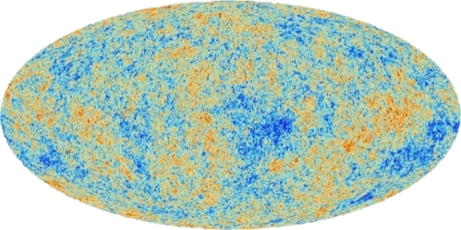
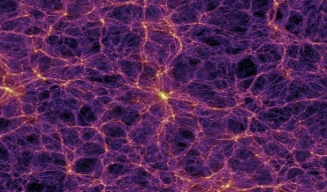
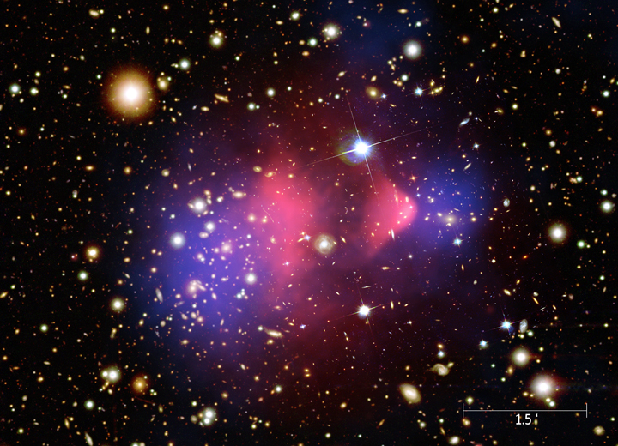
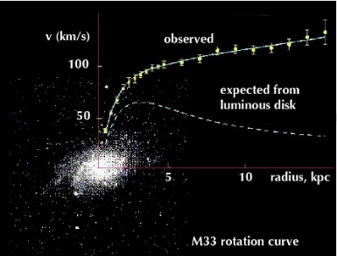
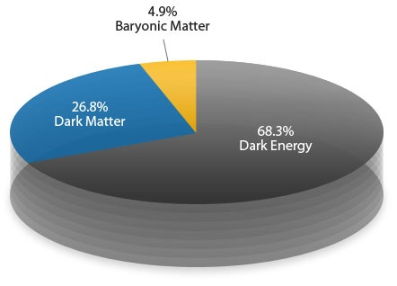
Dark Matter in the Universe
Larger scale
Earlier universe
Smaller scale
Later universe

Slide 3
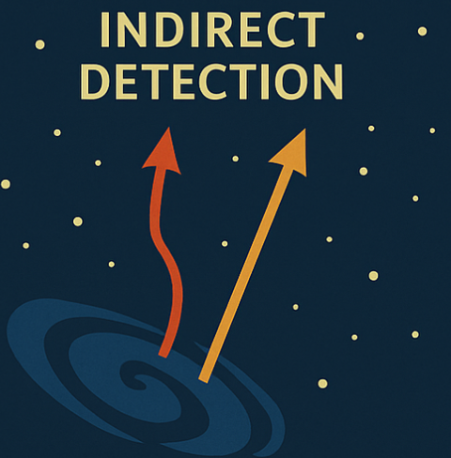

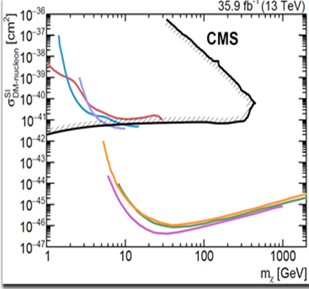
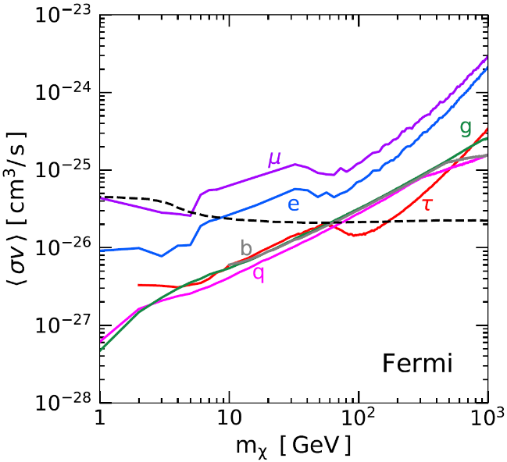
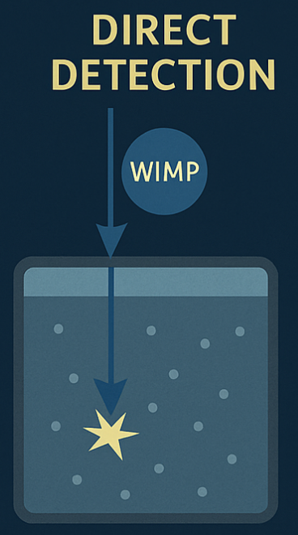
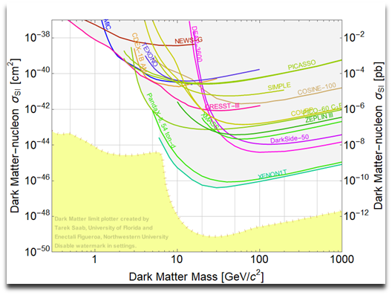
Status of (WIMP-like) Dark Matter Searches
DM
DM
SM
SM
No conclusive evidence yet via non-gravitational interactions

Slide 4

Alternative Ideas
Nonconventional dark matter: boosted dark matter, different thermal history, etc
Lower mass: MeV-range light dark matter, super-/ultra-light dark matter etc
Higher mass: primordial black holes, extended objects etc
Lower cross-section: increasing the volume of detectors (e.g., XENONnT, DarkSide20k, LZ etc)

Slide 5
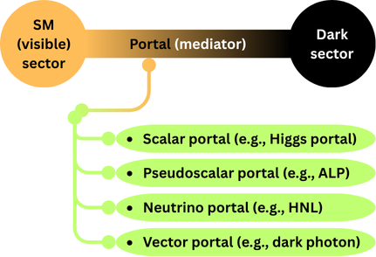
MeV-Scale Light Dark Matter (LDM) with Portal Scenarios

Slide 6
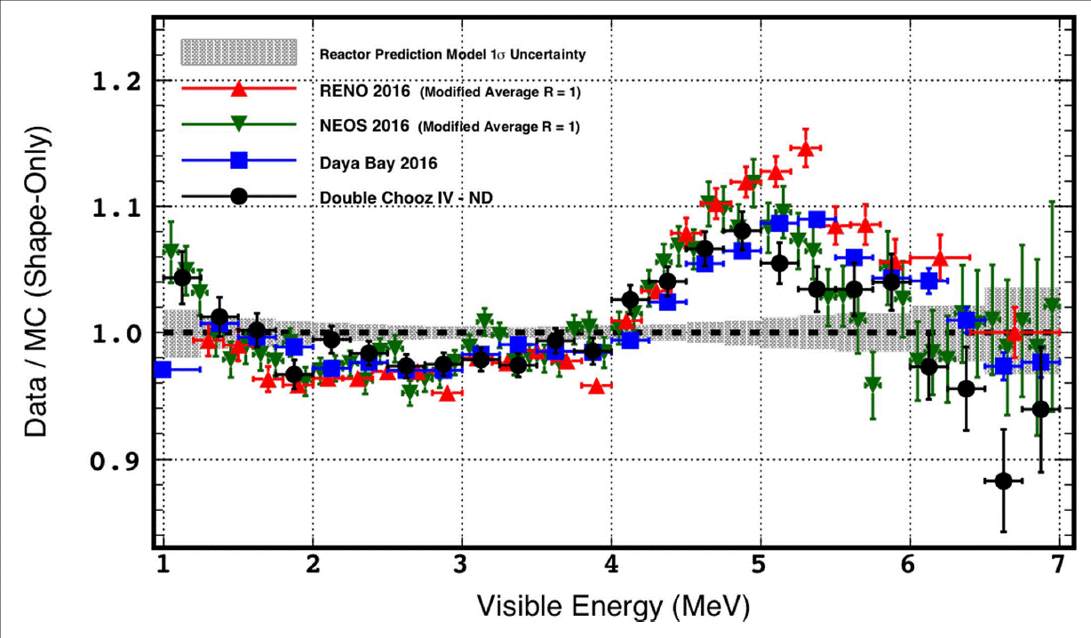
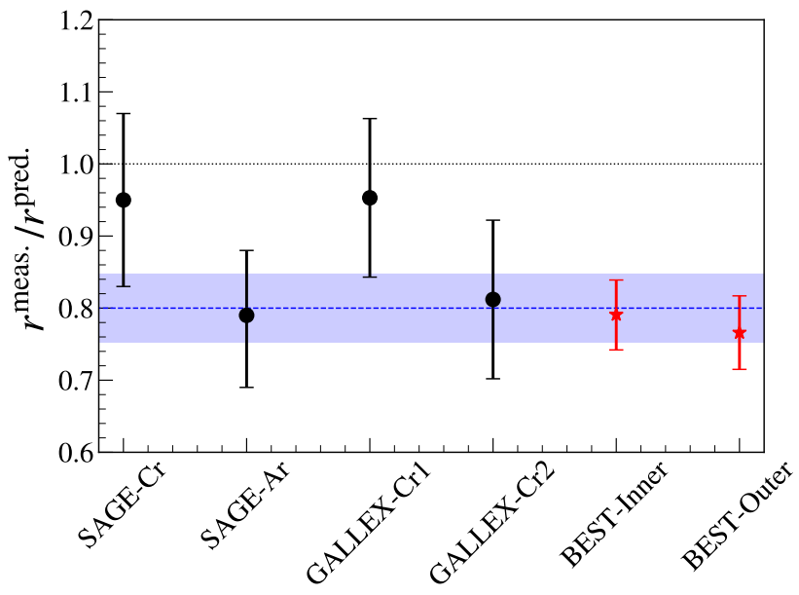
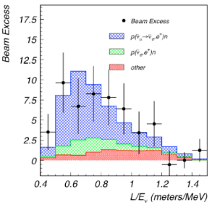
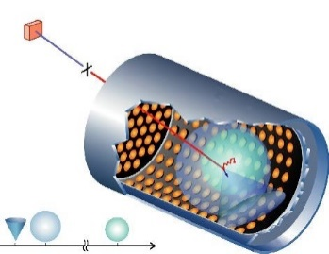
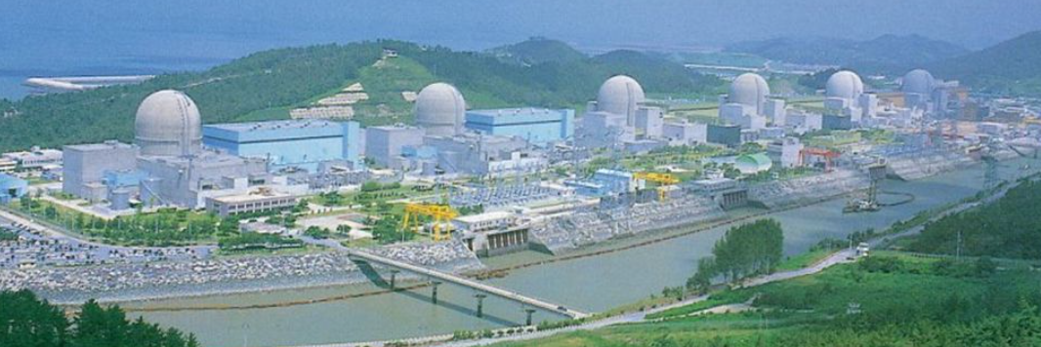
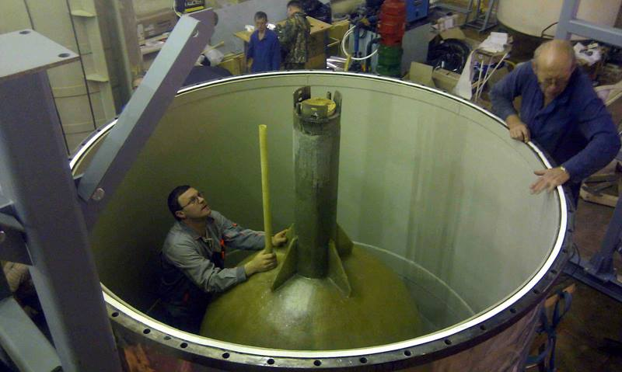
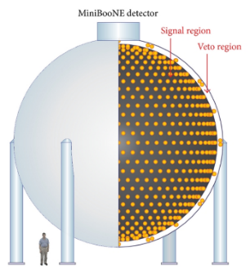
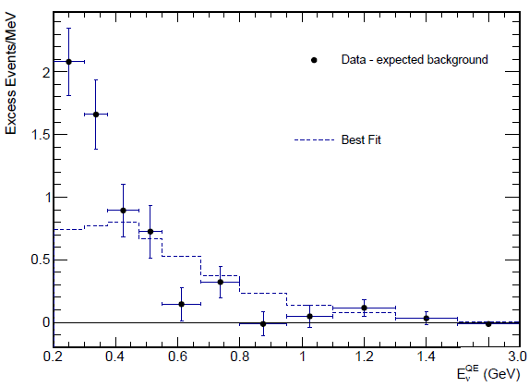
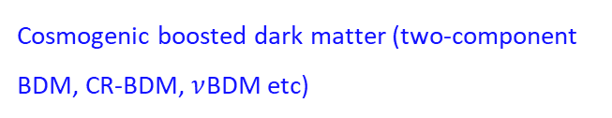



Various Anomalies & Light Dark(-Matter) Sector Interpretations
Various HEP phenomena including excesses, anomalies, non-minimal dark-sector scenarios motivate light dark matter (and/or light mediators).
Gallium anomaly
Reactor anomalies
LSND/MiniBooNE Excess
$$χ_{0}$$
$$χ_{1}$$
SM
$$χ_{0}$$
$$χ_{1}$$
SM
Cosmogenic boosted dark matter (two-component BDM, CR-BDM, $ν$BDM etc)
…

Slide 7
Key Words for Light Dark Matter
Small flux of
Cosmogenic LDM
Light (MeV – sub GeV mass range)
Feebly (or very weakly) interacting
Large-volume
detectors needed
Intense production
Sources needed
Neutrino experiments

Slide 8






Neutrino Experiments: A Landscape
Reactors
IsoDAR, LSC
Stopped-Pion (CCM, COHERENT, JSNS²)
T2K, SBN (SBND, μBooNE, ICARUS)
DUNE, ICARUS@NuMI
FASER/FASER𝜈
$\sim$MeV
$\sim$GeV
$\sim$TeV
𝜈-flux isotropic
𝜈-flux (effectively) forward-focused
Borexino
DUNE, JUNO, Super-K
Hyper-K
DeepCore
IceCube
GEN2
$\sim$kt
$\sim$Mt
$\sim$Gt
Featuring large-volume detectors and/or high-intensity beam
Disclaimer: Not an exhaustive list of neutrino experiments/observatories

Slide 9






Dark Matter Searches in Neutrino Experiments
Cosmogenic
$$χ$$
$$χ$$
(Near) detectors
$$χ$$
$$χ$$
$$χ$$
$$χ$$
Observatories/(far) detectors
Beam/Lab-produced

Slide 10
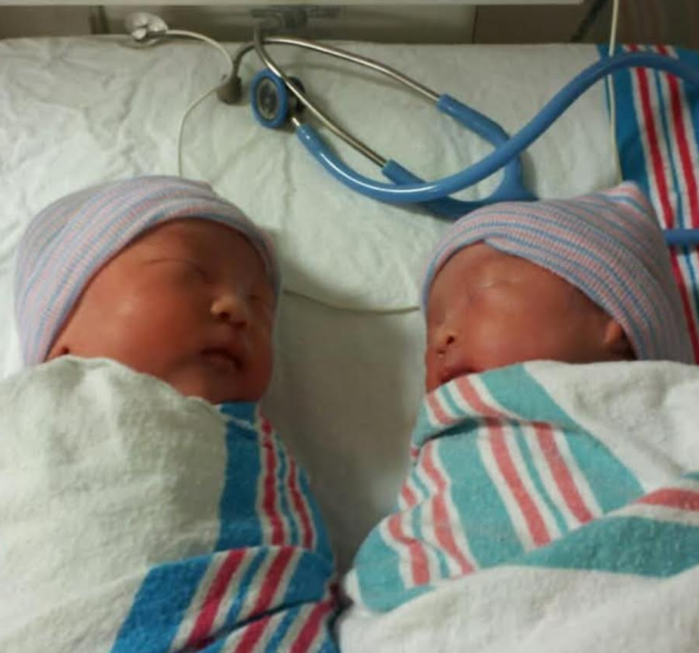

Neutrinos as Backgrounds to Light Dark Matter Signals
DM?
Neutrino?
DM
Neutrino
Both dark matter and neutrinos are
  very weakly interacting,
  leaving experimental signatures via scattering.
Neutrinos usually fake light dark matter signals.
Studies focusing on improving signal-over-background
(new rejection schemes, new channels, new sources, etc)

Slide 11
Cosmogenic
Light Dark Matter

Slide 12
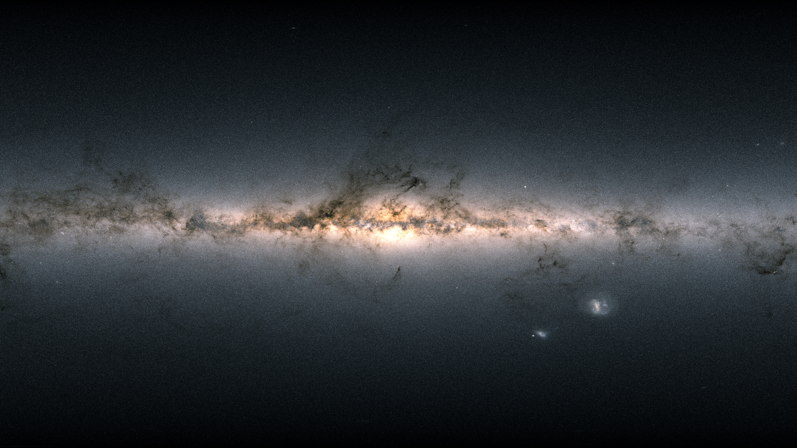
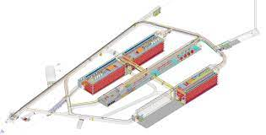
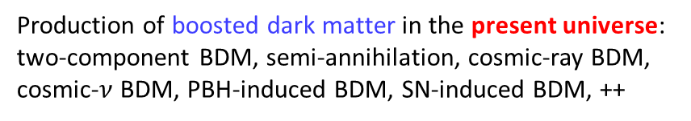
Searches for Cosmogenic Boosted Dark Matter (BDM)
Production of boosted dark matter in the present universe: two-component BDM, semi-annihilation, cosmic-ray BDM, cosmic-$ν$ BDM, PBH-induced BDM, SN-induced BDM, ++
Relativistic experimental signatures

Slide 13
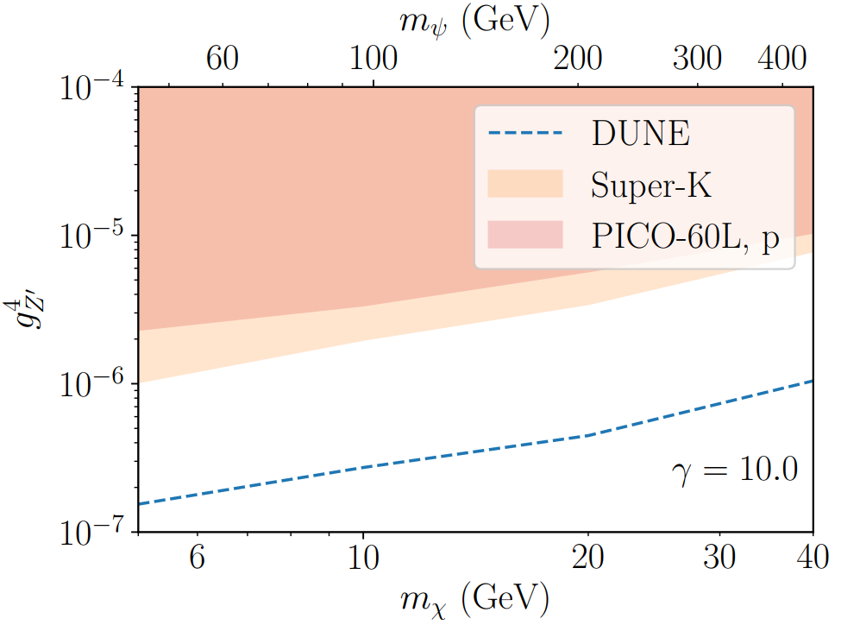




Elastic Boosted Dark Matter
Solar-captured two-component DM
Nucleon scattering or DIS
$$χ$$
$$χ$$
$$V^{∗}$$
$$e^{−}/p$$
Simple electron/nucleon recoil
⇒ Featureless signal not free from BGs ⇒ Angular cut, energy cut
[Berger, Cui, Graham, Necib, Petrillo, Stocks, Tsai, Zhao, PRD (2021)]
See also [Necib, Moon, Wongjirad, Conrad, PRD (2017); Alhazmi, Kong, Mohlabeng, Park, JHEP (2017); Bhalla, Hajkarim, DK, Sinha, arXiv:2506.15765; ++]

Slide 14
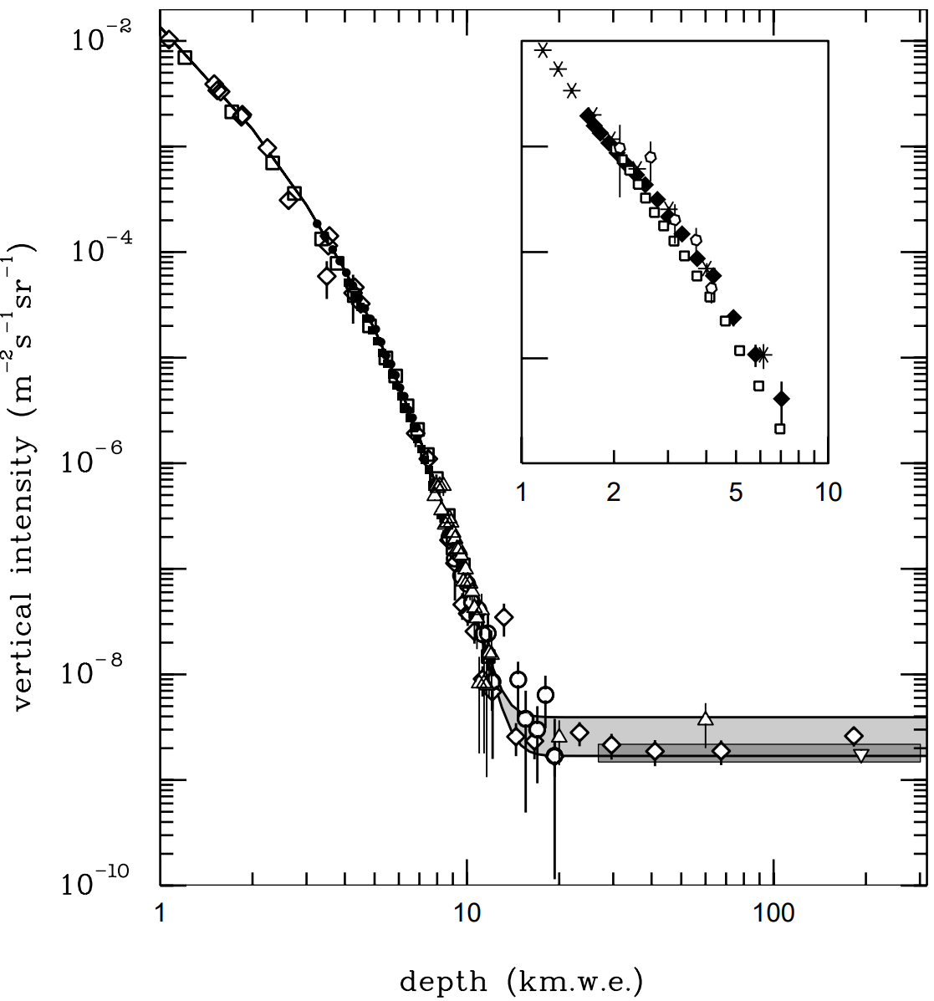
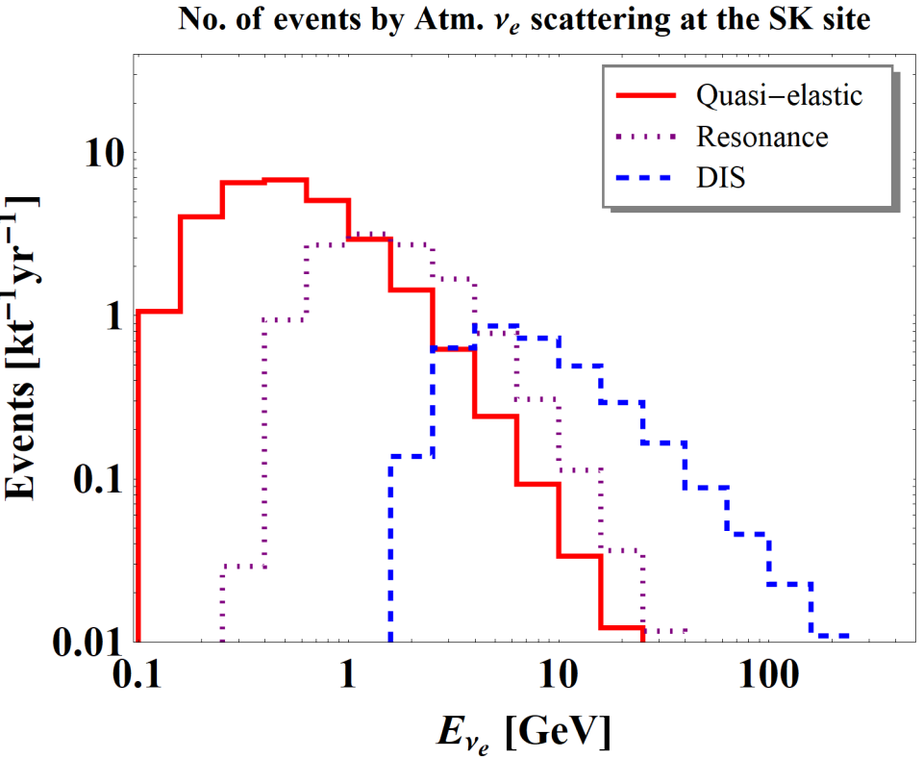
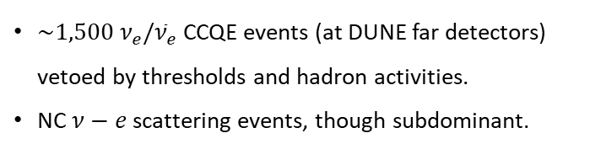
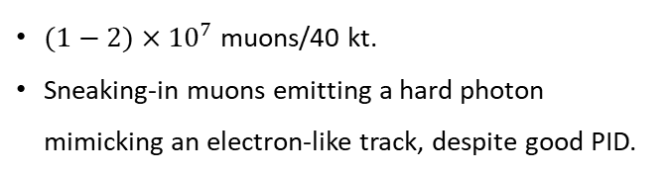

Background Considerations
Cosmic-muon-induced BGs
Atmospheric-$ν$-induced BGs
DUNE location
[PDG (2022)]
[De Roeck, DK, Moghaddam, Park, Shin, Whitehead, JHEP (2020)]
$(1−2)×{10}^{7}$ muons/40 kt.
Sneaking-in muons emitting a hard photon mimicking an electron-like track, despite good PID.
$\sim 1,500 ν_{e}/{\overline{ν}}_{e}$ CCQE events (at DUNE far detectors) vetoed by thresholds and hadron activities.
NC $ν−e$ scattering events, though subdominant.

Slide 15
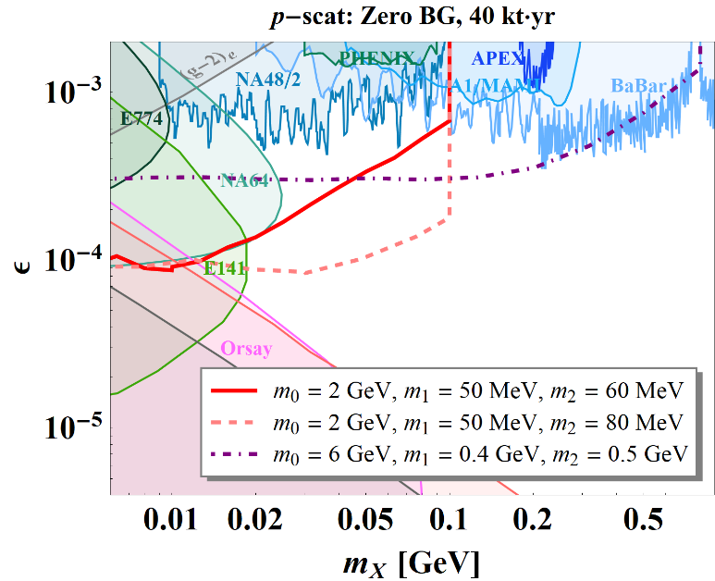









Inelastic Boosted Dark Matter
Galactic two-component DM
Nucleon scattering $⊕$ decay to an $e^{+}e^{−}$ pair
$$χ$$
$$χ$$
$$χ′$$
$$V^{(∗)}$$
$$V^{∗}$$
$$e^{−}$$
$$e^{−}/p$$
$$e^{+}$$
[DK, Park, Shin, PRL (2017)]
Featured by
Multiple visible final-state particles
Possibly displaced decay vertex
[De Roeck, DK, Moghaddam, Park, Shin, Whitehead, JHEP (2020)]

Slide 16
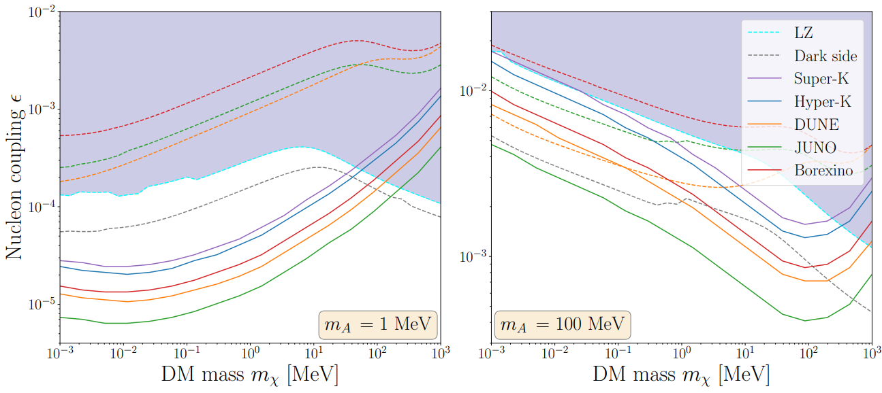
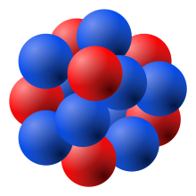





Nuclear Inelastic Scattering of Boosted Dark Matter
Cosmic-ray boosted dark matter
$$χ$$
$$χ$$
$$N$$
$$N^{∗}$$
$$γ$$
[Dutta, Huang, DK, Newstead, Park, Shaukat Ali, PRL (2024)]
Characteristic de-excitation photon line signature

Slide 17
What Neutrino Detectors?
[DK, Machado, Park, Shin, JHEP (2020)]
(Total) energy of
BDM
100 GeV
10 GeV
Hyper-K
Hyper-K
Super-K
Super-K
DUNE
DUNE
1 GeV
SBN Program, ProtoDUNE
SBN Program, ProtoDUNE
100 MeV
Borexino
Borexino
10 MeV
CUORE
Xe-1T, LZ, DarkSide
Xe-1T, LZ, DarkSide
CUORE
1 MeV
small
(Fiducial) volume
large
poor
Angular/position res.
good
Detectors are complementary to one another rather than superior to the others!

Slide 18
Beam-Produced
Light Dark Matter

Slide 19















Production & Detection of Light Dark Matter
Proton
beam
Target/dump
Near detector
$$π^{0}, η, …$$
$$χ$$
Meson-induced
$$V$$
LDM-electron elastic scattering
$$π^{0}, η, …$$
$$χ$$
$$χ$$
$$γ$$
$$χ$$
$$p$$
Beam-bremsstrahlung
$$χ$$
$$V^{∗}$$
$$p$$
Better for heavier $χ$
$$V$$
$$e^{−}$$
$$χ$$
$$e^{−}$$
$$N$$
$$N$$
Drell-Yan
$$p$$
$$χ$$
$$V$$
Cf.) Nucleon scattering challenged by backgrounds, thresholds, etc.
$$p$$
$$χ$$

Slide 20
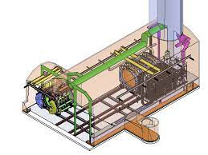
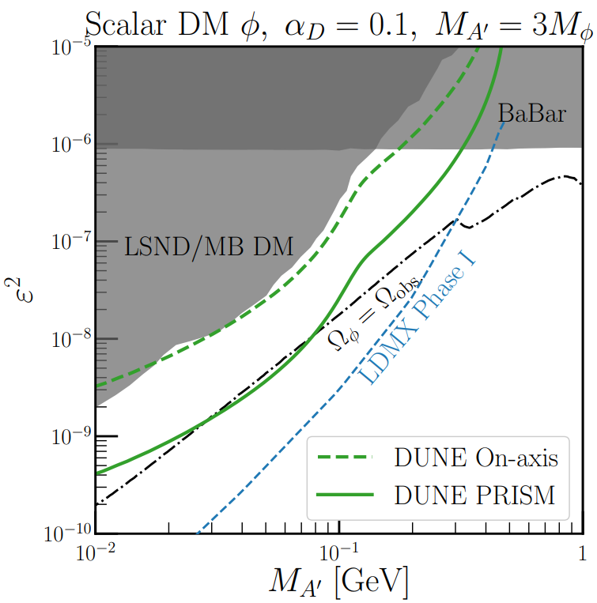
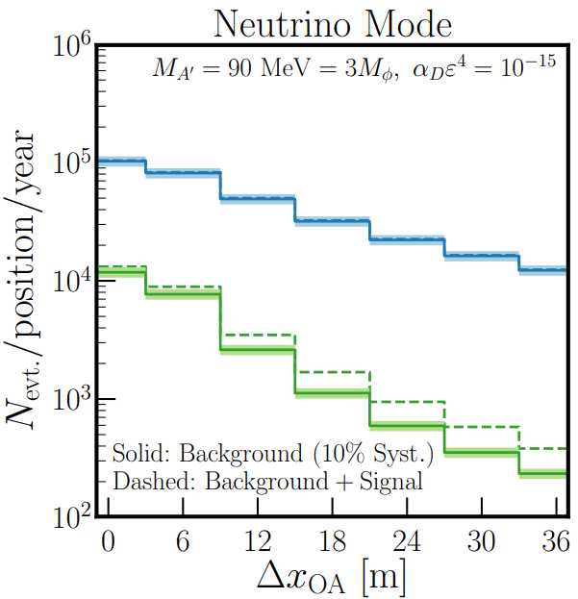

Elastic LDM-Electron Scattering: On-Axis vs. PRISM
[De Romeri, Kelly, Machado, PRD (2019)]

Slide 21
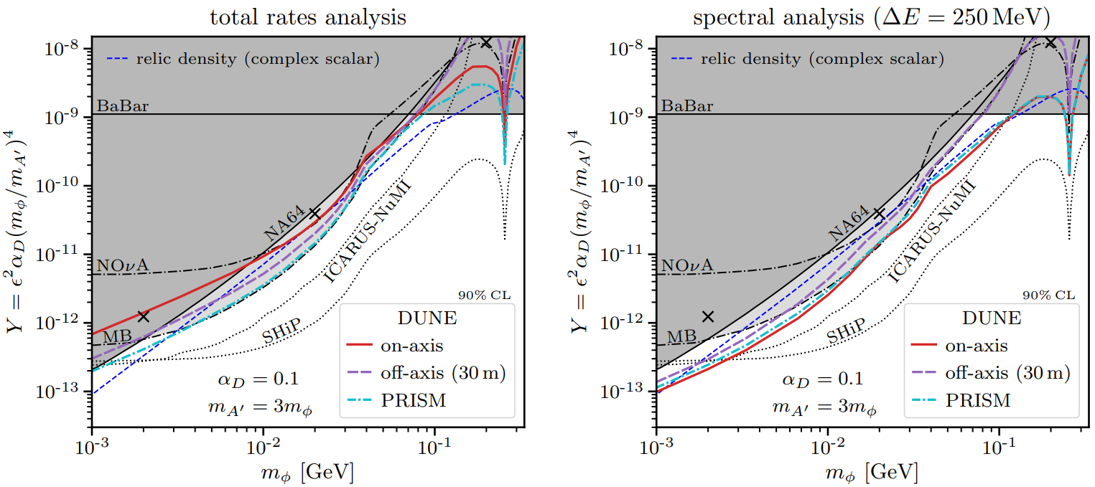
Shape Analysis
[Breitbach, Buonocore, Frugiuele, Kopp, Mittnacht, JHEP (2022)]

Slide 22
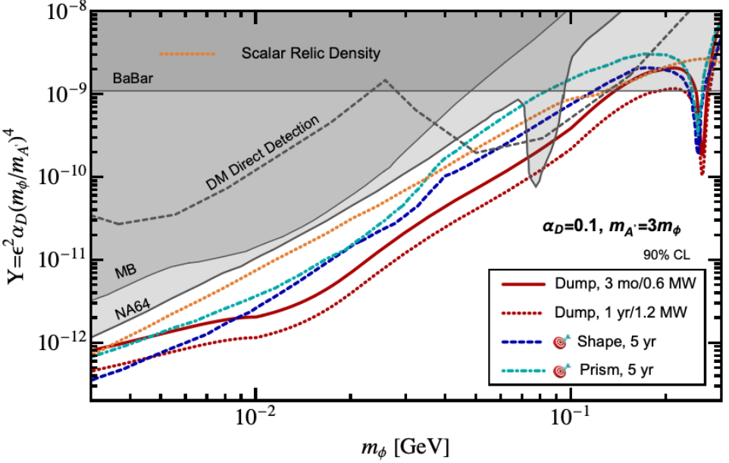
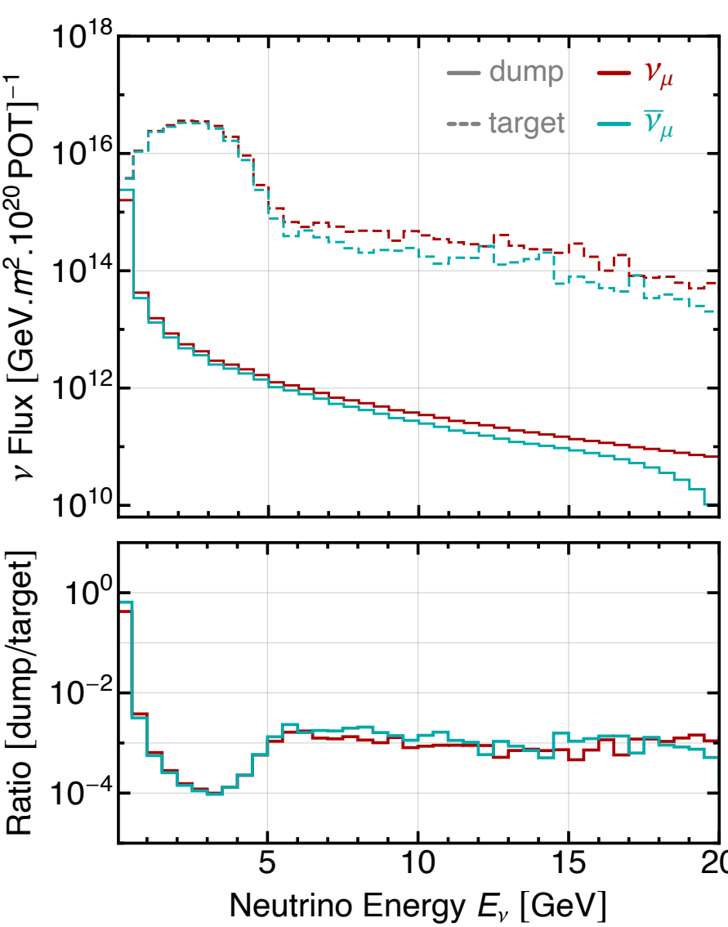
Targetless-Mode Measurement
[Brdar, Dutta, Jang, DK, Shoemaker, Tabrizi, Thompson, Yu, PRD (2023)]
Cf.) Effective targetless-mode measurement utilizing proton beam leakage from the target [Brdar, Dutta, Jang, DK, Shoemaker, Tabrizi, Thompson, Yu, to appear soon]

Slide 23

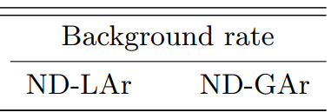
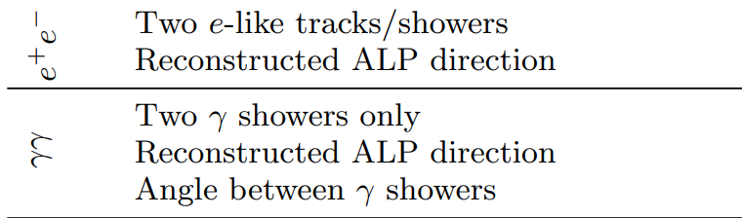
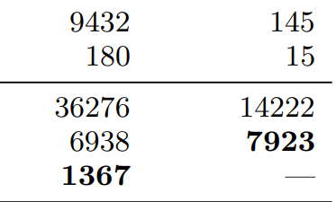
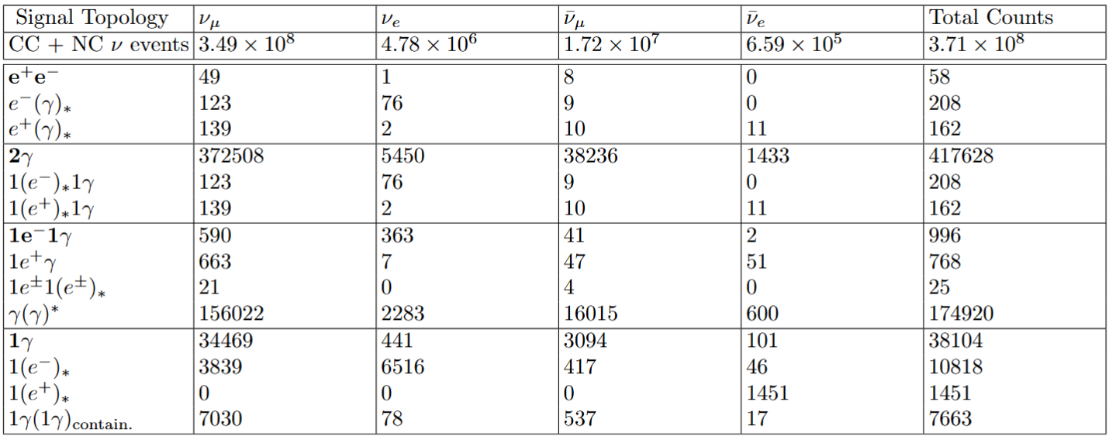
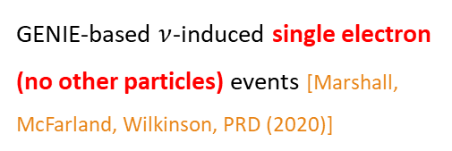
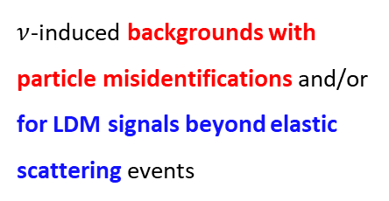
Studies on Major Backgrounds
5 years – 1.2MW beam intensity
GENIE-based $ν$-induced single electron (no other particles) events [Marshall, McFarland, Wilkinson, PRD (2020)]
$ν$-induced backgrounds with particle misidentifications and/or for LDM signals beyond elastic scattering events
[Coloma, Martin-Albo, Urrea, PRD (2024)]
[Brdar, Dutta, Jang, DK, Shoemaker, Tabrizi, Thompson, Yu, to appear soon]

Slide 24






Emerging Opportunities: New Production Channels
Beam target
Focusing horn
Shielding
Near detector
$$π^{+}$$
$$ℓ^{+}$$
Proton
beam
$$χ$$
$$ν_{ℓ}$$
$$K^{+}$$
$$ℓ^{+}$$
Exotic charged-meson 3-body decays
Focused dark-matter “beam”
Application for the MiniBooNE excess [Dutta, DK, Thompson, Thornton, Van de Water, PRL (2022)]
Exotic charged-meson 3-body decays [Barger, Chiang, Keung, Marfatia, PRL (2012); Carson, Rislow, PRD (2012); Laha, Dasgupta, Beacom, PRD (2014); Bakhti, Farzan, PRD (2017); ++]

Slide 25

















Emerging Opportunities: New “Featureful” Detection Channels
$$χ$$
$$χ$$
$$χ$$
$$χ$$
$$χ$$
$$χ$$
$$ℓ^{(′)}$$
$$Z′$$
$$ℓ^{(′)}$$
$$Z′$$
$$φ$$
$$Z′$$
$$γ$$
$$ℓ$$
$$γ$$
$$φ$$
$$ℓ$$
$$γ$$
$$ℓ$$
$$N$$
$$N$$
$$N$$
$$N$$
$$N$$
$$N$$
$$χ$$
$$χ$$
$$χ$$
$$ℓ^{(′)}$$
$$χ$$
$$χ′$$
$$Z′$$
$$Z′$$
$$ℓ$$
$$Z′$$
$$ℓ$$
$$e$$
$$e/p$$
$$e$$
$$γ$$
$$e/p$$
Many more…

Slide 26
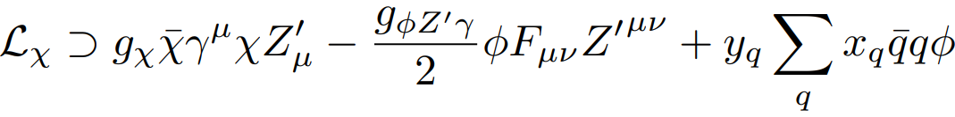













Beyond Search Prospects: a Solution to Mini-/$μ$-BooNE Excesses
(cf. Dark-matter flux from charged mesons [Dutta, DK, Thompson, Thornton, Van de Water, PRL (2022)])
Focused dark-matter flux
$$ν_{μ}$$
$$χ$$
$$χ$$
$$χ$$
$$π^{+}$$
$$Z′$$
$$Z′$$
…
$$γ$$
$$φ$$
$$\overline{χ}$$
$$μ^{+}$$
$$N$$
$$N$$
[Dark-matter production]
[Dark-matter scattering]

Slide 27
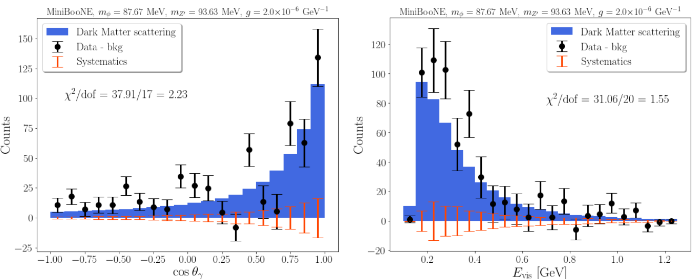
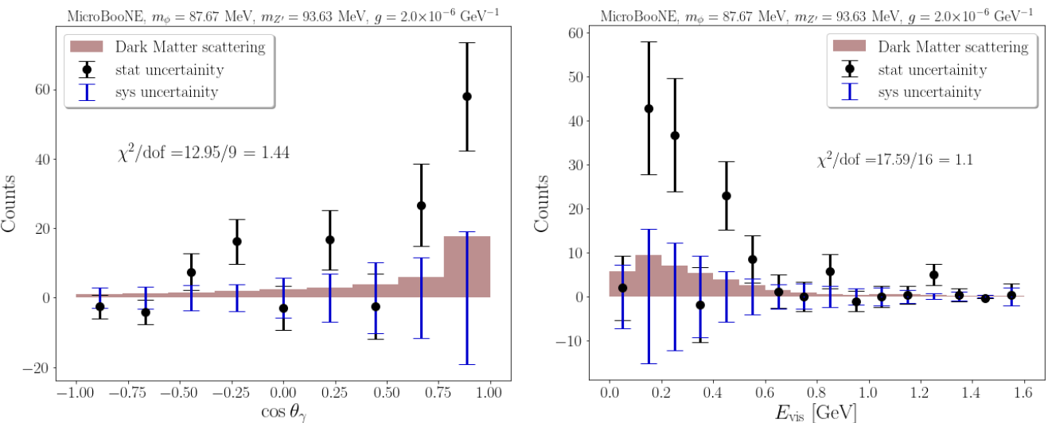
An Example Dark-Matter Fit
[Dutta, Karthikeyan, DK, Thompson, Van de Water, arXiv:2504.08071]

Slide 28
Conclusions
Many well-motivated dark-sector models and scenarios contain feebly or very weakly interacting (MeV-range) light dark matter candidates.
Neutrino experiments provide a great place to look for light dark matter signals:
  Large-volume detectors can provide great opportunities for searching for cosmogenic light dark matter signals.
  High-intensity neutrino beam experiments enable copious production of light dark matter particles.
Dark matter research in neutrino experiments is an area of active investigation.
Thank you!

Slide 29
Bonus Slides

Slide 30




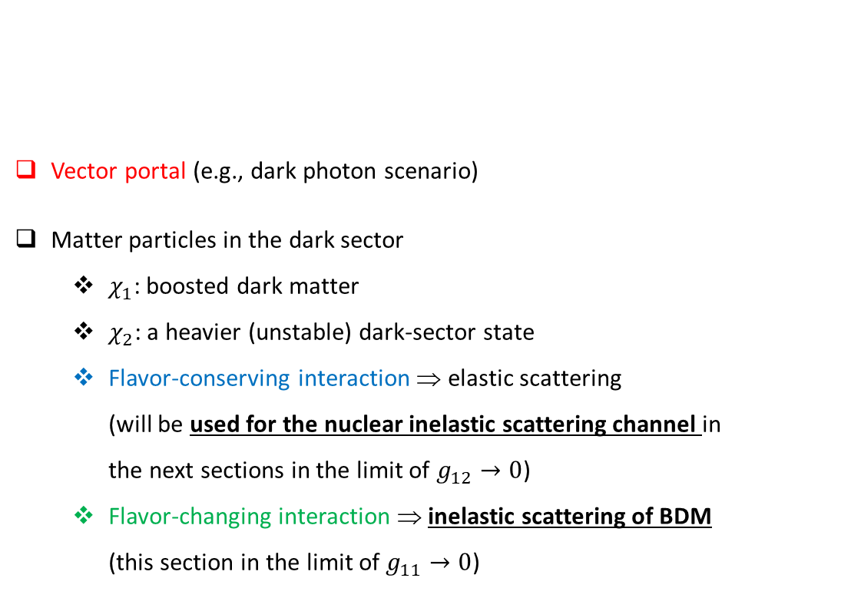





Example Interactions between DM and SM Particles
Vector portal (e.g., dark photon scenario)
Matter particles in the dark sector
  $χ_{1}$: boosted dark matter
  $χ_{2}$: a heavier (unstable) dark-sector state
  Flavor-conserving interaction ⇒ elastic scattering (will be used for the nuclear inelastic scattering channel in the next sections in the limit of $g_{12}→0$)
  Flavor-changing interaction ⇒ inelastic scattering of BDM (this section in the limit of $g_{11}→0$)
$$ℒ_{int}∋−\frac{ε}{2}F_{μν}V^{μν}+g_{11}{\overline{χ}}_{1}γ^{μ}χ_{1}V_{μ}+g_{12}{\overline{χ}}_{2}γ^{μ}χ_{1}V_{μ}+h.c.+(others)$$
$$e^{−}$$
$$V$$
$$ε$$
$$e^{+}$$
$$g_{11}$$
$$χ_{1}$$
•
$$χ_{1}$$
$$V$$
$$g_{12}$$
$$χ_{1}$$
•
$$χ_{2}$$
$$V$$
Cf.) The model setup is straightforwardly extended to scalar dark matter.

